Slide 1
GOPPIKKHA K
711721104041
Final Project
3/21/2024 Annual Review

Slide 2
PROJECT TITLE
TRAFFIC SIGN IDENTIFICATION USING CONVOLUTIONAL NEURAL NETWORKS (CNN) AND KERAS
3/21/2024 Annual Review

Slide 3


AGENDA
Problem Statement
Project Overview
End Users
Our solution and Proposition
Key Features
Modelling
Results
3/21/2024 Annual Review

Slide 4

PROBLEM STATEMENT
Traffic Sign Identification is a critical component of autonomous driving systems and advanced driver-assistance systems (ADAS). The accurate detection and classification of traffic signs are vital for ensuring safe and efficient navigation on roadways.
The goal of this project is to develop a robust Traffic Sign Identification system using Convolutional Neural Networks (CNNs) implemented with Keras.
By leveraging deep learning techniques, we aim to create a model capable of accurately recognizing and classifying various types of traffic signs from input images captured by onboard cameras or external sensors.
3/21/2024 Annual Review

Slide 5

PROJECT OVERVIEW
Here we’re developing a system to help people recognize traffic signs better using Convolutional Neural Networks (CNNs).
Our goal is to make driving safer by teaching people to quickly and accurately identify signs, even in challenging conditions. By doing this, we aim to enhance road safety and efficiency, ultimately benefiting both drivers and pedestrians.
3/21/2024 Annual Review

Slide 6

WHO ARE THE END USERS?
People who make self-driving cars, companies with delivery trucks, regular drivers, city planners, and researchers could all use our system.
It helps people recognize traffic signs better, making driving safer and smoother for everyone.
3/21/2024 Annual Review

Slide 7

YOUR SOLUTION AND ITS VALUE PROPOSITION
Solution:
Our smart system uses advanced technology to help people recognize traffic signs accurately, even in tricky conditions like bad weather.
Value Proposition:
Safety: Prevent accidents by ensuring cars always follow signs correctly.
Efficiency: Reduce congestion and travel times by helping cars navigate roads more efficiently.
Convenience: Make driving easier and less stressful for drivers.
Future-Readiness: Prepare for the future of transportation with reliable sign recognition technology.
3/21/2024 Annual Review

Slide 8

THE WOW IN YOUR SOLUTION
Our system sets a new standard in traffic sign recognition with unparalleled accuracy and adaptability.
Using state-of-the-art technology, it ensures safety, efficiency, and convenience across various transportation scenarios.
Plus, our commitment to innovation ensures it remains at the forefront of future advancements in mobility.
In essence, our solution isn't just impressive it's revolutionizing transportation as we know it.
3/21/2024 Annual Review

Slide 9
MODELLING
Understanding the Problem:
We start by understanding the problem we're tackling: helping cars recognize traffic signs better. We know that sometimes cars struggle to understand signs, especially in tricky situations like bad weather or when signs are hard to see.
Research and Planning:
Next, we do some research to figure out how we can solve this problem. We look into different technologies and techniques that can help cars recognize signs accurately. We also plan out how we're going to build our solution step by step.
Data Collection:
One important step is gathering lots of pictures of different traffic signs. This helps us teach the system to recognize all kinds of signs, like stop signs, speed limit signs, and more. We need a big collection of images to make sure the system learns properly.
3/21/2024 Annual Review

Slide 10
MODELLING
Training the System:
With our collection of sign images, we train our system to recognize them. We use a special kind of computer program called a Convolutional Neural Network (CNN) to do this. The CNN looks at the pictures and learns to identify the signs based on their shapes, colors, and patterns.
Testing and Refinement:
Once our system has been trained, we test it to see how well it works. We show it new pictures of signs that it hasn't seen before and see if it can recognize them correctly. If there are any mistakes, we go back and adjust the system to make it better.
Integration and Deployment:
Once we're happy with how our system performs, we integrate it into cars or other vehicles. This means making sure it works smoothly with the vehicle's other systems and sensors. Then, we deploy it out into the real world where it can start helping cars recognize signs on the road.
3/21/2024 Annual Review

Slide 11
MODELLING
Monitoring and Updates:
Even after deployment, we keep an eye on how our system is doing. We monitor its performance and make updates as needed to keep it working well. This might involve adding more sign images to its training data or tweaking its algorithms to improve accuracy.
Future Development:
Finally, we're always looking ahead to the future. We continue researching and developing new technologies to make our system even smarter and more reliable. Our goal is to keep pushing the boundaries of what's possible in traffic sign recognition and make driving safer and more efficient for everyone.
3/21/2024 Annual Review

Slide 12
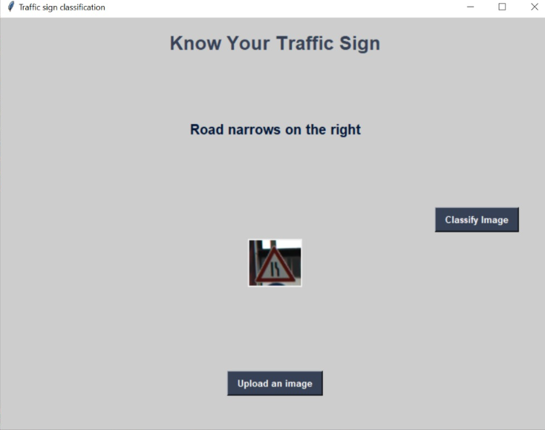
RESULTS
3/21/2024 Annual Review

