Slide 1
Predicting Real Estate Market Trends: A Machine Learning Approach
Gopu Akshaya 2010030553
Marri Sahasra Reddy 2010030556
Arika Asha Susmitha 2010030471
Under the Guidance of
Dr. Pavan Kumar Pagadala
Assitant Professor
Computer Science and Engineering Department
KL Hyderabad Off Campus, Aziz Nagar ,Hyderabad

Slide 2
Overview
Introduction
Objectives of the Project
Proposed Methodology
Implementation Details
Results
References

Slide 3
Introduction
The real estate market is a dynamic and ever-changing world which makes precise land property price forecasts difficult for buyers ,sellers and investors.
Considering this situation ,Machine learning (ML) algorithms have recently become effective tools for analyzing massive volumes of data and making remarkably accurate property price predictions.
That’s how our project i.e Predicting Real Estate Market Trends system implemented where we use machine learning application in real estate domain.
In this approach, historical data, encompassing factors like location, size, amenities, and past sales, serves as the foundation for training models that can interpret intricate patterns and relationships.
And go through the intricacies of Land prices.

Slide 4
Objectives of the Project
Our objective is to predict the efficient Land pricing for real estate customers for their budgets and priorities. By analyzing previous market trends and price ranges, and upcoming developments future prices will be predicted which can help the developer determine the selling price of a Land and also can help the customer to arrange the right time to purchase a Land.
We use linear regression and Random Forest algorithm in machine learning where this application will help customers to invest in an estate without approaching an agent and provide a better price to users without getting cheated.

Slide 5
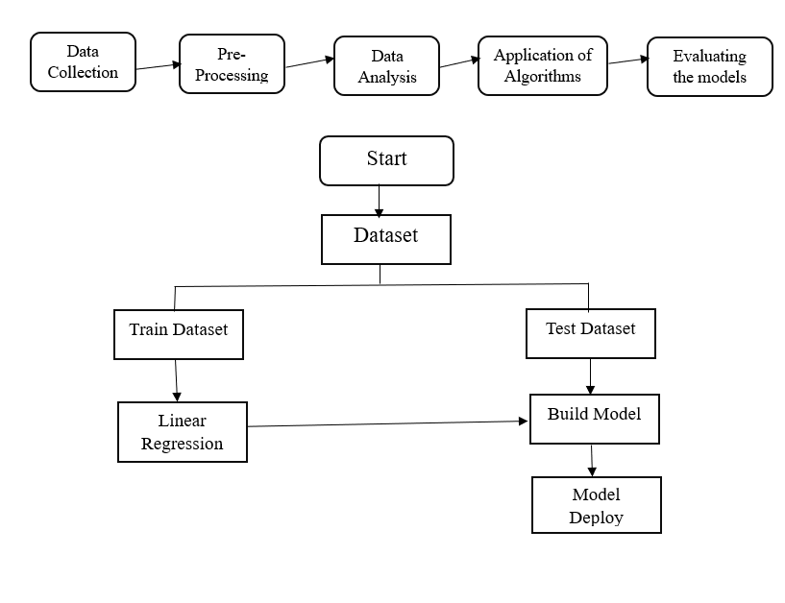
Proposed Methodology

Slide 6
Implementation Details
Datasets:
The real estate housing data is used in this and it is taken from the UCI machine learning repository and data is spread across 20000 rows and has the ten attributes.
Algorithms:
Random Forest
Decision Tree Algorithm
Linear Regression

Slide 7
Contd..
Hardware Requirements:
System: i3 Processor
Hard Disk: 500 GB.
Monitor: 15’’LED
Input Devices: Keyboard, Mouse
Ram: 4GB.
Software Requirements:
Platform: Google Colab
Coding Language: Python

Slide 8
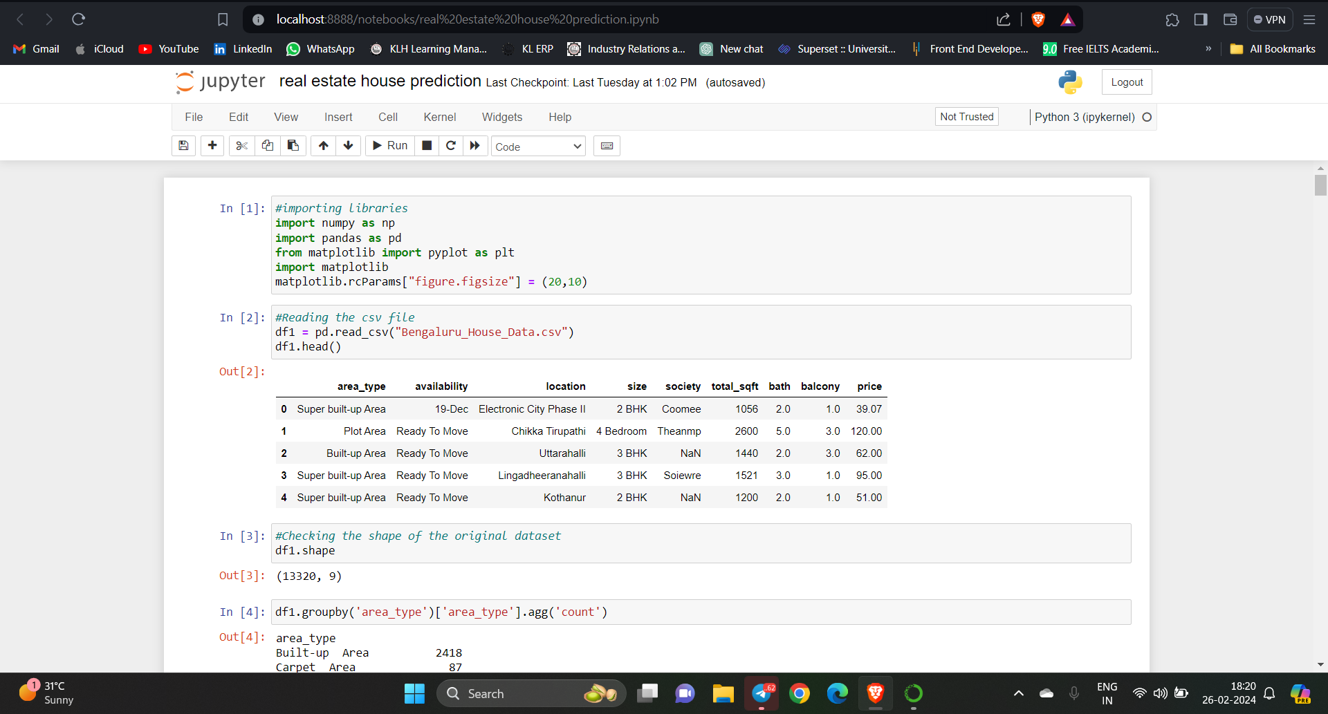
Results
The coding part is still in progress

Slide 9
References
https://www.researchgate.net/publication/349477129_Land_Price_Prediction/link/60322284299bf1cc26de117f/download?_tp=eyJjb250ZXh0Ijp7ImZpcnN0UGFnZSI6InB1YmxpY2F0aW9uIiwicGFnZSI6InB1YmxpY2F0aW9uIn19
https://www.tandfonline.com/doi/full/10.1080/15140326.2022.2045466
https://github.com/SouravG/Housing-price-prediction-using-Regularised-linear-regression

Slide 10
Thank you and Any Queries

