Slide 1

DARK WEB
PRESENTED BY :-
GOPAL PANDEY(12500115043)
VIBHAV(12500115121)
Computer Science & Engineering
FINAL YEAR PROJECT

Slide 2
contents
Intro
Difference
History
How to access Dark Web
Tor
Cybercrime and Terrorism
How Hacker use Dark web
How NSA use Dark Web
Review of Literature
Sites where never visit
Other Browser we can access Dark Web
Result and Discussion
Future Scope
Conclusion

Slide 3
Intro
The Dark web is the World Wide Web content that exists on dark nets, overlay networks that use the Internet but require specific software, configurations, or authorization to access. The dark web forms a small part of the deep web, the part of the Web not indexed by web search engines, although sometimes the term deep web is mistakenly used to refer specifically to the dark web.
The Dark web is a place on the internet that is not accessible using the regular browsers or your regular connections. This is where all or most of the connections went. Dark net websites are accessible only through networks such as Tor aka “The Onion Router” and I2P (“Invisible Internet Project”). Tor browser and Tor-accessible sites are widely used among the dark net users and can be identified by the domain “.onion”. While Tor focuses on providing anonymous access to the Internet, I2P specializes on allowing anonymous hosting of websites

Slide 4
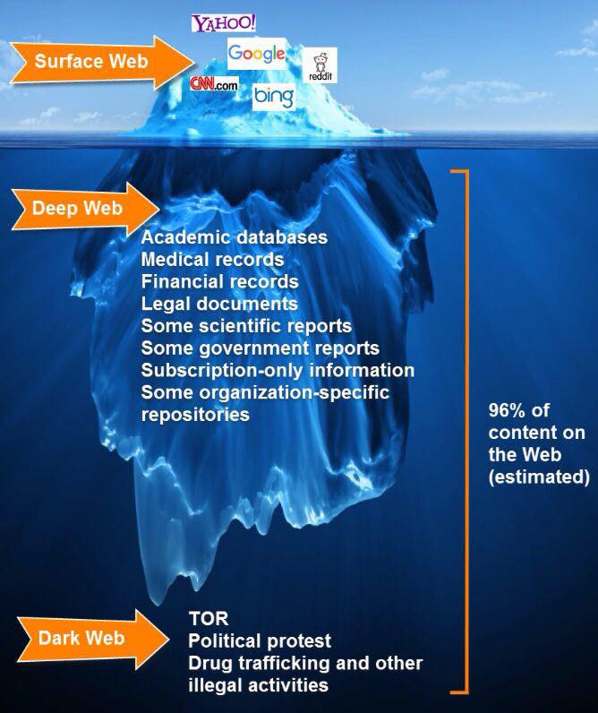
Difference

Slide 5
History
October 29, 1969
Charley Kline, a student at the University of California, Los Angeles, types out the first message between computers connected by ARPANET, the Internet progenitor developed by the Pentagon’s Defense Advanced Research Projects Agency. (Only the first two letters of the electronic dispatch, “LOGIN,” make it all the way to computers at Stanford University.) Within just a few years, a number of isolated, secretive networks begin to appear alongside ARPANET. Some eventually become known as “darknets.”

Slide 6

Access
Through
Tor
●
●
●
●
“The
onion
router”
Similar
Simple,
to
a
Firefox
browser
anyone
can
get
it
Host
machine is
untraceable
○
○
○
Can
Can
Can
stay
anonymous
access
Darknet
see
.onion
extensions

Slide 7


How
Tor
Works?
---
Onion
Routing
Alice
Bob
M
√
M
OR2
M
C2
C3
M
OR1
OR3
C1
C2
C3
Port
• A circuit
is built incrementally one hop
by one hop
• Onion-like encryption
• Alice negotiates an AES key with each router
• Messages are divided into equal sized cells
• Each router knows only its predecessor and successor
• Only the Exit router (OR3) can see the message, however it does not
know where the message is from

Slide 8
CYBERCRIME & TERRORISM
A general term for someone who gains unauthorised access to a system for malice or personal gain exists – a Black Hat. However, given the breadth of actors and intentions involved, a classification system has been proposed to simplify discussion on cybercrime which can be of multiple types: offences against CIA of data/systems e.g. Advanced Persistent Threat (APT) – a highly evolved, sophisticated and well-resourced threat actor – involved in espionage; computer-related e.g. identity theft; content-related e.g. child pornography, religious opinions in countries where it is illegal; copyright infringements; and a combination of the above e.g. cyber warfare. The offenders can also be categorised into individuals, e.g. insiders, hacktivists and script kiddies, or entities, e.g. nation state agencies.

Slide 9
HOW HACKER USE DARKWEB
DDOS ATTACK
In computing, a denial-of-service attack (DoS attack) is a cyber-attack in which the perpetrator seeks to make a machine or network resource unavailable to its intended users by temporarily or indefinitely disrupting services of a host connected to the Internet.

Slide 10
How NSA Use Dark Web
The FoxAcid system
According to various top-secret documents provided by Snowden, FoxAcid is the NSA codename for what the NSA calls an “exploit orchestrator,” an internet-enabled system capable of attacking target computers in a variety of different ways. It is a Windows 2003 computer configured with custom software and a series of Perl scripts. These servers are run by the NSA’s tailored access operations, or TAO, group. TAO is another subgroup of the systems intelligence directorate. The servers are on the public internet. They have normal-looking domain names, and can be visited by any browser from anywhere; ownership of those domains cannot be traced back to the NSA.

Slide 11
REVIEW OF LITERATURE
A major initial challenge of performing a literature review includes identifying and structuring the most relevant literature surrounding the topic. The primary approach taken for this included performing a keyword search with filters in major databases, going backwards and forward, i.e. reviewing citations for key articles, and reviewing material which cites those key articles, respectively .

Slide 12
Sites Where Never Visit
Reddit.com
The Death Clock
Magic 8 Ball
Take This Lollipop
Rotten.com
Rate My Po
4 Chan
Silk Road
Ever.com
BlueWaffle.net

Slide 13
Other Browser we can access Dark Web
I2P – Invisible Internet Project
Whonix
Subgraph OS
TAILS – The Amnesic Incognito Live System

Slide 14
RESULT AND DISCUSSION ACCORDING TO IMPLEMENTATION
Hosting sites on the dark web is free and can be accessed through Tor browser. Since it is hosted on our own computers it cannot be closed. you need to know about Xampp server and tor browser, without its knowledge you cannot host your website.

Slide 15









Dark
Web
Usage
17% Child pornography
Drugs
39% Counterfeit goods
Hacking information
Politics
Hardware/Software information
_{8%} Art
2% _{3%} Other/Unknown
15%
7%
9%
telegraph.co.uk, 22
April 2014

Slide 16

Anonymity?
•
•
•
Tor
designed
to
hide
identity
Surface
Doesn’t
internet
browsing
protect against
vulnerabilities
o
Server
▪
▪
Anonymous
Showboating?
o
User’s
computers
▪
▪
Compromise
Traps?
=
exposure
•
Impossible
to
be
completely
anonymous
online!

Slide 17
Privacy
Issues
of
Dark
Web
•
The temptation of pursuing illegal activities on
overcome.
Installing the TOR browser does not make you come in the form of whistleblowers.
the Deep Web is difficult to
•
a criminal, modern day patriots
•
The deep web can be considered a safe haven to expose corruption in high
levels of government and business.
It is now revealed that NSA is invading the privacy of millions around the world through its Surveillance
TOR network can provide you Privacy of your contents by applying
cryptographic techniques (encrypted multiple times passing through nodes)
but if required, the agencies can invade your privacy, as it is evident from the
case of closing down the Silk road trading site in Oct, 2014.
One need to take all those steps one takes on a Surface Web to protect his/her identity
•
•
•

Slide 18
Conclusion
Most of the Dark Web is simply a bunch of boring webpages not indexed by search engines and that can only be accessed by knowing exactly where these sites are and using the proper access mechanism.
But other parts of the Dark Web are more nefarious and a cause for concern for law enforcement, intelligence agencies and large companies.

Slide 19

ANY QUERY?
Thank you

