Slide 1
Marvel Dataset Analysis
Social Network Analytics
UE16CS424

Slide 2
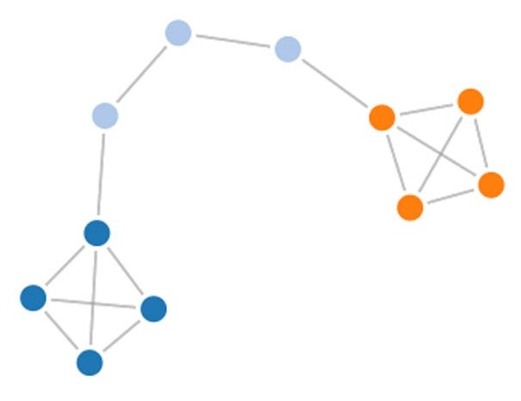
About NetworkX
NetworkX is a Python package for the creation, manipulation, and study of the structure, dynamics, and functions of complex networks.
Features: i. Data structures for graphs, digraphs, and multi-graphs ii. Many standard graph algorithms iii. Network structure and analysis measures iv. Generators for classic graphs, random graphs, and synthetic networks v. Nodes can be "anything" (e.g., text, images, XML records) vi. Edges can hold arbitrary data (e.g., weights, time-series) vii. Additional benefits from Python include fast prototyping, easy to teach, and multi-platform

Slide 3

About Cytoscape
Cytoscape is an open source software platform for visualizing complex networks and integrating these with any type of attribute data.
Although Cytoscape was originally designed for biological research, now it is a general platform for complex network analysis and visualization. Cytoscape core distribution provides a basic set of features for data integration, analysis, and visualization.

Slide 4
About the Data Set
After finding out about the Marvel Social Graph dataset, I was excited to use data visualisation to see how the various characters interacted with one another and provide insights. I aim to uncover these by utilising cluster analysis.
The superhero co-occurrences in the Marvel dataset are listed in two columns and 574468 rows. For instance, Spider Man and Captain America will always be included in a row whenever they appear together in a comic book.

Slide 5
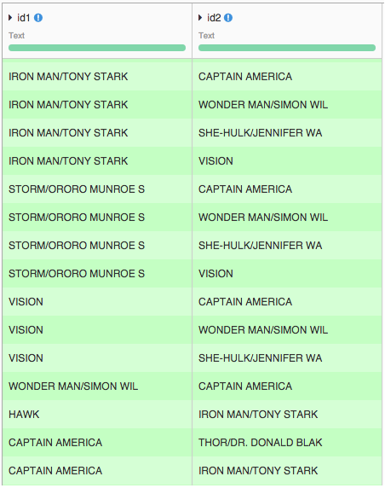

Slide 6
Constructing the graph
The Networkx package was used in order to create the graph. The steps involved in creating the graph from the dataset were as follows:
Using the pandas package, creating a dataframe using the .csv dataset
Iterating through the rows to create a node for every character that doesn’t already have a node.
Iterating through the dataframe to create edges for every interaction between character1 and character2.
Converting the graph into GraphML format - Graph markup language, this is a file type supported by Cytoscape in order to visualize the graph and form insights

Slide 7
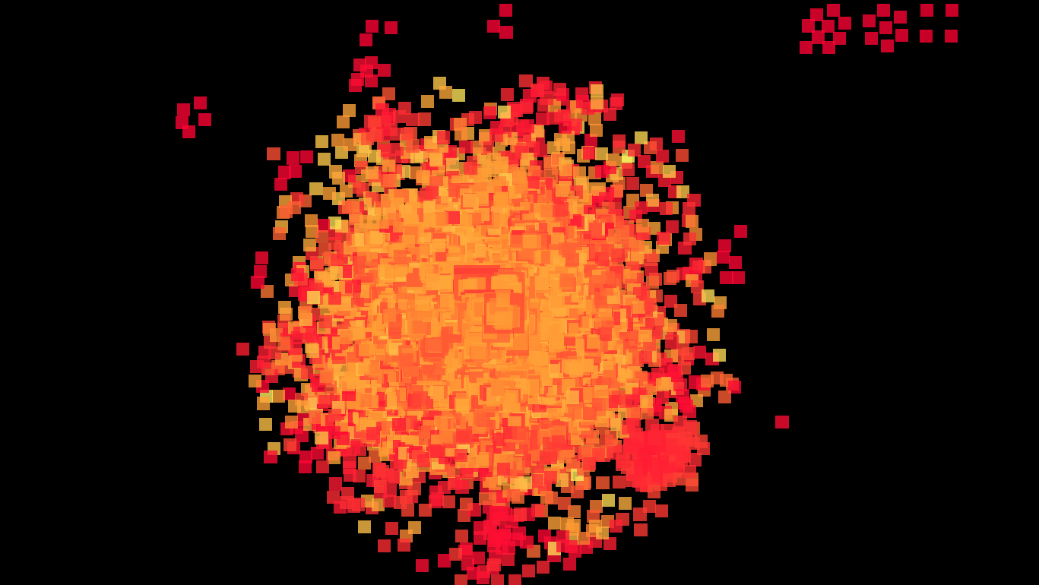
Analysis
By using the network analysis tool in Cytoscape, the node bigger in size has a higher degree centrality value. The colours depict the neighbourhood connectivity of the node, yellow indicates low, orange for medium, and red for high.

Slide 9
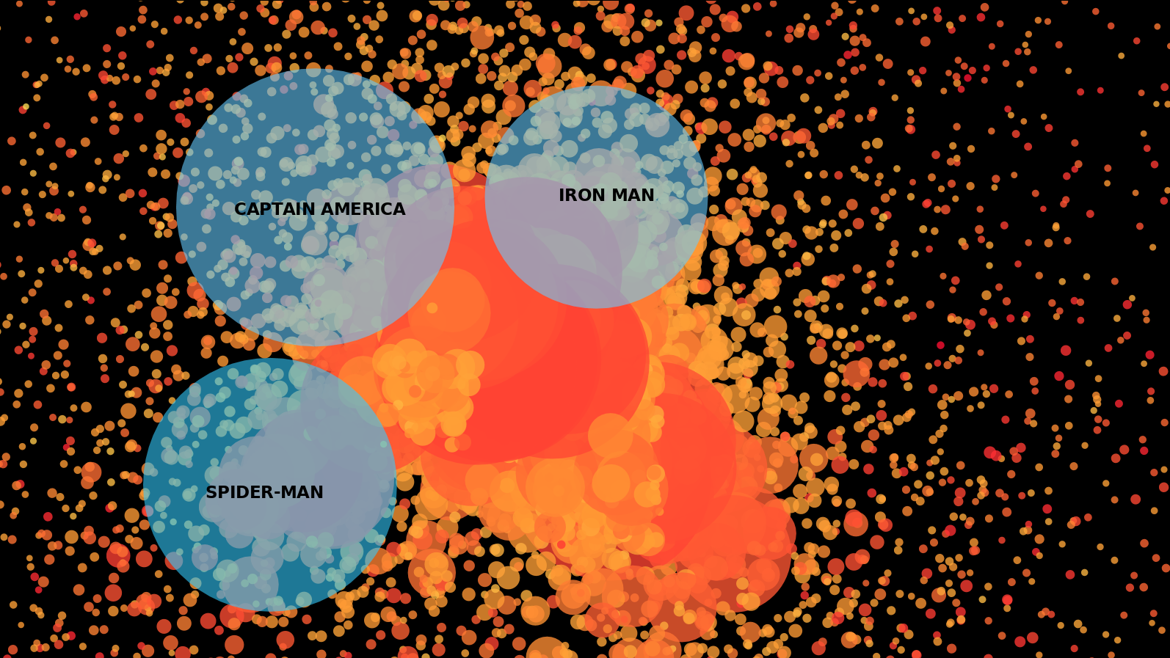
Degree Centrality
On zooming into the graph, we can see that, the 3 characters with the highest degree centrality are Captain America, Spider Man and Iron Man, which is logical as they appear at the very beginning of the Marvel Universe.

Slide 11
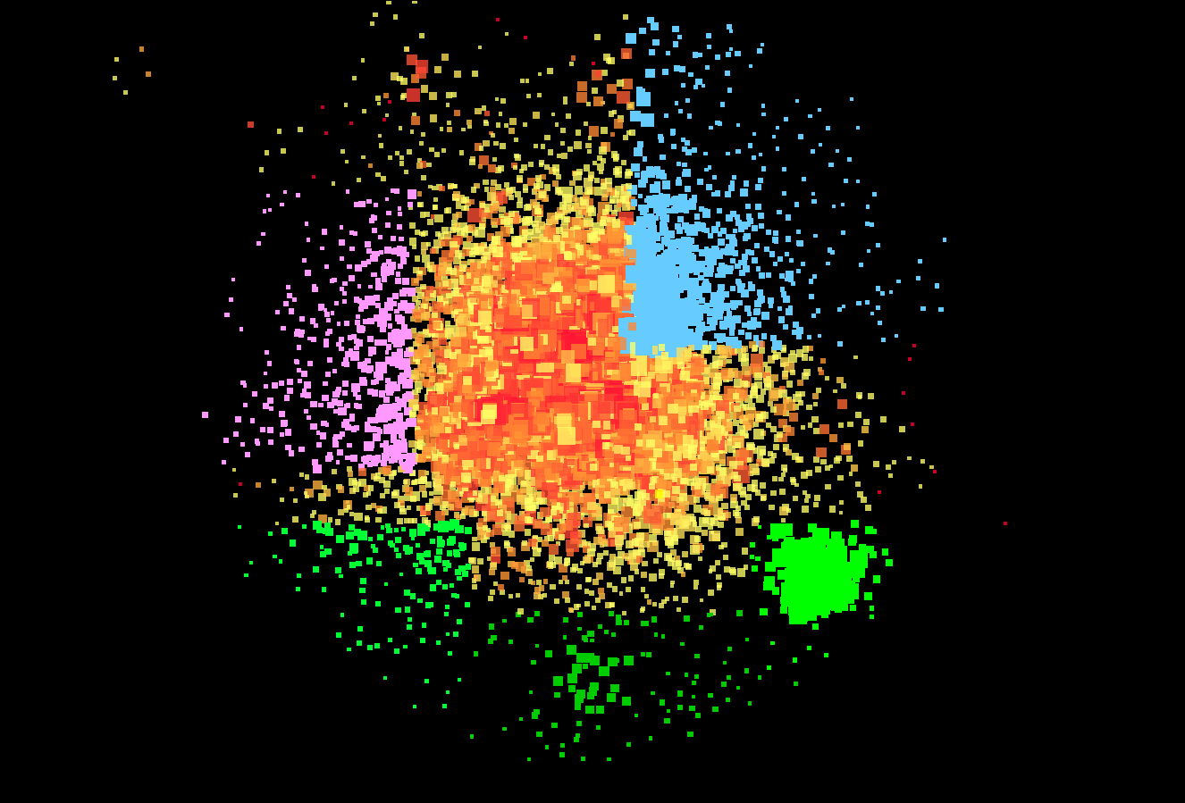
Clustering Coefficient
By using clustering coefficient to analyse the graph, we find different clusters, some important ones being:
The pink one corresponds to Thor and his related characters. The green one represents X-Men, and the blue one represents Spider Man and his related characters. The smaller clusters on the outskirts are a bunch of unrelated characters.

Slide 13
Pruning the Graph
The dataset is polluted with unknown characters, I have removed these unwanted characters by giving each edge a weight. Previously, an edge was defined by the existence of one co-occurrence. An edge weight is some extra information about the node that we add to our graph to change its shape. In our case, this extra information will be the number of co-occurrences between characters.
If we prune the graph by keeping only edges (and corresponding nodes) having a weight higher than a specific threshold (K for example), we will drastically simplify the graph: all nodes with less than K appearances in the dataset and all edges with weight less than K will disappear.
The graph I have generated is when the value of k = 50

Slide 14
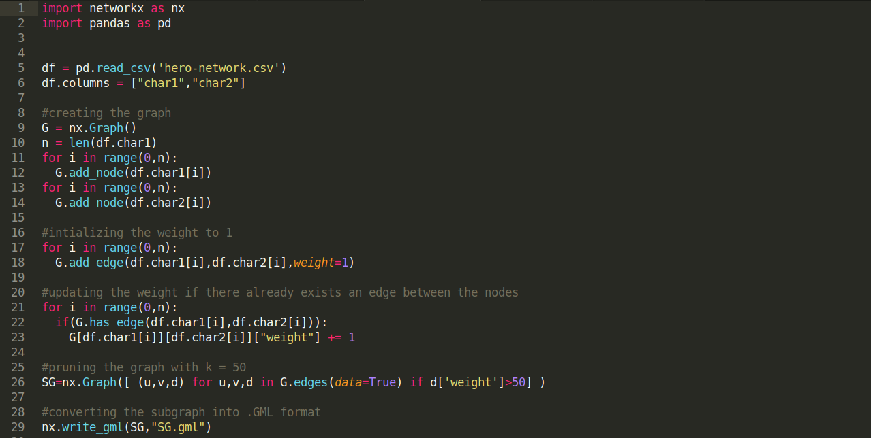
Pruning

Slide 15
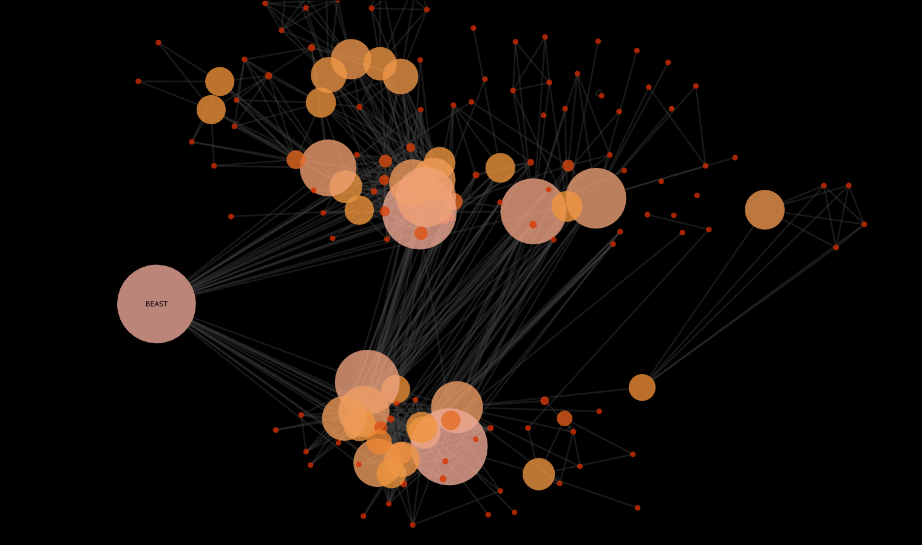
Betweenness Centrality
By using the betweenness centrality measure we can identify the most influential nodes in a network. The betweenness centrality value is very important as it represents how important the node is in conveying information in the network to other individuals in the network who are not connected to each other.
Obviously, Marvel Stars like Spider Man, Thor, and Hulk are good candidates and have indeed very high values of all imaginable centrality measures. But if we draw the graph for a value of K = 50 the real Marvel Universe influencer clearly appears. The most influential is BEAST, this insight is validated by the fact that beast is the main character that connects the two biggest hero groups in the marvel universe i.e The Avengers and The X-Men.

Slide 17
Thank You!

