Slide 1
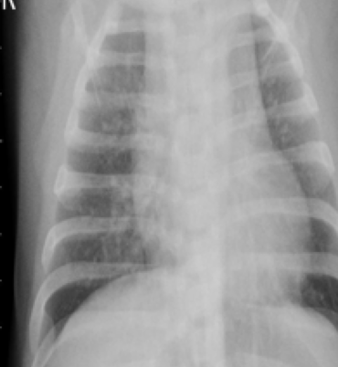
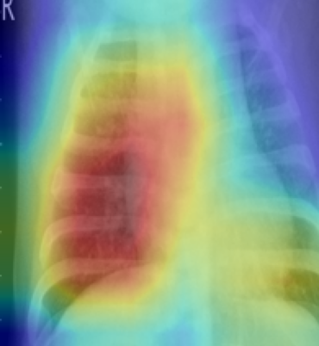
UE24CS352A MACHINE LEARNING · MINI-PROJECT 34
Pneumonia Diagnosis Detection and Localization
Input X-ray
Where the model looks
Chest X-ray classification with DenseNet121, localized with Grad-CAM
97.2%
test accuracy · 0.996 ROC-AUC
[Name 1, SRN] · [Name 2, SRN]
Notes:
Introduce the problem: given a chest X-ray, say whether it shows pneumonia and show where. Mention both team members and who built what.

Slide 2
Problem and dataset
Detect pneumonia in a chest X-ray and highlight the region behind the decision.
Split | Images | Normal | Pneumonia
Train | 4,077 | 1,061 | 3,016
Validation | 901 | 258 | 643
Test | 878 | 264 | 614
Kaggle Chest X-Ray Images (Pneumonia)
5,856 pediatric X-rays, 2 classes
Official val set has only 16 images, so we pooled everything and re-split 70/15/15
Split by patient ID, so no patient is in two splits
73%
of images are pneumonia, so we use class weights and report recall and F1, not just accuracy
2
Notes:
The imbalance matters: a model that always says pneumonia would get 70%+ accuracy. That's why we use class weights and look at recall and F1. Patient-level split avoids leakage.

Slide 3
Approach
1
2
3
4
Chest X-ray
›
DenseNet121
›
Prediction
›
Grad-CAM
Resize 224x224, normalize, light augmentation
ImageNet-pretrained, fine-tuned end to end
Weighted cross-entropy for imbalance
Heatmap from last conv layer gradients
Why DenseNet121? Dense connections reuse features, which works well on a few thousand medical images. Why Grad-CAM? This dataset has no bounding boxes, and Grad-CAM needs none.
3
Notes:
Be ready for: why transfer learning (small data), why class weights (imbalance), why not a detector (no box labels in this dataset; would need RSNA).

Slide 4
Implementation
Training setup
pneumonia-project/
src/
common.py model, Grad-CAM
train.py split, train, eval
run_gradcam.py heatmap grid
app/
app.py Gradio demo
results/ metrics, figures
README.md
PyTorch + torchvision, Colab T4 GPU
AdamW, lr 1e-4, cosine schedule
Batch 32, 6 epochs, mixed precision
Augmentation: random crop, rotation up to 10°, brightness/contrast
Best epoch chosen by validation AUC
4
Notes:
Walk through the repo structure. Say who wrote which part. Mention the repo is private and shared with faculty and TAs.

Slide 5
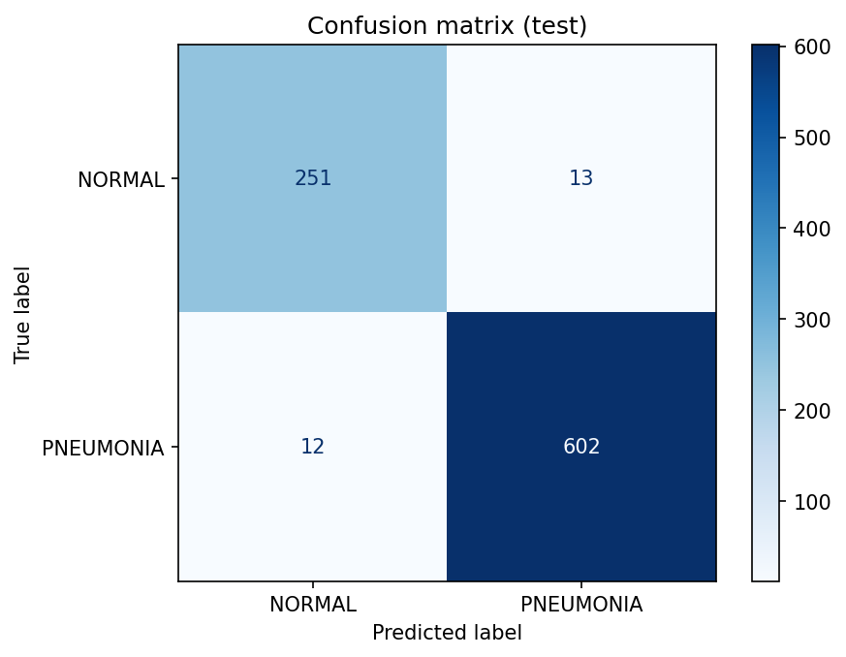
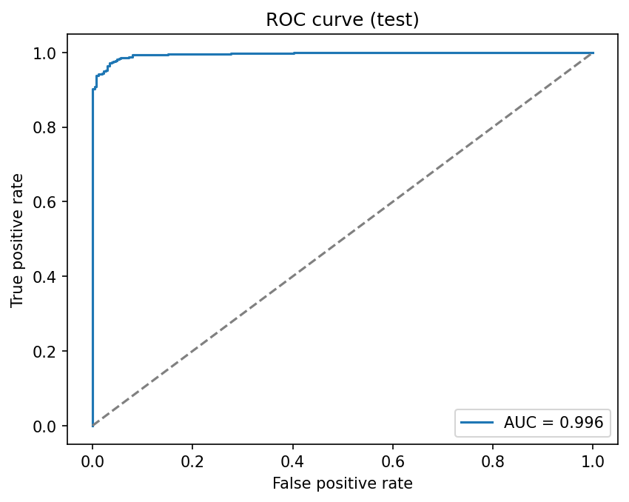
Results on the held-out test set
97.2%
Accuracy
98.0%
Pneumonia recall
0.980
Pneumonia F1
Only 12 of 614 pneumonia cases were missed, and 13 of 264 normal cases were flagged. In screening, missed cases cost more than false alarms, so recall is the number to watch.
0.996
ROC-AUC
5
Notes:
NORMAL: precision 0.95, recall 0.95. PNEUMONIA: precision 0.98, recall 0.98. 878 test images, split by patient. Don't claim clinical readiness: single pediatric dataset.

Slide 6
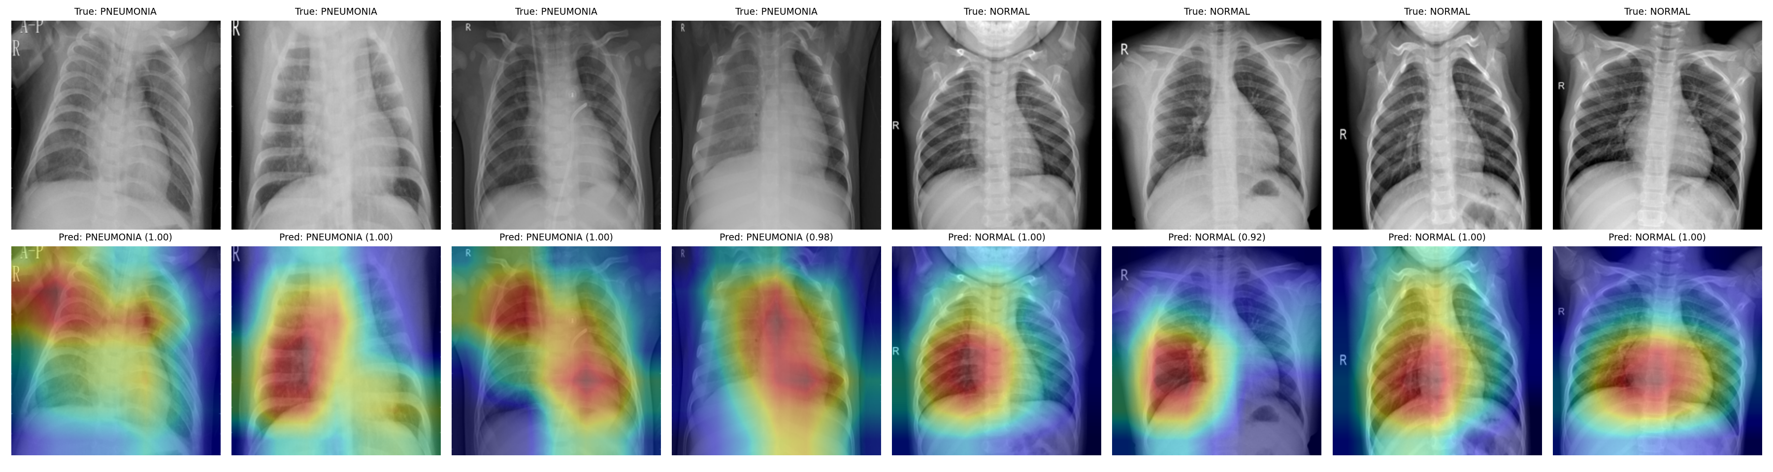
Localization with Grad-CAM
Red marks the region that most increased the predicted class score.
Heatmaps mostly sit on the lungs, which supports that the model uses lung tissue.
Caveat: a few maps touch image markers (e.g. the 'A-P' label), a possible shortcut cue.
6
Notes:
Top row is the X-ray, bottom row the heatmap. Be honest that Grad-CAM is coarse and we did not score it against ground-truth boxes.

Slide 7
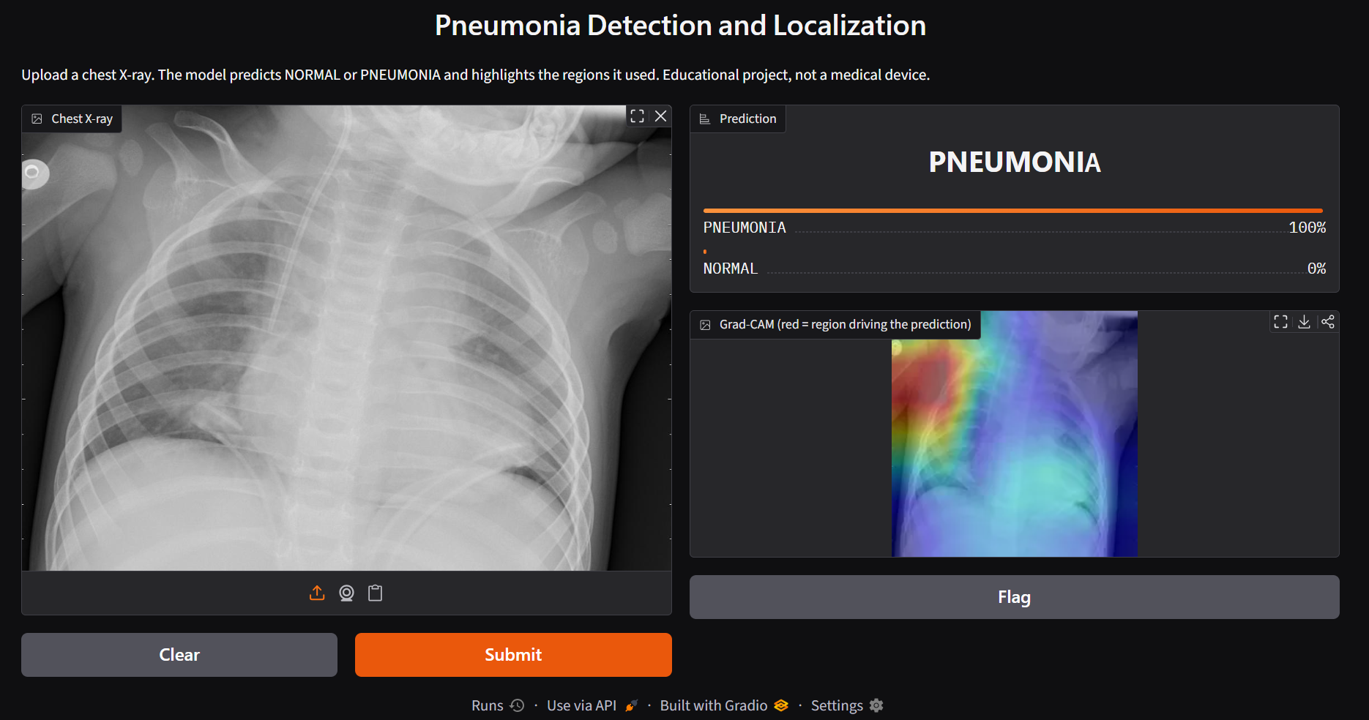
Live demo
Gradio app
Upload an X-ray
Get label and confidence
See the Grad-CAM heatmap
Try one pneumonia and one normal case
7
Notes:
Run the app live: python app/app.py --share. Upload one pneumonia and one normal image from demo_images. Keep the screen recording ready as a backup.

Slide 8
Limitations and next steps
Limitations
Next steps
Pediatric data from one source; may not transfer to adults or other hospitals
Grad-CAM is coarse and was not scored against ground-truth boxes
Kaggle labels contain some noise
Train a detector (Faster R-CNN or YOLO) on RSNA bounding boxes and score with IoU/mAP
Test on external data
Tune the threshold toward higher recall
Educational prototype, not a medical device.
8
Notes:
Likely Q&A: why not accuracy alone, how is leakage avoided, what would you change with more time, how does Grad-CAM work.

