Slide 1
Predicting Microsoft's Weekly Returns with Supervised Learning
Five frameworks compared: XGBoost, Keras, fastai, TabNet, Lightning Flash
Notes:
This project predicts the next-week return of Microsoft stock from its own past returns and from correlated assets, using five machine-learning frameworks, and compares them on accuracy, simplicity and transparency. All code is in the GitHub repository on the slide.

Slide 2
A weak but real signal: fastai edges past the baseline
0.0367
3.5%
61.7%
fastai test RMSE, against 0.0374 for always predicting the average
of the variance in weekly returns explained by fastai (R² = 0.035)
directional accuracy (Lightning Flash), against 56.3% for always predicting “up”
Next-week returns are close to unpredictable from correlated assets and past returns
Only fastai beats the baseline on every metric; TabNet does worse and changes between runs
XGBoost is the simplest and most transparent; Lightning Flash was the hardest to set up
Notes:
Headline: the best model improves on a naive baseline by under 2% in RMSE. That is the expected, honest outcome for weekly stock returns. A low R-squared here is not a bug.

Slide 3
Problem: predict next week's MSFT return
The task
Five frameworks, same data, same split
1
XGBoost
Supervised regression on 16 years of market data
Target: MSFT log return over the next 5 trading days
Inputs: correlated assets plus MSFT's own past returns
Returns, not prices: prices trend and are non-stationary; returns are stable and are what investors care about
Gradient-boosted trees
2
Keras
Multi-layer perceptron
3
PyTorch + fastai
tabular_learner network
4
PyTorch + TabNet
Attention network for tables
5
PyTorch + Lightning Flash
TabularRegressor
Notes:
Why returns: an ADF test shows prices are non-stationary (p = 0.99) while returns are stationary (p < 0.001). A model trained on price levels would learn values that never come back.

Slide 4
Data: 8 series from Yahoo Finance, 2010–2026
Target
Stocks
Currencies
Indices
MSFT
IBM, GOOGL
USD/JPY, GBP/USD
S&P 500, Dow Jones, VIX
Features (11)
Chronological split, never shuffled
Past 5-day log return of the 7 correlated assets
MSFT's own past return over 5, 15, 30 and 60 days
Sampled once a week so windows do not overlap: 834 weeks
Train: 667 weeks
Test: 167
Mar 2010 – Jun 2023
Jun 2023 – Oct 2026
Shuffling would leak the future into training (look-ahead bias).
Notes:
Target is the log return over the next 5 trading days, shifted forward so each row predicts the future. 6 missing currency days were forward-filled. Yahoo Finance was used for every series, including those the case study takes from FRED, so everything is on one calendar.

Slide 5
Five models, one evaluation
XGBoost
Keras
fastai
TabNet
Lightning Flash
Grid search, 5-fold time-series CV
Dense 32 → dropout → 16 → 1
tabular_learner, layers 64 + 32
3 attention steps, width 8
Category-embedding backbone
Best: 100 trees, depth 2, rate 0.01
Adam 0.001, early stopping
One-cycle, best epoch kept
Early stopping, batch 128
Separate Python 3.10 env
Evaluated on the 167 test weeks
Two baselines
RMSE and MAE: size of the error
R²: share of variance explained (0 = no better than the mean)
Directional accuracy: share of weeks with the right sign
Mean: always predict the training-period average (RMSE 0.0374)
“Always up”: always predict a rise (56.3% accuracy)
Keras, fastai and Flash train on returns ×100; tiny values stalled them
Notes:
Every model uses the same features, split and evaluation code from utils.py, so differences come from the frameworks only. Neural networks hold out the last 20% of training for early stopping.

Slide 6
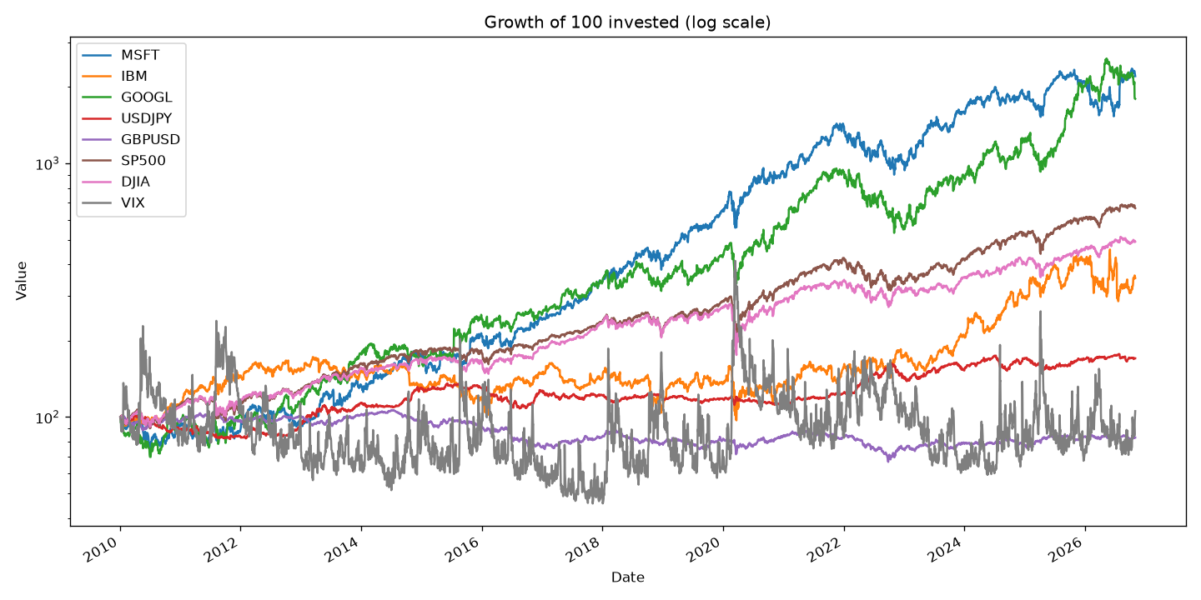
MSFT grew more than 20-fold since 2010
100 in MSFT became over 2,000; GOOGL similar
Indices grew steadily, IBM lagged until 2024
VIX spikes in sell-offs: 2011, 2015, 2018, 2020, 2025
Strong trends make prices unusable as targets
Notes:
Log-scale chart of 100 invested in each series. The point: prices trend strongly, which is why we model returns.

Slide 7
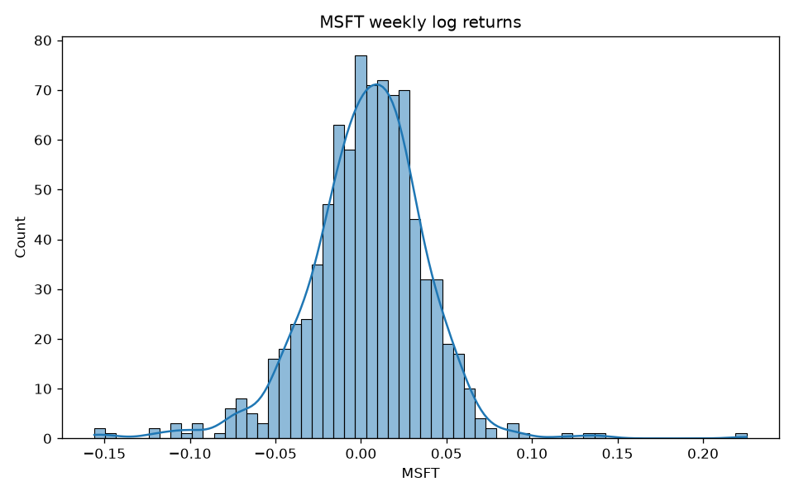
Weekly returns are noisy and fat-tailed
+0.37%
average MSFT weekly return
3.44%
standard deviation: the noise is about 10× the signal
Excess kurtosis 4.08: extreme weeks (−15.6%, +22.5%) are far more common than a normal curve predicts.
Notes:
All eight series have positive excess kurtosis (fat tails); stock indices are negatively skewed, VIX positively. A few extreme weeks dominate RMSE, which is why MAE is reported too.

Slide 8
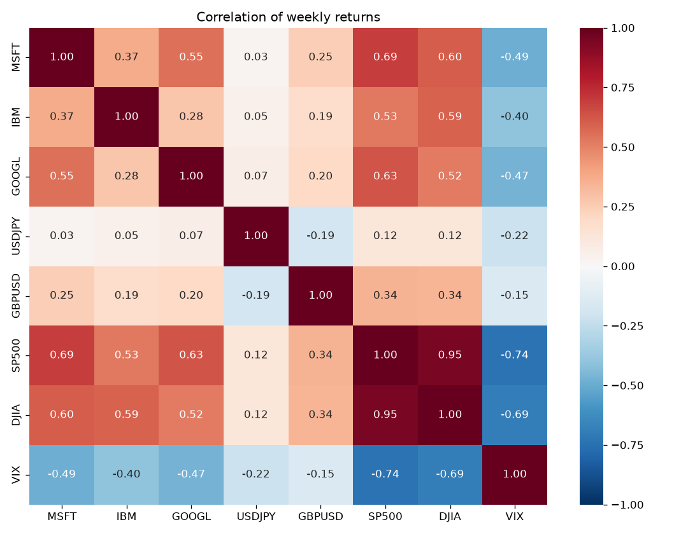
MSFT moves with the market in the same week
Correlation with MSFT, same week
S&P 500
0.69
Dow Jones
0.60
GOOGL
0.55
VIX
−0.49
USD/JPY
0.03
But the models must predict next week from this week's data, and that link is far weaker. This gap explains the results.
Notes:
S&P 500 and Dow Jones are correlated at 0.95, so they carry almost the same information. Strong same-week correlation does not mean predictive power for next week.

Slide 9
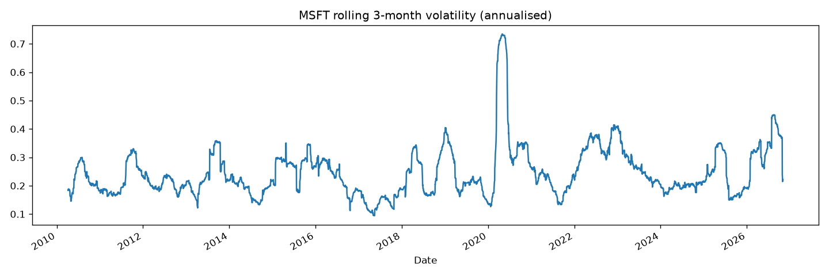
Volatility comes in bursts; returns are stationary
Usually 15–35% a year; about 73% in the March 2020 COVID crash
Calm and turbulent stretches both fall in the test period
ADF test | p-value | Result
MSFT price | 0.9875 | Non-stationary
MSFT weekly return | 0.0000 | Stationary
Notes:
Augmented Dickey-Fuller: p above 0.05 means we cannot reject a unit root (non-stationary). Prices fail, returns pass, which confirms modelling returns.

Slide 10
Only fastai beats the baseline on every metric
Model | RMSE | MAE | R² | Directional accuracy
Baseline (mean / always up) | 0.0374 | 0.0256 | 0 | 56.3%
PyTorch + fastai | 0.0367 | 0.0252 | 0.035 | 59.3%
PyTorch + Lightning Flash | 0.0373 | 0.0262 | 0.006 | 61.7%
Keras | 0.0373 | 0.0259 | 0.005 | 61.1%
XGBoost | 0.0373 | 0.0257 | 0.003 | 56.3%
PyTorch + TabNet | 0.0378 | 0.0267 | −0.023 | 51.5%
fastai: RMSE −1.8% and MAE −1.5% against the baseline
Flash and Keras call the direction best (~61%) but don't lower MAE
XGBoost predicted “up” in all 167 weeks
TabNet is the only model worse than the baseline
Test period: 167 weeks, Jun 2023 – Oct 2026
Notes:
With only 167 test weeks, a 1 to 2 percent change in RMSE could partly be luck. Honest reading: fastai shows a weak signal, the others little or none.

Slide 11
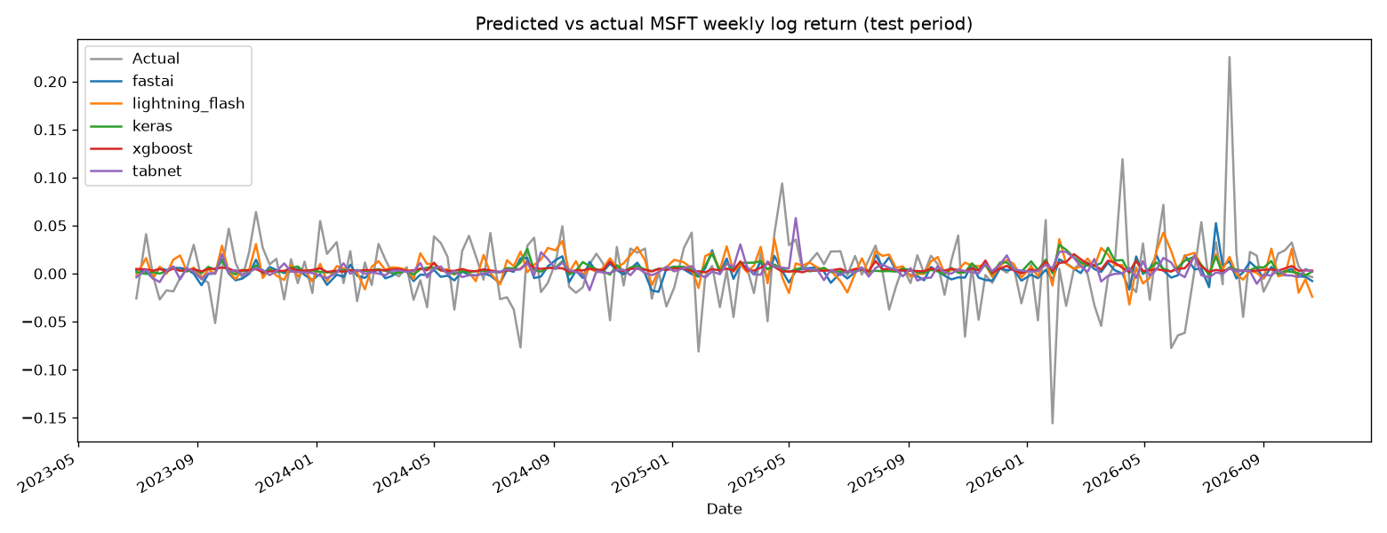
Predictions stay near zero while returns swing widely
Spread of predictions vs. actual returns (standard deviation)
XGBoost
0.3%
Keras
0.6%
TabNet
0.8%
fastai
0.9%
Flash
1.2%
Actual
3.75%
Notes:
When the signal is weak, predicting close to the average minimises error. Large predictions would be wrong most of the time, so the models play it safe.

Slide 12
Expected return for the coming week
Four models expect a small rise of 0.5–1.6%
TabNet's +7.1% is not credible: twice a normal week's swing, from the least accurate model
One prediction from one row: an illustration, not a forecast
Annualising (1.6% a week ≈ 129% a year) exaggerates it further
Notes:
Expected return is each model's prediction for the most recent feature row, 2 November 2026, whose outcome is not yet known.

Slide 13
Simplicity, transparency and efficacy
Framework | Simplicity | Transparency | Efficacy | Why
XGBoost | High | High | Medium | Easiest set-up; feature importance; only matched the baseline
Keras | Medium | Low | Medium | Network designed by hand; needed target scaling
PyTorch + fastai | Medium | Low | High | Auto-built network; best on every metric
PyTorch + TabNet | Medium | Medium | Low | Attention importances; RMSE 0.038–0.049 across runs
PyTorch + Lightning Flash | Low | Low | Medium | Archived: separate Python 3.10, pinned versions
TabNet's test RMSE on identical data in three runs: 0.0382, 0.0490, 0.0378. A result this sensitive to its random start is hard to trust.
Notes:
Simplicity: lines of code were 34 to 47 for all models, so set-up effort mattered more. Transparency: only XGBoost and TabNet expose feature importance without extra tools. Efficacy: test metrics plus stability.

Slide 14
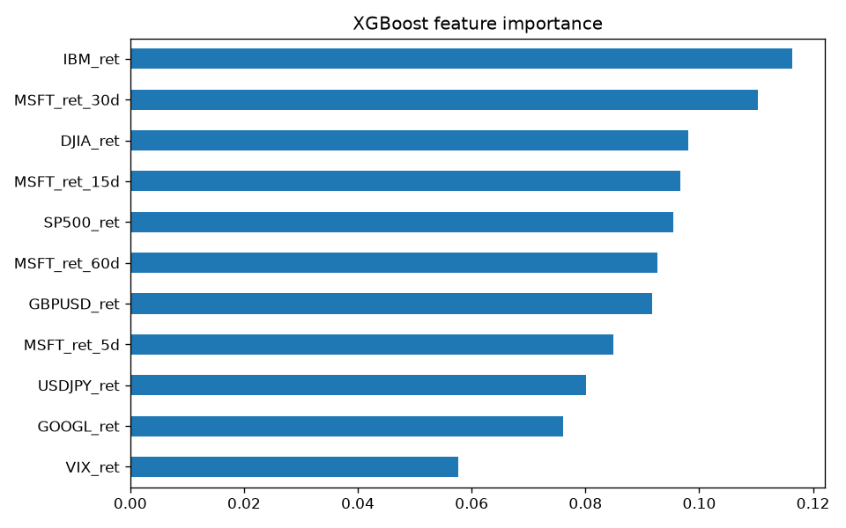
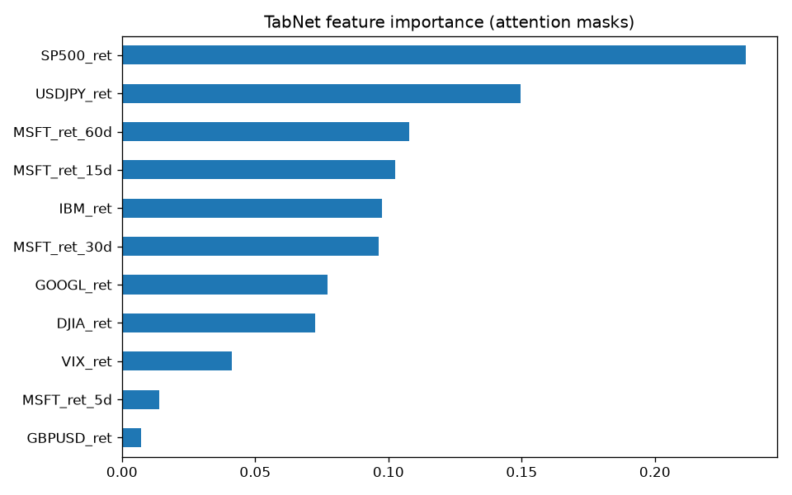
Transparency: the two models disagree on what matters
XGBoost: importance spread evenly (0.06–0.12); IBM, MSFT 30-day and Dow Jones on top
TabNet: S&P 500 (0.23) and USD/JPY (0.15) on top, and the ranking shifts when retrained
No single feature holds a strong, stable signal.
Notes:
Keras, fastai and Lightning Flash give no feature importance without extra tools such as SHAP. XGBoost's trees can also be inspected directly, making it the most transparent.

Slide 15
Conclusion
Next-week returns are close to unpredictable from these features: best gain under 2% in RMSE
Pick XGBoost for a quick, explainable model; fastai when accuracy matters most
Limits: 167 test weeks, one split, one seed per network, no trading costs
Next: technical and news features, walk-forward validation, SHAP, a backtest
Notes:
The results agree with the efficient-market view: past prices and related assets carry little information about next week's price. Neither model gives an edge large enough to trade on after costs.

