Slide 1
Stock Price Prediction using Supervised Machine Learning
• Predicting Microsoft's next-week return with five ML frameworks
• Team: [names]
• [Course / date]

Slide 2
Problem and objective
• Target: MSFT weekly return, one week ahead
• Why returns: prices are non-stationary (ADF p = 0.993), returns are stationary
• Features: correlated assets (IBM, GOOGL, USD/JPY, GBP/USD, S&P 500, Dow, VIX)
• Compare XGBoost, Keras, fastai, TabNet, Lightning vs baselines
• Criteria: RMSE, MAE, R², R²_OOS, direction; simplicity, transparency, efficacy

Slide 3
Data and features
• Yahoo Finance, daily closes 2010 to Oct 2026, 8 series
• Aligned to MSFT trading days; forward-fill only (never back-fill)
• 876 weekly returns; current + 4 lagged weeks = 40 features, 871 samples
• Extension: 5 technical indicators (MA ratios, EMA ratio, momentum, volatility)

Slide 4
Methodology and leakage controls
• Target shifted one week: features known at Friday close
• Chronological 80/20 split: train 696 weeks, test 175 weeks (Jun 2023 to Oct 2026)
• Scaler fit on training data only; TimeSeriesSplit for tuning
• Neural nets: last 15% of training as validation, early stopping, 3 seeds averaged
• Colab for Keras, fastai, TabNet, Lightning

Slide 5
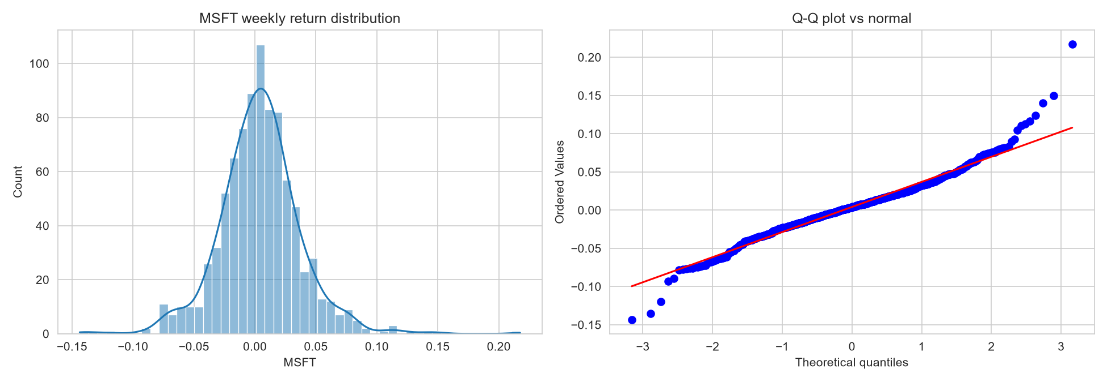
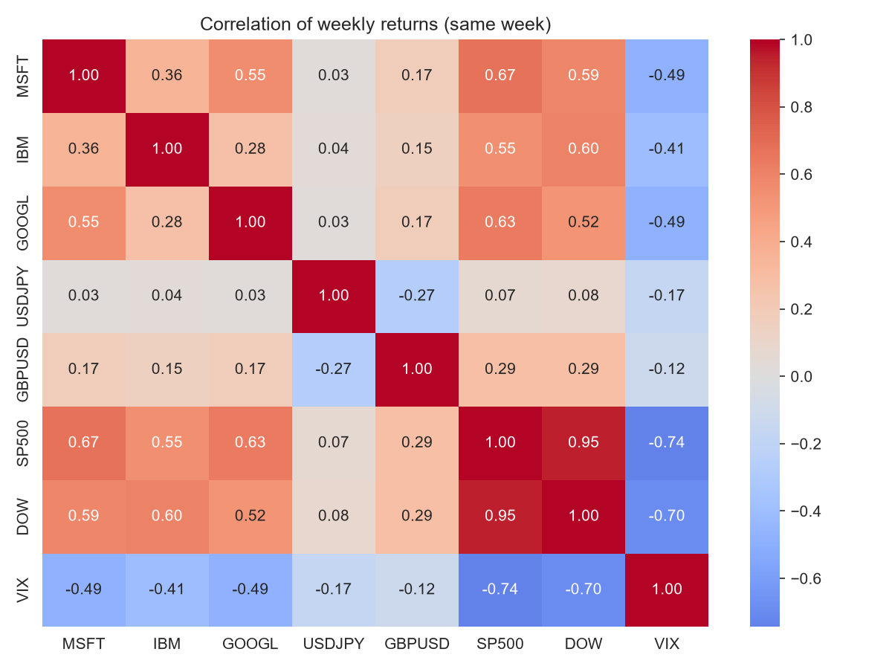
EDA: returns
• Fat tails (excess kurtosis 3.6, Jarque-Bera p ~ 4e-104); same-week correlation with S&P 500 is 0.67 but cannot be used for prediction

Slide 6
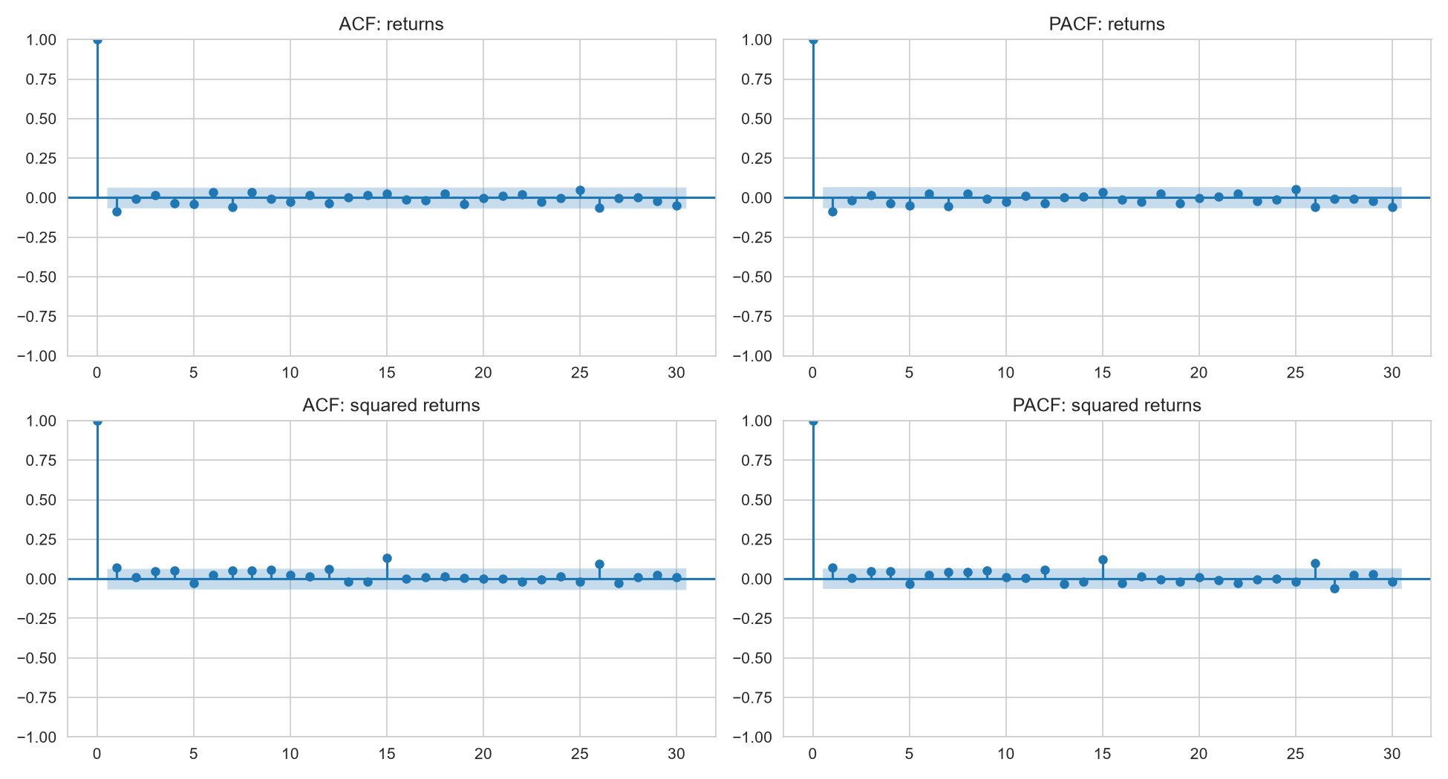
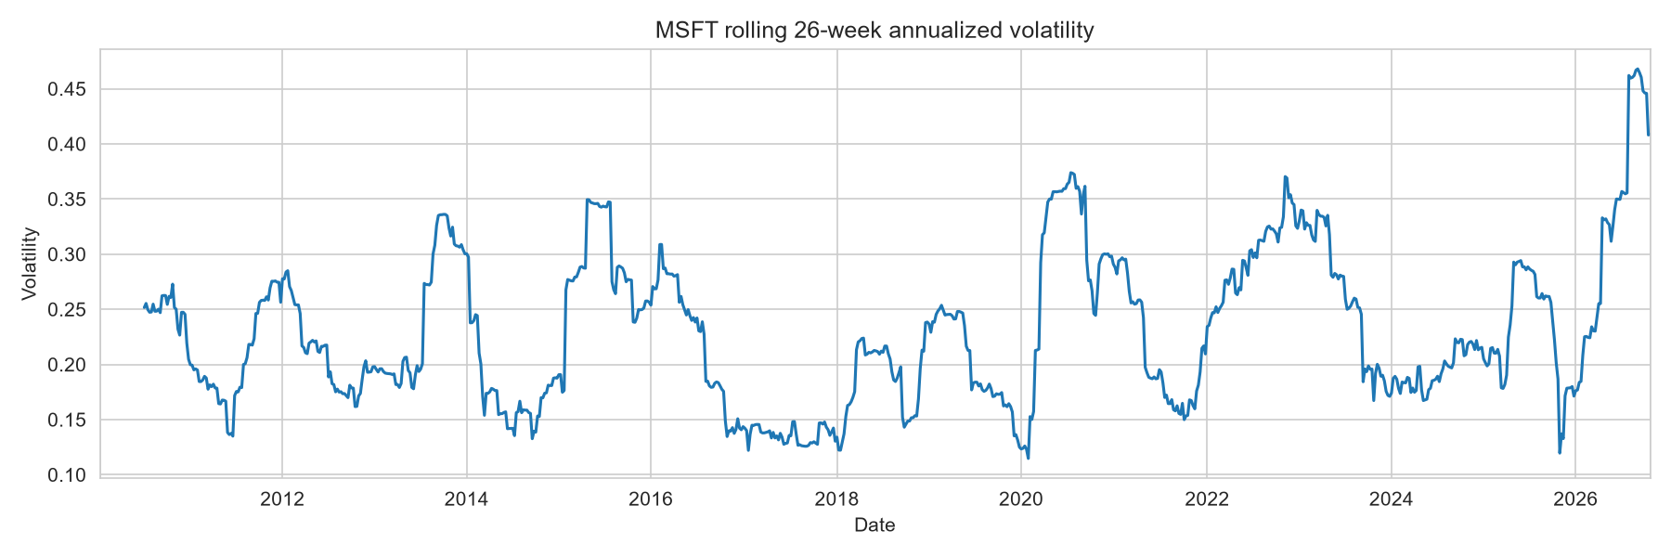
EDA: predictability
• No autocorrelation in returns; volatility clusters. Best lagged feature |r| = 0.099

Slide 7
Models used
• Baselines: train mean, zero, linear regression, Ridge (alpha ~ 2,976)
• XGBoost: default vs tuned (depth 3, 100 trees, lr 0.02, L2 = 50)
• Keras MLP (32-16), fastai tabular, PyTorch TabNet, PyTorch Lightning MLP
• Flash failed to install (needs numpy<1.24): plain PyTorch Lightning used instead

Slide 8
Results: base features
model | RMSE | MAE | R2 | R2_OOS | DirAcc
fastai tabular | 0.0363 | 0.0261 | 0.0218 | 0.0230 | 0.5086
PyTorch Lightning MLP | 0.0363 | 0.0260 | 0.0217 | 0.0229 | 0.4743
Linear regression | 0.0364 | 0.0265 | 0.0167 | 0.0179 | 0.4514
Keras MLP | 0.0366 | 0.0261 | 0.0071 | 0.0083 | 0.5257
Ridge | 0.0366 | 0.0260 | 0.0060 | 0.0072 | 0.5086
XGBoost (tuned) | 0.0366 | 0.0261 | 0.0059 | 0.0071 | 0.5429
Train mean | 0.0367 | 0.0260 | -0.0012 | 0.0000 | 0.5200
Zero forecast | 0.0368 | 0.0258 | -0.0078 | -0.0065 | 0.4800
TabNet | 0.0370 | 0.0260 | -0.0175 | -0.0163 | 0.5029
XGBoost (default) | 0.0381 | 0.0278 | -0.0808 | -0.0795 | 0.4914

Slide 9
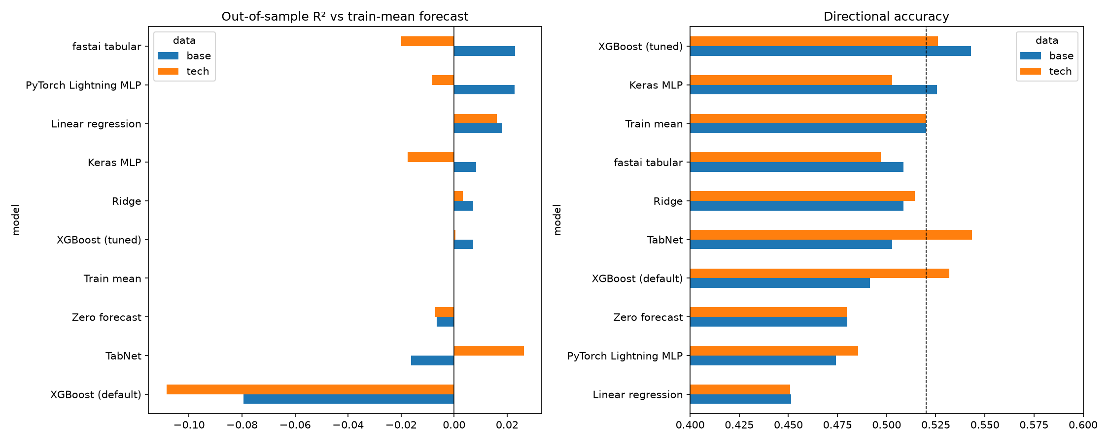
Model comparison

Slide 10
Key findings
• RMSE spread of only 0.0007 (excl. default XGBoost): no clear winner
• Best R²_OOS is 0.023; direction accuracy ~ 52% baseline, not beaten significantly
• Default XGBoost overfits (R² -0.08); regularization fixes it
• Technical indicators did not help consistently; TabNet flipped sign (unstable)
• Training loss falls, validation loss flat: little signal to learn

Slide 11
Simplicity / Transparency / Efficacy
model | Simplicity | Transparency | Efficacy
Linear regression | 5 | 5 | 3
Ridge | 5 | 5 | 3
XGBoost (tuned) | 4 | 4 | 3
Keras MLP | 3 | 2 | 3
fastai tabular | 3 | 2 | 3
TabNet | 2 | 3 | 2
PyTorch Lightning | 2 | 2 | 3
• Scores 1 to 5 (5 = best); efficacy differences are within noise

Slide 12
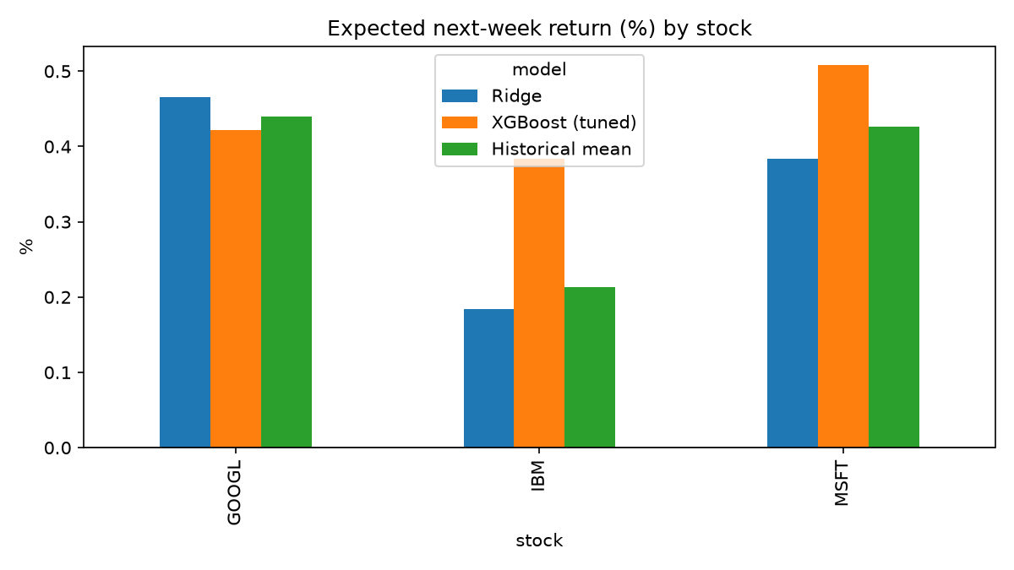
Expected returns
• Forecasts sit near historical means (MSFT 0.43%, IBM 0.21%, GOOGL 0.44% per week)
• IBM and GOOGL: R²_OOS ≤ 0 for all frameworks
• Models disagree widely: use the historical mean as the anchor
• Not investment advice

Slide 13
Limitations, conclusion, future work
• Weekly MSFT returns are almost unpredictable from these features
• Limits: single split, 2026 spikes in test set, no fundamentals/news, small samples
• Future: walk-forward validation, news sentiment, fundamentals, volatility or direction targets, longer horizons

