Slide 1
Performance & Tuning
AseMon – The GUI Version
Göran Schwarz

Slide 2
What is AseMon
Monitoring tool that work on Sybase MDA Tables
  Most MDA tables is just incremental counters, which could be hard to read...
  AseMon is just a ”difference engine” that calcultes number of ++ per second
  The vision for AseMon is ”information at the fingertips”
AseMon is not a Sybase Product, it has been developed by me.
The Goal was to make my Performance & Tuning gigs easier.
Available for download at: http://www.asemon.se
And it’s free ☺
Still in development (and will probably always be)

Slide 3
AseMon History
AseMon (original GUI version) was done by Jean-Paul Martin
  He is not doing any more work on that, since years...
  And I have basically rewritten the whole thing again.
Jean-Paul instead now develops AseMon_Logger, which basically does the same thing, but it just stores the information in a database.
The data can be view from a Web interface
AseMon_Logger can be found at: http://sourceforge.net/projects/asemon/

Slide 4
AseMon: Demo - Overview
To be able to show AseMon in Action I needed implement a dummy application, so I can drive the database, this so we can find problems…
The dummy application is a Queue Based system
  Take 1 queue record from a queue (a table in the database)
  Execute a stored procedure to do Action on the entry.
  The above is done by X number of worker threads, this so we can emulate more than 1 user.
  For now it’s just a does Inserts... (no read application is implemented)

Slide 5
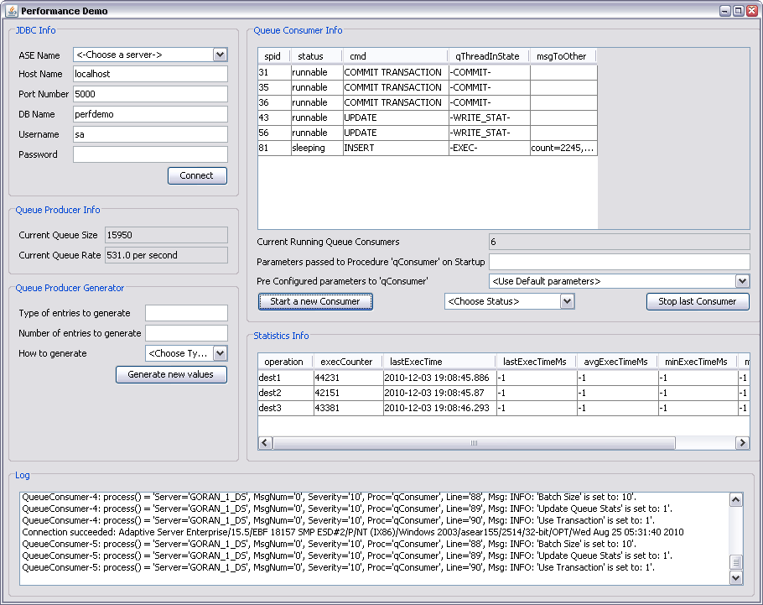
AseMon: Demo – Architecture
Hist1
Q Stat
Proc
Lookup1
Lookup2
Trigger
Dest1
Q Worker
Consume
Proc
View
Q Table
Trigger
Q Worker
Q Worker
Feed The Queue
Q Worker
Dest2
Consume
Proc
View
Driver GUI
Start/Stop/Control Queue Workers
Consume
Proc
Dest3
View
Queue Generator

Slide 6
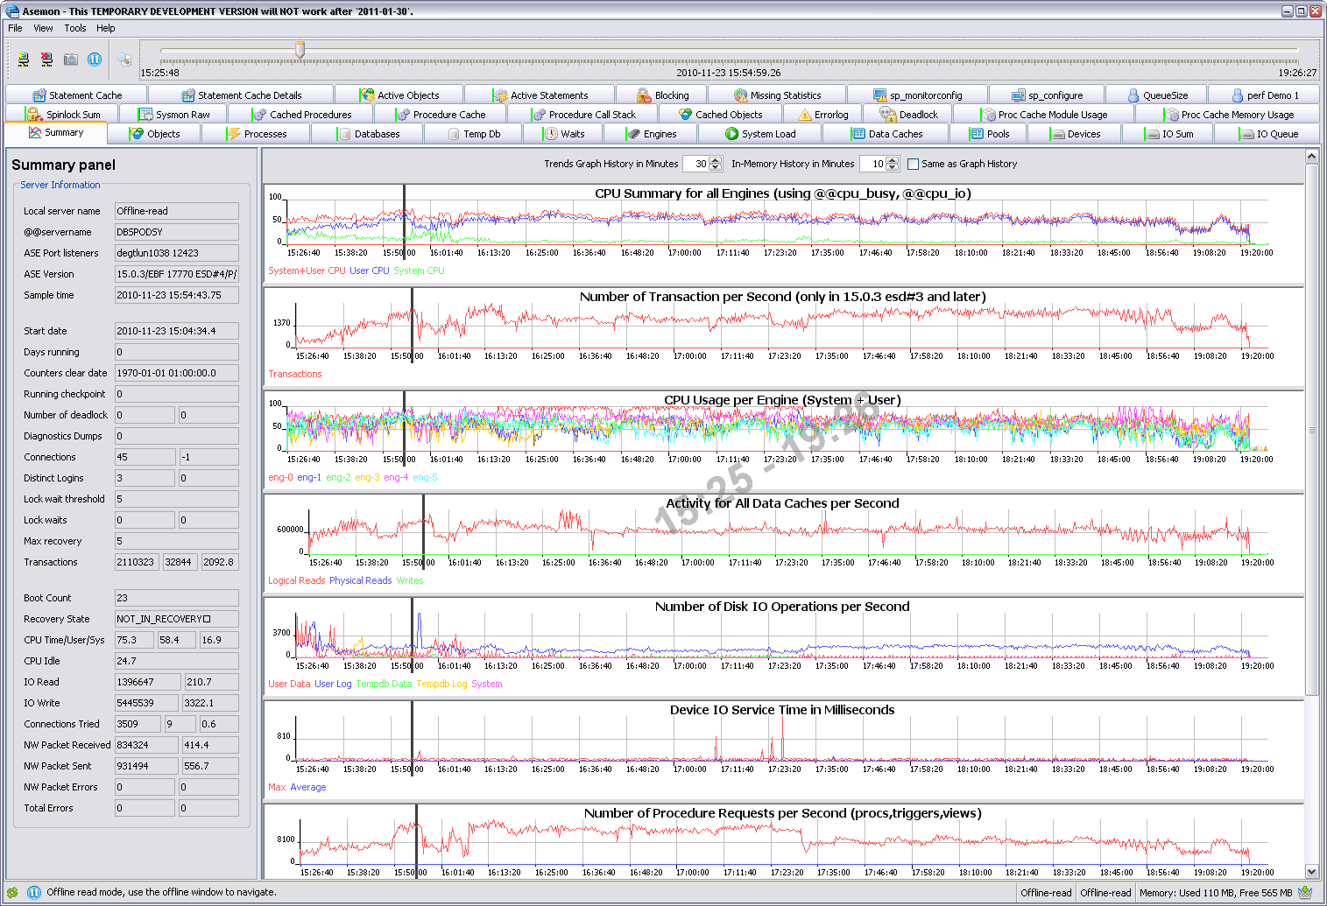
AseMon: Screen Capture

