Slide 1
IoT Device Identification from Network Traffic using KNN
Leveraging K-Nearest Neighbors for Efficient Device Detection
By: GORASH PLATON
Student ID: 22605107
Date: 2025.05.22

Slide 2
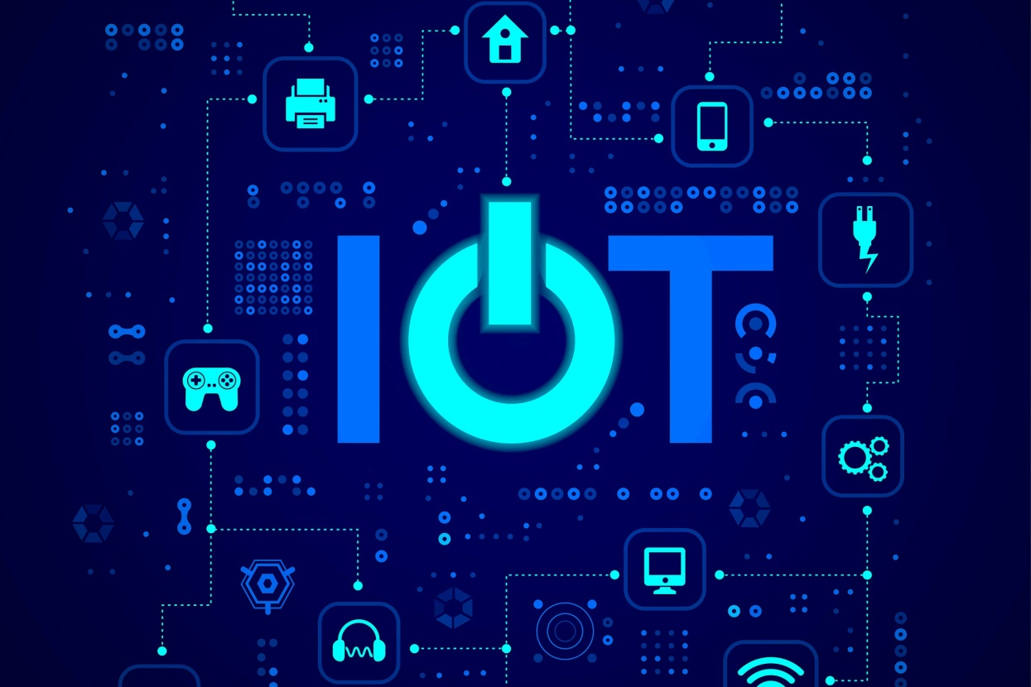
Introduction
Goal of the study:
Develop a machine learning model using K-Nearest Neighbors (KNN) that can accurately identify IoT devices based on their network traffic patterns, achieving high accuracy by applying appropriate machine learning algorithms, feature selection techniques, and parameter tuning. Also apply KNN to classify IoT devices based on network traffic patterns.

Slide 3

Current Challenges:
Why KNN?
Traditional methods (Signature-based, Deep Packet Inspection) are costly and resource-intensive.
Growing number of IoT devices requires scalable solutions.
Simple, interpretable, and computationally efficient.
No prior knowledge required about devices.
Applicability in diverse, real-world scenarios

Slide 4

Motivation
The motivation for such a study comes from the increasing demand for efficient and scalable IoT device identification in today's network infrastructures. Fast but robust machine learning methods, such as the KNN algorithm, can identify devices with the help of pattern learning in the absence of any prior knowledge about the devices.

Slide 5

Data Overview: this dataset containing network traffic traces of various IoT devices collected over a day
Dataset Description:
Key Features:
18 distinct IoT devices.
137 features, including protocol details, IP addresses, packet sizes, etc.
258,000 records
Numerical (e.g., Frame_length, udp.dstport).
Categorical (e.g., Frame_protocols_in).
Boolean (e.g., ARP flags)
Classes:
Different device types such as Amazon Echo,
Samsung SmartCam, TP-Link Router, etc

Slide 6
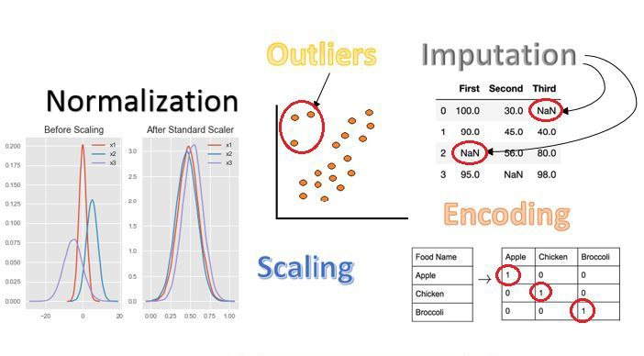
Data Preprocessing
1. Handling Missing Data
Imputation of numerical values with mean.
Imputation of categorical values with the most frequent value.
2. One-Hot Encoding
Conversion of categorical features to numerical format for KNN.
3. Feature Selection
Removal of unreliable features (IP/MAC addresses, which can be spoofed).
Random Forest used to select the top 10 important features.

Slide 7
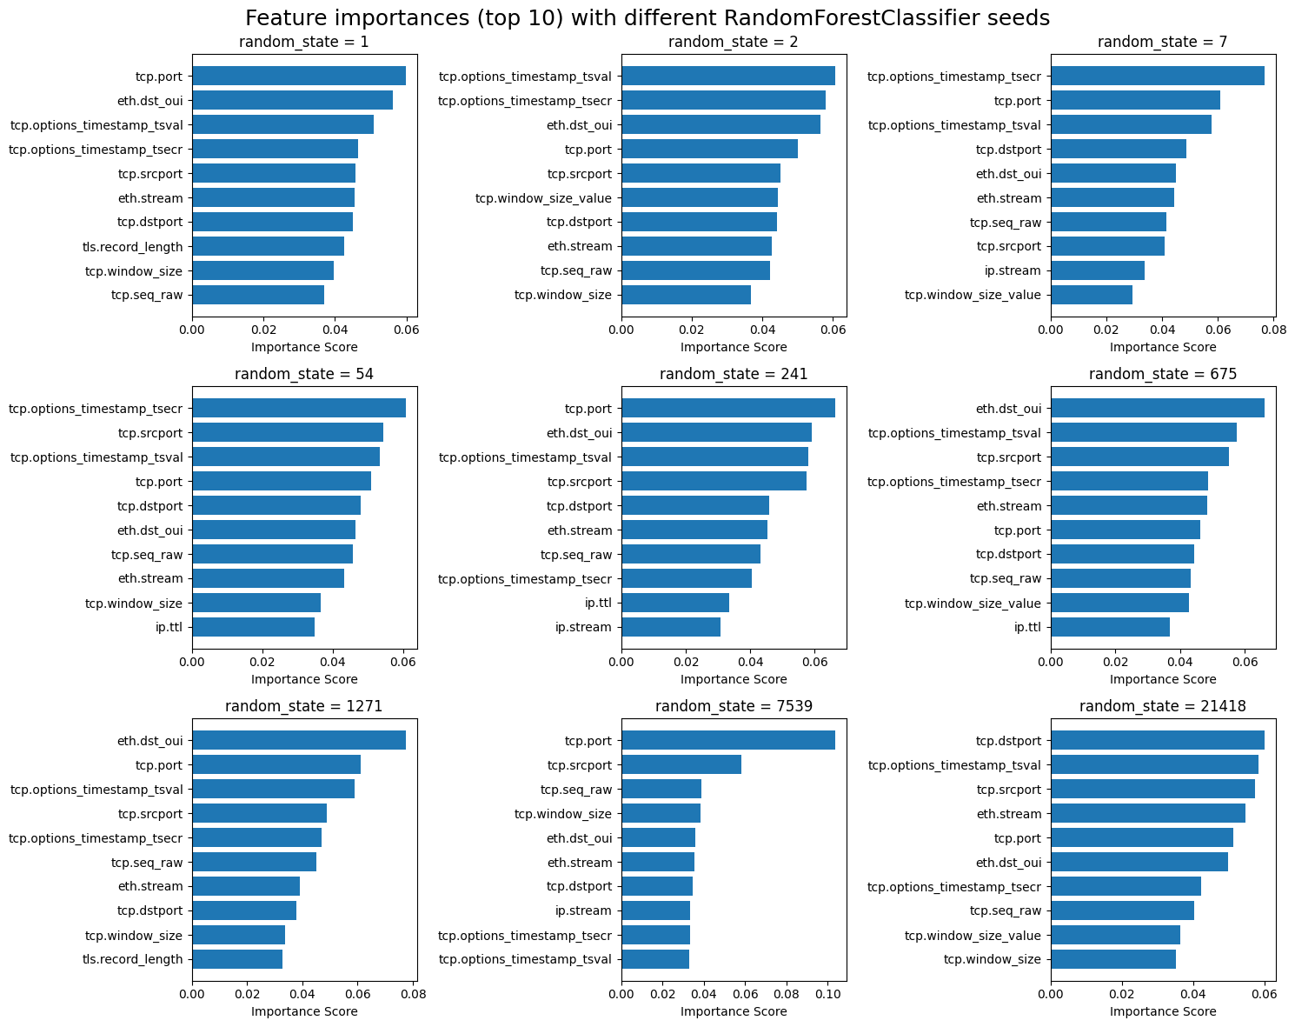

Slide 8
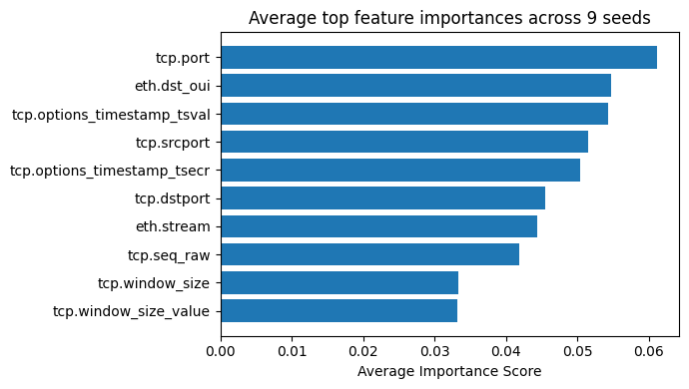

Slide 9
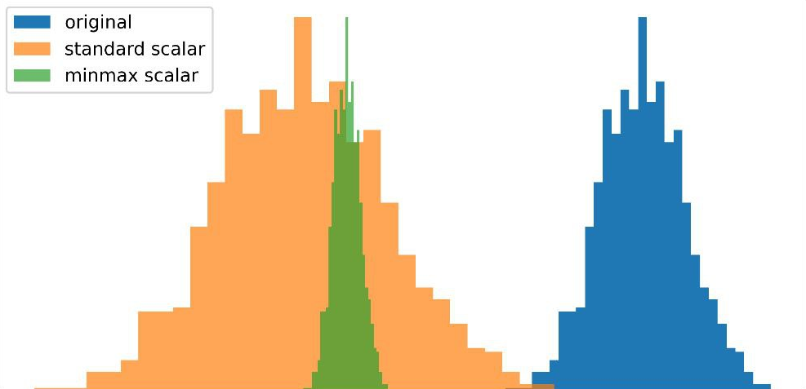
Feature Scaling
In our processed dataset, we have 185 columns (1 label columns and 184 features), which is too much for processing. Feature scaling is applied to the numerical features using StandardScaler from scikit-learn. This step standardizes the data by transforming the features to have a mean of 0 and a standard deviation of 1, ensuring that all numerical variables are on a similar scale. Scaling is crucial for distance-based algorithms like KNN, as it prevents features with larger ranges from dominating the distance calculations and ensures that each feature contributes equally to the model's performance.

Slide 10
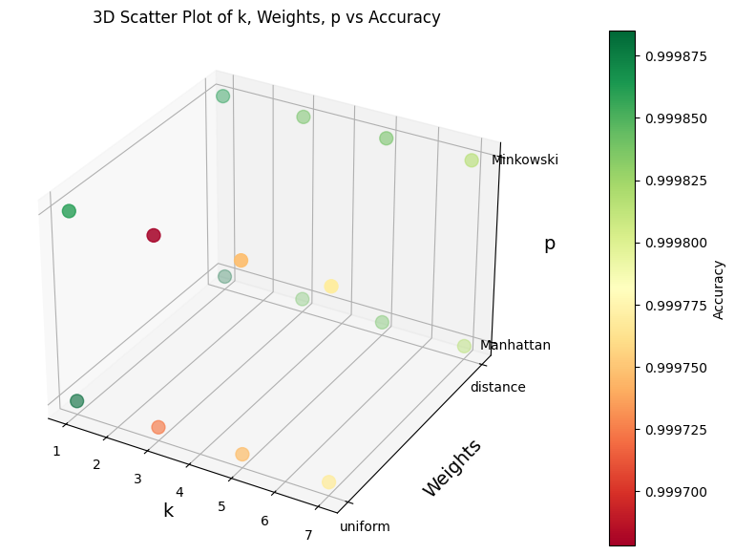
Hyperparameter Tuning
KNN Hyperparameters:
Process:
k: Number of neighbors.
Weights: Uniform or distance-based weights.
p: Distance metric (p=1 for Manhattan, p=2 for Minkowski)
Grid search across combinations of k, weights, and p.
Evaluating model accuracy using 80/20 train-test split

Slide 11
Results of Hyperparameter Tuning
Best Model Configuration: k=1, weights=uniform, p=1 (Manhattan distance); accuracy: 99.983909%
Model Performance:
Training Time: ~2 seconds per iteration;
Evaluation Time: ~8 seconds per iteration;
Bottleneck during evaluation (particularly for large k values and Minkowski distance)
Training Time: relatively stable with slight increase as k grows.
Evaluation Time: varies based on distance metric and weights: uniform weights; result in slower evaluations; Minkowski distance (p=2) slower than Manhattan (p=1).
Bottlenecks: primarily during evaluation phase, especially with large k values

Slide 12
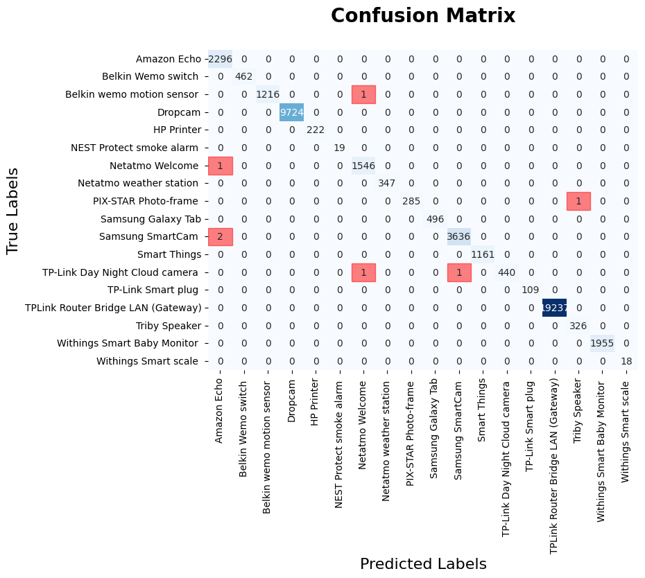
Model Evaluation
The model's great performance (more than 99.9% using scikit-learn’s accuracy_score metric) showed that even a simple KNN classifier is able to correctly classify IoT devices using correctly selected and preprocessed features from this structured dataset. Visualizing the confusion matrix, we see that in our train/test split case, only 7 devices were misclassified.

Slide 13
Limitations of the Approach:
Areas for Improvement
Risk of Overfitting: k=1 can lead to high bias and overfitting.
Dataset Bias: model performance may vary with more diverse or real-world data.
Computational Bottleneck: evaluation time increases with larger k values and Minkowski distance.
Hyperparameter Search: test broader hyperparameter ranges and advanced optimization techniques.
Alternative Algorithms: compare KNN with other models like Random Forest or SVM.
Data Diversity: test the model with more varied real-world IoT traffic to assess generalization

Slide 14
Key Insights and Contributions
Simplicity of KNN: even with a simple KNN classifier, high accuracy was achieved for IoT device identification.
Feature Selection Importance: careful preprocessing and feature selection dramatically improved model performance.
Real-World Implications: potential for integrating machine learning models into IoT network management for enhanced security and monitoring
The insights of the research could be used to educate best practices among IoT network administrators, cybersecurity professionals, and IoT equipment manufacturers looking to enhance network security and operational effectiveness in diverse and dynamic IoT ecosystems.

Slide 15

Conclusion
This project aimed to develop a machine learning model using the K-Nearest Neighbors (KNN) algorithm for identifying IoT devices based on their network traffic patterns. After extensive hyperparameter tuning, the final model achieved an impressive accuracy of 99.98%. The model's performance was analyzed in terms of training and evaluation times. Despite the performance, the model could benefit from testing with more diverse real-world data, experimenting with other algorithms. The work provides a solid foundation for further research into machine learning applications in IoT network security, management, and monitoring.

