Slide 1
AI-Powered Sentiment Analysis and Recommendation System for E-Commerce Reviews
Project Training Course Final Project
by Gorash Platon

Slide 2

Introduction
This project report describes the development of an AI-Powered Sentiment Analysis and Recommendation System for E-Commerce Reviews that turns raw review text into actionable insights.
Using the public Amazon Reviews dataset and a Django web interface backed by MySQL, we will implement a complete end-to-end application suitable for a course project.

Slide 3
Introduction
The project follows standard project management phases: Initiation, Planning, Execution, Monitoring & Control, and Closing. Scope control, mitigation of risk, and reproducibility are checked.
This report discusses the design, implementation plan, evaluation strategy, and ethical safeguards for guiding the team from prototype to tested, maintainable application.

Slide 4

Methodology
Initiation
Planning
Execution
Monitoring
Closing

Slide 5

Machine Learning Algorithms Overview
Naive Bayes (NB)
Support Vector Machines (SVM)
LSTM (Long Short-Term Memory) Neural Networks

Slide 6

Key challenges
Class Imbalance
Sarcasm, irony, idioms and other variations of subtle language create difficulties
E-commerce reviews present challenges because they can be written in many languages or contain informal language such as typos, slang, and emoji

Slide 7
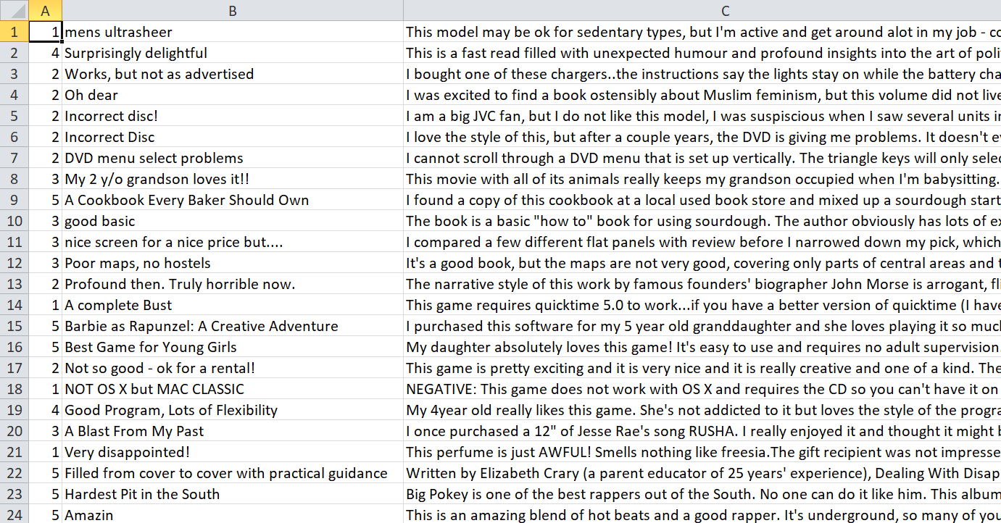
Data
This project relies on the Amazon Review Full Score Dataset Version 3 (September 2015). Testing examples were randomly selected, resulting in total of 3 million training samples and 650,000 testing samples. Each instance in the dataset includes three fields:
  numerical rating label (1–5, where 1 is negative and 5 is positive);
  review title;
  review body
Figure 1: Preview of the dataset (CSV table format)

Slide 8
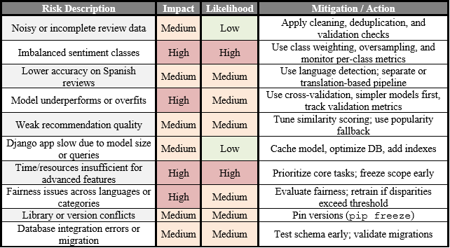
Initiation
Figure 2: Risk Register Table

Slide 9
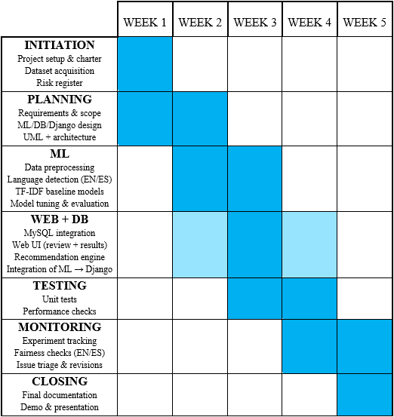
Initiation
Figure 3: Gantt Chart Timeline

Slide 10
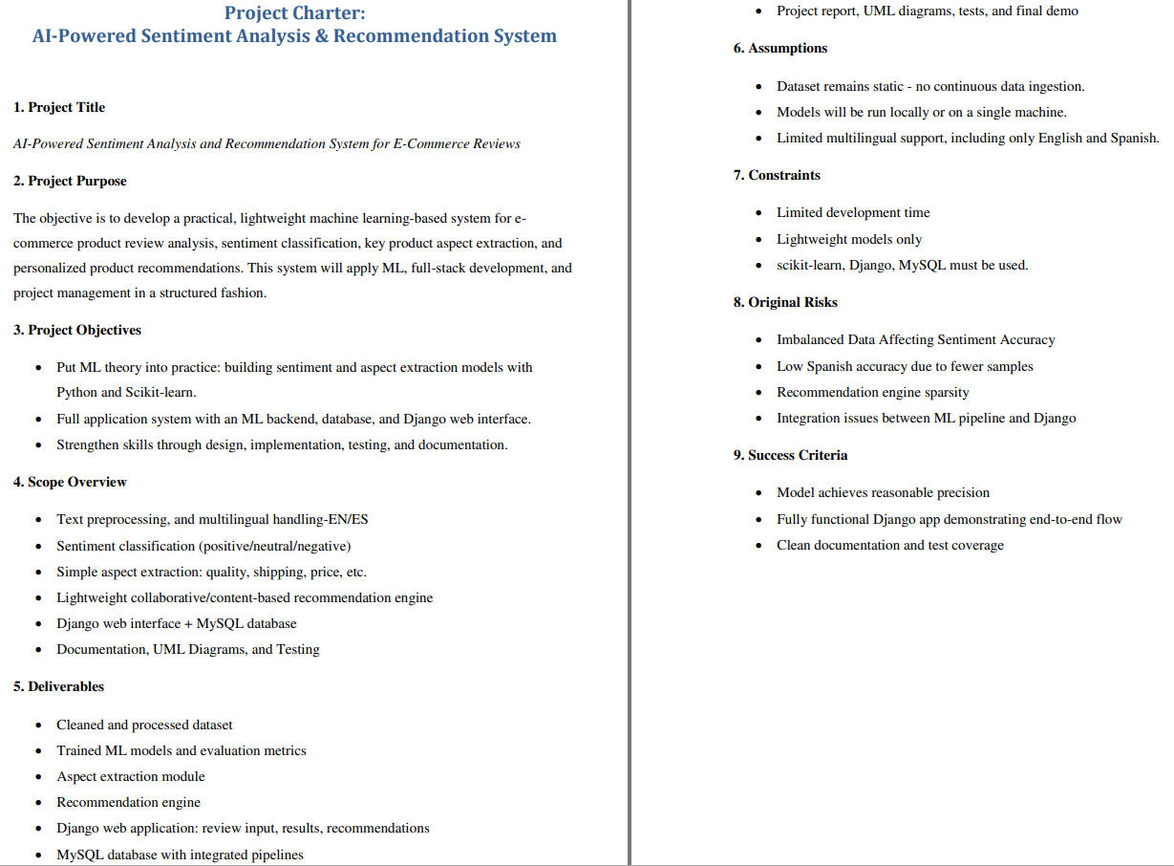
Initiation
Figure 4: Project Charter Overview

Slide 11
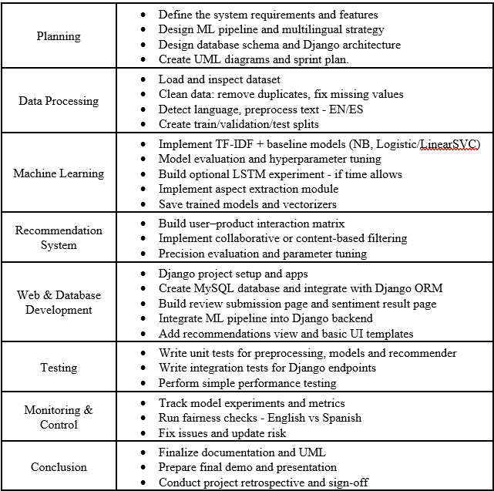
Planning
Figure 5: Task List

Slide 12
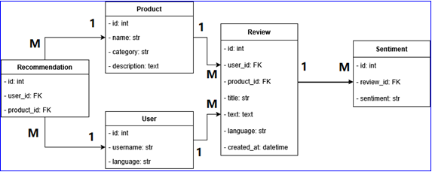
Planning
Figure 6: Database UML Scheme

Slide 13
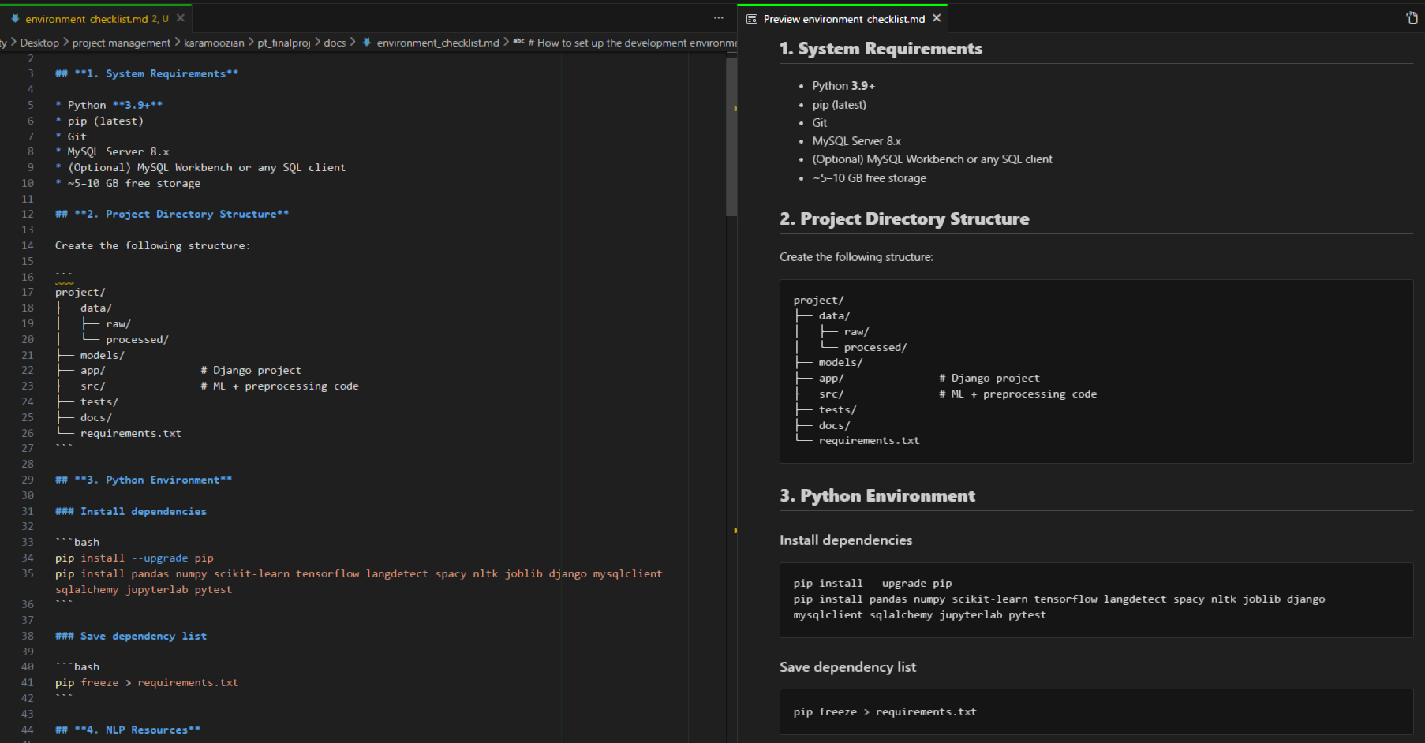
Planning
Figure 7: Environment Checklist in Markdown Format

Slide 14
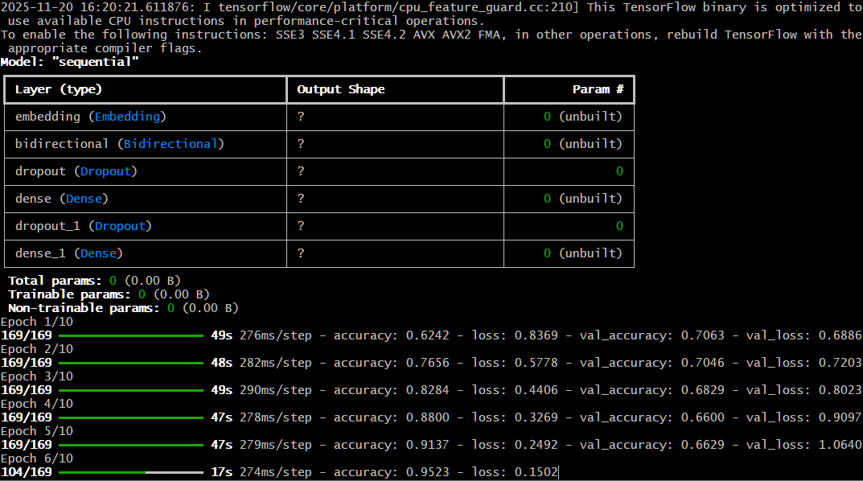
Machine Learning Pipeline
Figure 8: Tensorflow ML Training Process

Slide 15
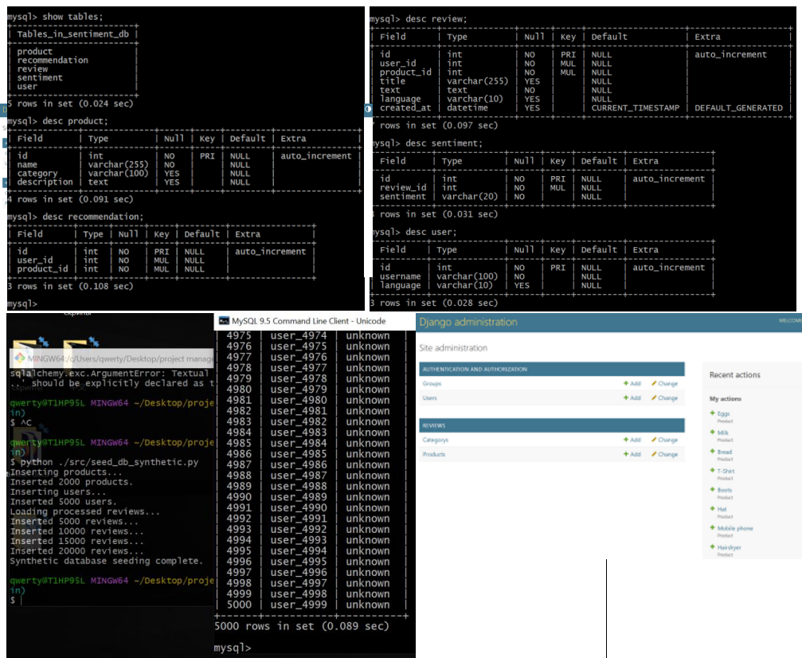
Database Development
Figure 9: MySQL Database Structure

Slide 16
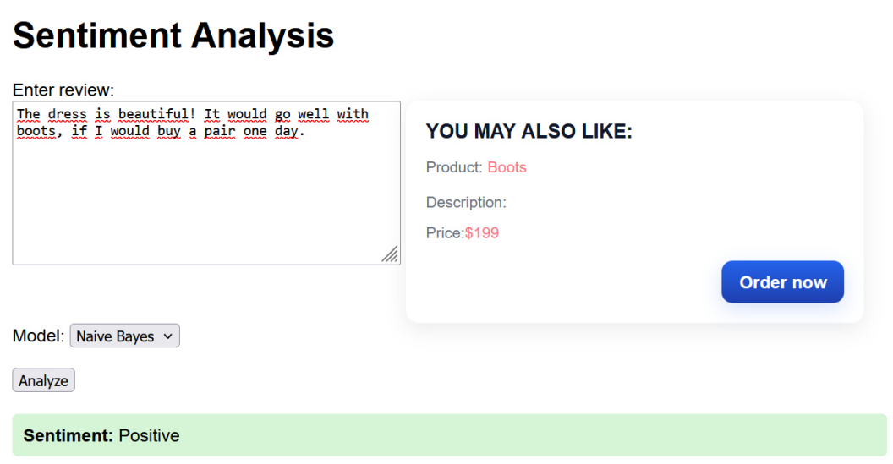
Django Web Application
Figure 10: Django Web Application Design (Sentiment Analysis & Recommendation System)

Slide 17
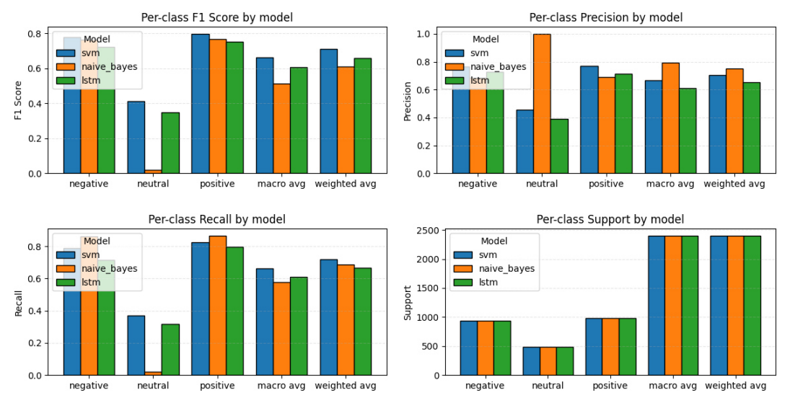
Django Web Application
Figure 11: ML Models Metrics Comparison

Slide 18
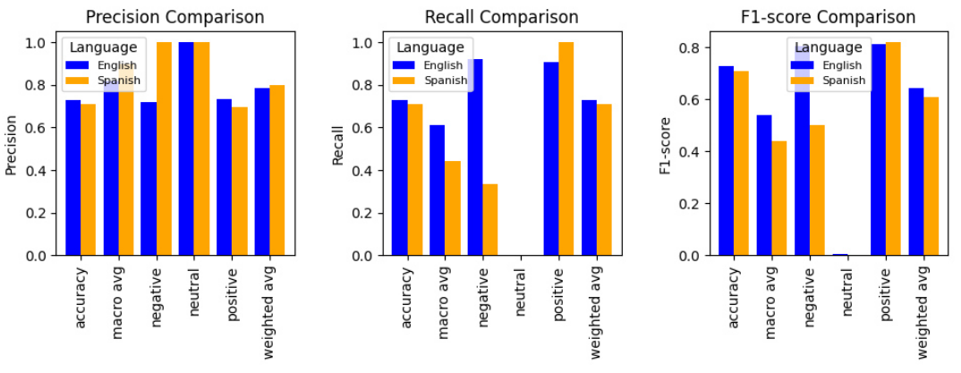
Django Web Application
Figure 12: English vs Spanish comparison

Slide 19

Results
In this work, we have developed an AI-driven sentiment analysis and recommendation system for e-commerce reviews, which:
classifies sentiments;
works with different languages, i.e. English & Spanish;
gives out personalized product recommendations.
The web interface was designed in Django; users can input their reviews, view sentiment analysis results, and get personalized recommendations for products.
Another implemented part is the MySQL database
for the storage of reviews, data about users, and recommendations.

Slide 20

Ethical Considerations
One way to deal with ethical complications is to add a fairness check in our project steps. For example, after training, we will figure out measurements on reviews in different languages or from different types of products to be sure no group is unfairly hurt. If we notice skews, we can try again with more balanced information or detailed tuning to help fairness.

Slide 21

Conclusion
Through sentiment analysis, e-commerce customer reviews become converted into valuable information for retailers. Major issues may be: imbalanced classes, sarcasm, different languages, possibly unfairness. Checking for fairness will be part of proving that our work is correct. Overall, this work helps us pick the right algorithms, deal with data problems, and create correct, fair sentiment analysis tools.

