Slide 1
Intelligent Classification of Rural Infrastructure Projects
ACITE INTERNSHIP
Presented By:
Student Name-Gorav Singh
College Name-Graphic Era Hill University
Department-CSE

Slide 2
OUTLINE
Problem Statement
Proposed System/Solution
System Development Approach
Algorithm & Deployment
Result (Output Image)
Conclusion
Future Scope
References

Slide 3
Problem Statement
India’s Pradhan Mantri Gram Sadak Yojana (PMGSY) has improved rural connectivity through various phases and schemes, each with different goals and features. With thousands of road and bridge projects underway, officials face the daunting task of manually sorting each project into its proper scheme for effective oversight and funding. This process is slow and often inaccurate. The challenge is to design a smart machine learning model that can automatically and accurately classify these projects into the correct PMGSY scheme based on their physical and financial details, making project management faster and more reliable.

Slide 4
Proposed Solution
The proposed system aims to address the challenge of automatically classifying rural infrastructure projects into their correct PMGSY scheme. This involves leveraging data analytics and machine learning techniques to analyze physical and financial project data and accurately identify each project's scheme. The solution will consist of components that streamline classification, support transparent decision-making, and enhance the efficiency of project monitoring and management.
Data Collection:
Historical data on rural road and bridge infrastructure projects—including their physical and financial features along with their PMGSY scheme labels—was collected from the AI Kosh website.
Data Preprocessing:
Data was cleaned and preprocessed to handle missing values, outliers, and inconsistencies, all using AutoAI to ensure a streamlined and reproducible workflow.
Feature extraction was also performed automatically by AutoAI, selecting and engineering the most relevant attributes for model training.
Machine Learning Algorithm:
A batched tree ensemble classifier (specifically, an XGBoost classifier) was implemented to classify each project into the correct PMGSY scheme according to its characteristics.
Deployment:
The trained model was saved and deployed on IBM Cloud, allowing users to easily access, update, and utilize the classifier for new and ongoing projects.
Evaluation:
PM-JANMAN: Perfect classification with 100% precision and recall.

Slide 5
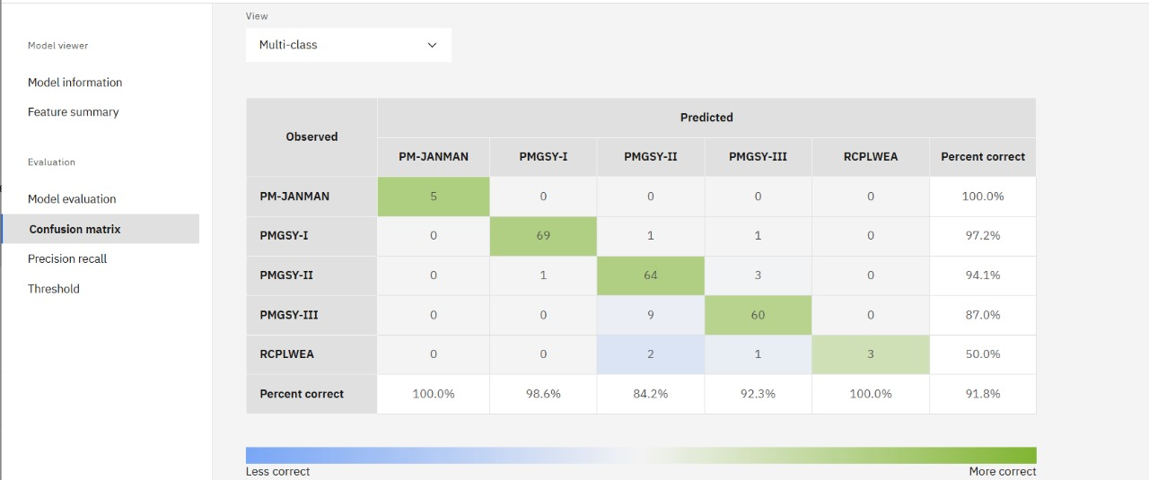
PMGSY-I: precision (98.6%) and recall (97.2%).
PMGSY-II: precision (84.2%) and recall (94.1%).
PMGSY-III: 92.3% precision and 87.0% recall.
RCPLWEA: Lower recall at 50%, but precision is high (100%) , indicating challenges in detecting this class accurately.
The model achieves an overall accuracy of 91.8%

Slide 6
System Approach
System requirements
The modeling and deployment workflow leveraged IBM’s watsonx.ai studio on IBM Cloud, ensuring a secure, scalable, and user-friendly environment for machine learning.
AutoAI automated and improved the tasks of data cleaning, feature engineering, pipeline selection, and model tuning—all within an integrated and easy-to-use cloud environment.
Library required to build the model
autoai-libs: Used for automated machine learning pipelines and feature engineering.
lale: Facilitates automated pipeline composition.
lightgbm: Provides fast gradient boosting for handling large datasets.
numpy: Supports efficient array processing and numerical computations.
pandas: Used for data manipulation and analysis.
scikit-learn: Offers core machine learning algorithms, preprocessing tools, and evaluation metrics.
scipy: Provides scientific and mathematical computing capabilities.
snapml: High-performance machine learning library for faster training.
xgboost: Implements scalable and portable gradient boosting for classification tasks

Slide 7
Algorithm & Deployment
Algorithm Selection:
We selected the Batched Tree Ensemble Classifier (XGBoost) as our core algorithm for classifying rural infrastructure projects under the correct PMGSY scheme. XGBoost excels at handling structured, tabular data with diverse features, offers robust handling of missing values, and can capture complex, non-linear relationships between project characteristics and scheme types. Its built-in support for feature importance ranking and hyperparameter optimization aligns well with the problem’s need for accurate, scalable, and transparent classification.
Data Input:
Physical attributes (e.g., project type—road or bridge, project length)
Financial details (e.g., total and per kilometer estimated cost, funding allocation)
These inputs were selected and refined by IBM’s AutoAI, ensuring the most relevant characteristics are used for optimal classification performance.
Training Process:
The training phase uses historical data from completed project each tagged with its true PMGSY scheme classification. AutoAI handles all stages, including:
Cleaning data and addressing missing values
Automatic feature extraction/selection
Pipeline and model selection
Hyperparameter optimization via cross-validation

Slide 8
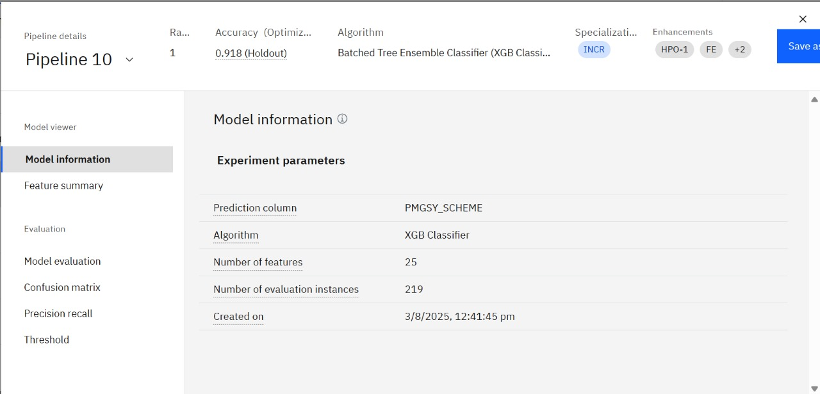
Prediction Process:
Once trained and deployed on IBM Cloud, the model predicts the correct PMGSY scheme for new projects. Users simply input relevant project details, and the model instantly classifies the project based on learned patterns in physical, financial, and geographic inputs. The prediction workflow benefits from AutoAI’s ability to update and retrain as new project data becomes available, keeping the system current and effective for future use.

Slide 9
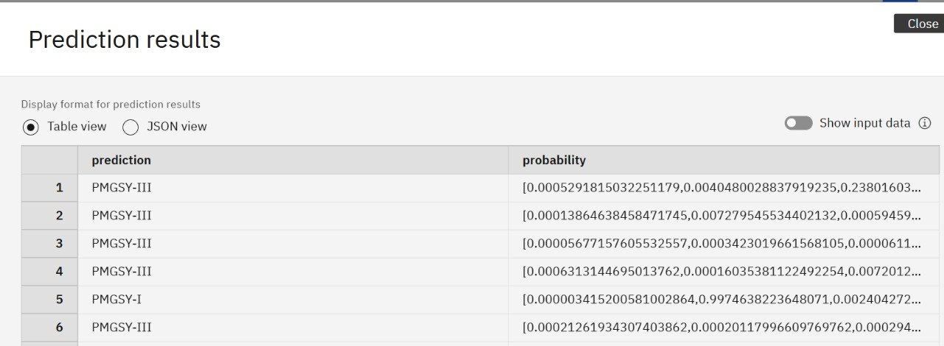
Result

Slide 10
Conclusion
The developed solution accurately classifies rural infrastructure projects into their respective PMGSY schemes using a Batched Tree Ensemble Classifier (XGBoost) trained and deployed through IBM’s watsonx.ai studio with AutoAI. The model leverages a range of physical, financial, and geographic project attributes, with AutoAI automating feature extraction, model selection, preprocessing, and hyperparameter optimization. The classifier achieves an impressive overall accuracy of 91.8%, with class-wise precision and recall values notably high for most schemes (especially PM-JANMAN and PMGSY-I), but challenges were observed with the RCPLWEA class, which exhibited lower recall despite high precision.

Slide 11
Future scope
Integration of Richer Data Sources
Incorporate real-time monitoring data, satellite imagery, and detailed contractor performance metrics to further enhance feature quality and prediction accuracy.
Encourage standardized and automated data collection across all states and agencies to ensure consistency.
Resolving Class Imbalance
Proactively gather more data for underrepresented schemes (especially RCPLWEA) to improve recall and achieve consistent classification performance across all PMGSY schemes.
Explainable and Transparent AI
Embed explainable AI components within the user interface so decision-makers can understand the rationale behind each scheme classification, building greater trust and accountability.
Continuous Learning with Feedback Loops
Establish mechanisms for end-users to provide real-time feedback or corrections, which can be used to retrain and refine the model—keeping it adaptive to changes in policy or project characteristics.
Expansion to Other Infrastructure Domains
Extend the platform to classify and monitor additional types of rural projects, such as water, electrification, or health care infrastructure, thereby broadening its impact.

Slide 12
References
A Novel Multi-Category Machine Learning Model Using XGBoost (2022). Explores XGBoost's superiority over traditional algorithms for multi-class classification, confirming its suitability for applications like scheme classification where data is structured and feature-rich.
Paperguide. Top Research Papers on XGBoost. Offers a curated overview of the most influential studies on the XGBoost algorithm, cementing best practices for its use in large-scale classification problems.
An extreme gradient boost based classification and regression tree... Illustrates advanced implementations of XGBoost in ensemble classification contexts similar to those used in your solution.

Slide 13
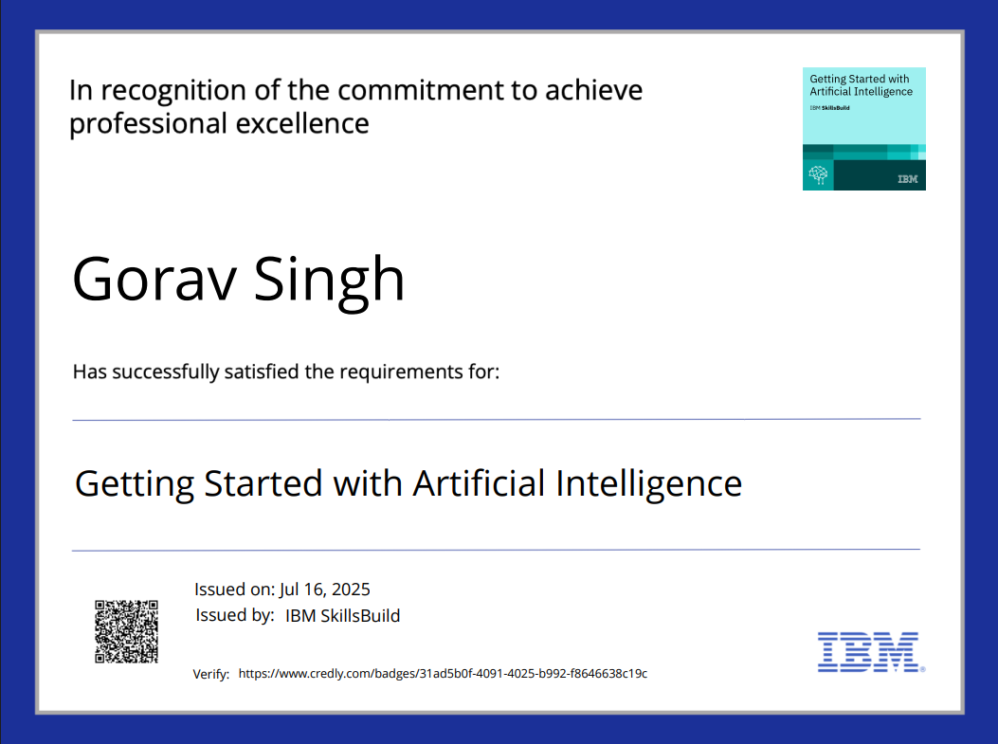
IBM Certifications

Slide 14

IBM Certifications

Slide 15
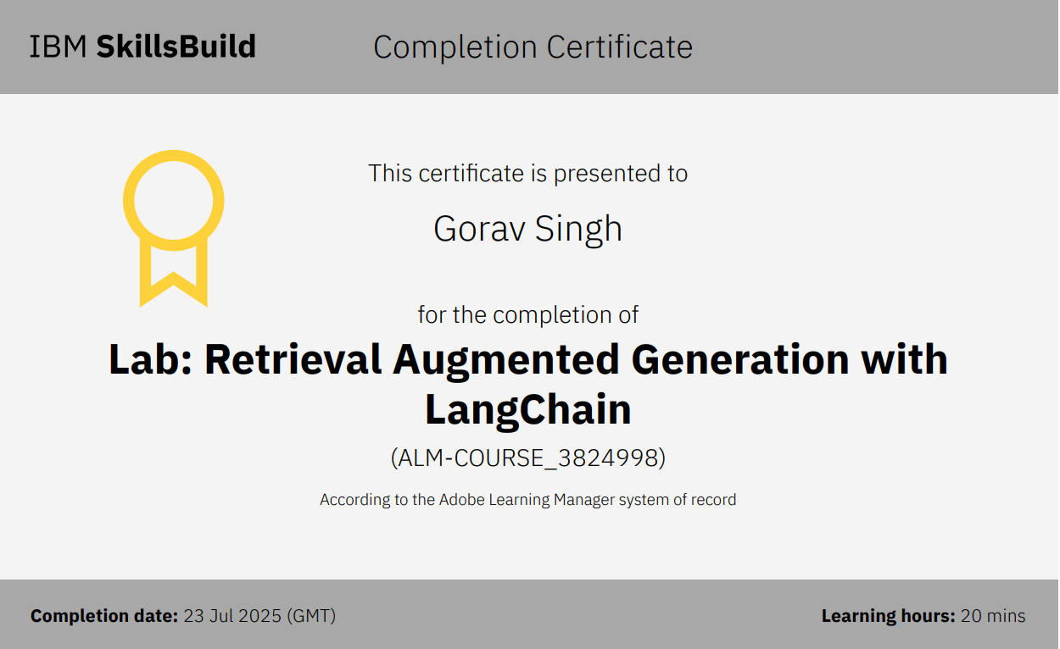
IBM Certifications

Slide 16
GITHUB LINK
https://github.com/goravsingh01/ACITE-Internship.git

Slide 17
THANK YOU

