Slide 1
Compute Resources

Slide 2
Agenda
EC2 / AMI Lifecycle
EBS volume
Security Groups
VPC
Sample AWS Architectures
EBS (Elastic Block Store)
EFS (File System)
S3 volumes

Slide 3
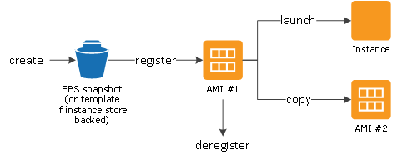
EC2 / AMI Lifecycle
Virtual machine
Machine Image
Ephemeral storage
Type = vCPU + Mem
EBS
Tags
EC2 <-User Data (bootstrap)
Meta Data

Slide 4
EBS Volume
Persistence
Snapshots
full
Incremental
Provisioned IOPS
Availability zone placement

Slide 5
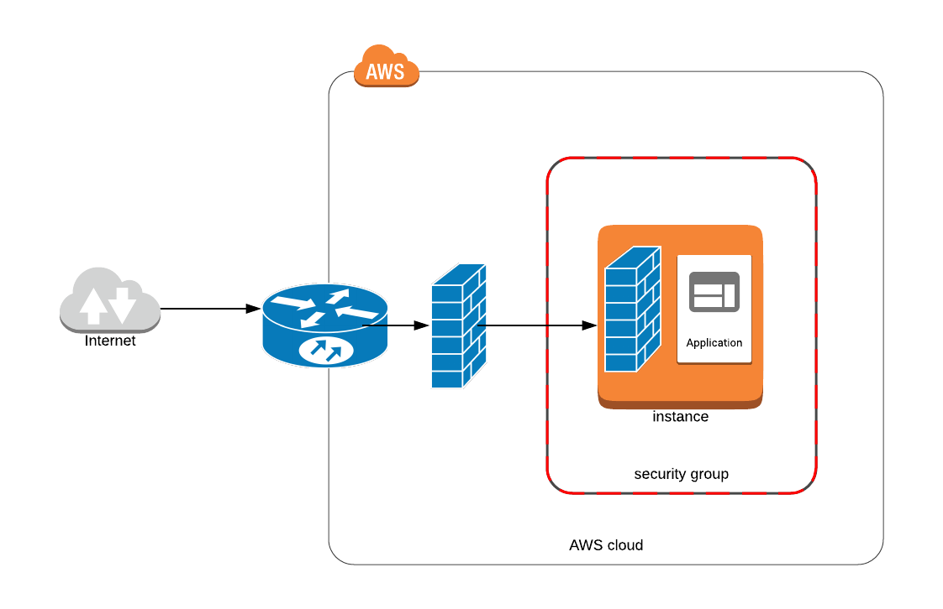
Security Groups
Configurable via API Router
You can have additional OS firewall
Elastic Network Interface
Limit of 250 rules per interface
Defines Inbound and Outbound ports mapping

Slide 6
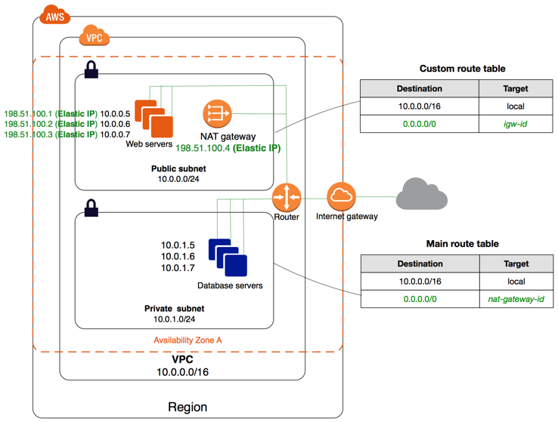
VPC
VPC
Region
Availability zone
Private Net
Public Net
Subnet
NAT
Route 53 (DNS)
Route table

Slide 7
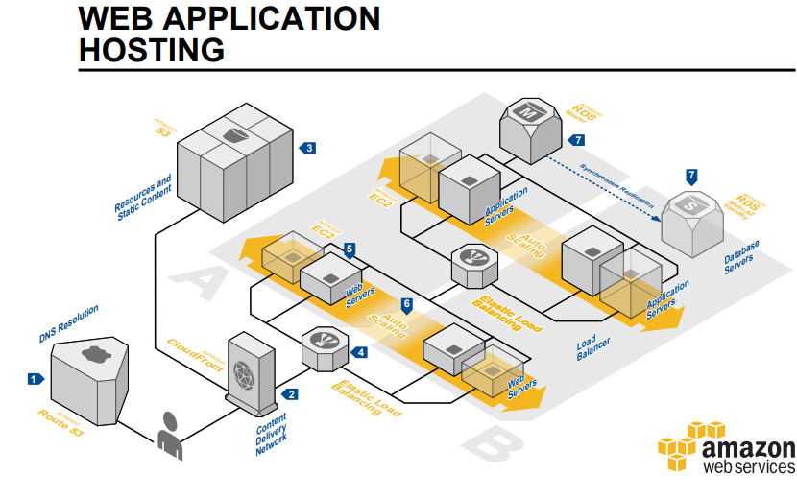
Sample AWS Architectures

Slide 8
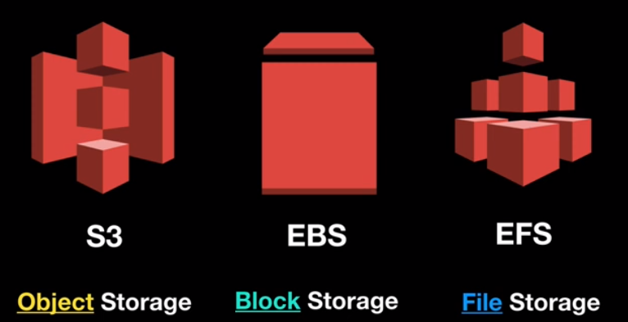
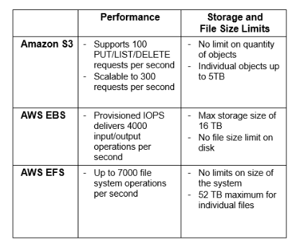
S3 vs EBS vs S3

Slide 9
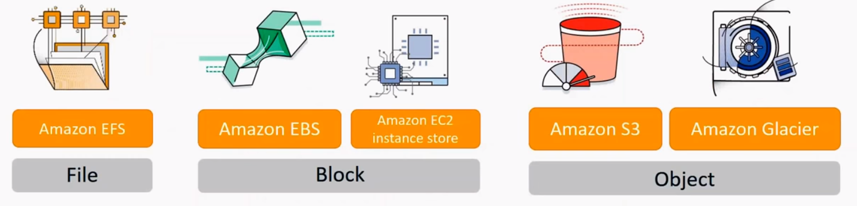
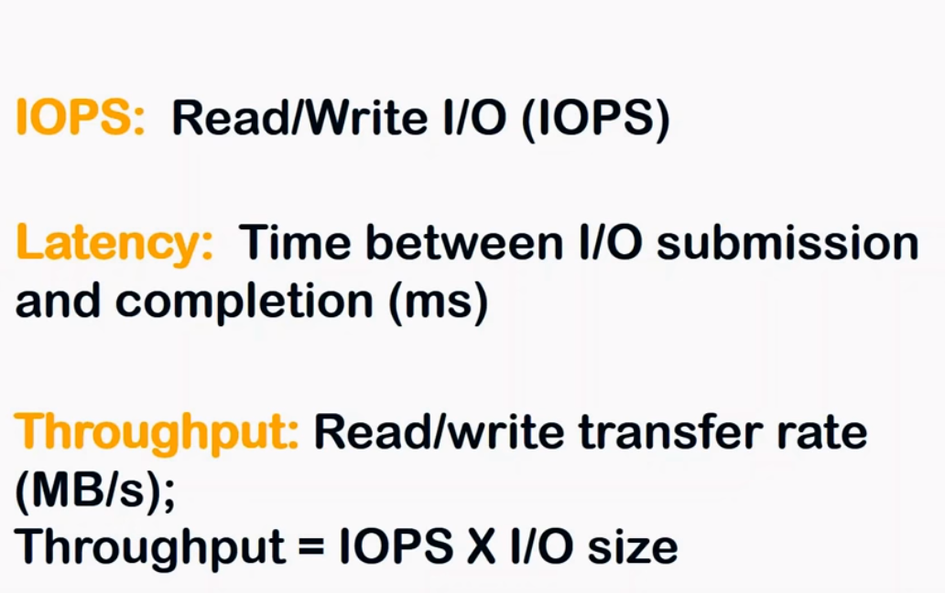
IOPS
Amazon EBS provides the following volume types: - General Purpose SSD (gp2) - Provisioned IOPS SSD (io1) - Throughput Optimized HDD (st1) - Cold HDD (sc1)

Slide 10
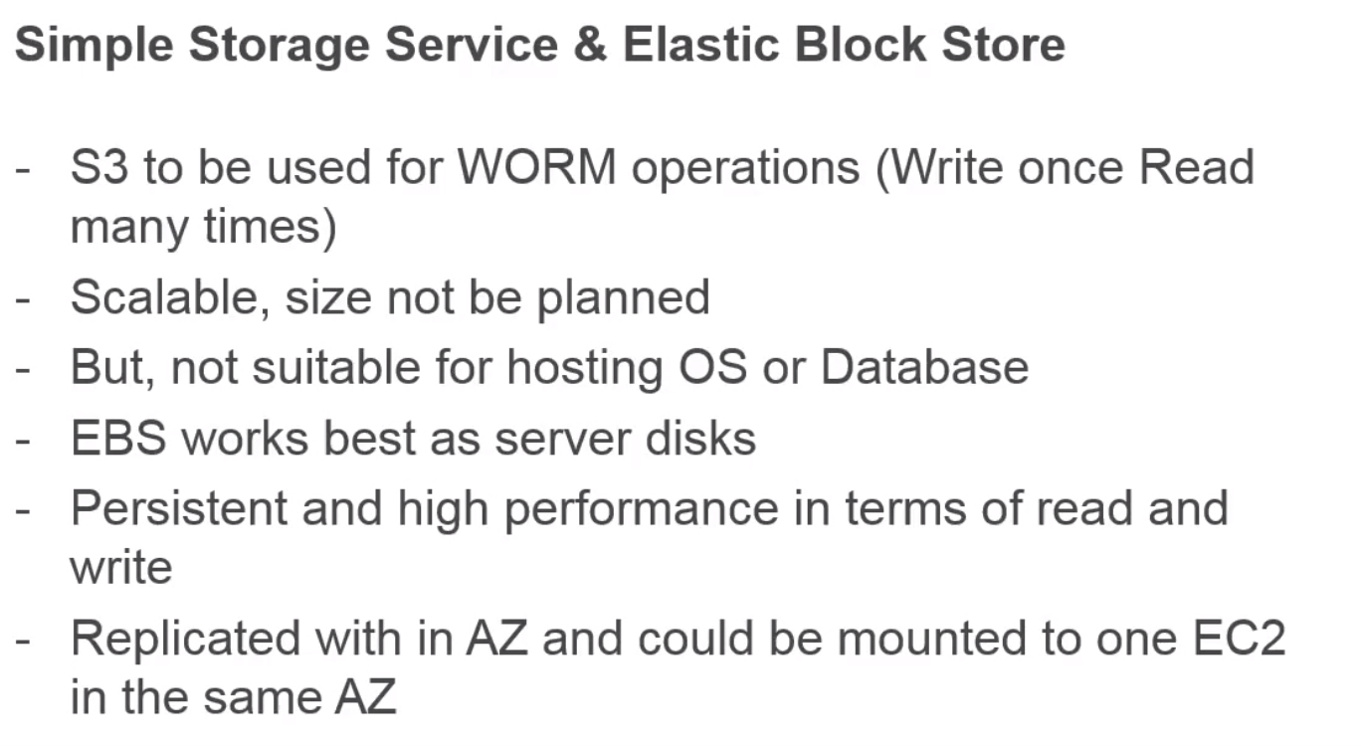
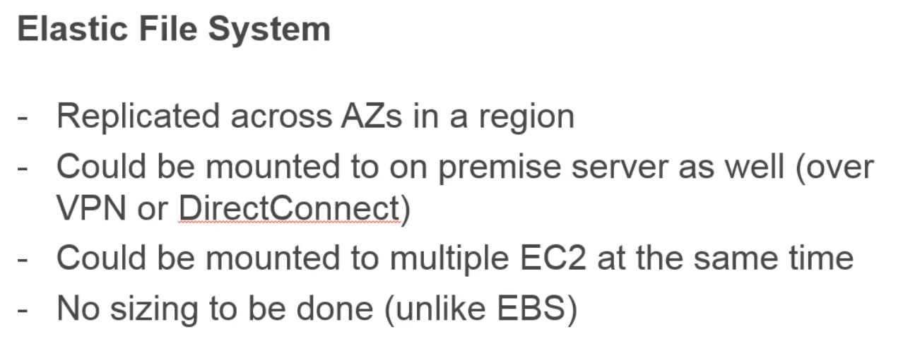
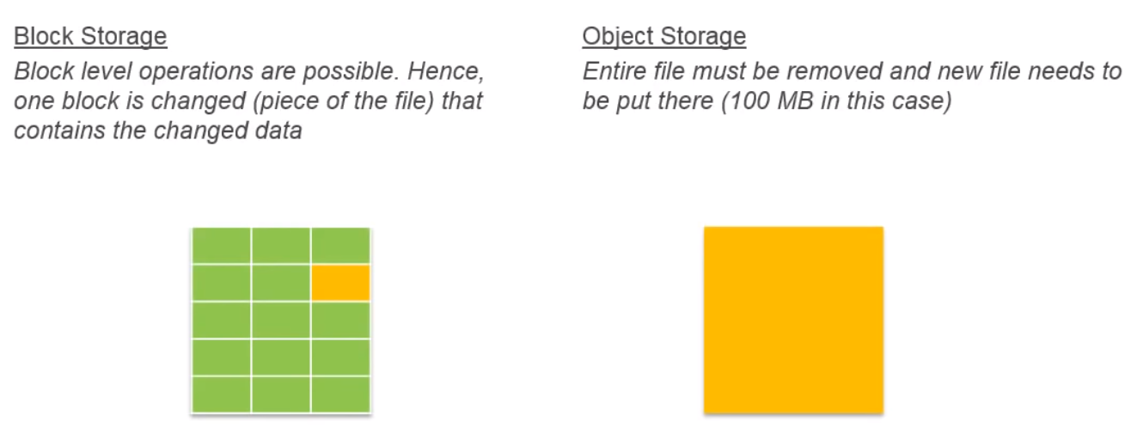
Block Storage vs Object Storage

Slide 11
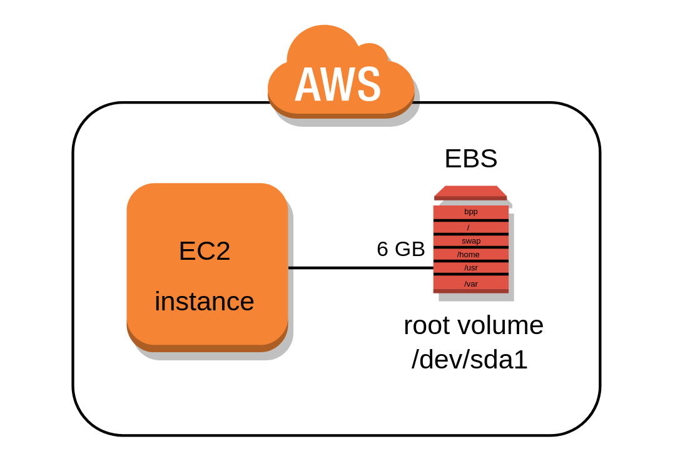
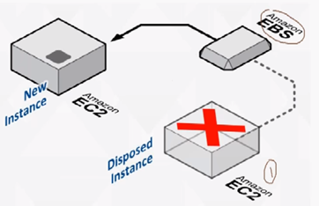
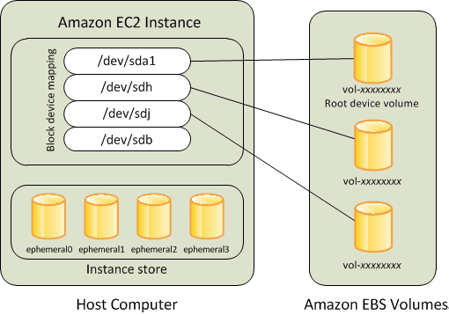
EBS (Elastic Block Store) volumes
Integrated with EC2
Bandwidth varies in 0-14000 Mbit/s
Calculate IOPS (restrict IOPS per volume)
Serves SSD Persistence store (caches, DB)
HDD Persistence (streaming)
Snapshots
Full (copy to S3)
Backup
Recovery
Alarms (IOPS)
Availability zone placement

Slide 12

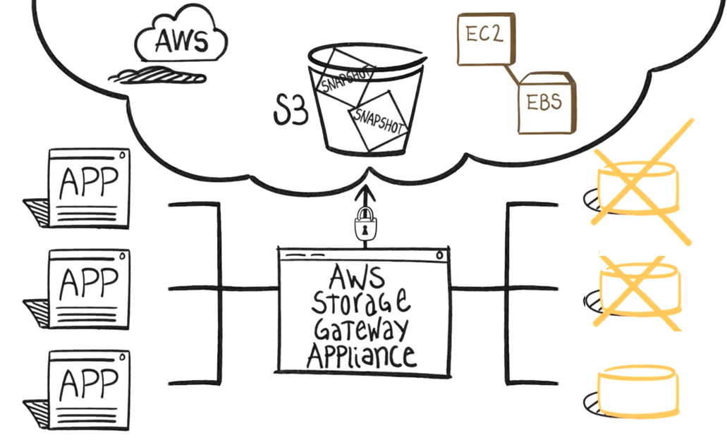
Back-up
EBS time-based snapshot for a block only

Slide 13
Home Task
Add Keypair
Launch EC2 instance
Create or make Snapshot of EBS Volume
***SSH EC2 instance (generate SSH key with Putty generator and Import to Console .pub part)

