Slide 1
Compute Resources

Slide 2
Agenda
EC2 / AMI Lifecycle
EBS volume
Security Groups
VPC
Sample AWS Architectures
EBS (Elastic Block Store)
EFS (File System)
S3 volumes

Slide 3
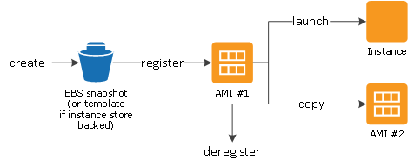
EC2 / AMI Lifecycle
Virtual machine
Machine Image
Ephemeral storage
Type = vCPU + Mem
EBS
Tags
EC2 <-User Data (bootstrap)
Meta Data

Slide 4
EBS Volume
Persistence
Snapshots
full
Incremental
Provisioned IOPS
Availability zone placement

Slide 5
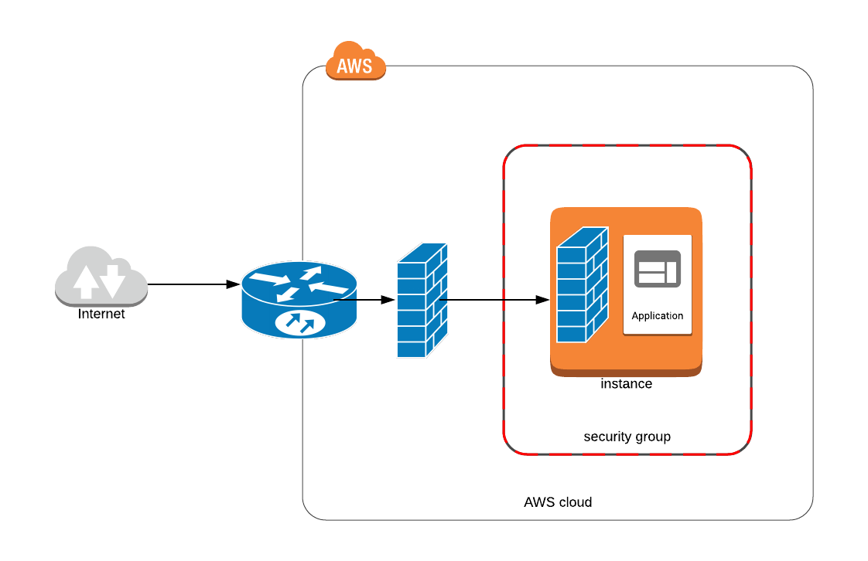
Security Groups
Configurable via API Router
You can have additional OS firewall
Elastic Network Interface
Limit of 250 rules per interface
Defines Inbound and Outbound ports mapping

Slide 6
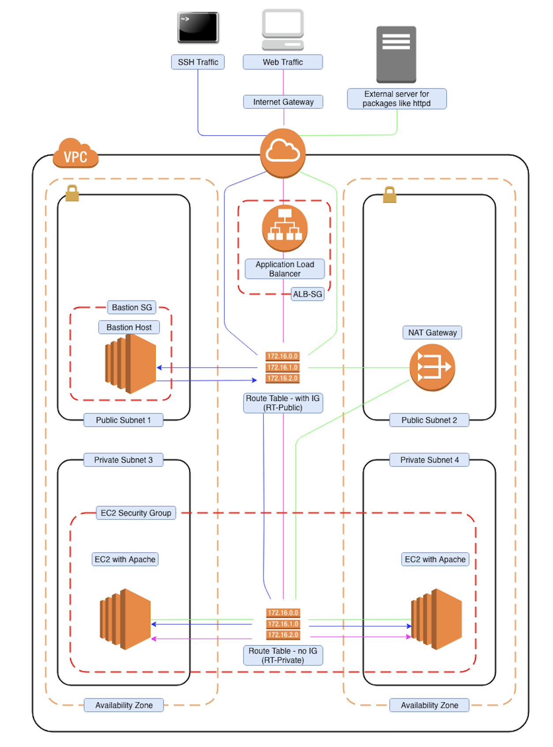
VPC
VPC
Region
Availability zone
Private Net
Public Net
Subnet
NAT
Route 53 (DNS)
Route table

Slide 7
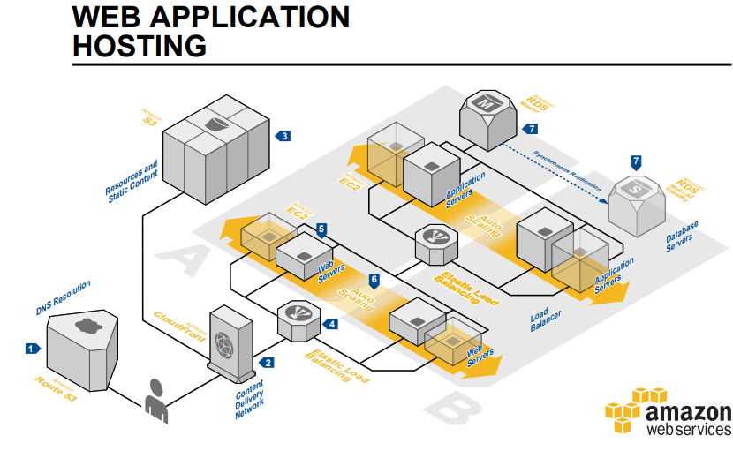
Sample AWS Architectures

Slide 8
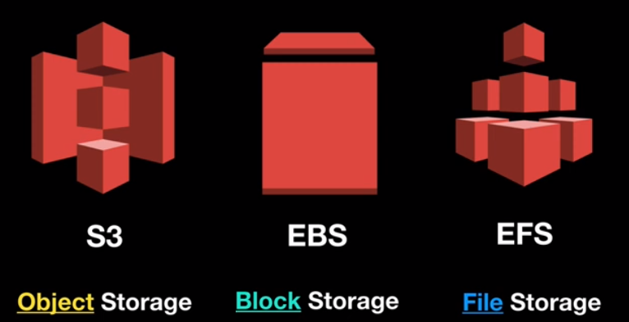
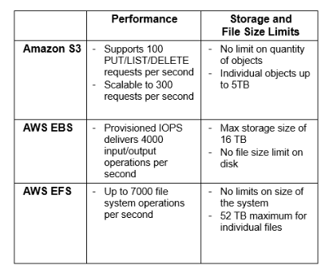
S3 vs EBS vs S3

Slide 9
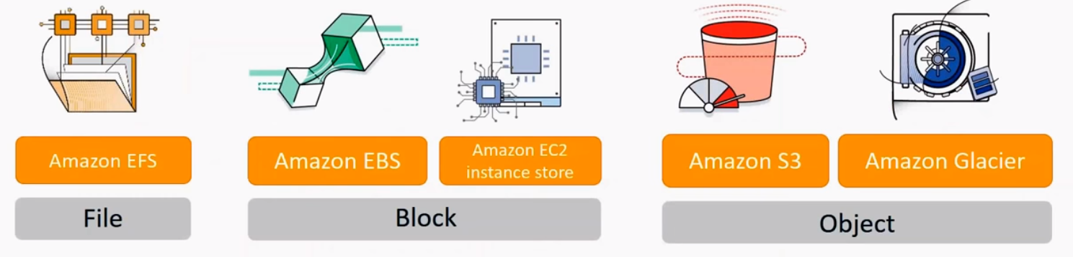
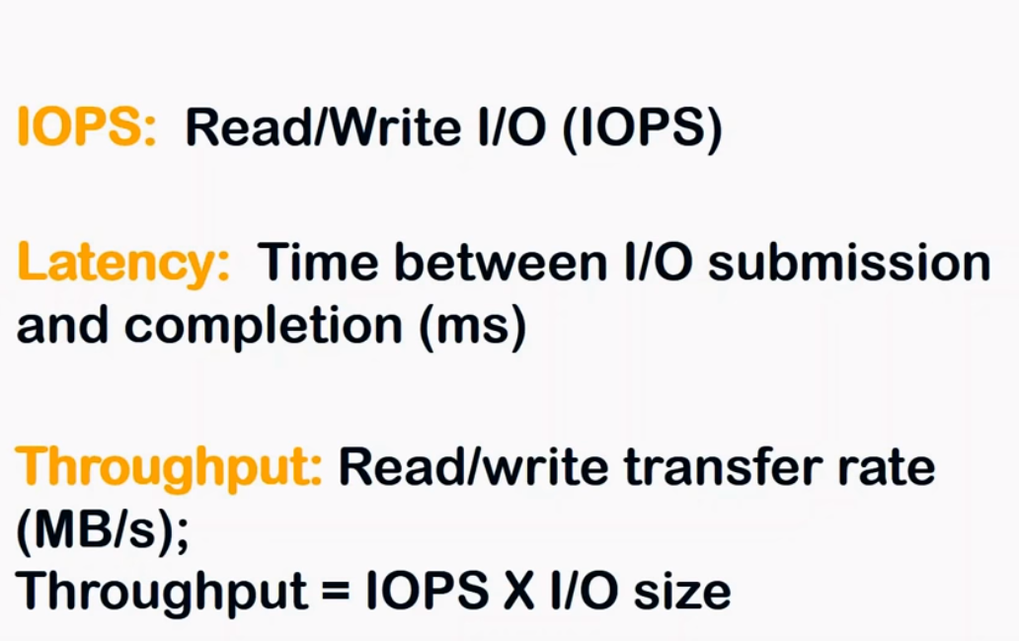
IOPS
Amazon EBS provides the following volume types: - General Purpose SSD (gp2) - Provisioned IOPS SSD (io1) - Throughput Optimized HDD (st1) - Cold HDD (sc1)

Slide 10
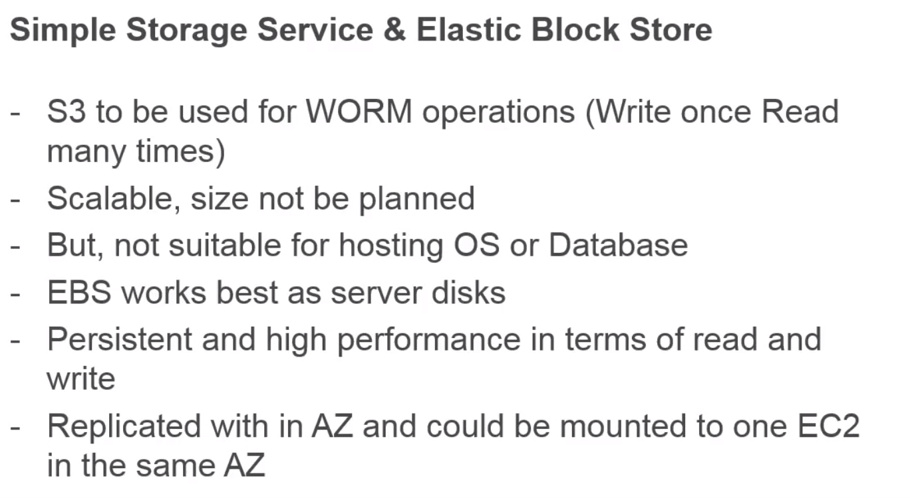
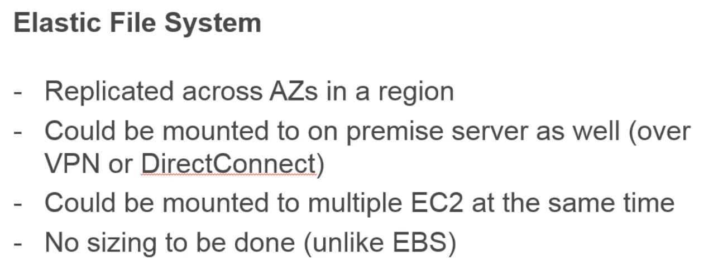
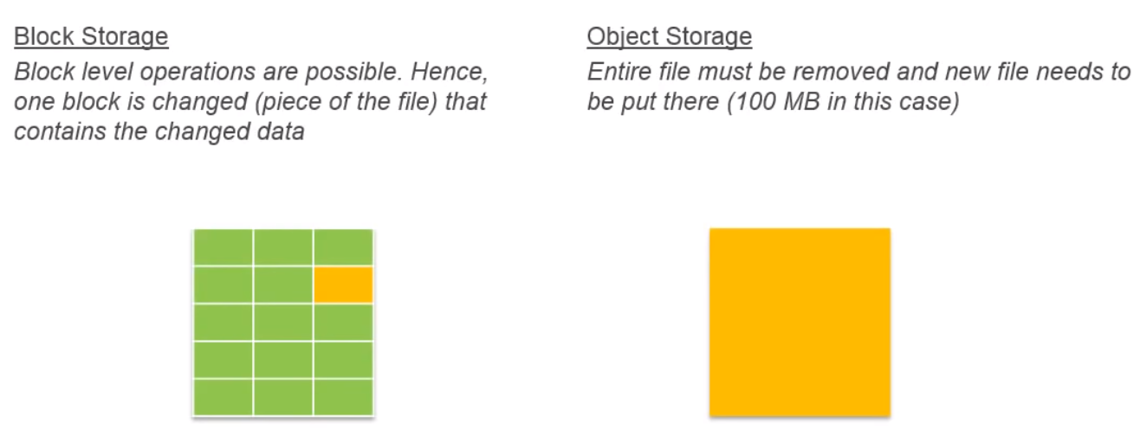
Block Storage vs Object Storage

Slide 11
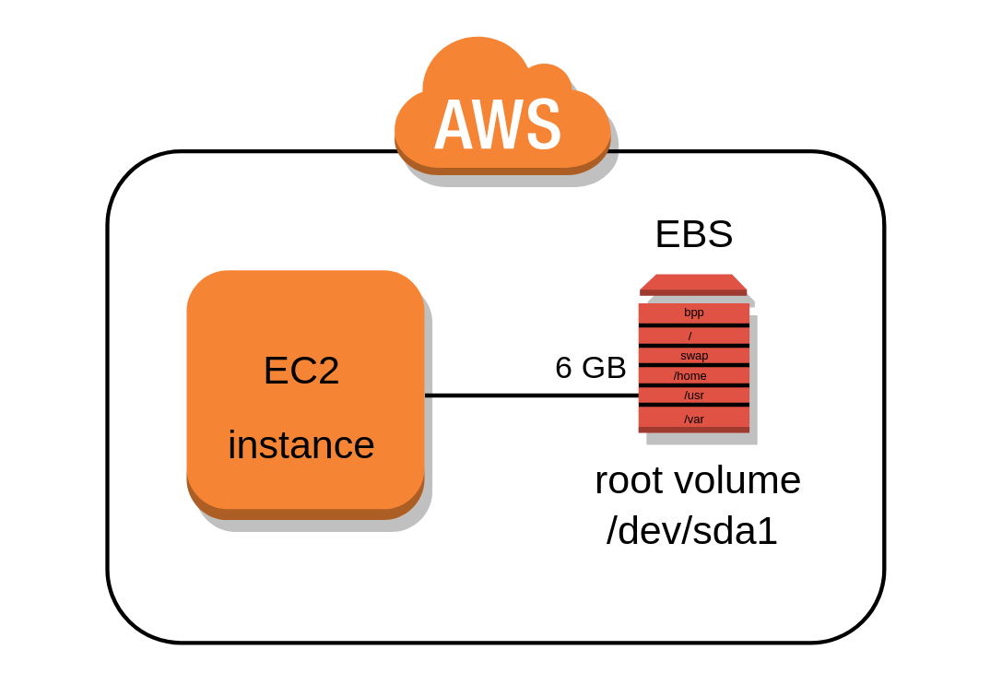
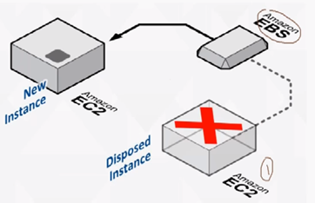
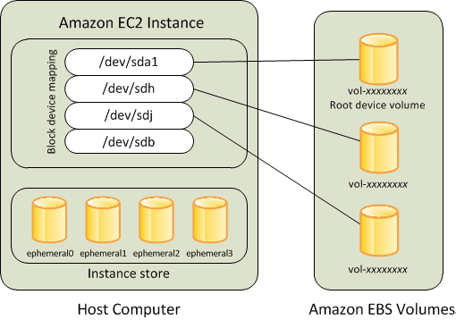
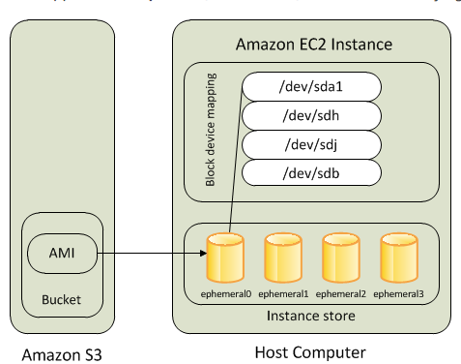
EBS (Elastic Block Store) volumes
Integrated with EC2
Bandwidth varies in 0-14000 Mbit/s
Calculate IOPS (restrict IOPS per volume)
Serves SSD Persistence store (caches, DB)
HDD Persistence (streaming)
Snapshots
Full (copy to S3)
Backup
Recovery
Alarms (IOPS)
Availability zone placement
AMI
Amazon EBS-backed Instances
Instance store-backed
VS.
Root Device Storage Concepts
Notes:
All AMIs are categorized as either backed by Amazon EBS or backed by instance store.
You can launch an instance from either an instance store-backed AMI or an Amazon EBS-backed AMI. The description of an AMI includes which type of AMI it is; you'll see the root device referred to in some places as either ebs (for Amazon EBS-backed) or instance store (for instance store-backed). This is important because there are significant differences between what you can do with each type of AMI.
nstance Store-backed Instances
Instances that use instance stores for the root device automatically have one or more instance store volumes available, with one volume serving as the root device volume. When an instance is launched, the image that is used to boot the instance is copied to the root volume. Note that you can optionally use additional instance store volumes, depending on the instance type.
Any data on the instance store volumes persists as long as the instance is running, but this data is deleted when the instance is terminated (instance store-backed instances do not support the Stop action) or if it fails (such as if an underlying drive has issues).
After an instance store-backed instance fails or terminates, it cannot be restored. If you plan to use Amazon EC2 instance store-backed instances, we highly recommend that you distribute the data on your instance stores across multiple Availability Zones. You should also back up critical data from your instance store volumes to persistent storage on a regular basis. Amazon EBS-backed Instances
Instances that use Amazon EBS for the root device automatically have an Amazon EBS volume attached. When you launch an Amazon EBS-backed instance, we create an Amazon EBS volume for each Amazon EBS snapshot referenced by the AMI you use. You can optionally use other Amazon EBS volumes or instance store volumes, depending on the instance type. An Amazon EBS-backed instance can be stopped and later restarted without affecting data stored in the attached volumes.

Slide 12

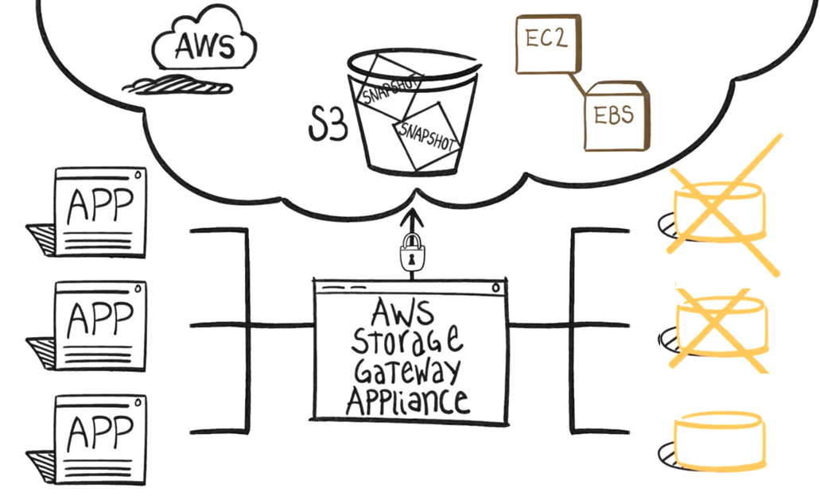
Back-up
EBS time-based snapshot for a block only

Slide 13
Home Task
Add Keypair
Launch EC2 instance
Create or make Snapshot of EBS Volume
***SSH EC2 instance (generate SSH key with Putty generator and Import to Console .pub part)

