Slide 1
CloudFormation

Slide 2
Agenda
AWS CLI commands
CloudFormation Templates
Infrastructure Building Blocks
Stack
CF Publishing Workflow
Cloud Formation Basics
Practice

Slide 3
AWS CLI scripts vs Stack
CLI commands
aws ec2 create-subnet --vpc-id vpc-0a91a30f0712e60ac --cidr-block 10.0.1.0/24
aws ec2 run-instances --image-id ami-035b3c7efe6d061d5 --count 1 --instance-type t2.micro --key-name id_rsa --security-group-ids sg-0b7f7fc6bd6b699f2 --subnet-id subnet-035428124fcbcfe44
aws elb create-load-balancer --load-balancer-name crash-course-elb --availability-zones us-east-1a us-east-1b --listeners Protocol=HTTP,LoadBalancerPort=80,InstanceProtocol=HTTP,InstancePort=80
STACK
aws cloudformation create-stack --stack-name crash-course --template-body file://./cloudformation/examples/json/elb-with-two-instances.cf.json --parameters ParameterKey=KeyName,ParameterValue=aws-crash-course-us ParameterKey=InstanceType,ParameterValue=t2.micro

Slide 4
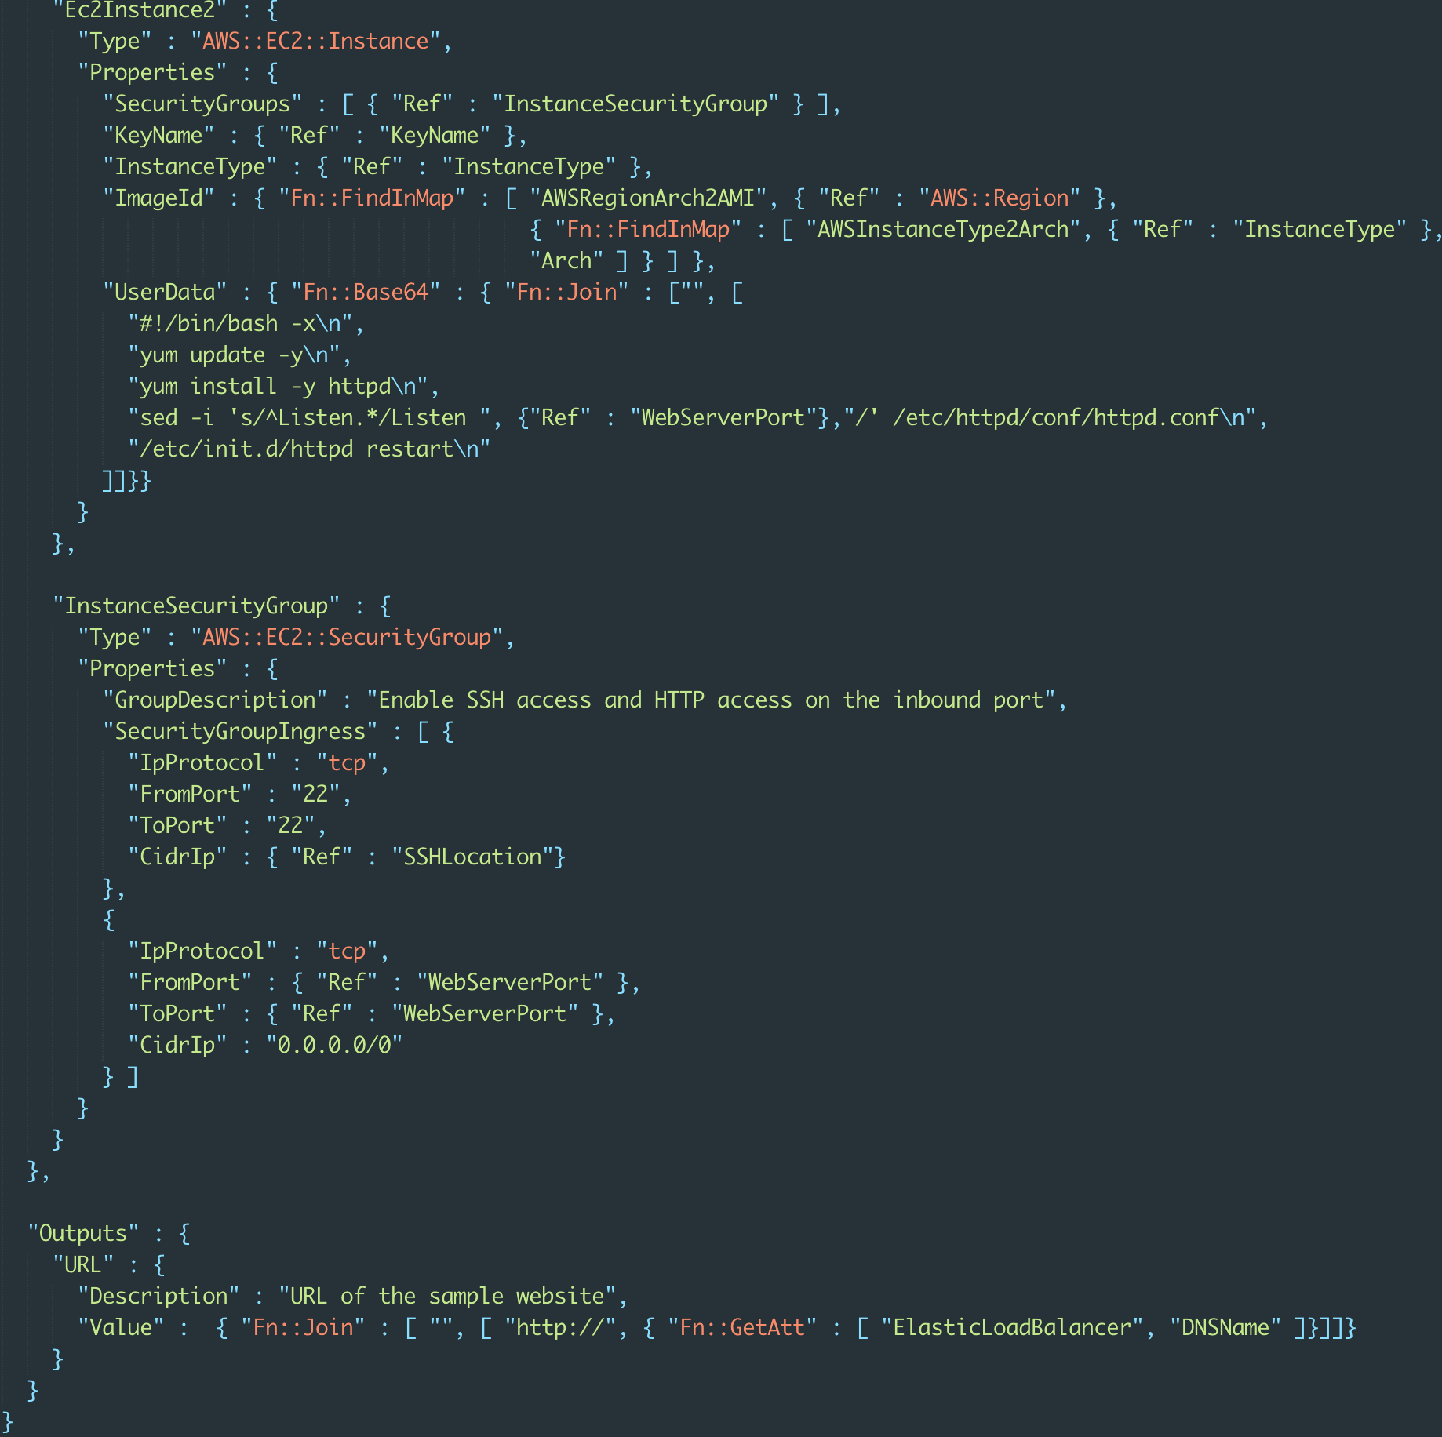
Infrastructure as a code
AWS::ProductIdentifier::ResourceType Describe infrastructure as a code
Track changes
Re-use code
Clone environments
Disaster Recovery (another region)
Boto3 and etc.
Notes:
If you use this template to create a stack, AWS CloudFormation will create an Amazon S3 bucket. Creating a bucket is simple, because AWS CloudFormation can create a bucket with default settings. For other resources, such as an Auto Scaling group or EC2 instance, AWS CloudFormation requires more information. Resource declarations use a Properties attribute to specify the information used to create a resource.

Slide 5
Work Flow
Existent template/snippets
http://docs.aws.amazon.com/AWSCloudFormation/latest/UserGuide/cfn-sample-templates.html
Validate template
IDE, json lint, aws cli
Create/update stack
AWS cli + CI Server
Notes:
Template – CloudFormation scripts for one Stack

Slide 6
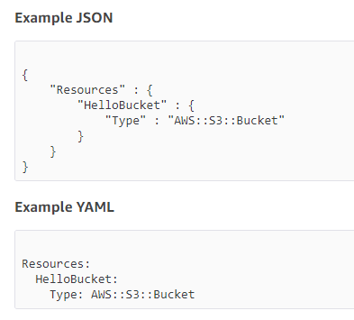
Building Blocks
Parameters
Validation
Types
Mappings
Conditions
Resources
AWS::ProductIdentifier::ResourceType
AWS::S3::Bucket
AWS::AutoScaling::AutoScalingGroup
AWS::CloudFormation::Stack
Outputs
Functions
Helper scripts
Notes:
Usually, a property for a resource is simply a string value. For example, the following template specifies a canned ACL (PublicRead) for the AccessControl property of the bucket.
Example JSON
{ "Resources" : {
"HelloBucket" : {
"Type" : "AWS::S3::Bucket",
"Properties" : {
"AccessControl" : "PublicRead"
}
}
}
}

Slide 7
Cloud Formation Objects definition: “Ref”, “Properties”
{
"Resources": {
"Ec2Instance": {
"Type": "AWS::EC2::Instance",
"Properties": {
"SecurityGroups": [
{
"Ref": "InstanceSecurityGroup"
}
],
"KeyName": "mykey",
"ImageId": ""
}
},
"InstanceSecurityGroup": {
"Type": "AWS::EC2::SecurityGroup",
"Properties": {
"GroupDescription": "Enable SSH access via port 22",
"SecurityGroupIngress": [
{
"IpProtocol": "tcp",
"FromPort": "22",
"ToPort": "22",
"CidrIp": "0.0.0.0/0"
}
]
}
}
}
}
"Listeners": [
{
"LoadBalancerPort": "8888",
"InstancePort": {
"Ref": "WebServerPort"
},
"Protocol": "HTTP"
}
],
"HealthCheck": {
"Target": { // set to HTTP:8888/
"Fn::Join": [
"",
[
"HTTP:",
{
"Ref": "WebServerPort"
},
"/"
]
]
},
"HealthyThreshold": "3",
"UnhealthyThreshold": "5",
"Interval": "30",
"Timeout": "5"
}
}

Slide 8
Cloud Formation Function: “Fn::FindInMap”, “Fn::GetAtt”
{
"Parameters": {
"KeyName": {
"Description": "Name of an existing EC2 KeyPair to enable SSH access to the instance",
"Type": "String"
}
},
"Mappings": {
"RegionMap": {
"us-east-1": {
"AMI": "ami-76f0061f"
},
"us-west-1": {
"AMI": "ami-655a0a20"
},
"eu-west-1": {
"AMI": "ami-7fd4e10b"
}
},
"Resources": {
"Ec2Instance": {
"Type": "AWS::EC2::Instance",
"Properties": {
"KeyName": {
"Ref": "KeyName"
},
"ImageId": {
"Fn::FindInMap": [
"RegionMap",
{
"Ref": "AWS::Region"
},
"AMI"
]
},
"UserData": {
"Fn::Base64": "80"
}
}
}
}
}
"Outputs": {
"InstallURL": {
"Value": {
"Fn::Join": [
"",
[
"http://",
{
"Fn::GetAtt": [
"ElasticLoadBalancer",
"DNSName"
]
},
"/wp-admin/install.php"
]
]
},
"Description": "Installation URL of the WordPress website"
},
InstallURL:
http://mywptests-elasticl-1gb51l6sl8y5v-206169572.us-east-2.elb.amazonaws.com/wp-admin/install.php

Slide 9
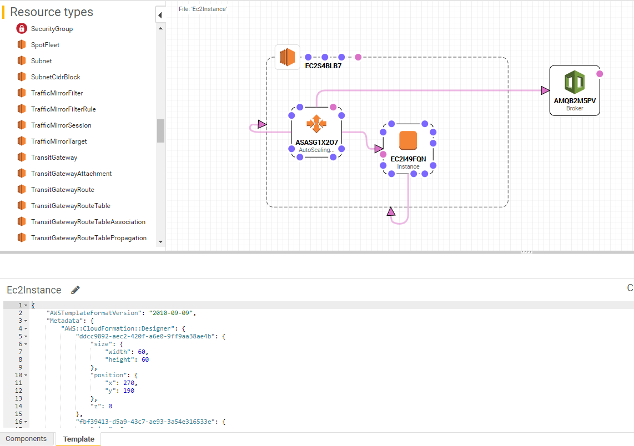
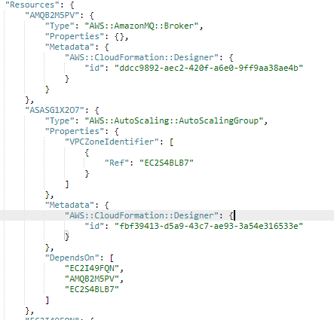
CF Designer
https://us-east-2.console.aws.amazon.com/cloudformation/designer/home?region=us-east-2#
Notes:
You're probably wondering how you set properties on one resource based on the name or property of another resource. For example, you can create a CloudFront distribution backed by an S3 bucket or an EC2 instance that uses EC2 security groups, and all of these resources can be created in the same template. AWS CloudFormation has a number of intrinsic functions that you can use to refer to other resources and their properties. You can use the Ref function to refer to an identifying property of a resource. Frequently, this is the physical name of the resource; however, sometimes it can be an identifier, such as the IP address for an AWS::EC2::EIP resource or an Amazon Resource Name (ARN) for an Amazon SNS topic. For a list of values returned by the Ref function, see Ref function. The following template contains an AWS::EC2::Instance resource. The resource's SecurityGroups property calls the Ref function to refer to the AWS::EC2::SecurityGroup resource InstanceSecurityGroup. Example:
{
"Resources": {
"Ec2Instance": {
"Type": "AWS::EC2::Instance",
"Properties": {
"SecurityGroups": [
{
"Ref": "InstanceSecurityGroup"
}
],
"KeyName": "mykey",
"ImageId": ""
}
},
"InstanceSecurityGroup": {
"Type": "AWS::EC2::SecurityGroup",
"Properties": {
"GroupDescription": "Enable SSH access via port 22",
"SecurityGroupIngress": [
{
"IpProtocol": "tcp",
"FromPort": "22",
"ToPort": "22",
"CidrIp": "0.0.0.0/0"
}
]
}
}
}
}
The Ref function is handy if the parameter or the value returned for a resource is exactly what you want; however, you may need other attributes of a resource. For example, if you want to create a CloudFront distribution with an S3 origin, you need to specify the bucket location by using a DNS-style address. A number of resources have additional attributes whose values you can use in your template. To get these attributes, you use the Fn::GetAtt function. The following template creates a CloudFront distribution resource that specifies the DNS name of an S3 bucket resource using Fn::GetAtt function to get the bucket's DomainName attribute.
Example:
{
"Resources": {
"myBucket": {
"Type": "AWS::S3::Bucket"
},
"myDistribution": {
"Type": "AWS::CloudFront::Distribution",
"Properties": {
"DistributionConfig": {
"Origins": [
{
"DomainName": {
"Fn::GetAtt": [
"myBucket",
"DomainName"
]
},
"Id": "myS3Origin",
"S3OriginConfig": {}
}
],
"Enabled": "true",
"DefaultCacheBehavior": {
"TargetOriginId": "myS3Origin",
"ForwardedValues": {
"QueryString": "false"
},
"ViewerProtocolPolicy": "allow-all"
}
}
}
}
}
}
Conditional Values in Mappings
Parameters are a great way to enable users to specify unique or sensitive values for use in the properties of stack resources; however, there may be settings that are region dependent or are somewhat complex for users to figure out because of other conditions or dependencies. In these cases, you would want to put some logic in the template itself so that users can specify simpler values (or none at all) to get the results that they want. In an earlier example, we hardcoded the AMI ID for the ImageId property of our EC2 instance. This works fine in the US-East region, where it represents the AMI that we want. However, if the user tries to build the stack in a different region he or she will get the wrong AMI or no AMI at all. (AMI IDs are unique to a region, so the same AMI ID in a different region may not represent any AMI or a completely different one.) The AWS::Region pseudo parameter is a value that AWS CloudFormation resolves as the region where the stack is created.
To avoid this problem, you need a way to specify the right AMI ID based on a conditional input (in this example, the region where the stack is created). There are two template features that can help, the Mappings object and the AWS::Region pseudo parameter.
Example: {
"Parameters": {
"KeyName": {
"Description": "Name of an existing EC2 KeyPair to enable SSH access to the instance",
"Type": "String"
}
},
"Mappings": {
"RegionMap": {
"us-east-1": {
"AMI": "ami-76f0061f"
},
"us-west-1": {
"AMI": "ami-655a0a20"
},
"eu-west-1": {
"AMI": "ami-7fd4e10b"
},
"ap-southeast-1": {
"AMI": "ami-72621c20"
},
"ap-northeast-1": {
"AMI": "ami-8e08a38f"
}
}
},
"Resources": {
"Ec2Instance": {
"Type": "AWS::EC2::Instance",
"Properties": {
"KeyName": {
"Ref": "KeyName"
},
"ImageId": {
"Fn::FindInMap": [
"RegionMap",
{
"Ref": "AWS::Region"
},
"AMI"
]
},
"UserData": {
"Fn::Base64": "80"
}
}
}
}
}

Slide 10
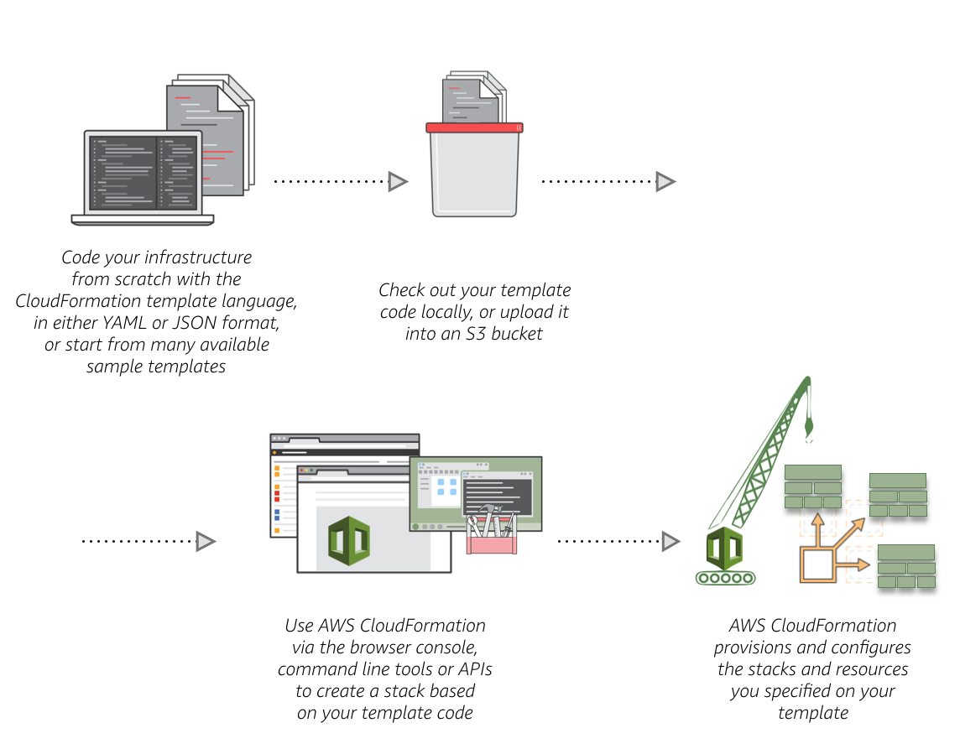
Template publishing in AWS
Create a new template or use an existing CloudFormation template using the JSON or YAML format.
Save your code template locally or in an S3 bucket.
Use AWS CloudFormation to build a stack on your template.
AWS CloudFormation constructs and configures the stack resources that you have specified in your template.
https://github.com/awslabs/aws-cloudformation-templates/blob/master/aws/services/
Notes:
Verify Quotas for All Resource Types
Before launching a stack, ensure that you can create all the resources that you want without hitting your AWS account limits. If you hit a limit, AWS CloudFormation won't create your stack successfully until you increase your quota or delete extra resources. Each service can have various limits that you should be aware of before launching a stack. For example, by default, you can only launch 200 AWS CloudFormation stacks per region in your AWS account. For more information about limits and how to increase the default limits
Use IAM to Control Access
IAM is an AWS service that you can use to manage users and their permissions in AWS. You can use IAM with AWS CloudFormation to specify what AWS CloudFormation actions users can perform, such as viewing stack templates, creating stacks, or deleting stacks. Furthermore, anyone managing AWS CloudFormation stacks will require permissions to resources within those stacks. For example, if users want to use AWS CloudFormation to launch, update, or terminate Amazon EC2 instances, they must have permission to call the relevant Amazon EC2 actions.

Slide 11
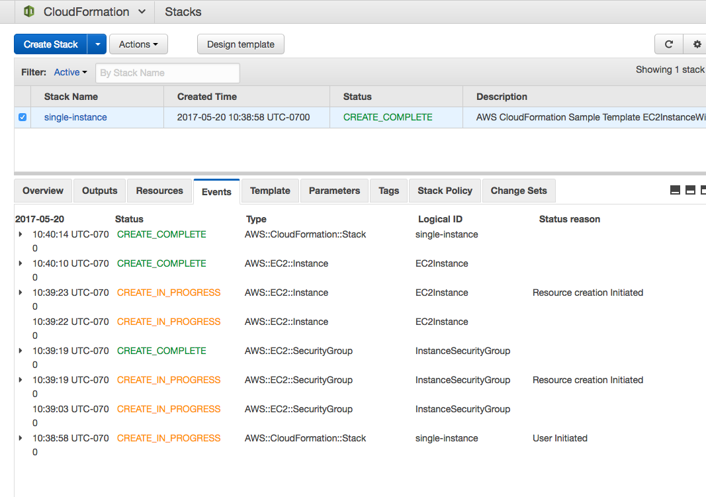
Cloud Formation Stack
Notes:
Good practice:
Reuse Templates to Replicate Stacks in Multiple Environments
After you have your stacks and resources set up, you can reuse your templates to replicate your infrastructure in multiple environments. For example, you can create environments for development, testing, and production so that you can test changes before implementing them into production. To make templates reusable, use the parameters, mappings, and conditions sections so that you can customize your stacks when you create them. For example, for your development environments, you can specify a lower-cost instance type compared to your production environment, but all other configurations and settings remain the same. For more information about parameters, mappings, and conditions,
Do Not Embed Credentials in Your Templates
Rather than embedding sensitive information in your AWS CloudFormation templates, use input parameters to pass in information whenever you create or update a stack. If you do, make sure to use the NoEcho property to obfuscate the parameter value.
For example, suppose your stack creates a new database instance. When the database is created, AWS CloudFormation needs to pass a database administrator password. You can pass in a password by using an input parameter instead of embedding it in your template. For more information
Use AWS-Specific Parameter Types
If your template requires inputs for existing AWS-specific values, such as existing Amazon Virtual Private Cloud IDs or an Amazon EC2 key pair name, use AWS-specific parameter types. For example, you can specify a parameter as type AWS::EC2::KeyPair::KeyName, which takes an existing key pair name that is in your AWS account and in the region where you are creating the stack.
Validate Templates Before Using Them
Before you use a template to create or update a stack, you can use AWS CloudFormation to validate it. Validating a template can help you catch syntax and some semantic errors, such as circular dependencies, before AWS CloudFormation creates any resources. If you use the AWS CloudFormation console, the console automatically validates the template after you specify input parameters. For the AWS CLI or AWS CloudFormation API.
During validation, AWS CloudFormation first checks if the template is valid JSON. If it isn't, AWS CloudFormation checks if the template is valid YAML. If both checks fail, AWS CloudFormation returns a template validation error.
Manage All Stack Resources Through AWS CloudFormation
After you launch a stack, use the AWS CloudFormation console, API, or AWS CLI to update resources in your stack. Do not make changes to stack resources outside of AWS CloudFormation. Doing so can create a mismatch between your stack's template and the current state of your stack resources, which can cause errors if you update or delete the stack. For more information, see Walkthrough: Updating a Stack.
Create Change Sets Before Updating Your Stacks
Change sets allow you to see how proposed changes to a stack might impact your running resources before you implement them. AWS CloudFormation doesn't make any changes to your stack until you execute the change set, allowing you to decide whether to proceed with your proposed changes or create another change set.
Use Code Reviews and Revision Controls to Manage Your Templates
Your stack templates describe the configuration of your AWS resources, such as their property values. To review changes and to keep an accurate history of your resources, use code reviews and revision controls. These methods can help you track changes between different versions of your templates, which can help you track changes to your stack resources. Also, by maintaining a history, you can always revert your stack to a certain version of your template.
Update Your Amazon EC2 Linux Instances Regularly
On all your Amazon EC2 Linux instances and Amazon EC2 Linux instances created with AWS CloudFormation, regularly run the yum update command to update the RPM package. This ensures that you get the latest fixes and security updates.

Slide 12
Home Task
Create Stack from CloudFormation template: “elb with 2 instances”
Load Stack to the AWS
Update Stack: Add 3d Instance
Upload changes to AWS

