Slide 1
VPC Public and Private Networks

Slide 2
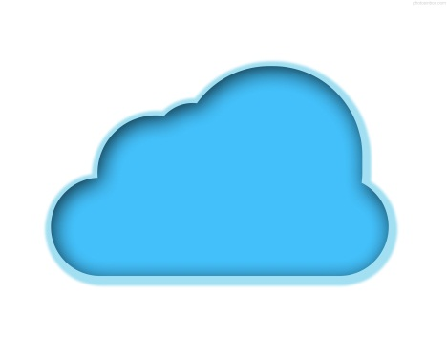


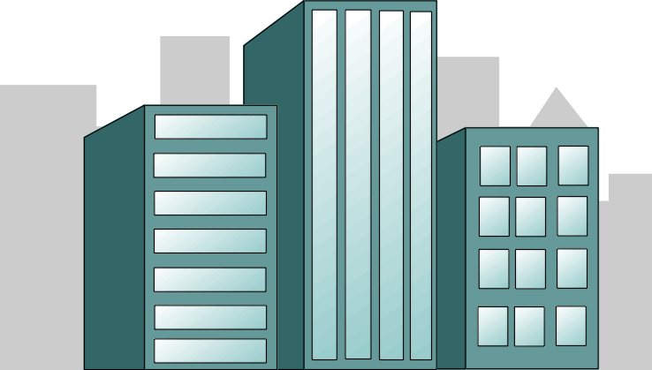
Private vs Public
Private Cloud
Public Cloud

Slide 3
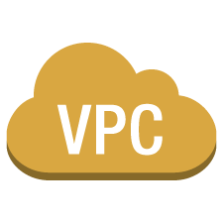
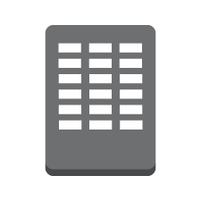


App migration from DC
Simple apps
Multi-tier web applications with lots of components
Environment isolation
Extend your Data Center
Disaster Recovery
Public subnets
Private subnets
VPN to your Data Center
Peer-to-Peer connect to another VPC(s)
Private Link
corporate data center
Notes:
Corporate network can be connected to Private Network (VPC) in public AWS cloud
It will help to add calculation power to Data Center
So a part of calculations can be shifted to VPC in AWS from Data Center
DHCP channels can be established between Private Networks

Slide 4
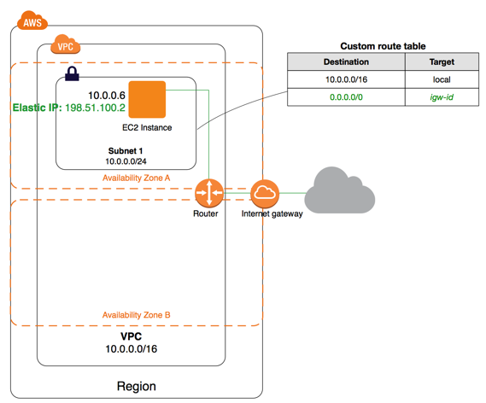
VPC: Public Network with Subnet and routing
A VPC with a size /24 IPv4
CIDR block (example: 10.0.0.0/24)
This provides Private Elastic IPv4 address
This provides 256 public IPv4 addresses
Routing table is associated with Subnet
Can add more subnets
Notes:
VPC with a Single Public Subnet
The configuration for this scenario includes a virtual private cloud (VPC) with a single public subnet, and an Internet gateway to enable communication over the Internet. We recommend this configuration if you need to run a single-tier, public-facing web application, such as a blog or a simple website.
The configuration for this scenario includes the following:
A virtual private cloud (VPC) with a size /16 IPv4 CIDR block (example: 10.0.0.0/16). This provides 65,536 private IPv4 addresses.
A subnet with a size /24 IPv4 CIDR block (example: 10.0.0.0/24). This provides 256 private IPv4 addresses.
An Internet gateway. This connects the VPC to the Internet and to other AWS services.
An instance with a private IPv4 address in the subnet range (example: 10.0.0.6), which enables the instance to communicate with other instances in the VPC, and an Elastic IPv4 address (example: 198.51.100.2), which is a public IPv4 address that enables the instance to be reached from the Internet.
A custom route table associated with the subnet. The route table entries enable instances in the subnet to use IPv4 to communicate with other instances in the VPC, and to communicate directly over the Internet. A subnet that's associated with a route table that has a route to an Internet gateway is known as a public subnet.
Routing
Your VPC has an implied router (shown in the configuration diagram above). In this scenario, the VPC wizard creates a custom route table that routes all traffic destined for an address outside the VPC to the Internet gateway, and associates this route table with the subnet.
Security
AWS provides two features that you can use to increase security in your VPC: security groups and network ACLs. Security groups control inbound and outbound traffic for your instances, and network ACLs (Access Control List) control inbound and outbound traffic for your subnets. In most cases, security groups can meet your needs; however, you can also use network ACLs if you want an additional layer of security for your VPC. For more information, see Security.
Your VPC comes with a default security group. An instance that's launched into the VPC is automatically associated with the default security group if you don't specify a different security group during launch.
We recommend that you create a custom security group for your web server. When you create a security group, it has a single outbound rule that allows all traffic to leave the instances. You must modify the rules to enable inbound traffic and restrict the outbound traffic as needed. You specify this security group when you launch instances into the VPC.

Slide 5
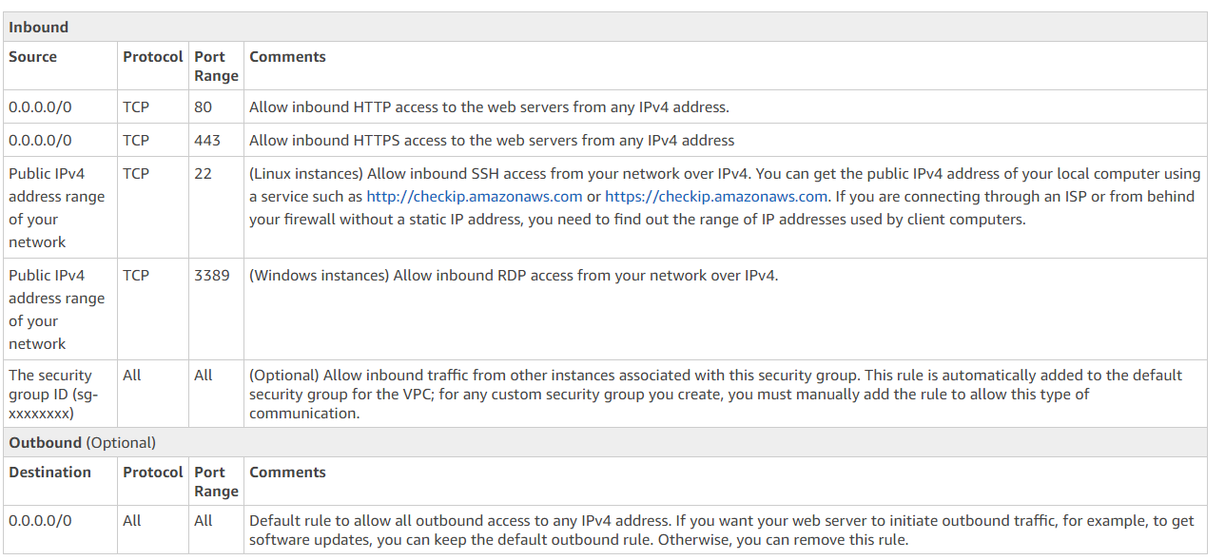
VPC: SG example for typical WebServer
Notes:
WebServer points to the Internet in VPC (VPC and its subnets has default ACL with opened ports)

Slide 6
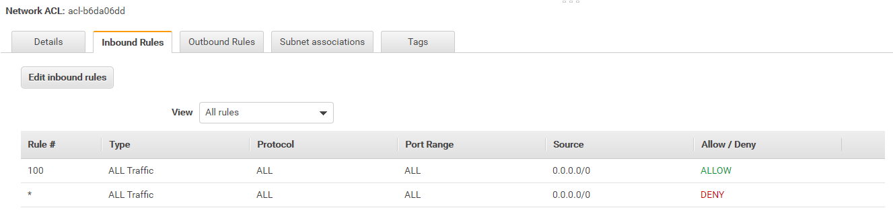
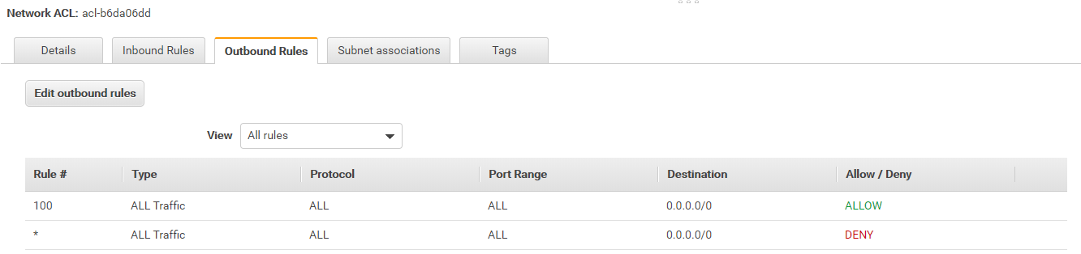
VPC: IGW ACL for Subnets in VPC (default setting)
Notes:
By default all Inbound and Outbound Ports for VPC (and subnets inside) are opened It (ACL) is a higher level (security perimeter) for the EC2 instances (managed by SG). ACL is like SG but for VPC (so, for all subnets inside and therefore all EC2 instances inside subnets)

Slide 7
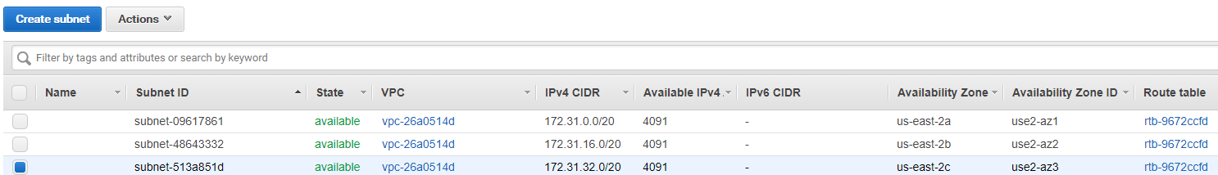
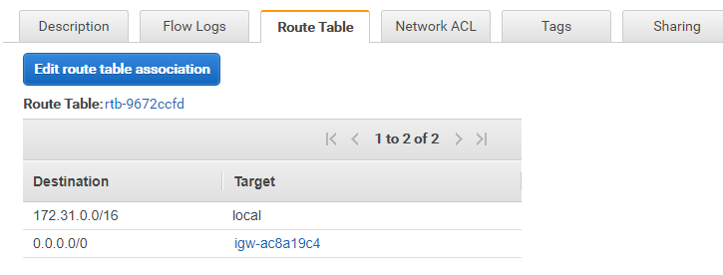
Subnet and AZ
Notes:
Every subnet in default VPC stands for AZ

Slide 8



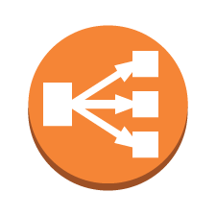
Public/Private Subnets diff
instance
Private subnet
Internet gateway
Internet
Elastic IP
instance
instance
Elastic Load
Balancing
Public subnet
Notes:
VPC: Public Network with Subnet and routing
Default VPC components:
- ACL (Build security perimeter around VPC and between IGW - like SG)
- IGW (just allow access to Internet for VPC - connect bi-directional)
- Subnet
- Routing (define communication allowness between subnets and EC2 instances inside in VPC)
- Route table that allows connection from Subnet to IGW makes subnet Public EC2 instances are deployed to VPC (specified or default)

Slide 9
Routing
Notes:
NAT(network address translation) exists and is needed to allow EC2 instance from Private Network to access internet (vs. IGW – destination for Public Network) NAT almost plays the same role as IGW for Public Network NAT is EC2 instance being deployed
You can use a network address translation (NAT) gateway to enable instances in a private subnet to connect to the internet or other AWS services, but prevent the internet from initiating a connection with those instances.
NAT is short for Network Address Translation. NAT is an Internet standard that enables a local-area network (LAN) to use one set of IP addresses for internal traffic and a second set of addresses for external traffic. A NAT box located where the LAN meets the Internet makes all necessary IP address translations.
The Purpose of NAT
NAT serves three main purposes:
Provides a type of firewallby hiding internal IP addresses

Slide 10
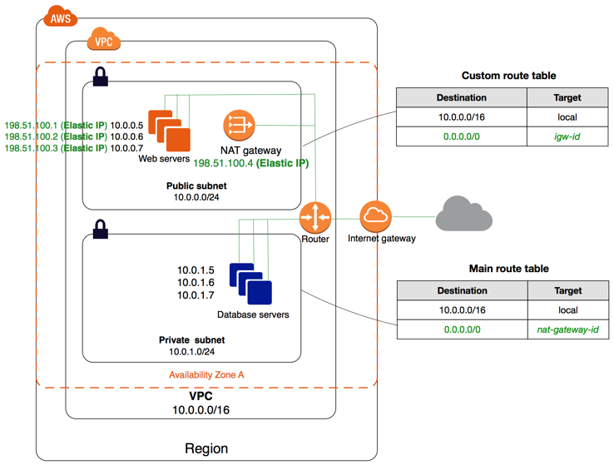
VPC : Private and Public networks example
A VPC with a size /16 IPv4
CIDR block (example: 10.0.0.0/16)
This provides 65,536 private IPv4 addresses.
Notes:
If you want your instance in a public subnet to communicate with the internet over IPv4, it must have a public IPv4 address or an Elastic IP address (IPv4).
If a subnet doesn't have a route to the internet gateway, the subnet is known as a private subnet. In this diagram, subnet 2 is a private subnet.
For example, if you create a VPC with CIDR block 10.0.0.0/24, it supports 256 IP addresses. You can break this CIDR block into two subnets, each supporting 128 IP addresses. One subnet uses CIDR block 10.0.0.0/25 (for addresses 10.0.0.0 - 10.0.0.127) and the other uses CIDR block 10.0.0.128/25 (for addresses 10.0.0.128 - 10.0.0.255).
An Elastic IP address is a static IPv4 address designed for dynamic cloud computing. An Elastic IP address is associated with your AWS account. With an Elastic IP address, you can mask the failure of an instance or software by rapidly remapping the address to another instance in your account.
An Elastic IP address is a public IPv4 address, which is reachable from the internet. If your instance does not have a public IPv4 address, you can associate an Elastic IP address with your instance to enable communication with the internet; for example, to connect to your instance from your local compute
Currently do not support Elastic IP addresses for IPv6.
To use an Elastic IP address, you first allocate one to your account, and then associate it with your instance or a network interface.
When you associate an Elastic IP address with an instance or its primary network interface, the instance's public IPv4 address (if it had one) is released back into Amazon's pool of public IPv4 addresses. You cannot reuse a public IPv4 address,

Slide 11
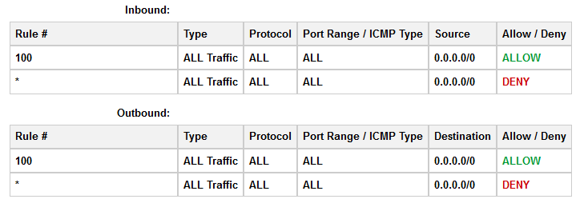
Security (ACL – subnet vs SG – EC2)
Public/Private subnets - Network ACL controls traffic to subnets
EC2 Instance - Security groups - Inbound and Outbound traffic
Notes:
Routing Table defines inter-subnet rules for communication
ACL is linked to subnet and allow to b
A VPC spans all the Availability Zones in the region. After creating a VPC, you can add one or more subnets in each Availability Zone. When you create a subnet, you specify the CIDR block for the subnet, which is a subset of the VPC CIDR block. Each subnet must reside entirely within one Availability Zone and cannot span zones. Availability Zones are distinct locations that are engineered to be isolated from failures in other Availability Zones. By launching instances in separate Availability Zones, you can protect your applications from the failure of a single location. We assign a unique ID to each subnet.uild Security Perimeter (Inset up /Out bound ports)

Slide 12
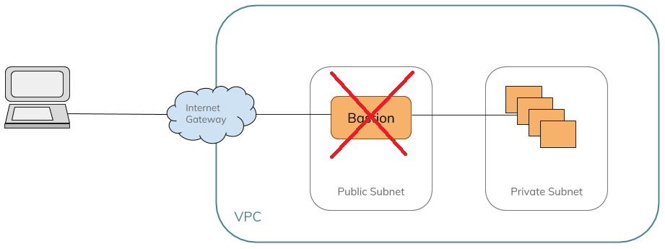
Bastion (Simple schema to cut off private VPC)
Public Network serves as a Bastion (NAT)
Routing is set between Private and Public network
Blocking EC2 Instance on Bastion isolate all Private subnets
Notes:
You can use a network address translation (NAT) gateway to enable instances in a private subnet to connect to the internet or other AWS services, but prevent the internet from initiating a connection with those instances.
Basically, NAT allows a single device, such as a router, to act as an agent between the Internet (or public network) and a local network (or private network), which means that only a single unique IP address is required to represent an entire group of computers to anything outside their network.
How do I configure NAT?
A. In order to configure traditional NAT, you need to make at least one interface on a router (NAT outside) and another interface on the router (NAT inside) and a set of rules for translating the IP addresses in the packet headers (and payloads if desired) need to be configured. In order to configure Nat Virtual Interface (NVI), you need at least one interface configured with NAT enable along with the same set of rules as mentioned above.

Slide 13
Home Task
Create customer VPC with scripts from the lecture

