Slide 1
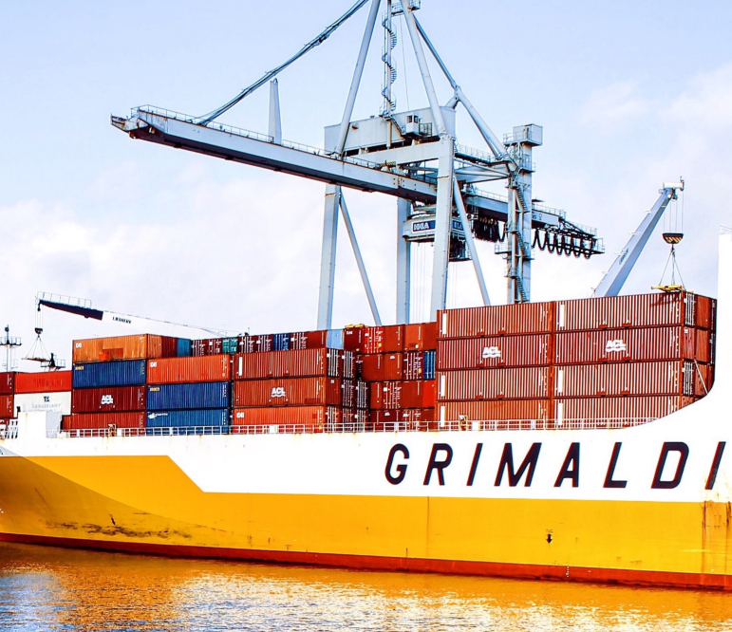
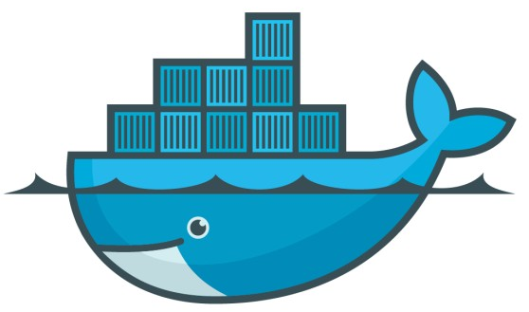
Docker Container

Slide 2
Agenda
Docker layers
Docker CLI commands
Docker Registries
Dockerfile
Fargate
ECS and ECR
Deployment of docker images
Notes:
A Docker container image is a lightweight, standalone, executable package of software that includes everything needed to run an application: code, runtime, system tools, system libraries and settings.
Container images become containers at runtime and in the case of Docker containers - images become containers when they run on Docker Engine
Docker is container-based technology and containers are just user space of the operating system. At the low level, a container is just a set of processes that are isolated from the rest of the system, running from a distinct image that provides all files necessary to support the processes. It is built for running applications. In Docker, the containers running share the host OS kernel. Docker is an open-source project based on Linux containers. It uses Linux Kernel features like namespaces and control groups to create containers on top of an operating system. Docker enclose an application’s software into an invisible box with everything it needs to run like OS, application code, Run-time, system tools and libraries etc. Docker containers are built off Docker images and the images are read-only, So Docker adds a read-write file system over the read-only file system of the image to create a container. Docker is currently the most popular container and why its so popular, different architecture components, use cases will describe in details in below sections.
Docker Client: This is the CLI (Command Line Interface) tool used to configure and interact with Docker. Whenever developers or users use the commands like docker run the client sends these commands to Docker daemon (dockerd) which carries them out. The docker command uses the Docker API and the Docker client can communicate with more than one daemon.
Docker Daemon: This is the Docker server which runs as the daemon. This daemon listens to API requests and manages Docker objects (images, containers, networks, and volumes). A daemon can also communicate with other daemons to manage Docker services.
Images: Images are the read-only template/snapshot used to create a Docker container and these Images can be pushed to and pulled from public or private repositories. This is the build component of docker. Images are lightweight, small, and fast as compared to Virtual Machine Images.
Docker file: Used for building images
Containers: Applications run using containers and containers are the running instance of an image. We can create, run, stop, move, or delete a container using the CLI and also can connect a container to one or more networks, attach storage to it, or even create a new image based on its current state.
Docker Registries: This is the distribution component of docker or called as Central repository of Docker images which stores Docker images. Docker Hub and Docker Cloud are public registries that anyone can use, and Docker is configured to look for images on Docker Hub by default. When we use the docker pull or docker run commands then the required images are pulled from our configured registry. When we use the docker push command, our image is pushed to our configured registry. We can upgrade the application by pulling the new version of the image and redeploying the containers.
Docker Engine: Combination of Docker daemon, Rest API and CLI tool

Slide 3
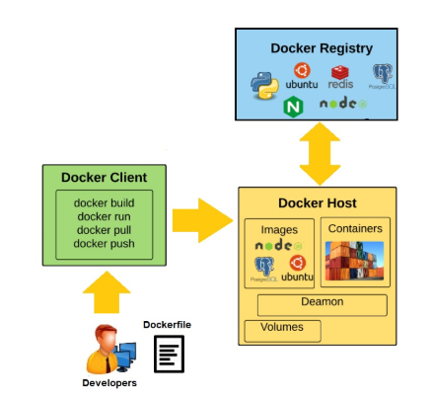
Docker
Docker is composed of six different components namely
Docker Client (CLI)
Docker Daemon (server)
Docker Images
Containers
Docker Containers
Docker Engine
Docker Registries (Docker Hub)
- artifact, file
runtime
Notes:
A Docker container image is a lightweight, standalone, executable package of software that includes everything needed to run an application: code, runtime, system tools, system libraries and settings.
Container images become containers at runtime and in the case of Docker containers - images become containers when they run on Docker Engine
Docker is container-based technology and containers are just user space of the operating system. At the low level, a container is just a set of processes that are isolated from the rest of the system, running from a distinct image that provides all files necessary to support the processes. It is built for running applications. In Docker, the containers running share the host OS kernel. Docker is an open-source project based on Linux containers. It uses Linux Kernel features like namespaces and control groups to create containers on top of an operating system. Docker enclose an application’s software into an invisible box with everything it needs to run like OS, application code, Run-time, system tools and libraries etc. Docker containers are built off Docker images and the images are read-only, So Docker adds a read-write file system over the read-only file system of the image to create a container. Docker is currently the most popular container and why its so popular, different architecture components, use cases will describe in details in below sections.
Docker Client: This is the CLI (Command Line Interface) tool used to configure and interact with Docker. Whenever developers or users use the commands like docker run the client sends these commands to Docker daemon (dockerd) which carries them out. The docker command uses the Docker API and the Docker client can communicate with more than one daemon.
Docker Daemon: This is the Docker server which runs as the daemon. This daemon listens to API requests and manages Docker objects (images, containers, networks, and volumes). A daemon can also communicate with other daemons to manage Docker services.
Images: Images are the read-only template/snapshot used to create a Docker container and these Images can be pushed to and pulled from public or private repositories. This is the build component of docker. Images are lightweight, small, and fast as compared to Virtual Machine Images.
Docker file: Used for building images
Containers: Applications run using containers and containers are the running instance of an image. We can create, run, stop, move, or delete a container using the CLI and also can connect a container to one or more networks, attach storage to it, or even create a new image based on its current state.
Docker Registries: This is the distribution component of docker or called as Central repository of Docker images which stores Docker images. Docker Hub and Docker Cloud are public registries that anyone can use, and Docker is configured to look for images on Docker Hub by default. When we use the docker pull or docker run commands then the required images are pulled from our configured registry. When we use the docker push command, our image is pushed to our configured registry. We can upgrade the application by pulling the new version of the image and redeploying the containers.
Docker Engine: Combination of Docker daemon, Rest API and CLI tool

Slide 4
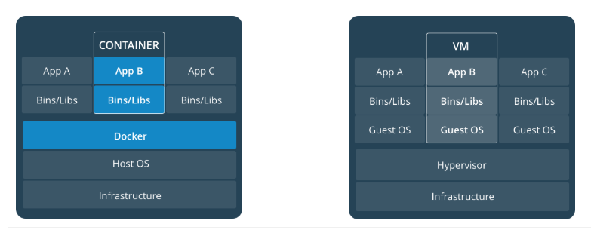
Containerized App vs App running on VM
Notes:
Standard(preferable): Docker created the industry standard for containers, so they could be portable anywhere
Lightweight: Containers share the machine’s OS system kernel and therefore do not require an OS per application, driving higher server efficiencies and reducing server and licensing costs
Docker container technology was launched in 2013
CONTAINERS
Containers are an abstraction at the app layer that packages code and dependencies together. Multiple containers can run on the same machine and share the OS kernel with other containers, each running as isolated processes in user space. Containers take up less space than VMs (container images are typically tens of MBs in size), can handle more applications and require fewer VMs and Operating systems
Containers and virtual machines
A container runs natively on Linux and shares the kernel of the host machine with other containers. It runs a discrete process, taking no more memory than any other executable, making it lightweight.
By contrast, a virtual machine (VM) runs a full-blown “guest” operating system with virtual access to host resources through a hypervisor. In general, VMs incur a lot of overhead beyond what is being consumed by your application logic.

Slide 5
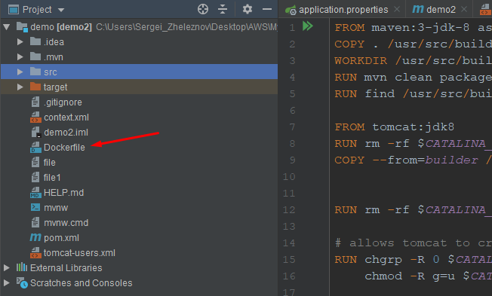
Docker Commands
Add Dockerfile
>docker images or >docker image ls
$ docker pull ubuntu or <image>
>docker ps
>docker build -f Dockerfile -t app:latest .
>docker run --rm -p 8080:8080 app:latest
>docker start/stop <hash>
$ docker container search redis
$ docker container run redis
$ docker container start <container ID>
$ docker container ls -a
Notes:
Docker engine running in the terminal tried to find an image named redis Since there are no images stored locally (Unable to find image…) so Docker engine goes to its default Docker registry, which is Docker Store, to look for an image named “redis”. It finds the image there, pulls it down, and then runs it in a container.
Docker store allows you to buy and sell Docker images or distribute them for free
Also you have option to buy a Docker image containing an application or service from a software vendor and use the image to deploy the application into your testing, staging, and production environments. You can upgrade the application by pulling the new version of the image and redeploying the containers.
IMAGES
An image is a read-only template with instructions for creating a Docker container. You can create an image with additional customization from a base image or use those created by others and published in a registry.
Docker uses a smart layered file system, where the base layer is read-only and top layer is writable. When you try to write to a base layer, a copy is created in the top layer, and the base layer remains unchanged. This base layer can be shared since it is a read-only and never changes.
For example, you may build an image, which based on the Centos image, but installs the Web server and your application, as well as the configuration details needed to make your application run.
Volumes
Volumes are the preferred mechanism for persisting data generated by and used by Docker containers. While bind mounts are dependent on the directory structure of the host machine, volumes are completely managed by Docker.
Bind mounts
Bind mounts have been around since the early days of Docker. Bind mounts have limited functionality compared to volumes. When you use a bind mount, a file or directory on the host machine is mounted into a container. The file or directory is referenced by its full or relative path on the host machine. By contrast, when you use a volume, a new directory is created within Docker’s storage directory on the host machine, and Docker manages that directory’s contents.
The file or directory does not need to exist on the Docker host already. It is created on demand if it does not yet exist. Bind mounts are very performant, but they rely on the host machine’s filesystem having a specific directory structure available. If you are developing new Docker applications, consider using named volumes instead. You can’t use Docker CLI commands to directly manage bind mounts.
Advantages of Volume over bind mounts
Volumes are easier to back up or migrate than bind mounts.
You can manage volumes using Docker CLI commands or the Docker API.
Volumes work on both Linux and Windows containers.
Volumes can be more safely shared among multiple containers.
Volume drivers let you store volumes on remote hosts or cloud providers, to encrypt the contents of volumes, or to add other functionality.
New volumes can have their content pre-populated by a container.
Docker creates a new container every time when you run docker run multiple times and leaving stray containers will eat up disk space. So clean up the containers once you are done with them. You can use the docker rm command to perform the cleaning
$ docker container rm < container ID >

Slide 6
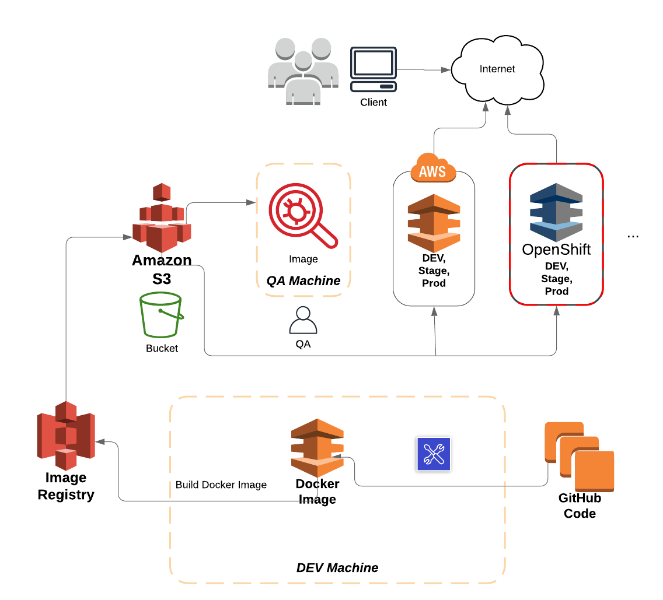
Development in Containers
Docker Image Prepare
Docker Image Registry
Deployment to S3 bucket
QA takes over and test Locally
Deploy to OpenShift, AWS (ECR)
Scale up Containers
Notes:
Docker store (for containers): https://hub.docker.com/ Docker hub (Docker registry): https://hub.docker.com/search/?q=&type=image
Compose is a tool for defining and running multi-container Docker applications. With Compose, you use a YAML file to configure your application’s services. Then, with a single command, you create and start all the services from your configuration.

Slide 7
Dockerfile
FROM ubuntu:18.04 FROM maven:3-jdk-8 as builder COPY . /usr/src/build WORKDIR /usr/src/build RUN mvn clean package -DskipTests -Plocalbuild -f /usr/src/build && mkdir /usr/src/wars/ RUN find /usr/src/build/ -iname 'material.war' -exec cp {} /usr/src/wars/ \; RUN rm -rf $CATALINA_HOME/webapps/ROOT COPY --from=builder /usr/src/wars/material.war $CATALINA_HOME/webapps/ROOT.war # allows tomcat to create ROOT dir when launching RUN chgrp -R 0 $CATALINA_HOME/webapps && \ chmod -R g=u $CATALINA_HOME/webapps EXPOSE 8080 CMD ["catalina.sh", "run"]
Notes:
How to build Your Own Image A Dockerfile is a manifest that describes the base image to use for your Docker image and what you want installed and running on it.
To build your own image, Create a Dockerfile with a simple syntax for defining the steps needed to create the image and run it. Each instruction in a Dockerfile creates a layer in the image. When you change the Dockerfile and rebuild the image, only those layers that have changed are rebuilt and this makes images so lightweight, small, and fast.
CONTAINERS
In simple words container is a runnable instance of an image. You can create, start, stop, move, or delete a container using the Docker API or CLI. You can connect a container to one or more networks, attach storage to it, or even create a new image based on its current state.
By default, a container is relatively well isolated from other containers and its host machine. You can control how isolated a container’s network, storage, or other underlying subsystems are from other containers or from the host machine.
A container is defined by its image as well as any configuration options you provide to it when you create or start it. When a container is removed, any changes to its state that are not stored in persistent storage disappear.
Volumes
Volumes are the preferred mechanism for persisting data generated by and used by Docker containers. While bind mounts are dependent on the directory structure of the host machine, volumes are completely managed by Docker.

Slide 8
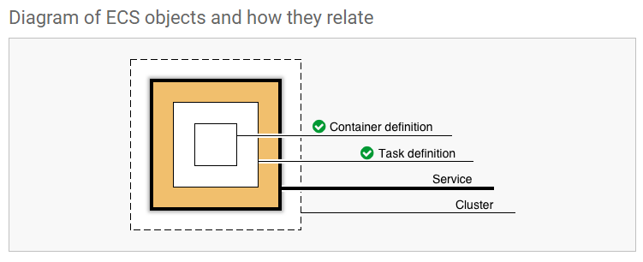
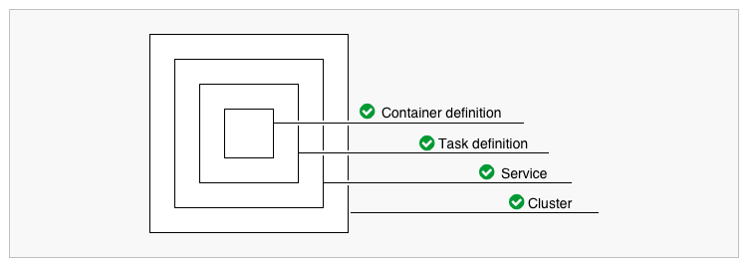
AWS ECS
Notes:
Amazon Elastic Container Service (Amazon ECS) is a highly scalable, high-performance container orchestration service that supports Docker containers and allows you to easily run and scale containerized applications on AWS. Amazon ECS eliminates the need for you to install and operate your own container orchestration software, manage and scale a cluster of virtual machines, or schedule containers on those virtual machines.
With simple API calls, you can launch and stop Docker-enabled applications, query the complete state of your application, and access many familiar features such as IAM roles, security groups, load balancers, Amazon CloudWatch Events, AWS CloudFormation templates, and AWS CloudTrail logs.
ECS runs your containers on a cluster of Amazon EC2 (Elastic Compute Cloud) virtual machine instances pre-installed with Docker.
AWS Fargate is a compute engine for Amazon ECS that allows you to run containers without having to manage servers or clusters
Task
An instance of a Task Definition, running the containers detailed within it. Multiple Tasks can be created by one Task Definition, as demand requires.

Slide 9
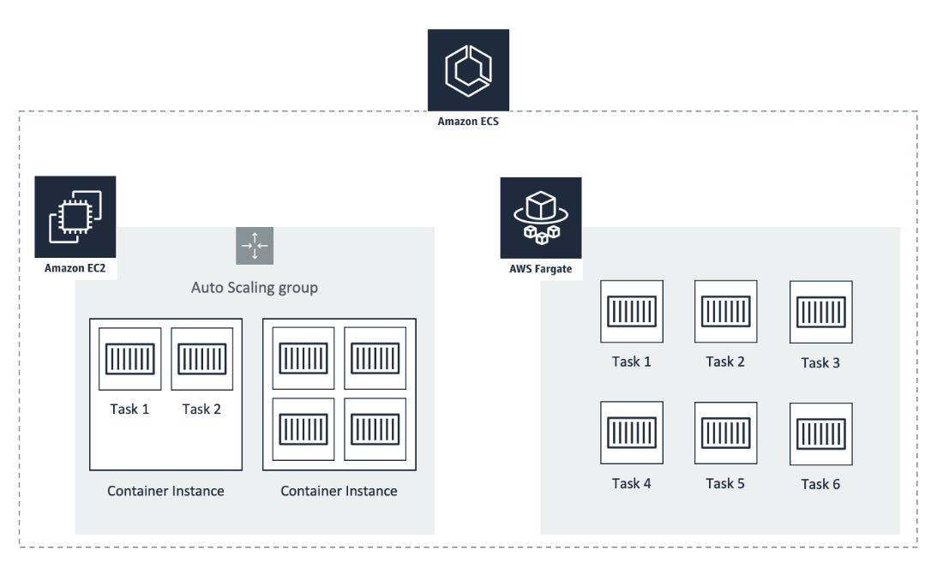
AWS ECS vs Fargate
Notes:
ECS container instance
An ECS container instance is nothing more than an EC2 instance that runs the ECS Container Agent. The EC2 instance is owned and managed by you. The instance appears in the list of EC2 instances like any other EC2 instance. The ECS Container Agent regularly polls the ECS API if new containers need to be started or stopped. Usually, you run a cluster of container instances in an auto-scaling group. ECS is free of charge. You only pay for the EC2 instances.
Fargate
AWS Fargate manages the task execution. No EC2 instances to manage anymore. You pay for running tasks. That’s it. As easy as it sounds.
you have to scale, monitor, patch, and secure the EC2 instances yourself. Especially the scaling is not easy because:

Slide 10
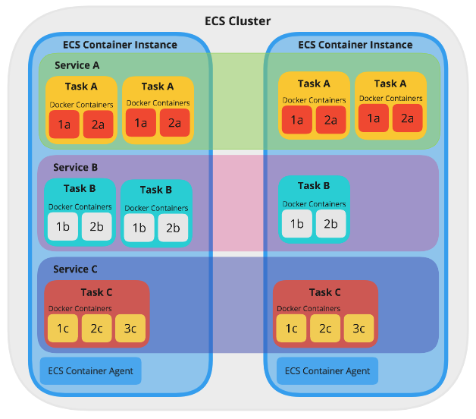
AWS ECS Containers
A Cluster running 3 Services, each running a different amount of Tasks, across two ECS Container Instances
Notes:
This Service is ECS Container Instances that provide the pool of resources needed to run and scale your application. Additional Services can be deployed to the same Cluster.
Cluster is a group of ECS Container Instances. Amazon ECS handles the logic of scheduling, maintaining, and handling scaling requests to these instances. It also takes away the work of finding the optimal placement of each Task based on your CPU and memory needs.

