Slide 1

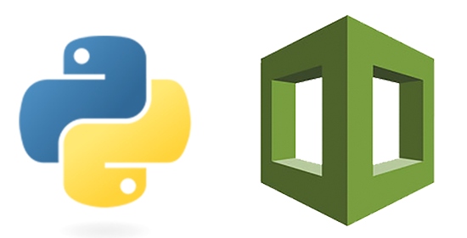
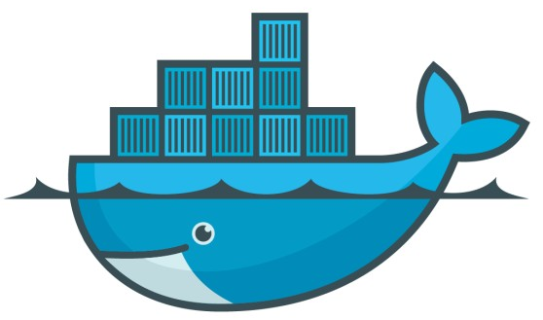
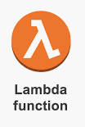
Docker Lambda Troposphere

Slide 2
Agenda
Docker with Spring Boot App
- External Tomcat
- Embedded Tomcat
Serverless Lambda
Alexa AI Service (Voice Assistant)
Troposphere

Slide 3
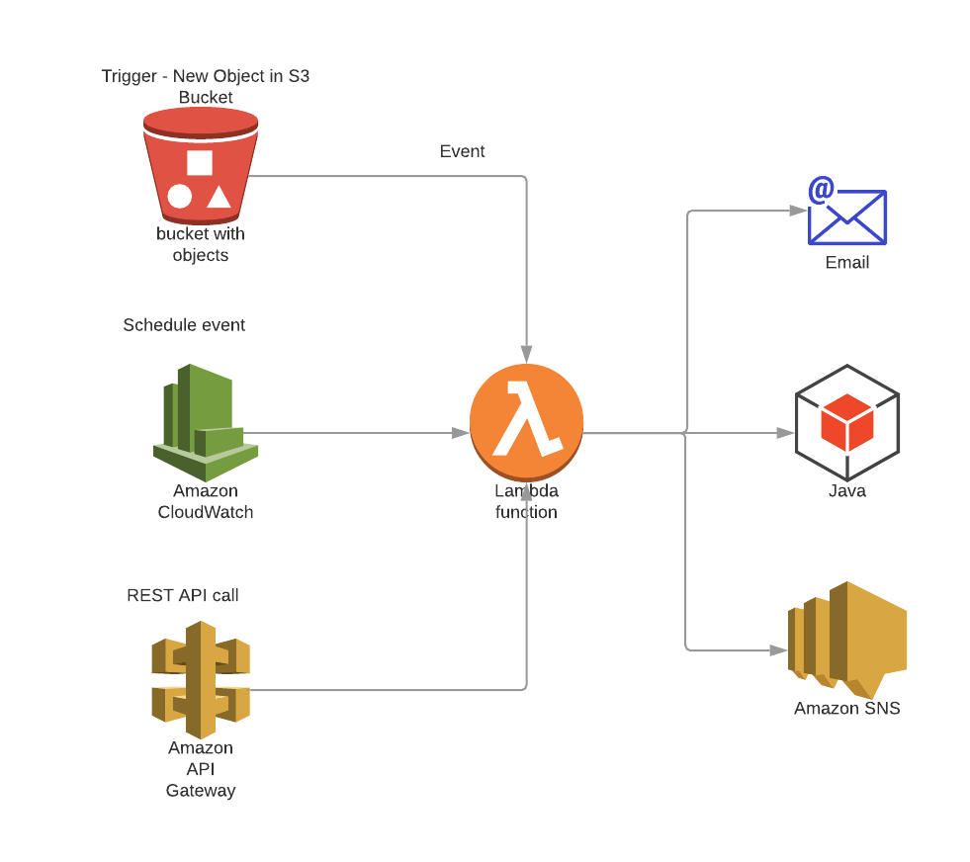
Lambda
Concepts
Function
Runtime
Event
Concurrency
Trigger
Notes:
What Is AWS Lambda?
AWS Lambda is a compute service that lets you run code without provisioning or managing servers. AWS Lambda executes your code only when needed and scales automatically, from a few requests per day to thousands per second. You pay only for the compute time you consume - there is no charge when your code is not running. With AWS Lambda, you can run code for virtually any type of application or backend service - all with zero administration. AWS Lambda runs your code on a high-availability compute infrastructure and performs all of the administration of the compute resources, including server and operating system maintenance, capacity provisioning and automatic scaling, code monitoring and logging.
You can use AWS Lambda to run your code in response to events, such as changes to data in an Amazon S3 bucket or an Amazon DynamoDB table; to run your code in response to HTTP requests using Amazon API Gateway
AWS Lambda Applications Lambda intercepts JSON events.
An AWS Lambda application is a combination of Lambda functions, event sources, and other resources that work together to perform tasks. You can use AWS CloudFormation and other tools to collect your application's components into a single package that can be deployed and managed as one resource. Applications make your Lambda projects portable and enable you to integrate with additional developer tools, such as AWS CodePipeline, AWS CodeBuild
AWS Lambda Concepts
With AWS Lambda, you run functions to process events. You can send events to your function by invoking it with the Lambda API, or by configuring an AWS service or resource to invoke it.
Concepts
Function
Runtime
Event
Concurrency
Trigger
Function
A function is a resource that you can invoke to run your code in AWS Lambda. A function has code that processes events, and a runtime that passes requests and responses between Lambda and the function code. You provide the code, and you can use the provided runtimes or create your own.
For more information, see AWS Lambda Runtimes.
Runtime
Lambda runtimes allow functions in different languages to run in the same base execution environment. You configure your function to use a runtime that matches your programming language. The runtime sits in between the Lambda service and your function code, relaying invocation events, context information, and responses between the two. You can use runtimes provided by Lambda, or build your own.
For more information, see AWS Lambda Runtimes.
Event
An event is a JSON formatted document that contains data for a function to process. The Lambda runtime converts the event to an object and passes it to your function code. When you invoke a function, you determine the structure and contents of the event. When an AWS service invokes your function, the service defines the event.
For details on events from AWS services, see Using AWS Lambda with Other Services.
Concurrency
Concurrency is the number of requests that your function is serving at any given time. When your function is invoked, Lambda provisions an instance of it to process the event. When the function code finishes running, it can handle another request. If the function is invoked again while a request is still being processed, another instance is provisioned, increasing the function's concurrency.
Concurrency is subject to limits at the region level. You can also configure individual functions to limit their concurrency, or to ensure that they can reach a specific level of concurrency. For more information, see Reserving Concurrency for a Lambda Function.
Trigger
A trigger is a resource or configuration that invokes a Lambda function. This includes AWS services that can be configured to invoke a function, applications that you develop, and event source mappings. An event source mapping is a resource in Lambda that reads items from a stream or queue and invokes a function.

Slide 4
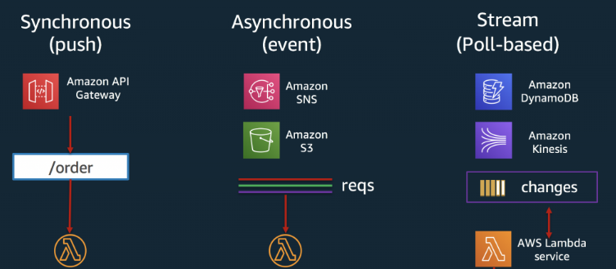
Lambda
Notes:
Synchronous Invokes
Synchronous invocations are the most straight forward way to invoke your Lambda functions. In this model, your functions execute immediately when you perform the Lambda Invoke API call. This can be accomplished through a variety of options, including using the CLI or any of the supported SDKs.
Here is an example of a synchronous invoke using the CLI:
>aws lambda invoke —function-name MyLambdaFunction —invocation-type RequestResponse —payload “[JSON string here]”
Many AWS services can emit events that trigger Lambda functions. Here is a list of services that invoke Lambda functions synchronously:
Elastic Load Balancing (Application Load Balancer)
Amazon Cognito
Amazon Lex
Amazon Alexa
Amazon API Gateway
Asynchronous Invokes
Here is an example of an asynchronous invoke using the CLI:
>aws lambda invoke —function-name MyLambdaFunction —invocation-type Event —payload “[JSON string here]”
Notice, the Invocation-type flag specifies “Event.” If your function returns an error, AWS will automatically retry the invoke twice, for a total of three invocations.
Here is a list of services that invoke Lambda functions asynchronously:
Amazon Simple Storage Service
Amazon Simple Notification Service
Amazon Simple Email Service
AWS CloudFormation
Poll-Based Invokes
This invocation model is designed to allow you to integrate with AWS Stream and Queue based services with no code or server management. Lambda will poll the following services on your behalf, retrieve records, and invoke your functions At the time you create a Lambda function, you specify a handler, which is a function in your code, that AWS Lambda can invoke when the service executes your code. Use the following general syntax structure when creating a handler function in Python.
def handler_name(event, context):
...
return some_value
Invoking AWS Lambda Functions
You can invoke Lambda functions directly with the Lambda console, the Lambda API, the AWS SDK, the AWS CLI, and AWS toolkits. You can also configure other AWS services to invoke your function or configure Lambda to read from a stream or queue and invoke your function. When you invoke a function, you can choose to invoke it synchronously or asynchronously.
AWS services and resources invoke your function directly. For example, you can configure CloudWatch Events to invoke your function on a timer, or Amazon S3 to invoke your function when an object is created. Each service varies in the method it uses to invoke your function, the structure of the event, and how you configure it.

