Slide 1
Troposphere

Slide 2
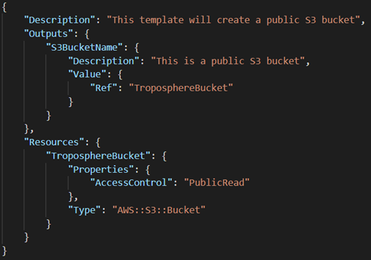
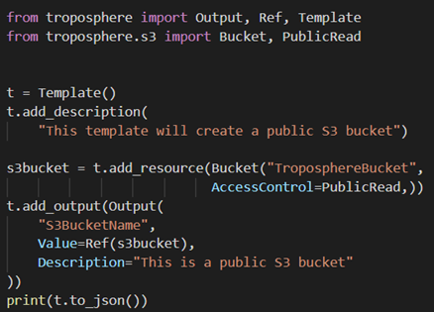
From Python to CloudFormation
>pip install troposphere
>python template.py > template.json

Slide 3
Concepts: Terraform vs Troposhere
Terraform as "Describe your complete infrastructure as code”
With Terraform, you describe your complete infrastructure as code, even as it spans multiple service providers
VS
Troposphere is detailed as "Library to create AWS CloudFormation descriptions“
AWS CloudFormation JSON by writing Python code to describe the AWS resources

Slide 4
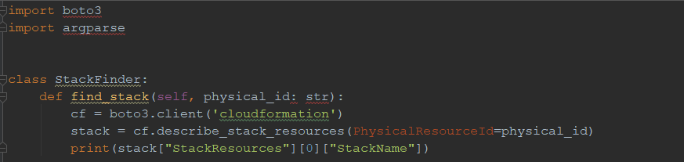
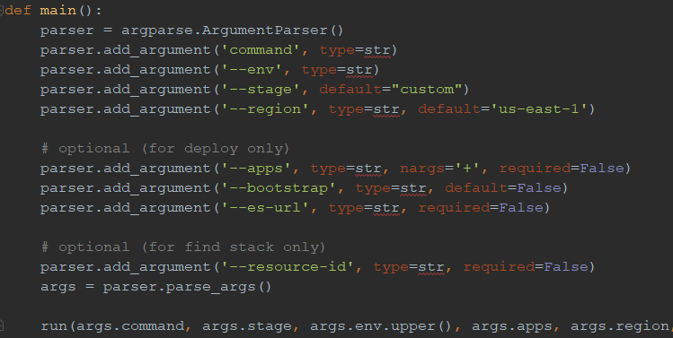
Python and AWS Boto3
AWS-provided Boto3 library to execute AWS API
python vpc_stack.py > vpc_stack.json

Slide 5
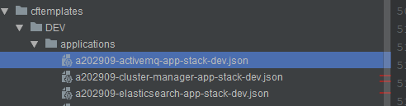
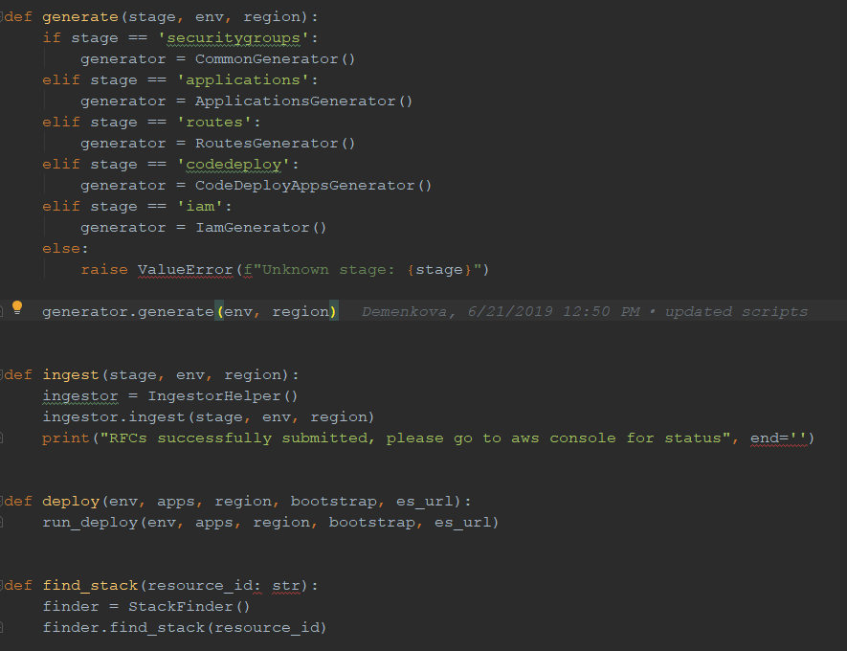
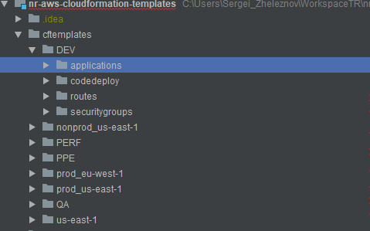
Building and Deployment CF scripts

