Slide 1
Git
Eine kurze Einführung
TU Chemnitz
Professur Softwaretechnik
Dominik Gorgosch

Slide 2
git

Slide 3
git (engl. Slang für Blödmann)
“The joke ‘I name all my projects for myself, first Linux, then git’ was just too good to pass up. But it is also short, easy-to-say, and type on a standard keyboard. And reasonably unique and not any standard command, which is unusual.”

Slide 4
Keep track of changes to code.
a = | 1
b = | 2
c = | 3
Create file

Slide 5
Keep track of changes to code.
a = | 1 | a | = | 1
b = | 2 | b | = | 2
c = | 3 | c | = | 3
 |  | d | = | 4
Create file
Add a line

Slide 6
Keep track of changes to code.
a = 1
b = 2
c = 3
a = 1
b = 2
c = 3
a = 1
c = 3
d = 4
d = 4
Create file
Add a line
Remove a line

Slide 7



Synchronizes code between different people.
b = 2
c = 3

Slide 8
Synchronizes code between different people.
b = 2
c = 3
b = 2
c = 3
b = 2
c = 3

Slide 9
Synchronizes code between different people.
b = 2
c = 3
a = 1
b = 2
c = 3
b = 2
c = 3
d = 4

Slide 10

Synchronizes code between different people.
a = 1
b = 2
c = 3
d = 4
a = 1
b = 2
c = 3
b = 2
c = 3
d = 4

Slide 11
Synchronizes code between different people.
a = 1
b = 2
c = 3
d = 4
a = 1
b = 2
c = 3
d = 4
aint= b1 = 2; bint= c2 = 3; cint= 3d = 4; d = 4

Slide 12
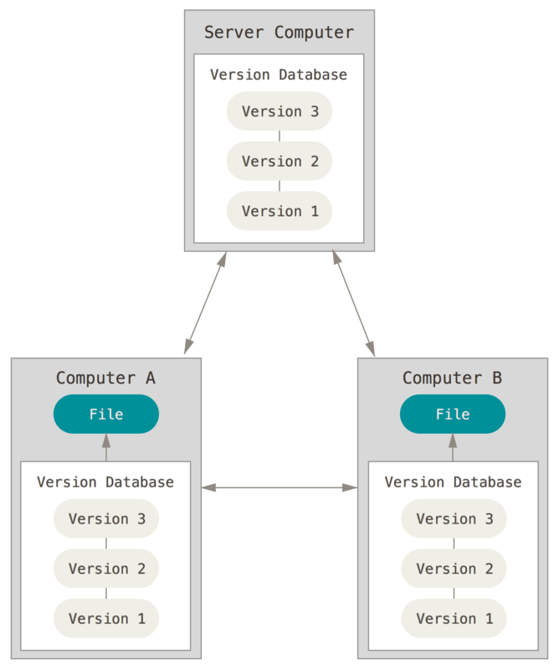

Slide 13
Test changes to code without losing the original.
a = 1 b = 2 c = 3

Slide 14
Test changes to code without losing the original.
a = | 1
b = | 2
c = | 3
a = | 1
b = | 2
c = | 3
d = | 4

Slide 15
Test changes to code without losing the original.
a = | 1
b = | 2
c = | 3
a = | 1
b = | 2
c = | 3
d = | 4
a = | 1
b = | 2
c = | 3
d = | 4

Slide 16
Revert back to old versions of code.
a = 1
b = 2
c = 3
a = 1
b = 2
c = 3
a = 1
c = 3
d = 4
d = 4
Create file
Add a line
Remove a line

Slide 17
Revert back to old versions of code.
a = | 1 | a | = | 1
b = | 2 | b | = | 2
c = | 3 | c | = | 3
 |  | d | = | 4
Create file
Add a line

Slide 18
GitHub

Slide 19
git clone

Slide 20


git clone <url>
a = 1 b = 2 c = 3 d = 4

Slide 21
git clone <url>
a = 1 b = 2 c = 3 d = 4
git clone <url>

Slide 22

git clone <url>
a = 1 b = 2 c = 3 d = 4
a = | 1
b = | 2
c = | 3
d = | 4
git clone <url>

Slide 23
git add

Slide 24
git add <filename>
a = 1 b = 2 c = 3 d = 4
a = | 1
b = | 2
c = | 3
d = | 4

Slide 25
git add <filename>
a = 1 b = 2 c = 3 d = 4
a = | 1
b = | 2
c = | 3
d = | 4
e = | 5

Slide 26
git add <filename>
a = 1 b = 2 c = 3 d = 4
a = | 1
b = | 2
c = | 3
d = | 4
e = | 5
git add foo.py

Slide 27
git add <filename>
a = 1 b = 2 c = 3 d = 4
a = | 1
b = | 2
c = | 3
d = | 4
e = | 5
git add foo.py
Changes to be committed:
modified: foo.py

Slide 28
git commit

Slide 29

git commit -m "message"
a = 1 b = 2 c = 3 d = 4
a = 1 b = 2 c = 3 d = 4
a = 1 b = 2 c = 3 d = 4 e = 5

Slide 30
git commit -m "message"
a = 1 b = 2 c = 3 d = 4
a = 1 b = 2 c = 3 d = 4
a = | 1
b = | 2
c = | 3
d = | 4
e = | 5
git commit -m "Add line"

Slide 31
git commit -m "message"
a = 1 b = 2 c = 3 d = 4
a = 1 b = 2 c = 3 d = 4
a = | 1 | a | = | 1
b = | 2 | b | = | 2
c = | 3 | c | = | 3
d = | 4 | d | = | 4
 |  | e | = | 5
git commit -m "Add line"
Add line

Slide 32
git status

Slide 33
git status
a = 1 b = 2 c = 3 d = 4
a = | 1 | a | = | 1
b = | 2 | b | = | 2
c = | 3 | c | = | 3
d = | 4 | d | = | 4
 |  | e | = | 5
Add line

Slide 34
git status
a = 1 b = 2 c = 3 d = 4
a = | 1 | a | = | 1
b = | 2 | b | = | 2
c = | 3 | c | = | 3
d = | 4 | d | = | 4
 |  | e | = | 5
git status
Add line

Slide 35
git status
a = 1 b = 2 c = 3 d = 4
a = | 1 | a | = | 1
b = | 2 | b | = | 2
c = | 3 | c | = | 3
d = | 4 | d | = | 4
 |  | e | = | 5
git status
Add line
On branch master
Your branch is ahead of 'origin/master' by 1 commit. (use "git push" to publish your local commits)

Slide 36
git push

Slide 37

git push
a = 1
b = 2
c = 3
d = 4
a = 1
b = 2
c = 3
d = 4
e = 5
a = 1
b = 2
c = 3
d = 4
Add line

Slide 38
git push
a = 1 b = 2 c = 3 d = 4
a = 1
b = 2
c = 3
a = 1
b = 2
c = 3
git push
d = 4
d = 4
e = 5
Add line

Slide 39

git push
a = 1
b = 2
c = 3
d = 4
a = 1
b = 2
c = 3
d = 4
e = 5
Add line
git push
a = | 1 | a | = | 1
b = | 2 | b | = | 2
c = | 3 | c | = | 3
d = | 4 | d | = | 4
 |  | e | = | 5
Add line

Slide 40
git pull

Slide 41

git pull
a = 1
b = 2
c = 3
d = 4
a = 1
b = 2
c = 3
d = 4
e = 5
a = 1
b = 2
c = 3
e = 5
Add line
Remove line
a = | 1 | a | = | 1
b = | 2 | b | = | 2
c = | 3 | c | = | 3
d = | 4 | d | = | 4
 |  | e | = | 5
Add line

Slide 42
git pull
a = 1
b = 2
c = 3
d = 4
a = 1
b = 2
c = 3
d = 4
e = 5
a = 1
c = 3
d = 4
e = 5
Add line
Remove line
git pull
a = | 1 | a | = | 1
b = | 2 | b | = | 2
c = | 3 | c | = | 3
d = | 4 | d | = | 4
 |  | e | = | 5
Add line

Slide 43
git pull
a = 1
b = 2
c = 3
d = 4
a = 1
b = 2
c = 3
d = 4
e = 5
a = 1
c = 3
d = 4
e = 5
Add line
Remove line
a = 1
b = 2
c = 3
a = 1
b = 2
c = 3
a = 1
c = 3
d = 4
e = 5
git pull
d = 4
d = 4
e = 5
Add line
Remove line

Slide 44
Merge Conflicts

Slide 45
Merge Conflicts

Slide 46
Merge Conflicts
git pull

Slide 47
Merge Conflicts
git pull
CONFLICT (content): Merge conflict in foo.py Automatic merge failed; fix conflicts and then commit the result.

Slide 48
Merge Conflicts
a = 1
<<<<< HEAD
b = 2
=====
b = 0
>>>>> 57656c636f6d6520746f20576562
git pull
c = | 3
d = | 4
e = | 5

Slide 49
Merge Conflicts
a = 1
your changes
<<<<< HEAD
conflicting commit
{ b = 2
=====
remote changes
{ b = 0
>>>>> 57656c636f6d6520746f20576562
git pull
c = | 3
d = | 4
e = | 5

Slide 50
Merge Conflicts
a = 1
<<<<< HEAD
b = 2
=====
b = 0
>>>>> 57656c636f6d6520746f20576562
git pull
c = | 3
d = | 4
e = | 5

Slide 51
Merge Conflicts
a = 1
b = 2
git pull
c = | 3
d = | 4
e = | 5

Slide 52
Merge Conflicts
a = 1
b = 2
c = 3
d = 4
e = 5
git pull

Slide 53
git log

Slide 54
git log

Slide 55
git log
git log

Slide 56
git log
commit 436f6d6d6974204d73672048657265
Author: Brian Yu <brian@cs.harvard.edu> Date: Tue Jan 14 14:06:28 2020 -0400
Remove a line
git log
commit 57656c636f6d6520746f20576562
Author: Brian Yu <brian@cs.harvard.edu> Date: Tue Jan 14 14:05:28 2020 -0400
Add a line

Slide 57
git reset

Slide 58
git reset
- git | reset | --hard | <commit>
- git | reset | --hard | origin/master
a = 1
b = 2
c = 3
a = 1
b = 2
c = 3
a = 3
c = 3
d = 4
e = 5
d = 4
d = 4
e = 5
Add line 57656c6
Remove line 436f6d6

Slide 59
git reset
- git | reset | --hard | <commit>
- git | reset | --hard | origin/master
a = 1
b = 2
c = 3
a = 1
b = 2
c = 3
a = 3
c = 3
d = 4
e = 5
git reset --hard 57656c6
d = 4
d = 4
e = 5
Add line 57656c6
Remove line 436f6d6

Slide 60
git reset
- git | reset | --hard | <commit>
- git | reset | --hard | origin/master
git reset --hard 57656c6
a = | 1 | a | = | 1
b = | 2 | b | = | 2
c = | 3 | c | = | 3
d = | 4 | d | = | 4
 |  | e | = | 5
Add line 57656c6

Slide 61
Making Changes

Slide 62
first commit

Slide 63
changes
first commit

Slide 64
changes
first commit
more changes

Slide 65
changes
first commit
more changes
start new feature

Slide 66
first commit
changes
more changes
start new feature
keep working on new feature

Slide 67
Branching

Slide 68
first commit

Slide 69
changes
first commit

Slide 70
changes
first commit
more changes

Slide 71
start new feature
first commit
changes
more changes

Slide 72
keep working on new feature
start new feature
first commit
changes
more changes

Slide 73
keep working on new feature
start new feature
first commit
changes
more changes
fix bug

Slide 74
keep working on new feature
start new feature
← feature
← main
first commit
changes
more changes
fix bug

Slide 75
keep working on new feature
start new feature
← feature
← main
← HEAD
first commit
changes
more changes
fix bug

Slide 76
keep working on new feature
start new feature
← feature
← HEAD
← main
first commit
changes
more changes
fix bug

Slide 77
keep working on new feature
start new feature
first commit
changes
more changes
fix bug

Slide 78
keep working on new feature
start new feature
first commit
changes
more changes
fix bug
merge

Slide 79
Branching
git branch
git checkout
git merge

Slide 80

Beispiel Git-Repository
https://bit.ly/3tMom87

Slide 81
Weitere Informationen
https://cs50.harvard.edu/web/2020/weeks/1/

Slide 82
Lizenz und Quellen
[1] Diese Präsentation ist lizenziert unter einer Creative Commons Attribution-NonCommercial-ShareAlike 4.0 International License. (CC BY-NC-SA 4.0)[Brian Yu], [2020]. Link zur Lizenz: https://cs50.harvard.edu/web/2020/license/
[2] https://www.wired.com/2012/02/github-2/
[3] https://git-scm.com/book/de/v2/Erste-Schritte-Was-ist-Versionsverwaltung%3F

