Slide 1
Llama Landmine

Slide 2
Introduction
A twist on the classic game 'Minesweeper'
A short game designed for people looking to kill time
Minesweeper is no longer used in Windows systems and so holds a nostalgic appeal
Players are now tasked with finding Llamas as well as avoiding mines
When clicking on an empty field the player will be told if there are any llamas or mines in the tiles surrounding
Once the player reaches 'Game Over', they will be shown the Leader board and prompted to challenge their friends

Slide 3
High Level Architecture
Notes:
This is a basic three tier architecture where the client will handle the interaction with the user(s).
The middleware will deal with the logic of the application. The middleware will be created using the Django framework and will include an application server to implement the Twitter and Facebook APIs; a media server to house inputs from the user(s) (such as profile pictures); a static media server that will hold all of the images that are used throughout the web application. We will also look to include log files so that in the event there is an issue with the web application, it can be traced back and aid problem solving.
The database will store all of the information for each user that registers.

Slide 4
E-R Diagram
Notes:
This is the entity-relationship diagram shown in Compressed Chen notation. The database for Llama Landmine will store information about the users that have registered. The username, password and email address of each user will be stored. Each user will play many games resulting in many scores. Each score will compromised of an integer depicting the points achieved, as well as a date log. Users will also have the option to befriend other players to compete against them. This means that many users can befriend many other users. As the high level architecture diagram showed, this will done using the Facebook and Twitter APIs.

Slide 5
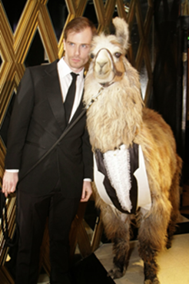
User Personas (1)
Garry Unknown Unemployed
 General Description
Garry is unemployed. After he got his undergraduate degree, he got hired by a bank, but he quickly like he was wasting his life. So he realized that he wanted more from his life. So he decided to travel around the world.
Ever since he visited Peru, he's been in love with llamas. He jumps on every occasion he gets to interact with llamas, whether they are real or not. Particularly, he enjoys reading and making memes, as well as playing games involving them. He also shares any picture of llama he can find on his Facebook wall and Twitter feed.

Slide 6

User Personas (2)
Jane Smith
Student
 General Description
Jane is an undergraduate student studying English at the University of Glasgow. She works a part-time job in a bar and so doesn’t have a large amount of free time between her studies and her job. This means she’s really only interested in small and short games.
She grew up playing games on her Windows PC’s like Solitaire and Minesweeper. During her free time between studies she likes to occasionally go back to playing these. However, her new laptop uses Windows 10 and doesn’t have minesweeper anymore. She is now looking for ways to play Minesweeper again but is open to playing slightly different styles of the game.

Slide 7
Notes:
This will be the first page that can be seen and will act as a home page.​ From there, the user will be able to:​
- create a new account, ​
- log in to an existing account, ​
- log in using a Facebook or Twitter account,​
- start playing without registering.

Slide 8
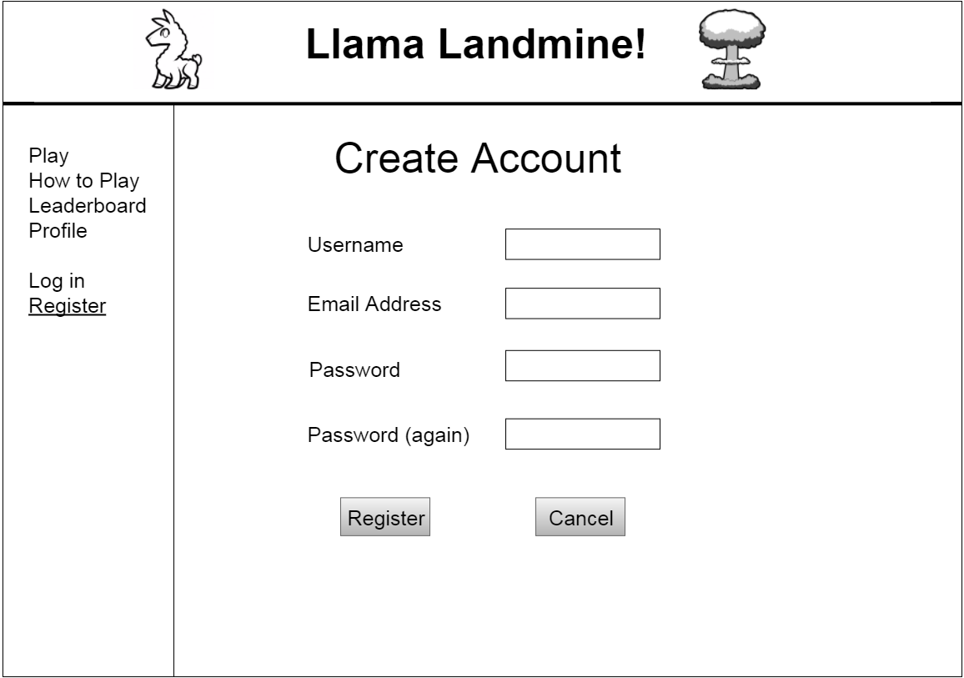
Notes:
If the user chooses not to link the game to his/her Facebook/Twitter account, this will be the page he/she will be sent to.
He/She will have to provide a username, an email address as well as a password in order to register.
The user will also have the option to cancel the registration, and use any of the links to other pages in the navigation bar (on the left side).

Slide 9
Notes:
Once the user has registered, he/she will automatically be redirected to this page. This will be the profile page for users where they can add information about themselves as well as adding a profile picture.
From this page they can view their high score, change their password or profile picture and invite their friends to come and play the game.

Slide 10
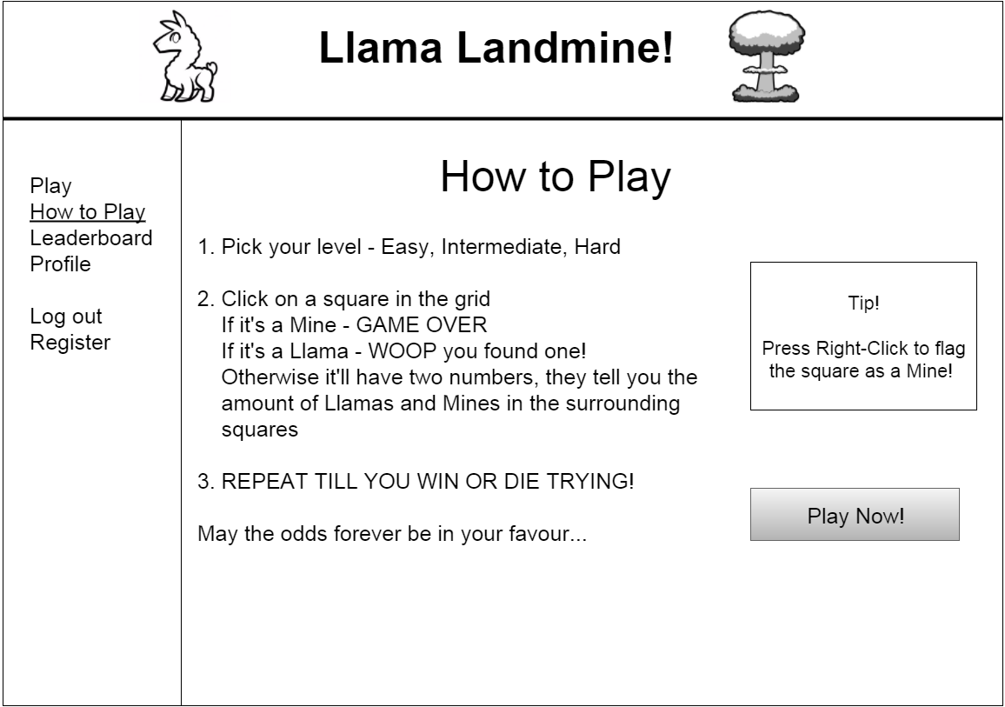
Notes:
Before the user starts playing, it is advised that he/she has a look on this page to get a quick idea about the basic rules of the game.
From there, he/she can click on a button to start playing.

Slide 11
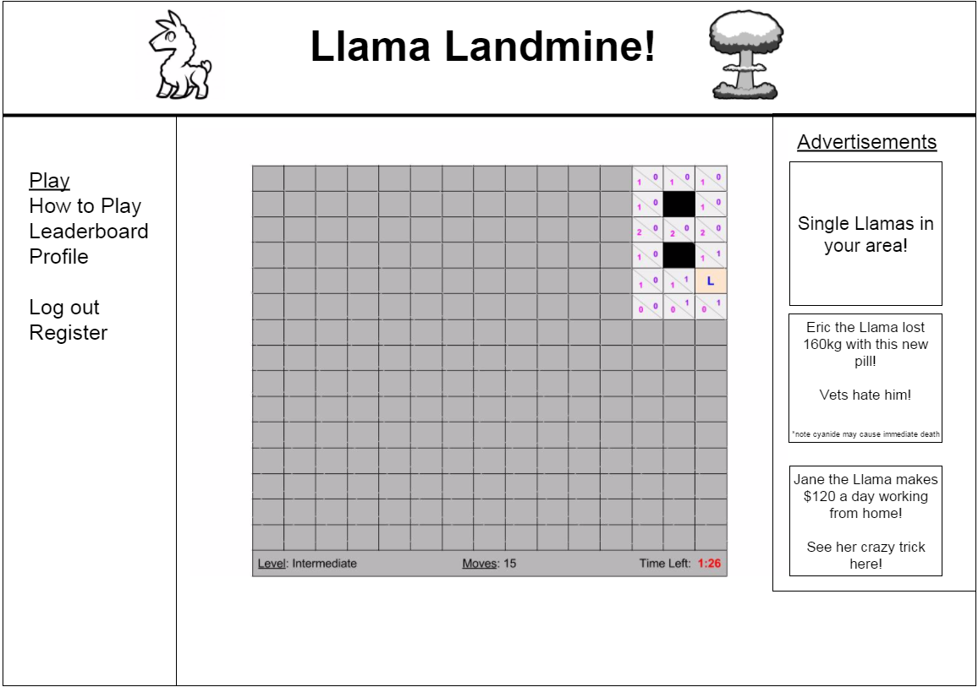
Notes:
This will be the main page from where the user will be able to play the game.
Before the game starts, the user will be prompted to select the difficulty level.

Slide 12
Notes:
Once the game will be over, the user will be redirected to this page (the image will be different, depending on whether they won or lost).
He/she will be able to view his/her score and ranking.
He/she will also have the option to start a new game, view the full leaderboard, or share his/her score with his/her friends.

Slide 13
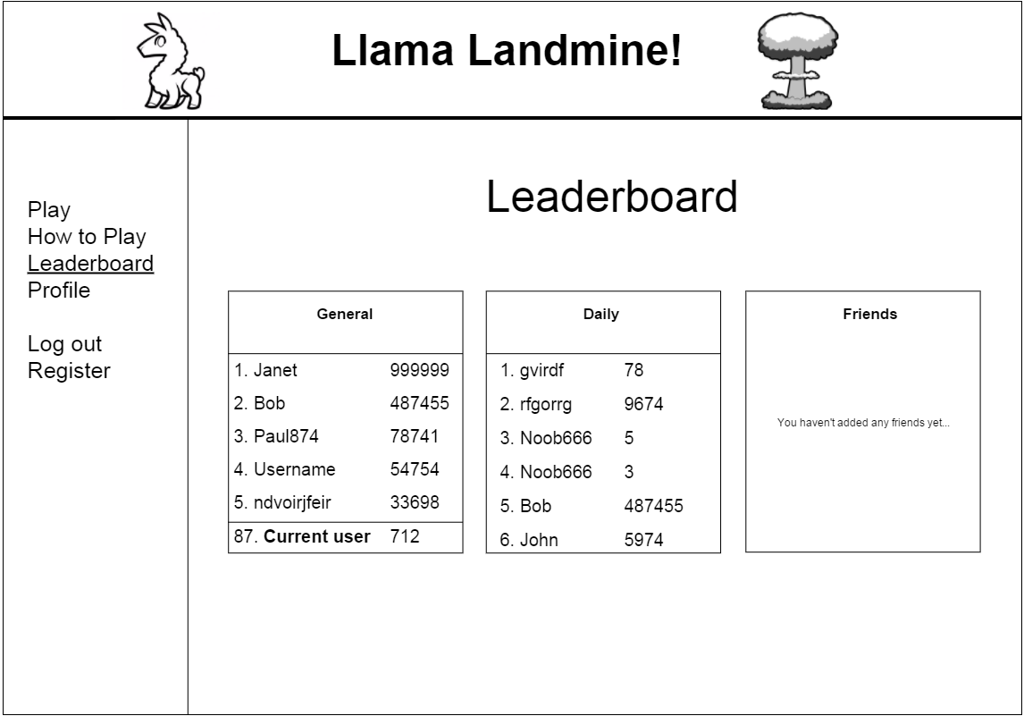
Notes:
This page will contain the list of all the scores and their corresponding ranks, as well as the most recent ones, and the ones obtained by the user's friends (if any).

Slide 14
Site Map
Notes:
The red arrow shows the path of users who choose not to register and that they are directed immediately to play the game.
The black arrows shows the paths where users can move backwards and forwards through the site.
The blue arrow shows the paths where there is only one direction that the users can take.

Slide 15
Thank you for listening.

