Slide 1
Can We Predict Heart Disease?
Exploring and Modeling Survey Responses in Effort to Predict Heart Disease

Slide 2
Introduction
Dataset formed using survey responses from the Behavioral Risk Factor Surveillance System operated by the Center for Disease Control
Dataset contains 253,690 rows and 22 columns
To use survey information to predict whether an individual will experience heart disease
Heart Disease is the leading cause of death in the United States
If we can accurately predict heart disease occurrence, the information and/or model can be used by medical professionals to intervene in higher risk individuals

Slide 3
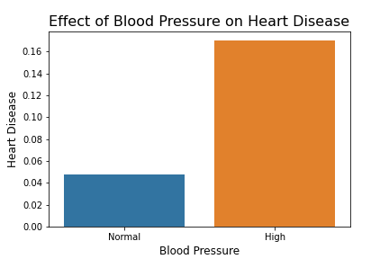
Effects of Blood Pressure on Heart Disease Risk
Shows us the prevalence of heart disease among individuals with normal blood pressure and high blood pressure
Individuals with high blood pressure are more than 3 times as likely to develop heart disease

Slide 4
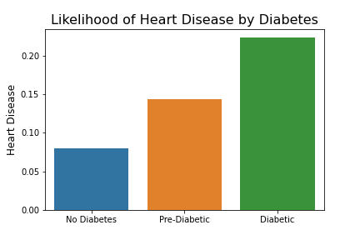
Effect of Diabetes on Heart Disease Risk
Shows us the prevalence of heart disease among different diabetic statuses
Pre-diabetic individuals are almost twice as likely to experience heart disease compared to non-diabetic individuals
Diabetics are nearly three times as likely to experience heart disease compared to individuals without diabetes

Slide 5
Production Model
Final Production Model is an XGBOOST classifier
Accurately predicts 81% of individuals that will suffer from heart disease
28% of the individuals our model predicts to suffer from heart disease do not
These are the high-risk individuals
No harm done in this error
Perhaps individuals make lifestyle changes to prevent heart disease, but these are generally accepted as beneficial habits
19% of the individuals our model predicts to not suffer from heart disease do
The most glaring weakness of the model
Individuals in this group will be given a false sense of security

Slide 6
Final Observations and Recommendations
Most of the strongest correlated factors for heart disease and attack are health related
High blood pressure, Diabetes, Stroke, etc.
All of these risks increase with age
Healthy lifestyles can minimize risk of heart disease
Proper diet and activity levels decrease risk of correlated risk factors
Preventative care as individuals age can keep individuals aware of their own risk factors

