Slide 1
Heart Disease Exploratory Data Analysis
Steps taken to clean and understand dataset prior to modeling to predict Heart Disease

Slide 2
Purpose
To use survey information to predict whether an individual will experience heart disease
Heart Disease is the leading cause of death in the United States
If we can accurately predict heart disease occurrence, the information and/or model can be used by medical professionals to intervene in higher risk individuals

Slide 3
Data Description
Dataset formed using survey responses from the Behavioral Risk Factor Surveillance System operated by the Center for Disease Control
Important to note that these responses are self-reported by individuals, not clinically measured
Using self-reported metrics can help to identify high risk individuals earlier, vastly decreasing their risk of cardiovascular events
Collected in 2015
Original dataset contained 253,690 rows and 22 columns
Each row contains the survey responses from an individual
For the sake of modeling, we utilized a random 100,000 sample from our dataset
Each column contains responses to specific survey questions
Including age, sex, income, health metrics such as blood pressure or cholesterol, smoking, diabetes, and individual reported general, physical, and mental health scores

Slide 4
Data Cleaning
No null values to impute
All data are properly formatted floats
6067 duplicated rows
Dropped using .drop_duplicates method
Utilized keep = ‘first’ to keep one instance of each duplicate
Possible issues to deal with prior to modeling:
Very imbalanced target vector
Must be aware while creating model
Several columns have large quantity of outliers above statistical maximum
Some data engineering may be required to achieve greater results while predicting

Slide 5
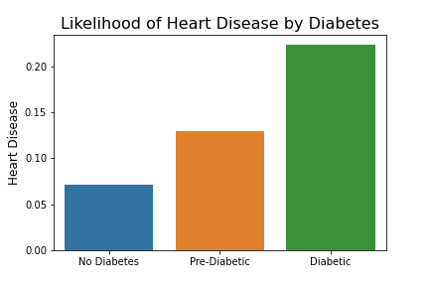
Effect of Diabetes on Heart Disease
Shows us the prevalence of heart disease among different diabetic statuses
Pre-diabetics are almost twice as likely to experience heart disease compared to individuals with non-diabetic individuals
Diabetics are nearly three times as likely to experience heart disease compared to individuals without diabetes
This is among the strongest correlations within the dataset
A very important feature for modeling

Slide 6
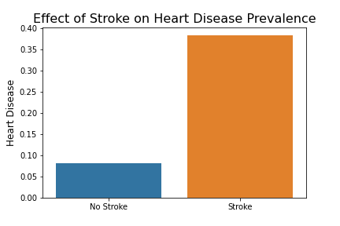
Effect of Stroke on Heart Disease
Individuals who have suffered a stroke are nearly four times more likely to experience Heart Disease
Will be another important feature for modeling

Slide 7
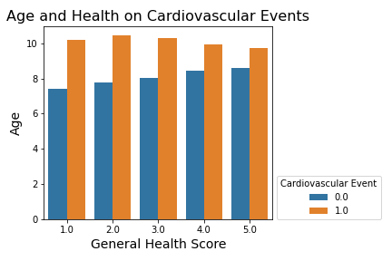
Effect of Age and General Health on Heart Disease
Across all health scores, individuals suffering cardiovascular events have a higher average age than those who have not
While both Age and General Health Score are correlated to our target, this visual shows that Age may be more important for predictive modeling

Slide 8
Conclusion
Age, Diabetes, and Stroke will be key features for predictive modeling
While the clean dataset provides no obstacles for EDA, the size of the dataset can be challenging for machine learning
This was offset by taking a smaller, random sample of the original dataset

