Slide 1
What Drives Food Sales?
Exploring Key Relationships and Predictors of Food Sales

Slide 2
Understand the Sample
Data
8523 entries
12 columns per entry
Including values for:
Item and Outlet Identifiers
Item Characteristics
Weight, Visibility, Fat Content, Type, and Minimum Retail Price
Outlet Characteristics
Establishment Year, Size, Location, Type
Sales
Goals
To interpret and understand trends in sales
To predict sales based on characteristics of item and outlets
Why?
By predicting which characteristics of items and/or outlets help drive sales, we can target these characteristics to maximize Item Sales

Slide 3
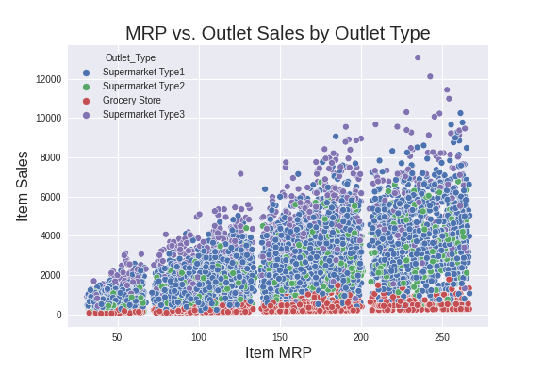
Relationship between Minimum Retail Price and Item Sales
2 clear observations
Relationship between MRP and Sales
Only notable correlation within the data
In general, as MRP increases, Sales will also increase
Influence of Outlet Type on Sales
Grocery Stores see decreased sales across all MRP
Supermarket Type 3 tends to see increased sales

Slide 4
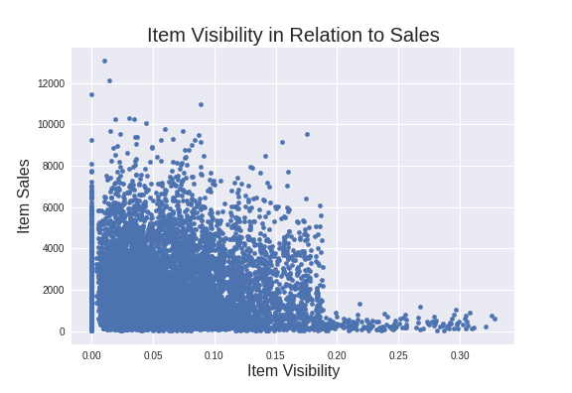
Unexpected Lack of Correlation
The expectation is that increased shelf space would increase the sales
We see a slight trend to the contrary
Why?
Are stores increasing shelf space of low sales items to increase the sales of that item?
Is the brand of an item more important than visibility of that item?

Slide 5
Summary and Conclusion
We were not able to develop a model to accurately predict sales. However, attempting to do so has led to several key insights:
Higher MRP tends to lead to higher Item Sales
Outlet Type can make or break Item Sales
Item Visibility has much less effect on Item Sales than you would expect
More research is required before further investment in Shelf Space
MRP is controllable
A small, reasonable increase in MRP will increase Item Sales
Be very mindful of what type of outlets are targeted to sell products
Avoid Grocery stores
Target Supermarket Type 3

