Slide 1
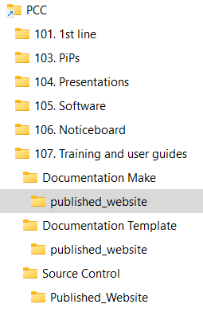
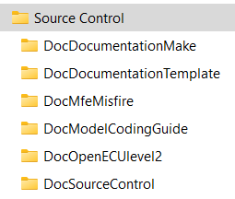
\\itc.global.mahle\nh-group\PCC\107. Training and user guides
\\itc.global.mahle\nh-group\AFT Development Project\Source Control

