Slide 1
SWIFTLOG LOGISTICS
BUSINESS INTELLIGENCE AND OPERATIONAL PERFORMANCE ANALYSIS
AUTHOR: GORDON MOENGA

Slide 2
Business Overview
SwiftLog Logistics' business performance was analysed using Power BI to provide insights into revenue, customers, inventory, deliveries and product returns.
The project focused on transforming operational data into interactive dashboards to evaluate key performance indicators, identify operational challenges and uncover opportunities for business growth.
Key Focus Areas
Revenue and Customer Performance
Inventory and Warehouse Operations
Delivery and Shipment Performance
Product Returns and Service Quality

Slide 3
PROJECT OBJECTIVES
The key objectives were to:
Evaluate revenue performance across products, customers and locations.
Analyse monthly revenue and order trends.
Assess delivery performance and identify delays.
Examine inventory levels and warehouse activity.
Investigate product return volumes and reasons.
Develop evidence-based recommendations to improve business performance.

Slide 4
DATA PREPARATION PROCESS
Data preparation was an essential step in developing a reliable Power BI solution.
The workflow involved:
Reviewing the available datasets and their structures.
Inspecting data types and identifying potential quality issues.
Preparing date fields and other columns for analysis.
Establishing relationships between relevant tables.
Creating measures and aggregations for business KPIs.
Building visuals to support interactive analysis.
Limitation: Some metrics require further validation because certain dashboard values are rounded, difficult to read or potentially inconsistent.

Slide 5
EXECUTIVE OVERVIEW
This project used Power BI to analyse SwiftLog Logistics' revenue, customers, inventory, shipments and product returns.
Key findings from the dashboard include:
Total Revenue: NGN 7.11 million
Total Orders: Approximately 5,000
Total Customers: Approximately 1,000
On-Time Deliveries: 63.72%
Delayed Deliveries: 36.28%
Inventory Value: NGN 83.80 million
Returned Items: 500
The analysis highlights delivery delays, product returns and inventory management as important areas for operational improvement.

Slide 6
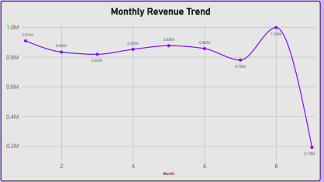
MONTHLY REVENUE TREND
SwiftLog Logistics recorded approximately NGN 7.11 million in total revenue.
The monthly revenue analysis shows variations throughout the reporting period.
Month 8 recorded the highest visible monthly revenue, at approximately NGN 1.00 million.
Month 6 recorded approximately NGN 0.78 million.
Month 9 recorded approximately NGN 0.19 million, which requires validation to determine whether the month is incomplete.

Slide 7
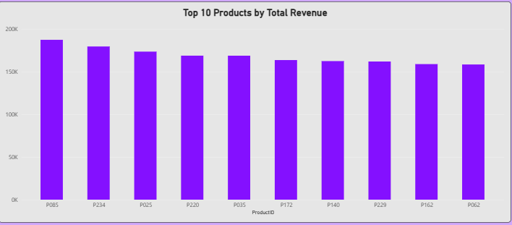
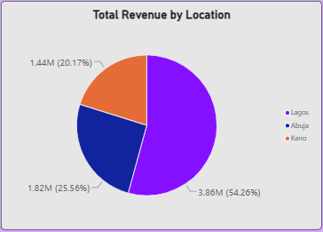
CUSTOMER&PRODUCT PERFORMANCE
The dashboard provides visibility into customer contributions and product revenue.
Key findings include:
Lagos generated approximately NGN 3.86 million, representing 54.26% of total revenue.
Abuja contributed approximately NGN 1.82 million, while Kano contributed approximately NGN 1.44 million.
Customer C0924 appears first in the Top 10 Customers by Total Revenue chart.
Product P085 appears first in the Top 10 Products by Total Revenue chart.
The dashboard records approximately 951 repeat customers.

Slide 8
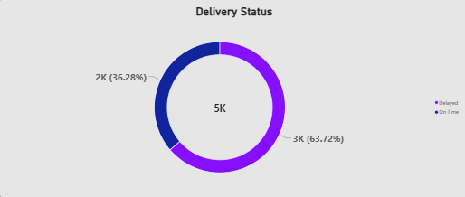
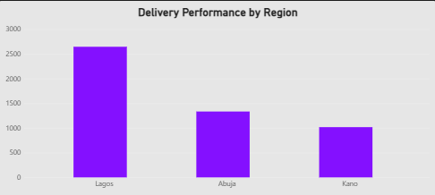
DELIVERY PERFORMANCE ANALYSIS
The reported figures show:
On-Time Deliveries: 3.19K, representing 63.72%.
Delayed Deliveries: 1.81K, representing 36.28%.
Average Delivery Delay: 3.57, as reported by the dashboard.
More than one-third of shipments were classified as delayed, indicating an opportunity to improve delivery reliability.

Slide 9
PRODUCT RETURN ANALYSIS
Return reason | Items | Share
Late delivery | 185 | 37.0%
Damaged items | 163 | 32.6%
Wrong items | 152 | 30.4%
Total | 500 | 100%
The dashboard records 500 returned items across three reported reasons.
Late delivery is the largest reported return category, followed by damaged items and incorrect items.

Slide 10
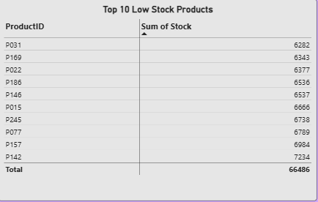
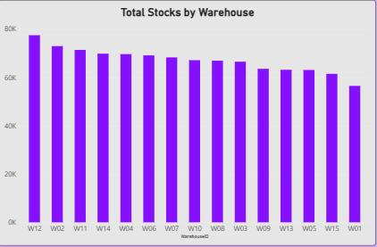
INVENTORY&WAREHOUSE ANALYSIS
The inventory dashboard reports a total inventory value of approximately NGN 83.80 million.
It also identifies products with comparatively low stock levels and shows order and stock distributions across warehouses.
The ten products listed in the Low Stock Products visual have a combined displayed stock value of 66,486.

Slide 11
KEY BUSINESS FINDINGS
1. Delivery reliability requires attention.
The reported delivery delay rate is 36.28%, creating an opportunity to improve service performance.
2. Returns have identifiable operational causes.
Late delivery, damage and wrong items account for all 500 returned items recorded in the dashboard.
3. Revenue is concentrated in Lagos.
Lagos contributes 54.26% of reported revenue, making it an important market to protect.
4. Inventory requires closer monitoring.
The reported inventory value is NGN 83.80 million, while the dashboard also highlights low-stock products.
5. Some performance questions remain unanswered.
Supplier performance, product-specific return rates and warehouse efficiency require additional measures or more detailed data.
6. Monthly reporting requires validation.
The unusually low Month 9 revenue should be checked before drawing conclusions about business performance.

Slide 12
BUSINESS RECOMMENDATIONS
Optimise deliveries: Analyse delays by route, region, carrier and warehouse.
Reduce late-delivery returns: Identify recurring delivery bottlenecks and improve dispatch planning.
Improve packaging: Introduce handling standards and monitor damage rates.
Prevent incorrect orders: Use barcode verification and picking checks.
Strengthen inventory control: Establish reorder points and safety stock for important products.
Review inventory value: Investigate slow-moving, excess and obsolete inventory.
Measure warehouse efficiency: Track cost per order, picking accuracy, processing time and dispatch performance.
Monitor suppliers: Evaluate on-time delivery, lead time, product quality and order fulfilment.
Improve customer retention: Monitor repeat purchasing and customer revenue trends.
Expand regional opportunities: Investigate ways to grow Abuja and Kano while maintaining Lagos performance.
Improve reporting quality: Validate Month 9 revenue and reconcile inconsistent KPI totals.
Establish KPI targets: Assign metric owners and review performance regularly.

Slide 13
CONCLUSION
The Power BI solution provides a consolidated view of SwiftLog Logistics' revenue, customers, inventory, deliveries and returns.
The analysis highlights delivery delays, return prevention, inventory control and performance measurement as key areas for improvement.
The next steps are to validate the reported figures, investigate operational causes, implement the recommended improvements and monitor results through clearly defined KPIs.
Final message: Reliable data, efficient operations and continuous performance monitoring can help SwiftLog Logistics improve service quality and make better business decisions.

