Slide 1
Spread of Infectious Diseases through Urban Transportation System
Xinwu Qian
AAE 668 Course Project Presentation
Dec 6, 2016

Slide 2
Content
Introduction
Research Problem
Stability
Algorithms for Reachability Analysis
Preliminary Results

Slide 3
Introduction
Epidemic modeling
Create a simple yet realistic model for representing the complex dynamics of disease spreading
Evolve, eliminate, outbreak, prevent, and control
In the literature
Compartment model (Kermack and Mckendrick, 1927)
Analysis of stability
Application on different diseases (e.g., SARS)
Trivial spatial extension

Slide 4
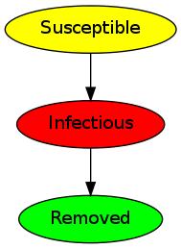
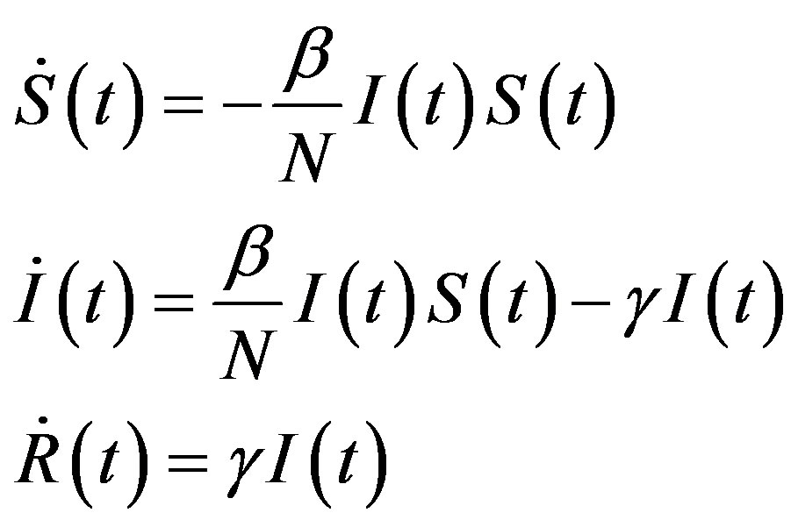
Introduction
A simple SIR model
S: susceptible
I: infected
R: recovered
Bilinear incident rate

Slide 5
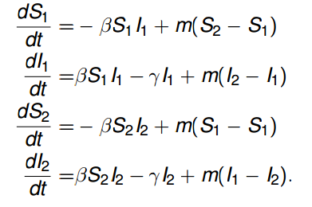
Introduction
Spatial extension
The basic model is too simple
Patch based model, and people move between patches
A simple example with two patches:

Slide 6
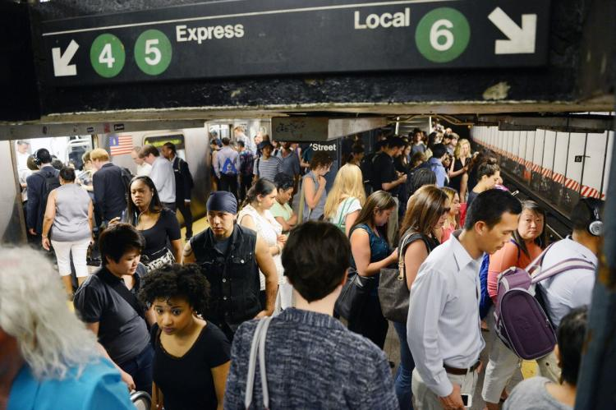
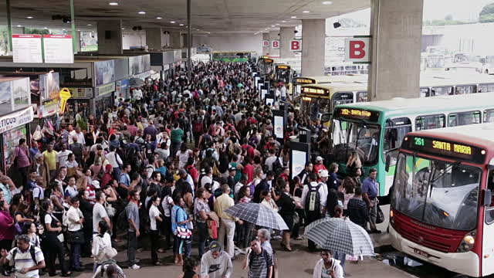
Introduction
Research Gap
Disease spreads through contact
The closer you are to an infected individual, the higher the chance you will get infected
Where contribute to the spreading of infectious diseases besides home and work places in urban areas?

Slide 7
Research Problem
Spatial epidemic model with travel contagion
Dived urban area into spatially connected zones
People move between zones
People get infected during travel
Three travel modes: high, medium, and low capacity
Place control on travel modes
Government may have k plans: different level of controls
Disease dynamics vary with the control: hybrid system
Effectiveness of the plan: reachability analysis

Slide 8
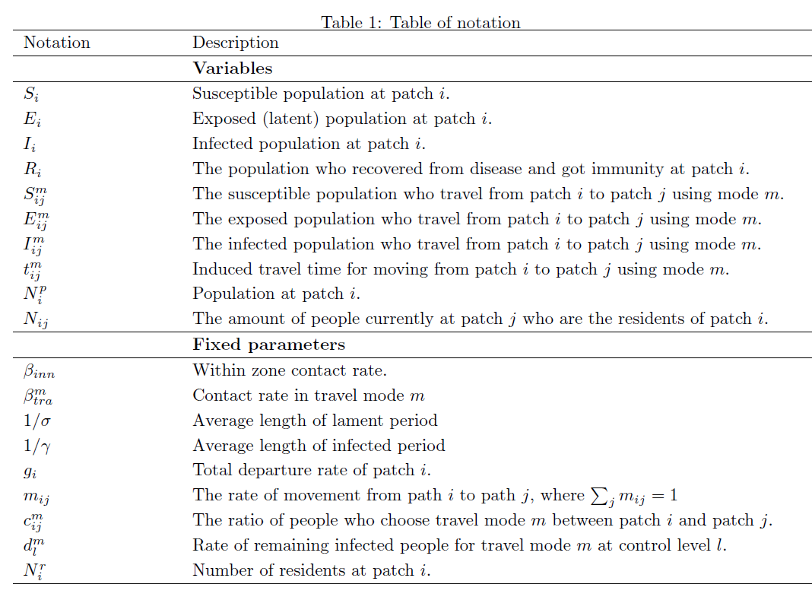
Research Problem
Notation

Slide 9
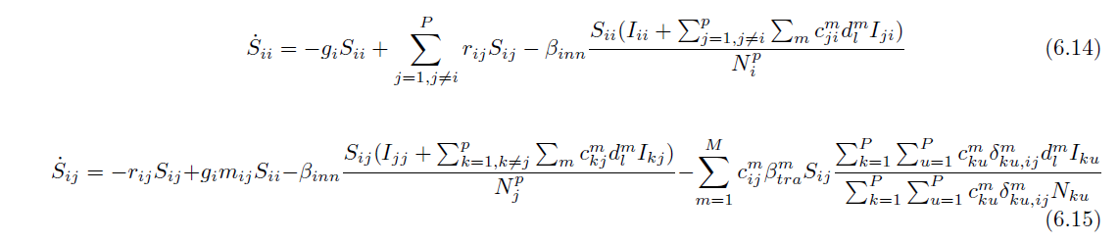
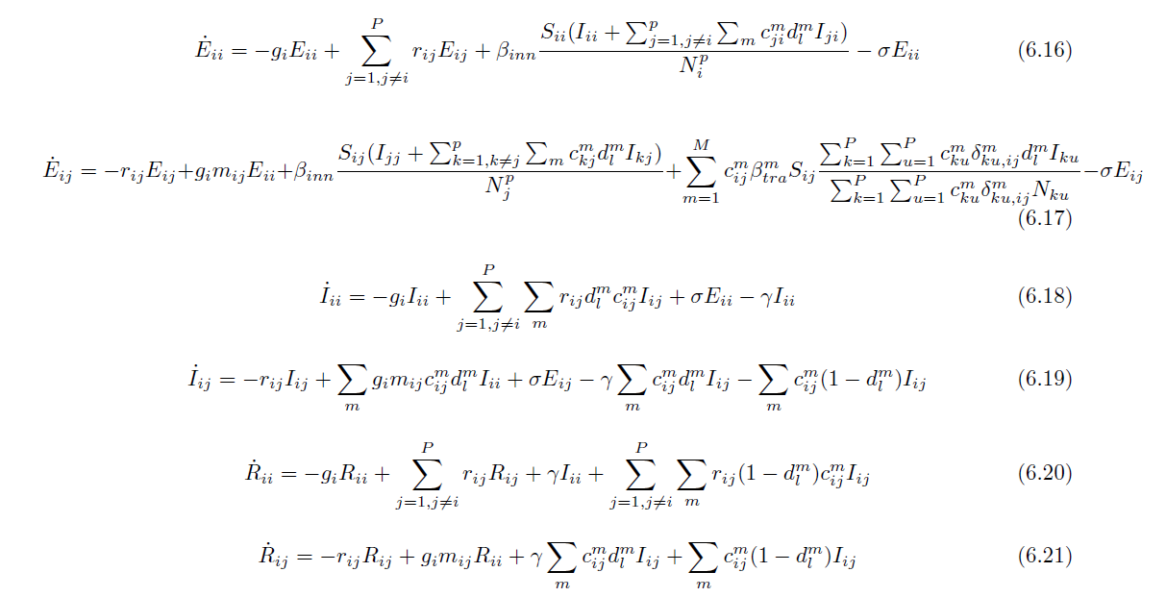
Research Problem
Disease dynamics
Travel
Contagion
S
E
I
Traffic
Control
R

Slide 10
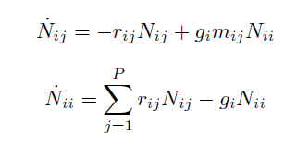
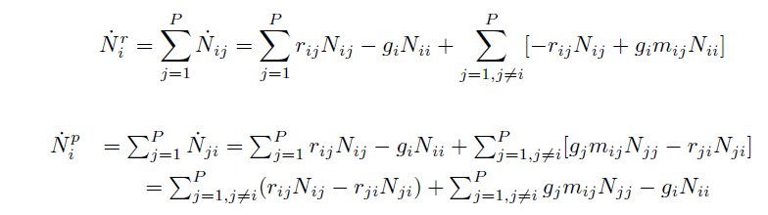

Research Problem
Population dynamics
Moving from i to j
Resident and Population
Fixed Total Population

Slide 11


Research Problem
Conceptual framework
Travel mode
Travel Contagion
Travel time
Destination Contagion
Traffic Control
Travel Equilibrium
$$c_{ij}^{m}=\frac{e^{−t_{ij}^{m}}}{\sum_{m}{e^{−t_{ij}^{m}}}}$$
Time
Level of control

Slide 12




The hybrid system
Three levels of control
No Control
$$∑I>0$$
$$∑I≤0$$
High
Control
Medium
Control
Low
Control
$$∑I≤I_{h}$$
$$∑I≤I_{m}$$

Slide 13


Stability
Population dynamics
Proposition 1: The dynamics of population movement has a unique equilibrium solution, and the solution is globally asymptotically stable (G.A.S). In particular, at equilibrium, we have:

Slide 14

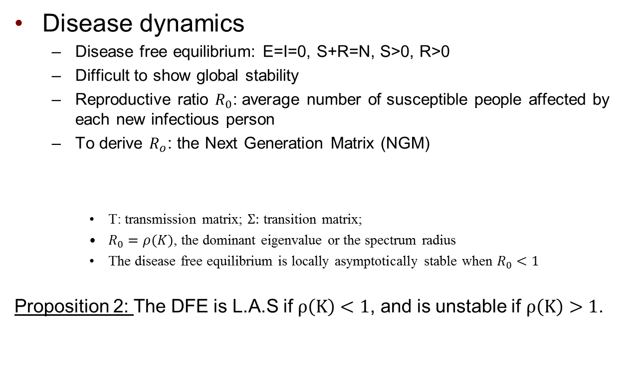
Stability
Disease dynamics
Disease free equilibrium: E=I=0, S+R=N, S>0, R>0
Difficult to show global stability
Reproductive ratio $R_{0}$: average number of susceptible people affected by each new infectious person
To derive $R_{o}$: the Next Generation Matrix (NGM)
T: transmission matrix; $Σ:$ transition matrix;
$R_{0}=ρ(K)$, the dominant eigenvalue or the spectrum radius
The disease free equilibrium is locally asymptotically stable when $R_{0}<1$
Proposition 2: The DFE is L.A.S if $ρ\left(K\right)<1$, and is unstable if $ρ\left(K\right)>1$.

Slide 15
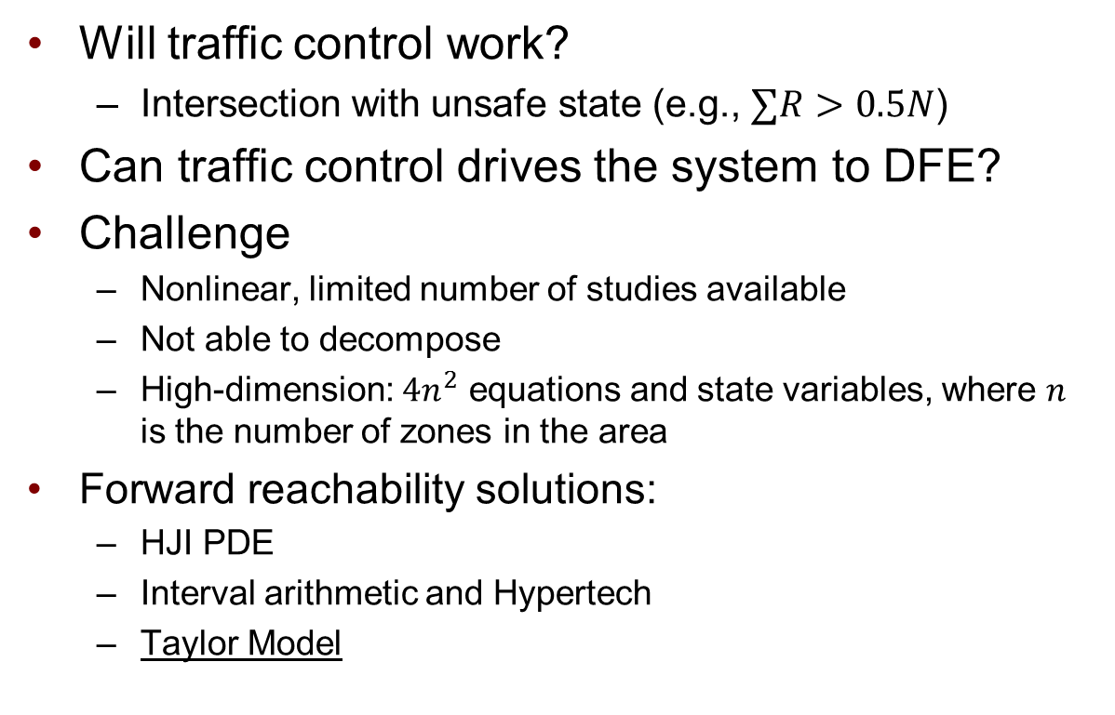
Reachability
Will traffic control work?
Intersection with unsafe state (e.g., $∑R>0.5N$)
Can traffic control drives the system to DFE?
Challenge
Nonlinear, limited number of studies available
Not able to decompose
High-dimension: ${4n}^{2}$ equations and state variables, where $n$ is the number of zones in the area
Forward reachability solutions:
HJI PDE
Interval arithmetic and Hypertech
Taylor Model

Slide 16
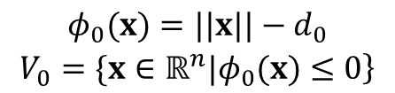
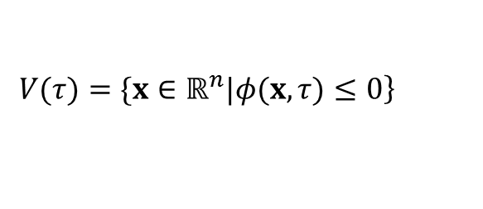
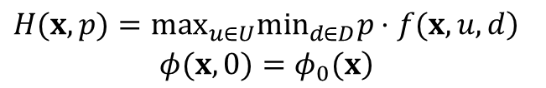
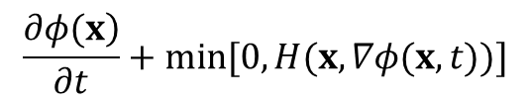
Reachability
1
HJI PDE approach
Describe the initial set as level set:
HJI PDE expression:
Reachable set specified as the zero sublevel set of the viscosity solution to HJI PDE:
$$\begin{matrix}φ_{0}(x)=||x||−d_{0} \\ \left.V_{0}=\{x∈ℝ^{n}|φ_{0}(x)≤0\right\}\end{matrix}$$
$$\frac{\left.∂φ(x\right)}{∂t}+min[0,H(x,∇φ(x,t))]$$
$$\begin{matrix}\left.H(x,p)=\max_{u∈U}\min_{d∈D}p⋅f(x,u,d\right) \\ \left.φ(x,0)=φ_{0}(x\right)\end{matrix}$$
$$\left.V(τ)=\{x∈ℝ^{n}|φ(x,τ)≤0\right\}$$
1. Claire J Tomlin, Ian Mitchell, Alexandre M Bayen, and Meeko Oishi. Computational techniques for the
verication of hybrid systems. Proceedings of the IEEE, 91(7):986-1001, 2003.

Slide 17
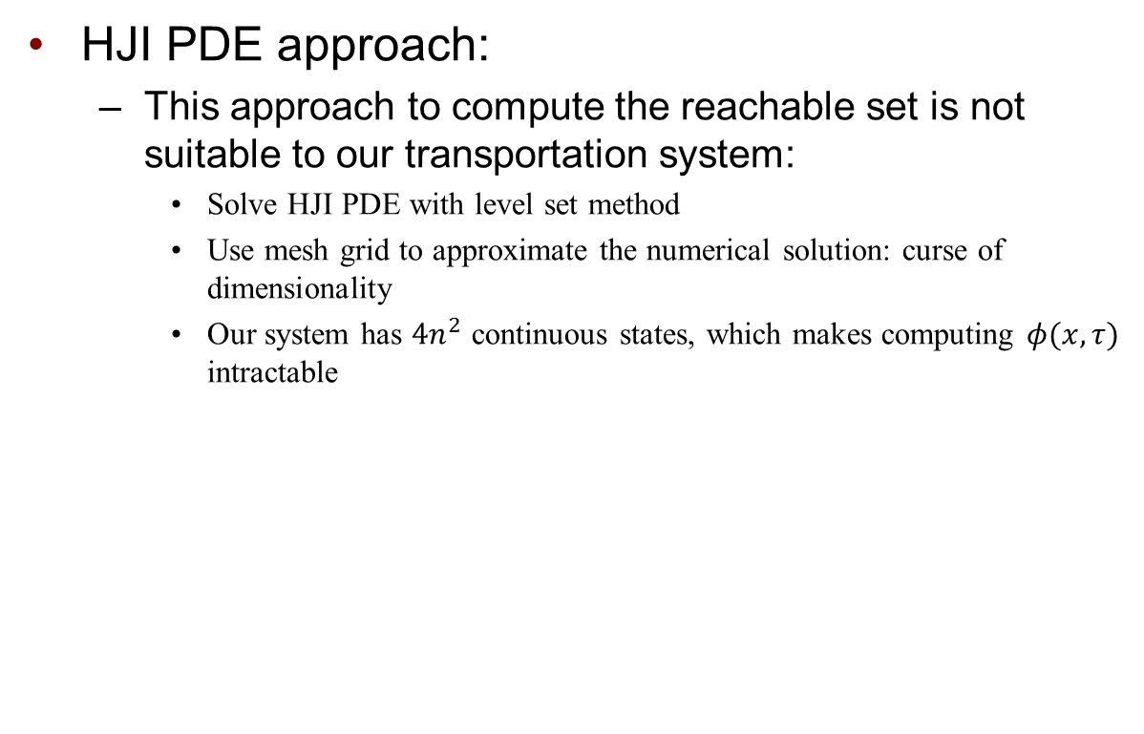
Reachability
HJI PDE approach:
This approach to compute the reachable set is not suitable to our transportation system:
Solve HJI PDE with level set method
Use mesh grid to approximate the numerical solution: curse of dimensionality
Our system has $4n^{2}$ continuous states, which makes computing $φ(x,τ)$ intractable

Slide 18
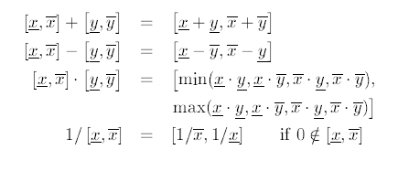
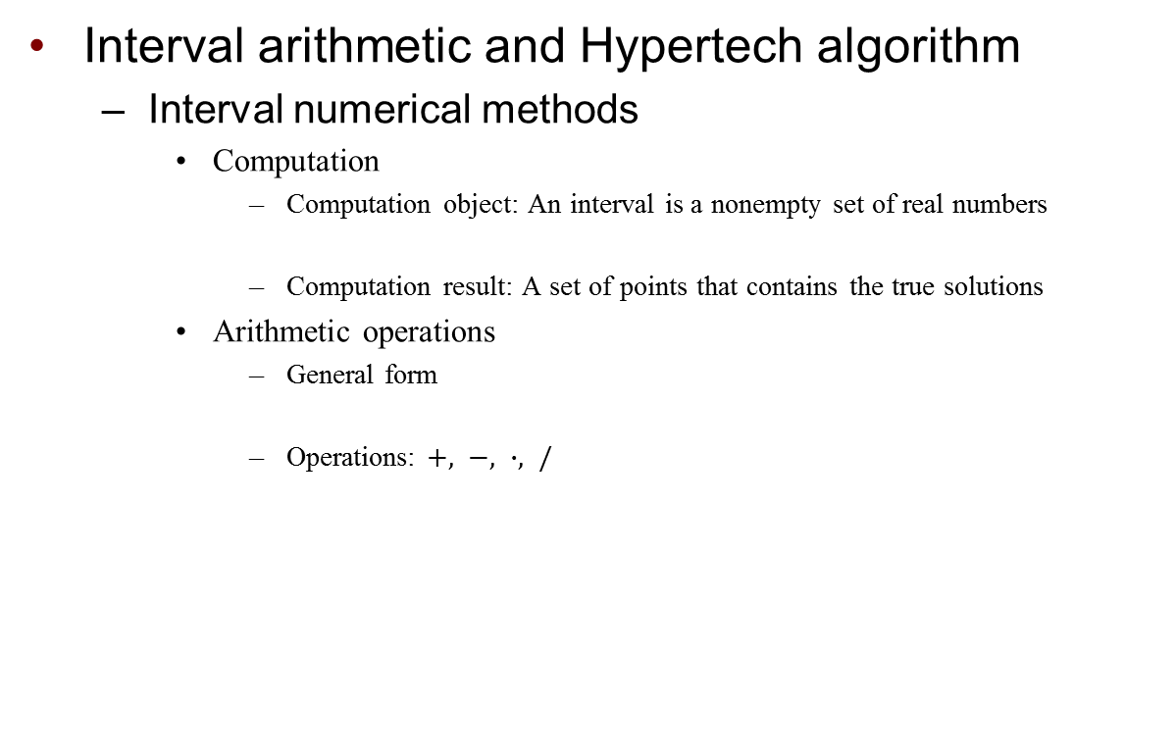

Reachability
Interval arithmetic and Hypertech algorithm
Interval numerical methods
Computation
Computation object: An interval is a nonempty set of real numbers
Computation result: A set of points that contains the true solutions
Arithmetic operations
General form
Operations: $+, −, ∙, /$
$$\left\{x∈ℝ∣\overset{̲}{x}≤x≤\overline{x}\right\}$$
$$\left[\overset{̲}{x},\overline{x}]∗[\overset{̲}{y},\overline{y}]=\{x∗y∣x∈[\overset{̲}{x},\overline{x}],y∈[\overset{̲}{y},\overline{y}]\right\}$$

Slide 19
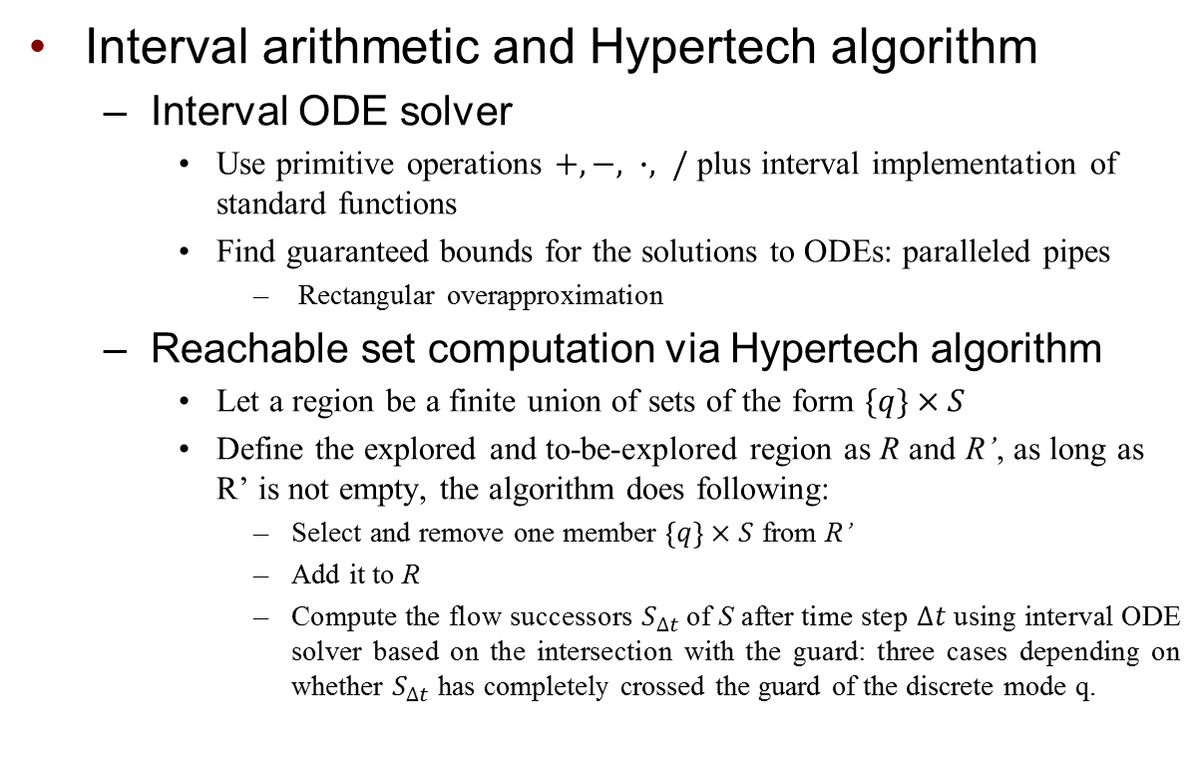
Reachability
2
Interval arithmetic and Hypertech algorithm
Interval ODE solver
Use primitive operations $+, −, ∙, /$ plus interval implementation of standard functions
Find guaranteed bounds for the solutions to ODEs: paralleled pipes
Rectangular overapproximation
Reachable set computation via Hypertech algorithm
Let a region be a finite union of sets of the form $\{q\}×S$
Define the explored and to-be-explored region as R and R’, as long as R’ is not empty, the algorithm does following:
Select and remove one member $\left\{q\right\}×S$ from R’
Add it to R
Compute the flow successors $S_{∆t}$ of S after time step $∆t$ using interval ODE solver based on the intersection with the guard: three cases depending on whether $S_{∆t}$ has completely crossed the guard of the discrete mode q.
2. Thomas A Henzinger, Benjamin Horowitz, Rupak Majumdar, and Howard Wong-Toi. Beyond hytech:
Hybrid systems analysis using interval numerical methods. In International Workshop on Hybrid Systems:Computation and Control, pages 130{144. Springer, 2000.

Slide 20
Reachability
Interval arithmetic and Hypertech algorithm
Potential restrictions of interval arithmetic
The rectangular overapproximation obtained by interval methods may be too conservative
Wrapping effect
Initial interval has to be small
Poor performance of rectangular overapproximation for nonlinear system

Slide 21
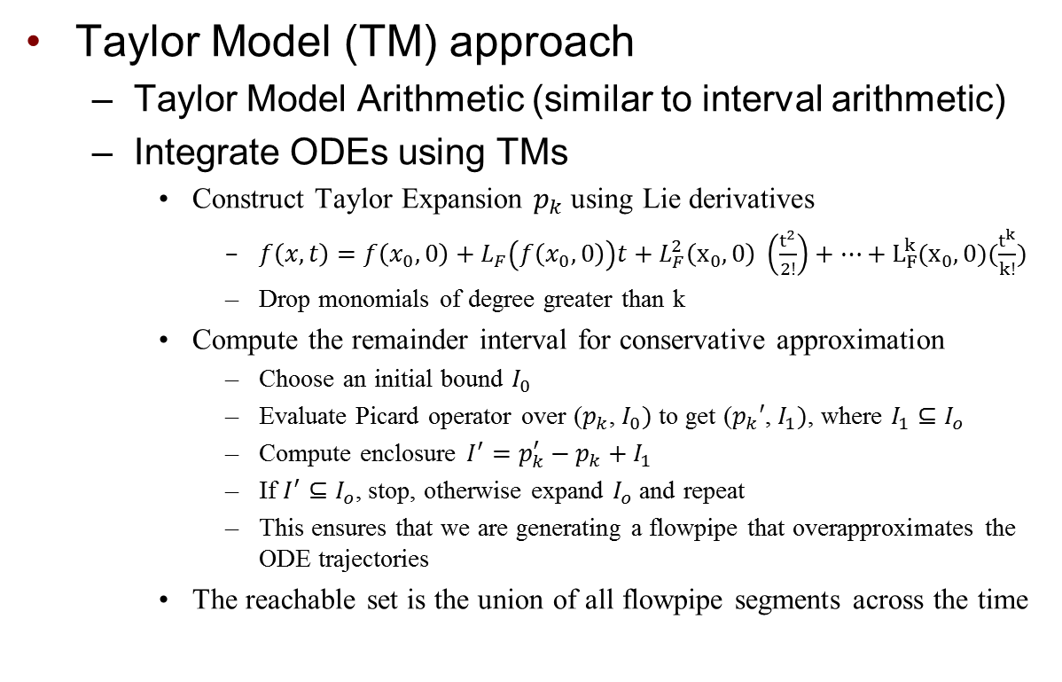
Reachability
3
Taylor Model (TM) approach
Taylor Model Arithmetic (similar to interval arithmetic)
Integrate ODEs using TMs
Construct Taylor Expansion $p_{k}$using Lie derivatives
$f\left(x,t\right)=f\left(x_{0},0\right)+L_{F}\left(f\left(x_{0},0\right)\right)t+L_{F}^{2}\left(x_{0},0\right) \left(\frac{t^{2}}{2!}\right)+…+L_{F}^{k}(x_{0},0)(\frac{t^{k}}{k!})$
Drop monomials of degree greater than k
Compute the remainder interval for conservative approximation
Choose an initial bound $I_{0}$
Evaluate Picard operator over ($p_{k}$, $I_{0})$ to get ($p_{k}′$, $I_{1})$, where $I_{1}⊆I_{o}$
Compute enclosure ${I^{′}=p}_{k}^{′}−p_{k}+I_{1}$
If $I^{′}⊆I_{o}$, stop, otherwise expand $I_{o}$ and repeat
This ensures that we are generating a flowpipe that overapproximates the ODE trajectories
The reachable set is the union of all flowpipe segments across the time
3. Chen, Xin, Erika Abraham, and Sriram Sankaranarayanan. "Taylor model flowpipe construction for non-linear hybrid systems." Real-Time Systems Symposium (RTSS), 2012 IEEE 33rd. IEEE, 2012.

Slide 22
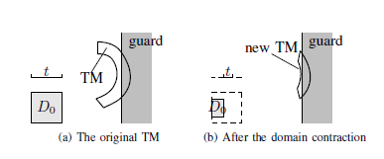
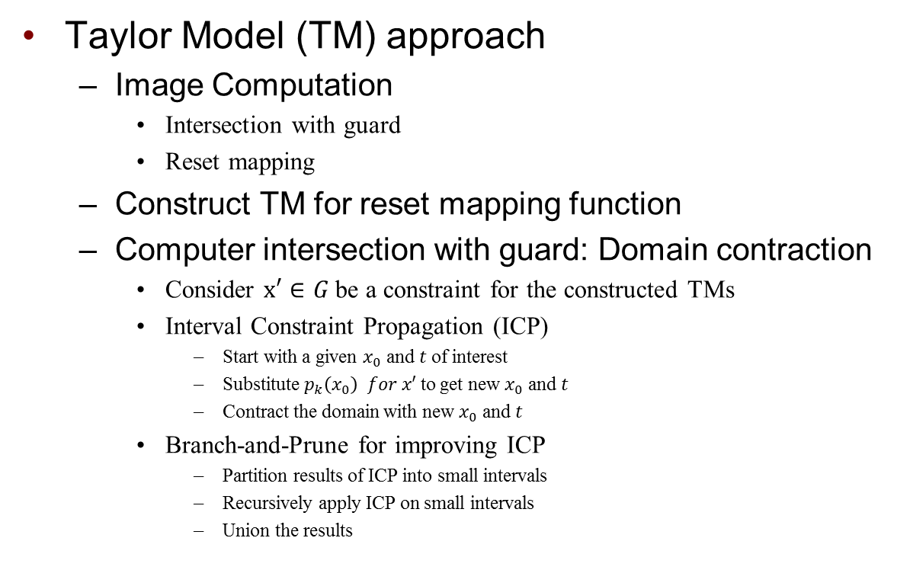
Reachability
Taylor Model (TM) approach
Image Computation
Intersection with guard
Reset mapping
Construct TM for reset mapping function
Computer intersection with guard: Domain contraction
Consider $x′∈G$be a constraint for the constructed TMs
Interval Constraint Propagation (ICP)
Start with a given $x_{0}$ and $t$of interest
Substitute $p_{k}\left(x_{0}\right) for x′$to get new $x_{0}$ and $t$
Contract the domain with new $x_{0}$ and $t$
Branch-and-Prune for improving ICP
Partition results of ICP into small intervals
Recursively apply ICP on small intervals
Union the results
Illustration of domain contraction method

Slide 23
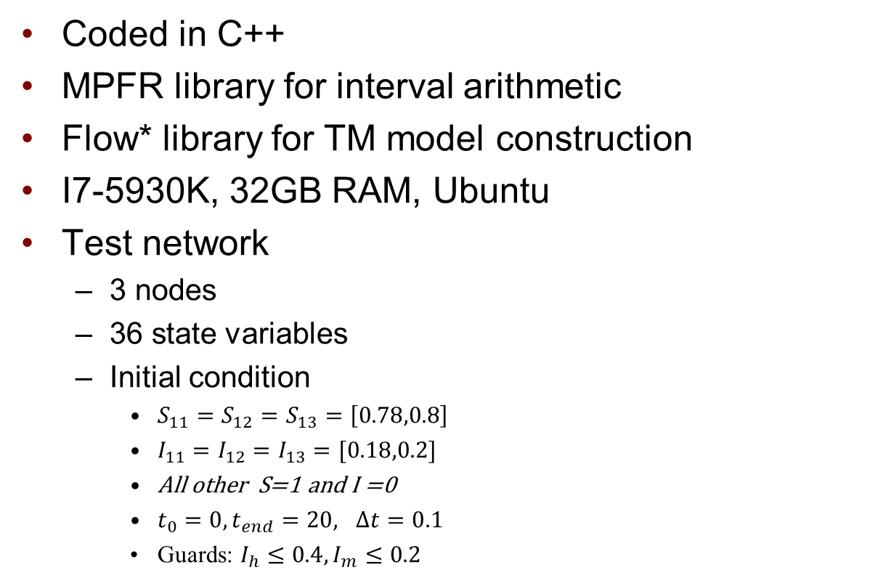
Preliminary Results
Coded in C++
MPFR library for interval arithmetic
Flow* library for TM model construction
I7-5930K, 32GB RAM, Ubuntu
Test network
3 nodes
36 state variables
Initial condition
$S_{11}=S_{12}=S_{13}=\left[0.78,0.8\right]$
$I_{11}=I_{12}=I_{13}=[0.18,0.2]$
All other S=1 and I =0
$t_{0}=0, t_{end}=20, Δt=0.1$
Guards: $I_{h}≤0.4, I_{m}≤0.2$
2
1
3
Test network

Slide 24
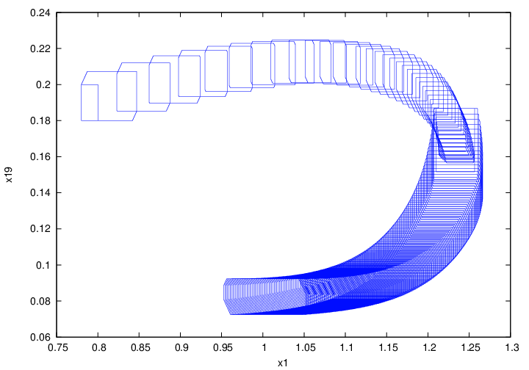
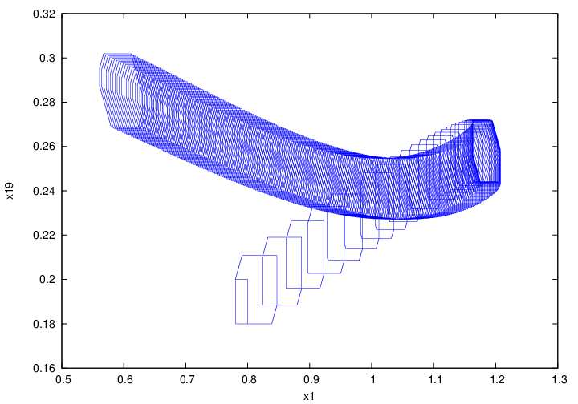
Preliminary Results
Initial Set
Jump
Initial Set
Hybrid system
No control
S_11 versus I_11

Slide 25
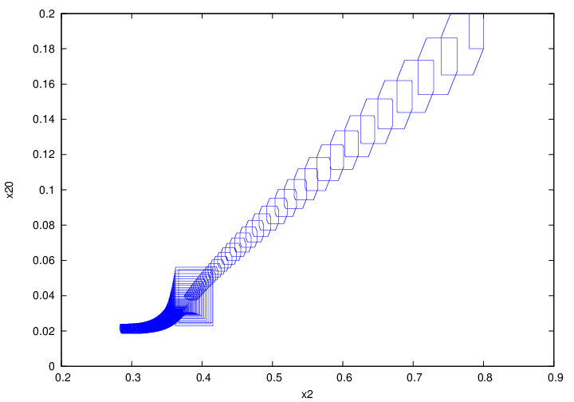
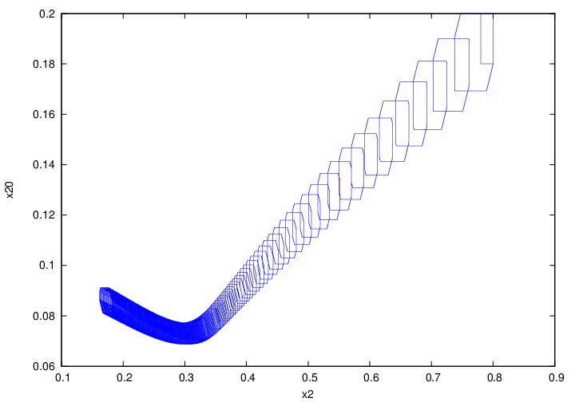
Preliminary Results
Initial Set
Initial Set
Hybrid system
No control
S_12 versus I_12

Slide 26
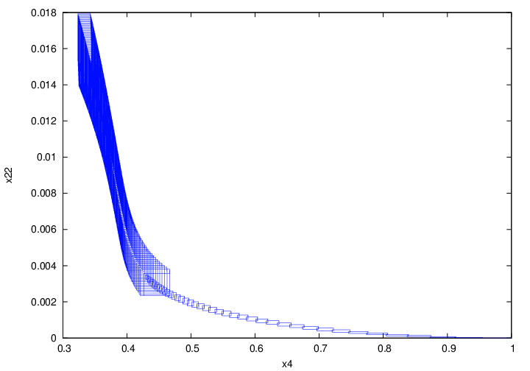
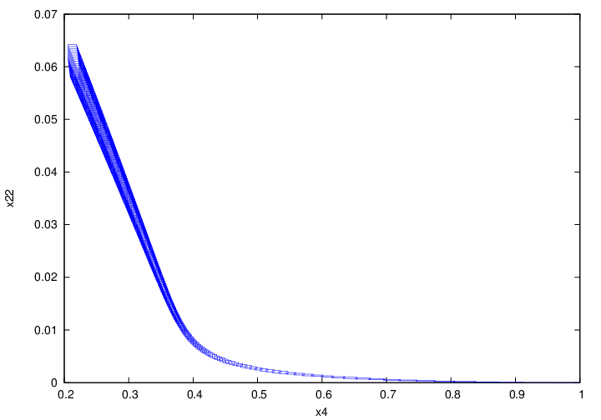
Preliminary Results
Hybrid system
No control
Initial Set
Initial Set
S_21 versus I_21

Slide 27
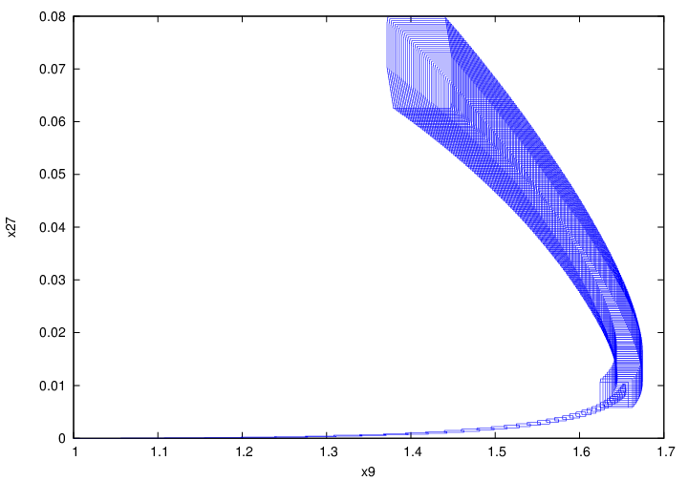
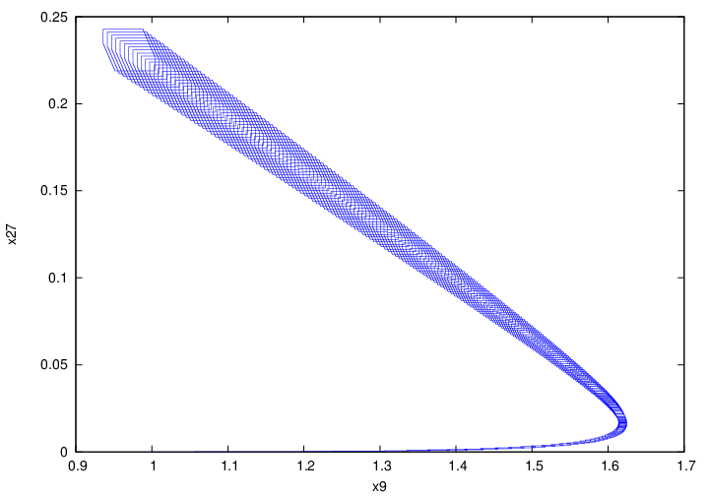
Preliminary Results
Hybrid system
No control
Initial Set
Initial Set
S_33 versus I_33

Slide 28
Questions & Comments

