Slide 1
Principle Component Analysis (PCA)
Gordon Dri
December 7, 2016

Slide 2
WHAT is PCA?
Quick Example:
You open a new wine store and have 50 different types of wine. Each wine can be defined by a set of characteristics such as…

Slide 3
WHAT is PCA?
…such as Sweetness, Acidity, Tannin, Fruit and Body. Your job is to allocate each type onto the shelves so that similar-tasting wines are on the same shelf.
HOW CAN YOU DO THIS?

Slide 4
WHAT is PCA?
Option #1: Choose one of the qualities that appears to be a good proxy for the taste (i.e sweetness) and group wines based on this one characteristic.
Option #2: Construct a new quality that ‘summarizes’ the taste in the 50 different types of wine and group the wines based on this new characteristic.

Slide 5
WHAT is PCA?
PCA executes the second option. It ‘summarizes’ a large set of predictors or input variables into fewer variables that appear as combinations of the original predictors.
For example, let us call the new wine characteristic: Gordon’s Taste
Gordon’s Taste = 2 * Sweetness + 0.5 * Acidity + 1 * Tannin + 3 * Fruit + 0.75 * Body

Slide 6
WHAT is PCA?
Gordon’s Taste will only be a successful characteristic at ‘summarizing’ taste if it accomplishes two goals (which are the two main goals of PCA):
1. The new characteristic should differ across wines (otherwise, my characteristic would be the same for multiple wines even if their taste is different)
- Known as maximizing variance
2. The new characteristic should be able to predict or ‘reconstruct’ the original wine’s characteristic (i.e it should relate to the original characteristics)
- Known as minimizing distance

Slide 7
WHY use PCA?
OVERALL:
PCA can reveal the ‘inner structure’ of the data in a way that explains the most variance
PCA can reduce dimensionality by converting a set of observations that may be correlated into linearly uncorrelated variables

Slide 8
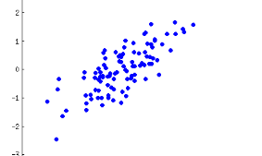
HOW does PCA work ?
- PCA sees this ‘cloud’ of blue dots corresponding to x and y values of two correlated variables (i.e Sweetness and Tannin). It recognizes these variables may be redundant and uses this as an opportunity to reduce the dimension from two to one.

Slide 9
HOW does PCA work ?
If you were PCA and you were asked to find a new variable that reduces the dimensionality in the previous picture from two to one, which direction would you place the ‘black line’ in the following 3 pictures?
REMEMBER the goals for this direction, it should…
Maximize variance (red dots should be spread evenly along this black line!)
Minimize distance (the lines between the blue dots and red dots should be as small as possible!)

Slide 10
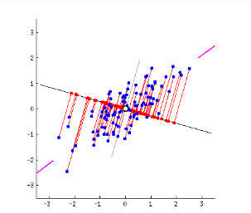
HOW does PCA work ?
OPTION A:

Slide 11
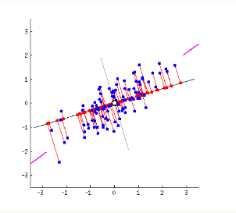
HOW does PCA work ?
OPTION B:

Slide 12
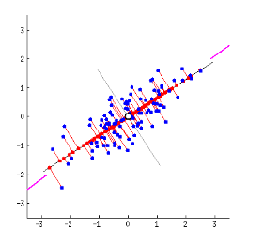
HOW does PCA work ?
OPTION C:

Slide 13
HOW does PCA work ?
PCA’s algorithm finds the ‘optimal’ direction for this black line and simultaneously accomplishes both goals (maximizing variance and minimizing distance). The black line becomes Principle Component 1 and the direction is the Principle Component Direction
The Principle Component is a linear combination of the two variables x and y (Recall: Gordon’s Taste)
The algorithm will iterate to find Principle Components 2 through n BUT each subsequent component must be orthogonal (i.e perpendicular) to the prior component
We hope to have MUCH less Principle Components than # of predictors

Slide 14
HOW does PCA work ?
How many Principle Components are ‘enough’? (i.e how many new characteristics will be required to allocate the wines such that if we used all the characteristics we could effectively differentiate wines OR how many dimensions do we need to explain variation in the data)
This is up to the user based on how much variation in the predictors they wish to explain (for some it is 80%, others it may be 90%)
The same discussion about how much R^2 to achieve in a linear model

Slide 15
HOW does PCA work ?
Okay...but How does PCA actually do this?

Slide 16
HOW does PCA work?
PCA is very clever and proposed the following course of actions:
Convert the input variables into a symmetric matrix
Decompose this matrix to uncover its ‘constituent parts’
Analyze these constituent parts to see if one of them contains a set of vectors (columns) that have been linearly transformed such that they 0 correlation between each other
These vectors will become the coefficients in the linear combination (otherwise known as factor loadings)

Slide 17
HOW can we do PCA?
To execute the course of action, PCA will:
Find the covariance matrix of the centered input data to ensure the matrix is symmetric (makes it possible to do the decomposition below)
Use eigen-decomposition (A = U /\ Ut) to uncover the eigenvectors of the matrix which happen to be orthogonal columns that are in the direction of maximum variance (same thing as finding the optimal direction as before!!!)
- Each eigenvector will correspond to the weights of principle component n, where the first eigenvector will have the largest eigenvalue corresponding to the most explained variance

Slide 18
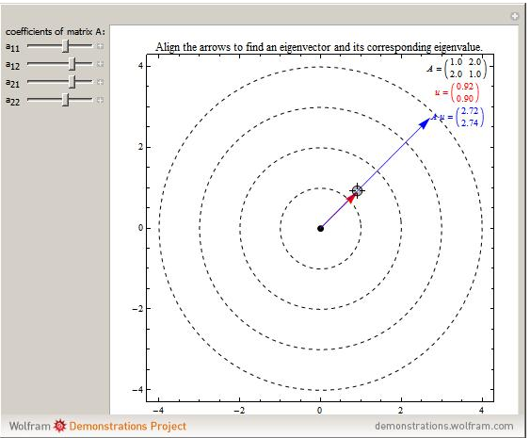
Why is finding eigenvectors the same thing as finding the optimal direction?

Slide 19
HOW can we do PCA?
Since we have a new coordinate system (i.e one-dimensional vs. two-dimensional), we need to transform our old, two-dimensional data, into one-dimensional coordinates to plot on the PC1 axis (i.e the optimal ‘black line’)
This is effectively a linear combination of the original data points, weighted by our factor loadings
These are known as principle component scores

Slide 20
HOW can we do PCA?
If we decide to have two dimensions, or two Principle Components, we will then have two vectors of factor loadings (weights for each predictor variable) and two vectors of principle component scores (translated data points on the new coordinate axis).
How can we predict the original input variables?
- Find a linear combination of principle component scores weighted by the coefficients of the factor loadings

Slide 21
REFERENCES
Yuri Balasanov’s Lecture Notes for Statistical Analysis (MSCA 31007) at the University of Chicago in the Master of Science in Analytics program (2014)
www.stats.stackexchange.com
S. Narasimhan’s Lecture Notes for Computer Vision (15-385,-685) at Carnegie Mellon University (2010)
Dataset #1 (City of Chicago Data Portal): https://data.cityofchicago.org/Health-Human-Services/Census-Data-Selected-socioeconomic-indicators-in-C/kn9c-c2s2
Dataset #2 (City of Chicago Data Portal): https://data.cityofchicago.org/Health-Human-Services/Public-Health-Statistics-Selected-public-health-in/iqnk-2tcu

