Slide 1

OpenTwin.
BASELHACK 2026
Test with your customer on the day you build the prototype.
Team OpenTwin · Alexander Boll · Dion Arifi · Johan Koller Stefanes · Xi Wang · Gordon Julian Koehn · Jiaqi Yu
Notes:
TIME 0:00–0:05 · SPEAKER [A] Purpose: the cover is on screen while the first speaker walks up. Do not spend time on it. The first sentence already belongs to the problem. SAY (one breath, then click): "Hi, we are OpenTwin. Let me start with a question every product team knows." DO: - Click to slide 2 on "a question". The problem minute starts there. - Stopwatch starts now. Target: 1:00 when the demo slide appears. TIMING PLAN FOR THE WHOLE PITCH (target 3:00): 0:00–0:45 Cover and problem, slides 1–3 0:45–1:10 Solution clip, slide 4 (plays by itself, 24 seconds) 1:10–2:10 Live demo, slide 5 2:10–3:00 Close: the jury asks the twin, QR code to GitHub, thank you, slide 6 ROLES (fill in): - Speaker A: problem and solution (slides 1–4) - Speaker B: drives the demo (laptop with OpenTwin and the Lumen prototype) - Speaker C: close BEFORE YOU GO ON STAGE: - OpenTwin app open, twin "Dr. Miriam Kessler" loaded, Lumen Renewal Kit open on screen S1 (email) - Second laptop with the recorded backup run, paused at 0:00 - Audio from the twin routed to the room speakers, tested once

Slide 2
A tested feature still takes weeks.
THE PROBLEM · 01
Design Thinking, Sprints and Scrum give the method. GenAI adds speed.
Classic path
Problem
Solution
Test with end customers
weeks to months
Design Sprint
Day 1
Day 2
Day 3
Day 4
Day 5
4 to 5 days
Sprint with GenAI
Day 1
Problem framed, ideas sketched, prototype built. In one day.
1 day
With an interdisciplinary team and AI agents doing the groundwork.
BASELHACK · OPENTWIN
Notes:
TIME 0:05–0:25 · SPEAKER A · about 20 seconds Goal: the jury understands in one sentence that validating a feature takes weeks, and that GenAI already fixed the sprint part. CLICKS: three builds, one per row. Click on the bold words. SAY: "In product and innovation work, getting from a problem to a feature that is really tested with end customers takes weeks. Often months. [CLICK 1: classic path] We already have good methods for the way there: Design Thinking, Design Sprints, Scrum. The fastest of them, the Design Sprint, takes four to five days. [CLICK 2: Design Sprint] With GenAI we compress that into ONE day: an interdisciplinary team frames the problem, sketches ideas and builds the prototype, with AI agents doing the groundwork. [CLICK 3 and 4: one day]" TRANSITION LINE (go straight to slide 3): "So the sprint got fast. But here is what happens after that one day." DELIVERY NOTES: - Point at the long "Test with end customers" bar when you say "weeks, often months". - Do not explain the methods. The jury knows them. Name them and move on. - Keep the smaragd "Day 1" block on screen for one beat before you click on. IF ASKED LATER: "Where does the one day come from?" Answer: sprintbox.ai runs AI-assisted sprints where agents prepare interviews, syntheses and prototypes, so a team gets from challenge to clickable prototype in one working day. [Confirm the exact claim the team wants to make.]

Slide 3
Most prototypes never meet a user.
THE PROBLEM · 02
The sprint takes a day. The test takes weeks, or never happens.
1-day sprint
Recruit testers
Schedule interviews
Go live untested
Long test phase
prototype ready
Feedback arrives late.
Rework gets expensive.
Nobody keeps track.
Users hit the problem months after the sprint.
Changes start when the feature is already built.
Which features were really tested? Hard to say.
Notes:
TIME 0:25–0:45 · SPEAKER A · about 20 seconds Goal: name the real bottleneck. Not the sprint, the test with real users. CLICKS: the timeline builds left to right (5 clicks), then the three consequence cards (3 clicks). If you are short on time, click through the timeline quickly and talk over it; the cards carry the message. SAY: "After the sprint, the prototype has to meet real users. [CLICK: recruit] Recruit testers. [CLICK: schedule] Schedule interviews. And in reality, most sprint teams never get there. [CLICK: go live] The prototype goes live untested, [CLICK: long test phase] into a long test phase. [CLICK: card 1] Feedback arrives months later. [CLICK: card 2] Rework starts when it is most expensive. [CLICK: card 3] And nobody really knows which features were tested and which were not." TRANSITION LINE: "Today, teams try to close this gap with GenAI agents that explore the problem space with experts. That helps the sprint, but it still does not put the customer in the room. That is what we built." DELIVERY NOTES: - Slow down on "most sprint teams never get there". That is the problem statement. Let it land. - Do not claim a percentage. If the jury asks "how many?", answer from experience: "In the sprints we run, most prototypes end in a demo, not in a test with five real users." [Team: only say this if it is true for you.] - The three consequence cards use the same amber as the challenge on slide 5: amber marks the problem throughout the deck.

Slide 4
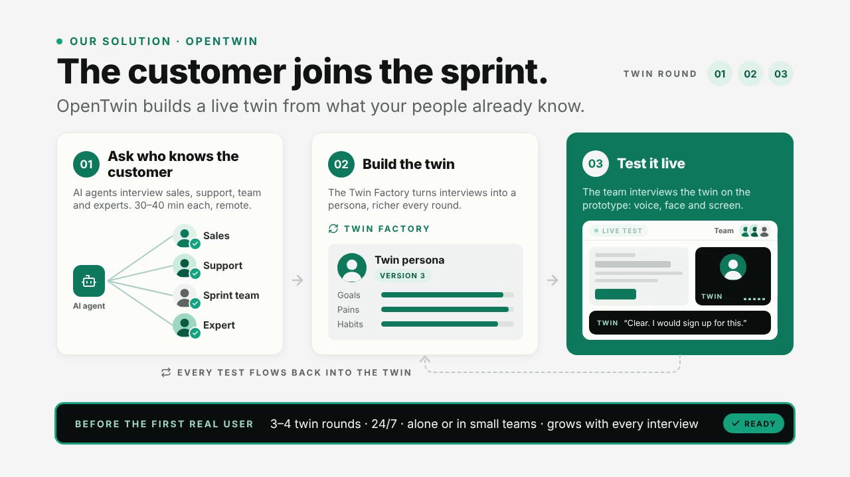
Notes:
TIME 0:45–1:10 · SPEAKER A · the clip runs 24 seconds and starts by itself with the slide The whole slide is the OpenTwin flow animation. It plays automatically and loops. Talk over it; do not click until it reaches the black bar at the bottom ("READY" tick, about second 22). WHAT THE CLIP SHOWS, IN ORDER: 1. Ask who knows the customer: an AI agent interviews sales, support, the sprint team and experts (30–40 min each, remote). 2. Build the twin: the Twin Factory turns the interviews into a persona, version 1, 2, 3, richer every round. 3. Test it live: the team tests the prototype with the twin (voice, face, screen). The twin's comments improve each round ("Where's the price? I'd leave here." → "Better. But what does delivery cost?" → "Clear. I would sign up for this."). 4. Every test flows back into the twin. Bottom bar: 3–4 twin rounds, 24/7, alone or in small teams, grows with every interview. SAY (paced to the clip): "OpenTwin brings the customer into the sprint. First, AI agents interview the people in your organisation who know the customer: sales, support, the sprint team and the experts. Our Twin Factory turns that into a persona, and it gets richer with every round. Then the team tests the prototype live with the twin: voice, face and screen. Watch how her feedback changes as the prototype gets better. Every test flows back into the twin. That means three or four rounds before the first real user, any time, even alone." HAND-OVER LINE (Speaker A to Speaker B): "Let me show you. Meet Miriam." TIMING NOTE: this slide now takes about 25 seconds instead of 15, so the whole pitch runs about 3:10. If you are tight on time, cut slide 3's consequence cards short. IF THE CLIP DOES NOT PLAY: the slide shows the final frame as a still picture. Explain the three steps over it.

Slide 5
Meet Miriam.
LIVE DEMO · 60 SECONDS
CHALLENGE
How might we help librarians prove the value of their Lumen agreement to budget holders?
Dr. Miriam Kessler, Open Access Coordinator, University Library Rheinfeld. A twin, not a person.
SOLUTION UNDER TEST
Lumen Renewal Kit
PERSONA · BUILT FROM
One board slide with savings, compliance and people, ready to forward.
Team interviews, 3 expert interviews and the sprint board
LIVE SESSION
Would Miriam use it?
TECH STACK
[Component]
[Component]
[Component]
[Component]
[Component]
[Component]
Notes:
TIME 1:00–2:00 · SPEAKER B drives, SPEAKER A or C plays the interviewer · 60 seconds hard limit Layout: left is Miriam, right is the challenge, the solution and the jump to the live session. TECH STACK BAR (bottom, always visible): six placeholder chips "[Component]". Replace each with a real component name, for example the speech model, avatar, screen understanding, orchestration, room and export you actually used. Delete chips you do not need. BUILDS: - Visible from the start: Meet Miriam (left) and the challenge (right, amber). - CLICK 1: persona card (what the twin is built from). - CLICK 2: the solution under test, Lumen Renewal Kit (big, green). - CLICK 3: "Live session · Would Miriam use it?" Then switch the projector to the OpenTwin window. SAY (about 10 seconds, while clicking): "Here is a real sprint. The challenge: how might we help librarians prove the value of their Lumen agreement to budget holders? Meet Miriam, Open Access Coordinator at the University Library Rheinfeld. [CLICK 1] Her twin is built from team and expert interviews. [CLICK 2] The sprint built a Renewal Kit, one slide for the board. [CLICK 3] Would Miriam use it? Let's ask her." SETUP (done before the pitch): - OpenTwin room open, twin "Dr. Miriam Kessler" (persona P1) loaded, AI-twin label visible - Prototype "Renewal Kit – Lumen Prototype" shared on screen, page 1 (S1, the email) - Twin language: English. SCRIPT (interviewer lines are fixed; twin answers are live, the expected gist is given): 0:10 · SHOW S1 (email) INTERVIEWER: "Hi Miriam. It's Monday, the 4th of January. This email just arrived. What would you do?" EXPECTED TWIN: reads the 51,060 euro saving first, opens the kit. Gist: "Finally something I don't have to build myself." 0:25 · SHOW S2 (renewal kit page) INTERVIEWER: "Your director, Dr. Hollmann, needs this before the board meeting. How would you brief him?" EXPECTED TWIN: stops at the board-meeting field. Gist: "Where do I put the meeting date? It says YOUR DATE. I can't send it like that." 0:45 · STAY ON S2 INTERVIEWER: "If you could change one thing before it goes out?" EXPECTED TWIN: "Let me add the meeting date. Then this saves me two days." 0:55 · INTERVIEWER: "Thank you, Miriam." Click END SESSION. SPEAKER B: "In one minute she found what our sprint team missed." STEERING RULES: - Twin talks too long: interrupt politely. Barge-in shows natural turn-taking. - Twin misses the placeholder: ask "Is anything missing that you would have to add by hand?" - Never go past 1:05. Cut to "Thank you, Miriam." FALLBACK (decide in 3 seconds): "Here is the same session from this morning." Play the recorded run from the S2 step. NOTE: all people, institutions and figures in the Lumen sprint are fictional.

Slide 6
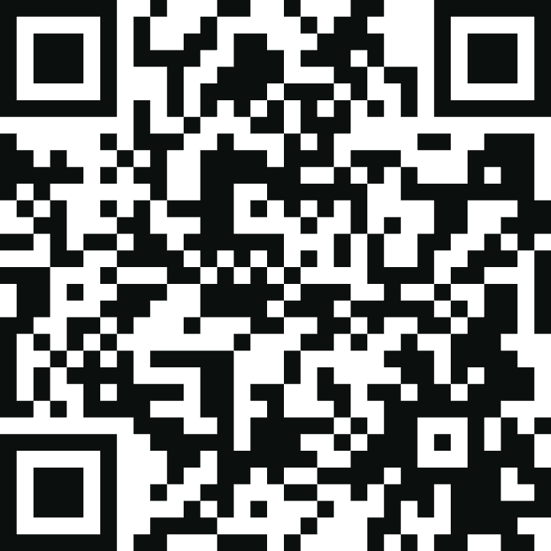
Ask Miriam yourself.
YOUR TURN
Everything is open on GitHub. Build a twin of your own customer and get closer to them, starting today.
Get it. We are happy to contribute.
github.com/gordonkoehn/
baselHack26-t3
A big thank you from Team OpenTwin.
OpenTwin · BaselHack 2026 · Alexander Boll · Dion Arifi · Johan Koller Stefanes · Xi Wang · Gordon Julian Koehn · Jiaqi Yu
Notes:
TIME 2:15–3:00 · SPEAKER C, Speaker B on the demo laptop · about 40 seconds Goal: end on the live product and an open invitation. The QR code links to the GitHub repository. CHECK BEFORE THE PITCH: the QR code points to https://github.com/gordonkoehn/baselHack26-t3. Scan it once with a phone. If the team repo is a different one, the code must be regenerated. SAY: "We started with weeks. The sprint made it one day. OpenTwin makes the customer test happen on that same day. [pause] Miriam is still in the room. Who on the jury wants to ask her one question?" DO: - Speaker B unmutes the twin, prototype stays on screen S2. - One question only. Let the twin answer 10–15 seconds. CLOSE (after the answer, or if nobody asks within 3 seconds): "Everything you saw is open on GitHub. Scan the code, build a twin of your own customer, and get closer to them, starting today. Get it, we are happy to contribute. A big thank you from all of us." IF NOBODY ASKS: ask Miriam yourself: "Miriam, would you trust these numbers coming from the publisher?" Expected gist: she trusts them because the method is disclosed, but her vice-president will ask who checked them. That shows the twin is not a yes-machine. IF THE ORGANISERS DO NOT ALLOW JURY INTERACTION: skip the question, go straight to the close. LIKELY JURY QUESTIONS, SHORT ANSWERS: - "Isn't a twin just telling you what you want to hear?" Persona rules allow and encourage disagreement, and we test for it: in the example round the vice-president twin rejected the publisher figures without an independent check. - "Where does the twin's knowledge come from?" Interviews with the people who know the customer, expert interviews and the sprint board. Every statement links to its source or is marked as an assumption. - "Privacy?" Fictional or composite personas by default, no clone of a real person without written consent, AI always disclosed, can be self-hosted in Switzerland or the EU. - "How is this different from Tavus or synthetic-user tools?" Tavus gives you a face, synthetic-user tools give you text. OpenTwin builds the persona from your organisation's knowledge and tests your prototype live inside the sprint. - "Does it replace real users?" No. It decides what is worth showing to real users.

