Slide 1
What It Takes To Win In The EPL
By Gordon McIntire

Slide 2
The Problem:
With goals affecting matches to such a degree, results can be difficult to predict in football.

Slide 3
The Solution:
Analyze match statistics and develop predictive model for match results.

Slide 4
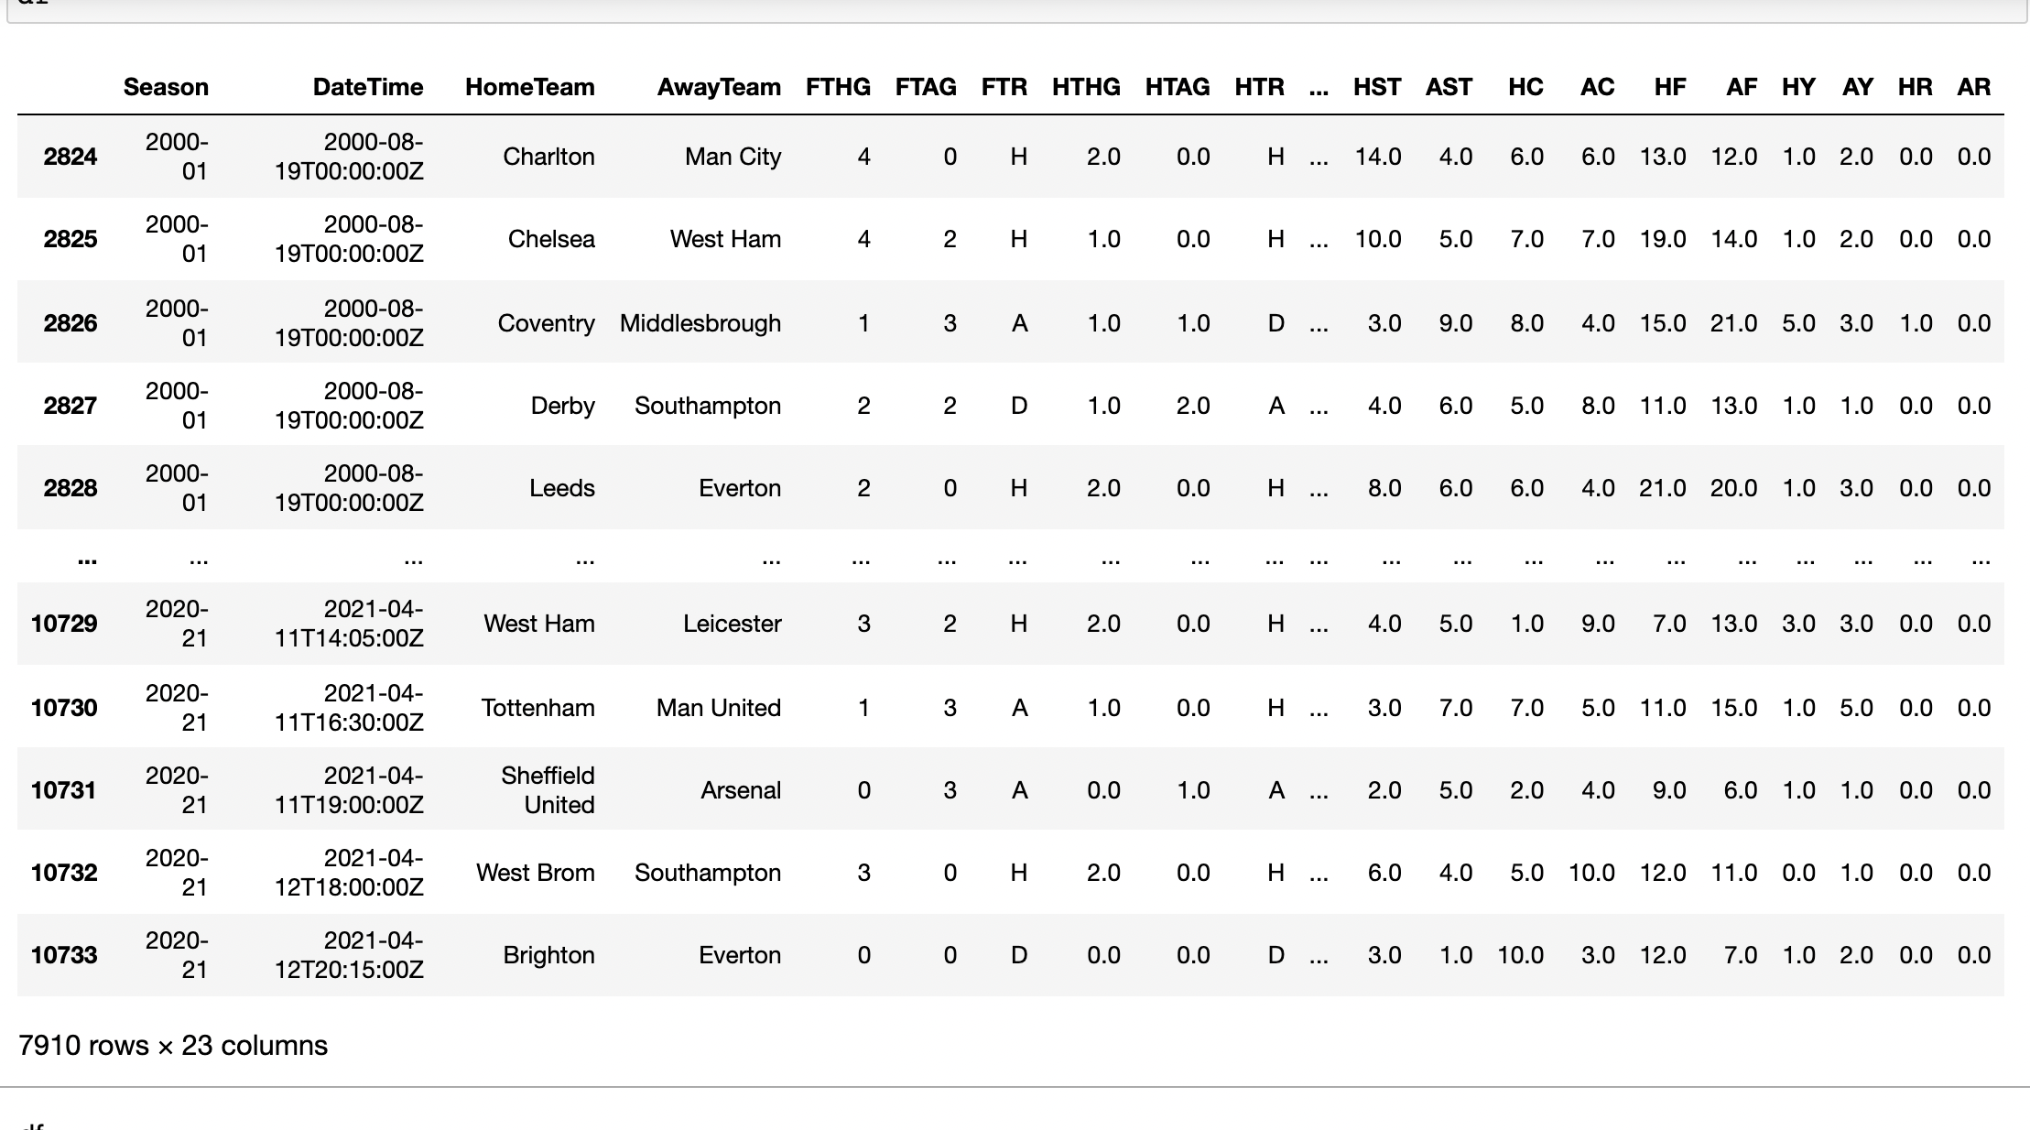
The Data

Slide 5
Data Wrangling
Original dataset had ~10,000 rows and 23 columns
Only consider data from the 2000-2001 season to present day.
Dataset has no null values
Target Variable: Full Time Result

Slide 6
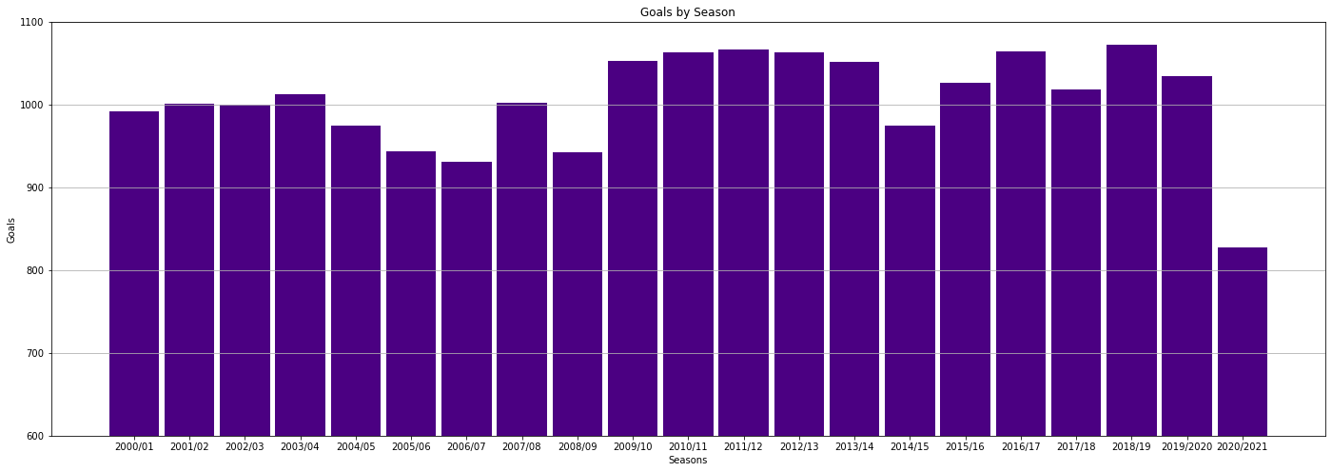
Exploratory Data Analysis
Exploratory Data Analysis

Slide 7
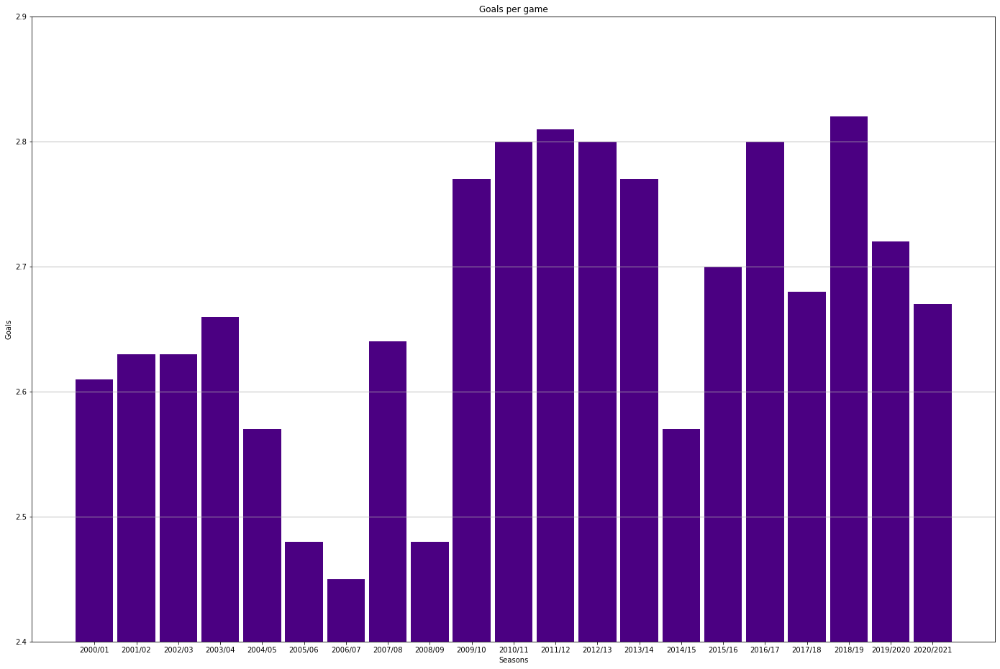

Slide 8
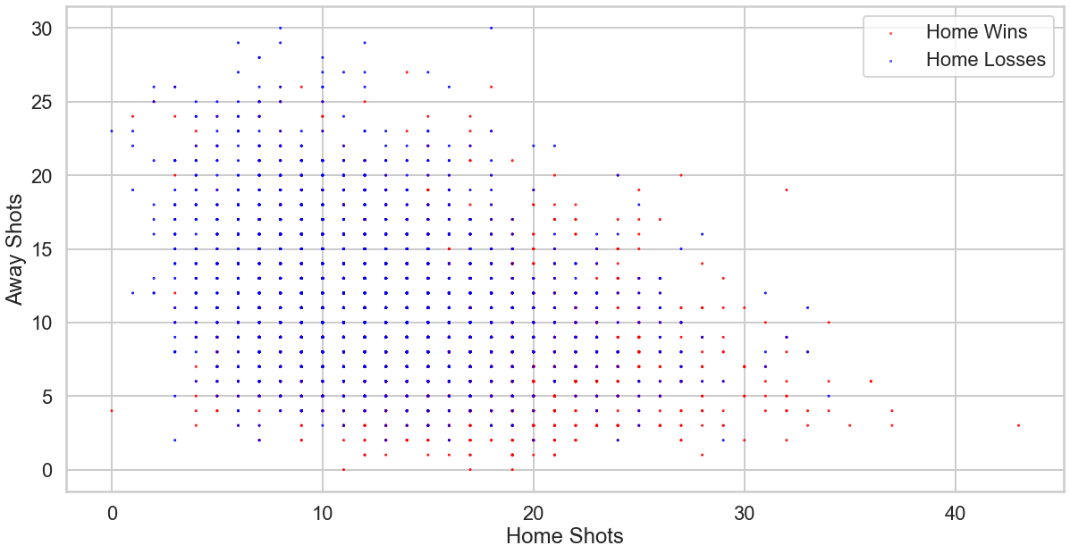
I used scatterplots to explore the weight that certain features have on the result of a match.

Slide 9
Model Selection: -Logistic Regression -Random Forest Classifier
Based on the figures above depicting home/away shot quantities and what results they tend to produce, I knew I wanted to form a Logistic Regression model to see how well this feature would perform in prediction. It didn’t perform very well, with only 0.59 accuracy, so I plugged shots on target instead. This produced an accuracy score of 0.67, which is better but certainly not enough to be satisfied.
Moving onto the Random Forest Classifier and looking to classify a match’s result based on its shots, shots on target, fouls, corners, and cards, the model’s performance scores were disappointing, just barely getting to an accuracy of 0.544.

Slide 10
Takeaways
Using Logistic Regression with on-target shots did produce model that one could use to predict the outcome of a match, though not one that would instill much confidence.
On-target shots was still a better statistic to model on than shots, which we less important.
Features like fouls, cards, and corners didn’t reach an accuracy level close to on-target shots either.

Slide 11
Future Research
Working on this project gave me a lot of ideas for further research in football. I looked at data from 20 years in the premier league, but obviously there are many other leagues in the world, and it would be interesting to compare different regions. I’m also aware of datasets with more features on each match.
Another interesting project would be to look at the profile of individual teams or players, and perhaps look to aggregate players’ winning tendencies to a team’s chance of success.

