Slide 1
Supercritical CO₂ extraction of nepetalactones from Madjack brand catnip
Presentation by Jennifer Hynes
and Gordon Stevens

Slide 2
Nepetalactones, Oil of Catnip, and Super CO₂
The purpose of this project was to extract a class of compounds called “nepetalactones”, which are the active components in catnip.
This extract contains nepetalactones, and various other components within the matrix, and the extract is collectively called “Oil of Catnip”.
The extraction method chosen to extract the nepetalactones was supercritical carbon dioxide (Super CO₂). The analysis was performed on a gas chromatograph.
Catnip products have a variety of uses, for both cats and humans alike.

Slide 3
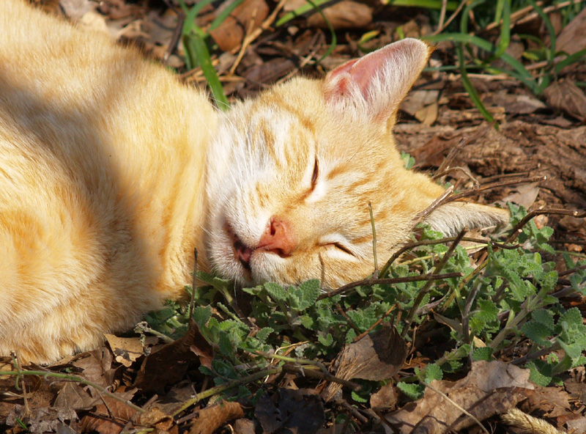
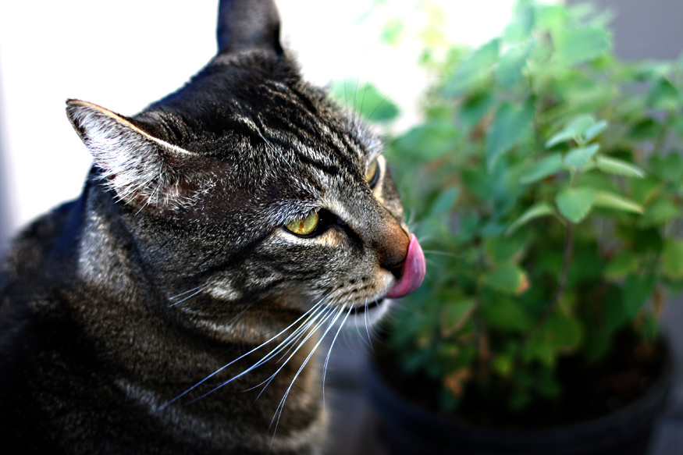
Catnip uses: Cats
2/3 of cats enjoy catnip: Catnip has hallucinogenic properties for cats, and research has shown it has no ill effects, and is non-toxic

Slide 4
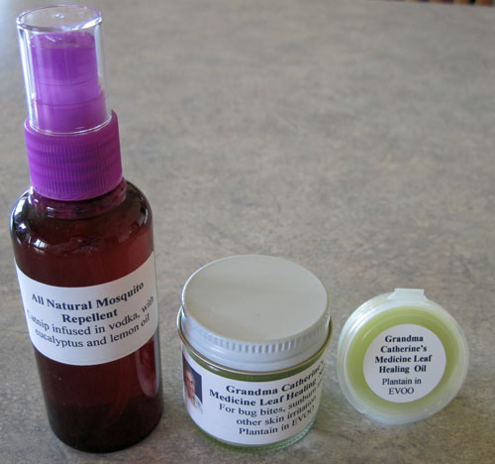
Catnip uses: Human products
Catnip insect repellent: At least 10x more potent than DEET insect repellent, and non-toxic!
Catnip lotions and cream: Soothes skin, usually scented with lemongrass.

Slide 5
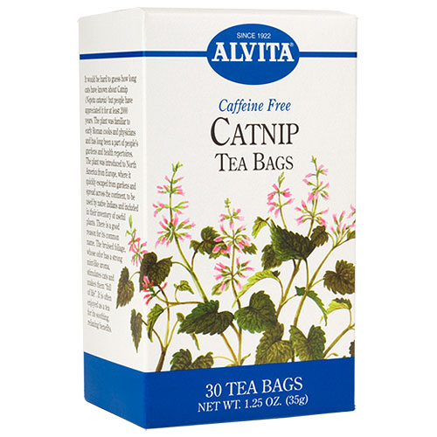
Catnip uses: Catnip tea
Catnip effect on humans: Catnip has a sedative effect on humans, and is available as a “soothing” catnip tea.

Slide 6
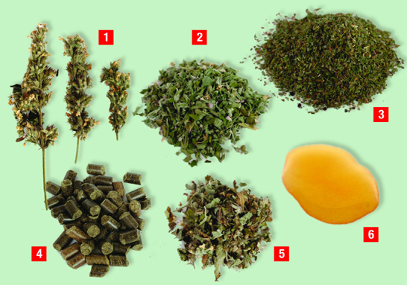
Commercially available catnip products
# | Description
1 | Flower buds
2 | Flowers and stems
3 | Ground catnip
4 | Compressed catnip
5 | Catnip mulch
6 | Oil of Catnip
Commercially available catnip: With respect to our extraction project, we chose to extract oil of catnip (6) from ground catnip (3).

Slide 7
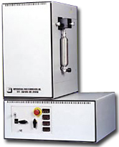
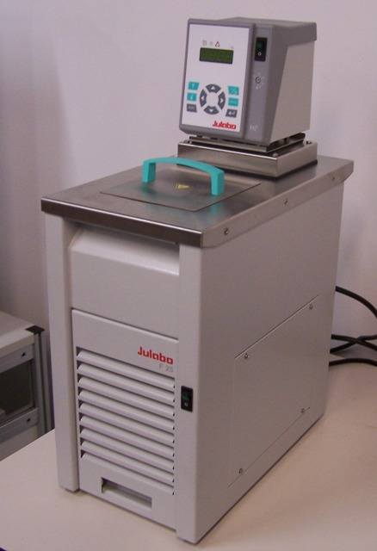
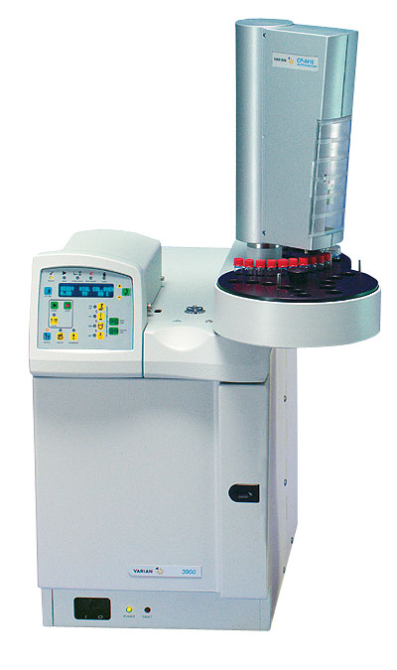
Catnip extraction: Equipment
Extraction equipment: Supercritical fluid technologies, inc. SFT-250 Super CO₂ Benchtop extractor and Julabo chiller
Analysis equipment: Varian Gas Chromatograph 3900 with diethyl glycol succinate column (DEGS) and Flame Ionization Detector (FID)

Slide 8
Catnip extraction: Operating conditions
Supercritical CO₂ extractor
Operating pressure (bar) | Operating temperature (°C) | Flow rate (L/min)
420 | 40.0 | 3.0
Gas chromatograph
Column (°C) | Rate (C/min) | Hold time (min) | Elapsed time (min)
42 | 0 | 5.00 | 5.00
150 | 15 | 1.00 | 13.20
180 | 5 | 1.00 | 20.20
215 | 10 | 1.00 | 24.70

Slide 9
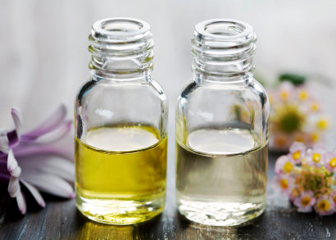
Catnip extraction: Operating conditions
Resultant biomass and oil of catnip
Madjack catnip biomass (g) | Madjack catnip biomass after extraction (g) | Change in biomass (g) | Change in biomass (%) | Oil of catnip extract (g) | % Recovery
10.0005 | 9.5684 | 0.4321 | 4.32 | 0.0860 | 0.86
GC Preparation (Standard): 1 drop of Catnip oil standard in 1mL DCM
GC Preparation (Madjack): 1 drop of Catnip oil extract in 1mL DCM
Madjack catnip extract (yellow)
Catnip oil standard (clear)

Slide 10
Catnip extraction: Overall GC chromatograms
Standard Reference
Solvent peaks
Peaks of interest
Extraction equipment: Supercritical fluid techn
Sample

Slide 11
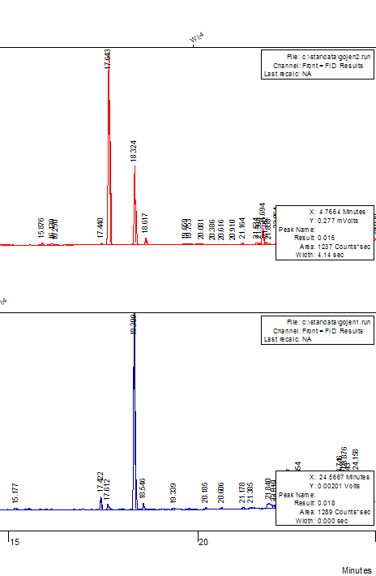
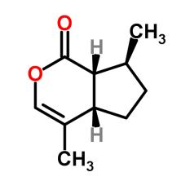

Catnip extraction: Extraction results
Standard Reference
GC Chromatograms:
The reference standard displayed peaks in a similar region to our sample, and displays a similar peak area, therefore it is likely that oil of catnip was extracted successfully!
Sample

Slide 12
Thank you for watching our presentation!
Also thanks to:
Bioniche (Provided catnip oil standard and technical data)
Madjack (Catnip)

