Slide 1
iSkin
Using Machine Learning to Diagnose Skin Cancer

Slide 2

Why we picked the topic?
We thought it would be cool.
Started discussing ways we could use machine learning academically.
Public Impact:
We thought this could be a highly useful early diagnosis tool. Kind of like WebMD.
An application that can be used at home
Rising cost of healthcare can often be a barrier to getting treatment
People are often too scared/ ashamed to go see a doctor until it may be too late
There is a need for this type of application
One thing we overlooked?

Slide 3
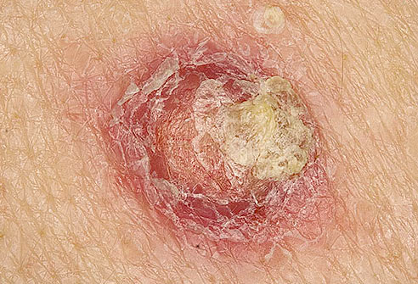
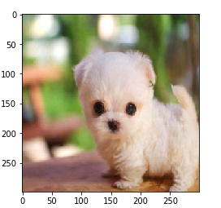
Remember the ML example from class with the cute puppy?
Cute
Not Cute

Slide 4
Not cute, but still highly Necessary
Anything to do with our skin is highly visible.
Skin disorders generally can vary greatly in:
symptoms and severity
temporary or permanent
painless or painful
situational causes
others may be genetic.
some skin conditions are minor, and others can be life-threatening
While most skin disorders are minor, others can indicate a more serious issue.

Slide 5
5 Most Common Skin Disorders
Acne. A skin disorder that causes pimples when the passageway that connects the skin's pores to the oil glands becomes clogged.
Eczema. There are three common forms of eczema:
Atopic dermatitis is the most common and is seen most often in children. One to three percent of adults compared to 10 to 20 percent of children have this long-term genetic disease, which causes itchy rashes in the crux of the elbows and behind the knees.
Allergic contact dermatitis begins to show in adulthood and is caused by environmental factors such as cosmetic agents, fragrances and the metals in jewelry.
Nummular dermatitis looks like red and flaky coin-shaped patches of skin and is due to dry skin. This can be very itchy.
Seborrheic Dermatitis. Causes oily, waxy patches to develop on the scalp, is distinct from other forms of dermatitis.
Skin Cancer. The most common type of cancer in the United States.
According to the American Academy of Dermatology, one million people are diagnosed with skin cancer annually, and 1 in 5 Americans will develop skin cancer in their lifetime.
Psoriasis. a chronic and disfiguring genetic disease. It is a buildup of excess skin tissue that looks red and thick and is covered with silvery scales.

Slide 6
Each year there are more new cases of skin cancer, than incidences of breast, prostate, lung and colon cancers combined.
Over the past three decades, more people have had skin cancer than all other cancers combined.
PSA:
After this presentation, if you think you might have skin cancer...
Please: Contact. Your. Doctor.

Slide 7
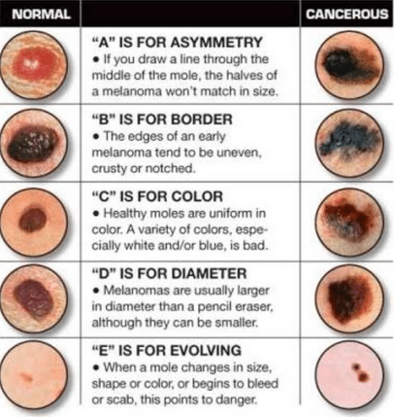
Diagnosing Melanomas:
Benign vs Malignant
(a,b,c,d,e method)
Understanding the warning signs. How to tell if a melanoma is benign or malignant

Slide 8
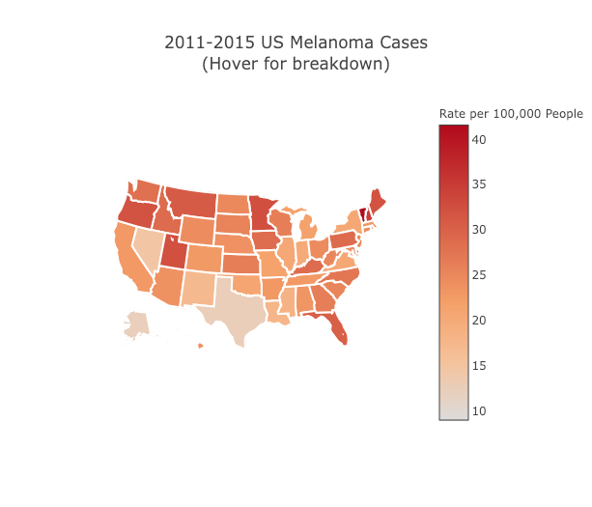

Slide 9
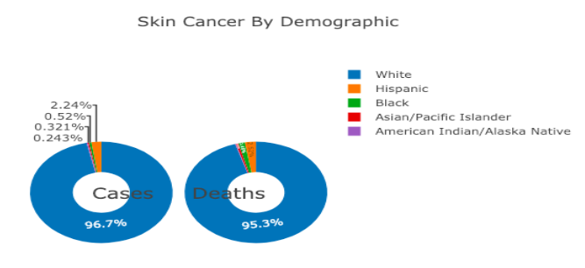
y

Slide 10
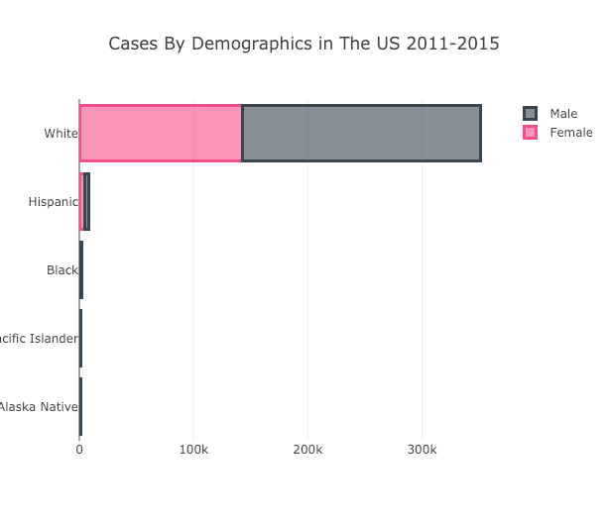
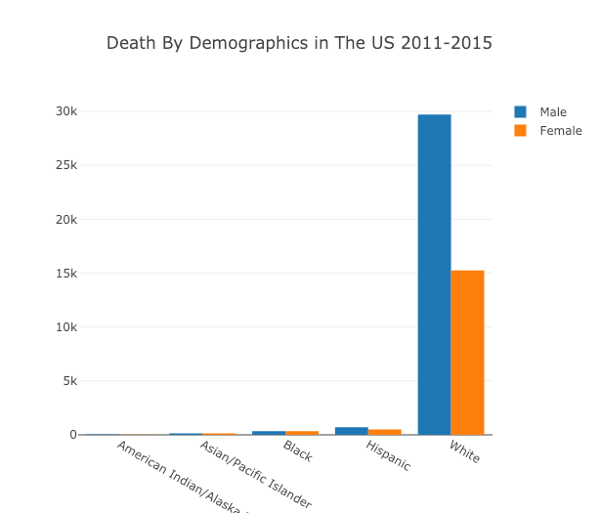
By Gender

Slide 11
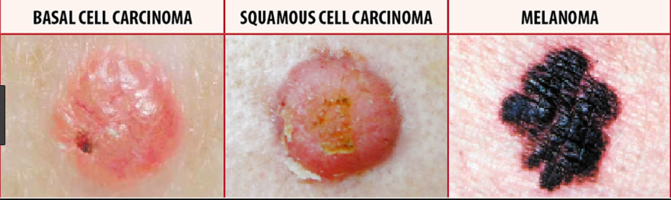


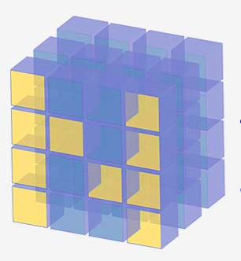
Classifying Skin Cancer by Type
The aim of this ML project is to classify the skin cancer images by type.
The model classifies the images into the three types of skin cancer -
Basal
Melanoma
Squamous
This project uses transfer learning methods using Inception v3 architecture for image classification.
Required Libraries:
Tensorflow
Keras
Numpy

Slide 12
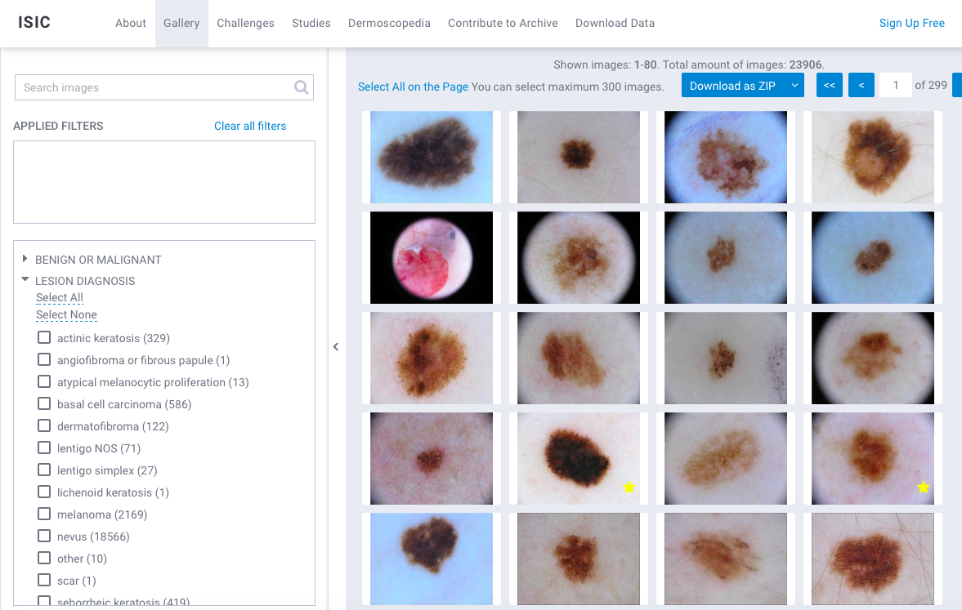
Image Dataset
International Skin Imaging Collaboration:
https://www.isic-archive.com/#!/topWithHeader/wideContentTop/main

Slide 13
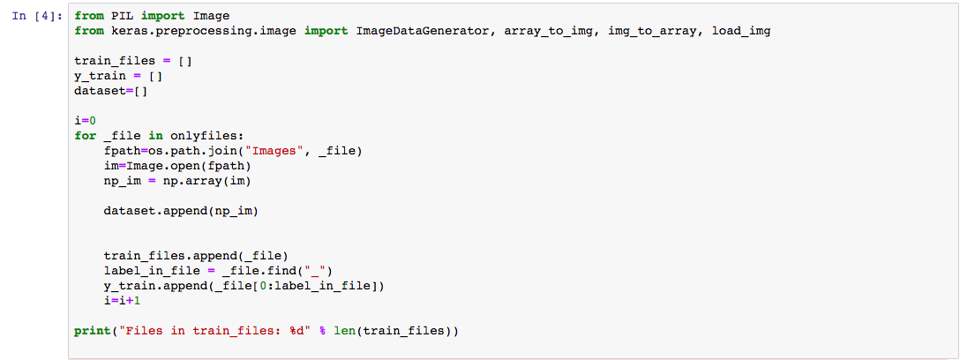
Image Dataset Preparation
Convert Image to Numpy Array
Divide data into test and training data

Slide 14
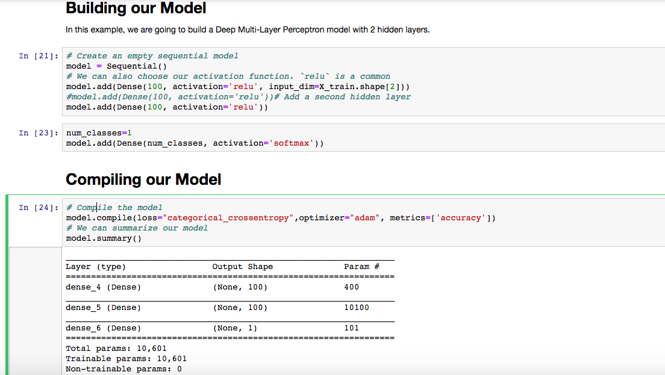
Model Building and Training Approach
CNN (Convolutional Neural Networks)
Keras

Slide 15
Challenges
Image Processing was challenge due to variation in pixel size.
Model fitting keeps crashing with more number of images.
Pre-trained Models (VGG, Imagenet) does not make accurate predictions for medical/ skin lesions
Small picture repository

Slide 16

The
End

