Slide 1
Chapter 1 – What is Psychology?
Major Topics in this Chapter
What is Psychology and What Do Psychologists Do?
Historical Foundations of Psychology
How Psychologists Study Behavior and Mental Processes
Methods of Research
Chapter 1: What is Psychology?

Slide 2

What is Psychology?
psychology: the scientific study of behavior and mental processes
behavior: anything an organism does that is directly observable
mental processes: the internal, private experiences an organism has that cannot be directly observed
Chapter 1-1: Psychology as a Science

Slide 3
Goals of Psychology
Goals of Psychology: describe, explain, predict, and control behaviors and mental processes
Theories: statements that propose relationships between events
We must TEST theories to demonstrate whether they are accurate or not!
Good theories generate predictions about what should happen, given a certain situation
We can then collect data to investigate whether the prediction really does occur – if so, we have evidence to support our theory!
Chapter 1-1: Psychology as a Science

Slide 4
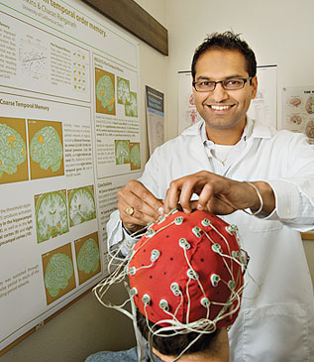


What Do Psychologists Do?
Research
  Pure research: research conducted without concern for immediate applications
  Applied research: research conducted in an effort to find solutions to particular problems
Practice
  applying psychological knowledge to help individuals change their behavior to accomplish goals or deal with the world more effectively
Teaching
  Sharing psychological knowledge in classrooms, seminars, and workshops
Chapter 1-1a: What Psychologists Do

Slide 5
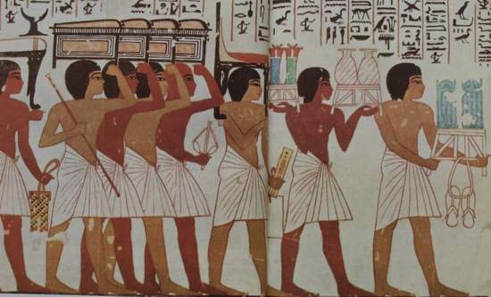
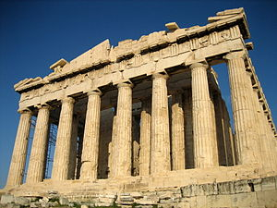
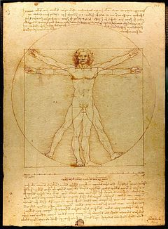
Historical Foundations of Psychology
Ancient Cultures
  Explanations often involved spirits and gods (the supernatural)
Ancient Greeks (a few hundred years BC)
  Philosophers like Socrates, Aristotle, and Democritus started making more investigations into psychological questions (often with more natural explanations for things!)
Modern Science (Renaissance forward)
  Empiricism - the view that knowledge originates in experience and that science should, therefore, rely on observation and experimentation.
Chapter 1-2: Historical Foundations of Psychology

Slide 6
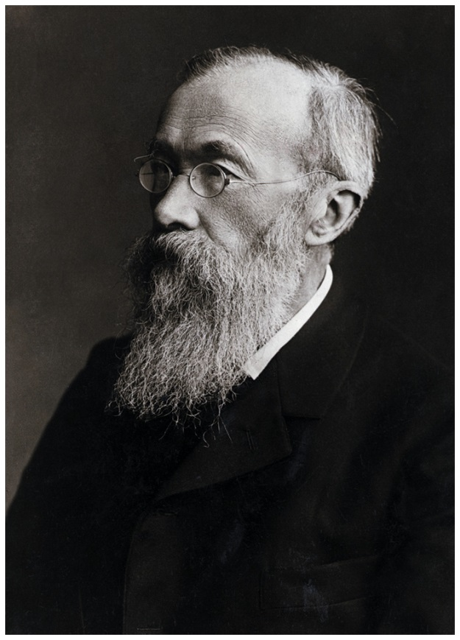
The Birth of Scientific Psychology
Wilhelm Wundt
  German physiologist
  Interested in measuring and discovering “atoms of the mind” – the simplest mental processes
  1879: First psychology experiment
    measuring time lag between hearing a sound and pressing a key
  First psychology laboratory: University of Leipzig (Germany)
  Considered one of the founders of the early branch of psychology known as structuralism
Chapter 1-2a: Structuralism

Slide 7
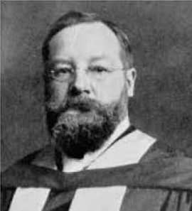
Structuralism
Structuralism
  Focuses on breaking conscious experience down its basic components (basic sensations, feelings, perceptions, mental processes, etc)
  Founded by Edward Titchener (student of Wundt) and Wundt
  Introspection
    Involves “looking inward” (inner reflection) and examining one’s own thoughts and emotions in order to break them down into their basic components
    Primary research technique of the structuralists
Chapter 1-2a: Structuralism

Slide 8
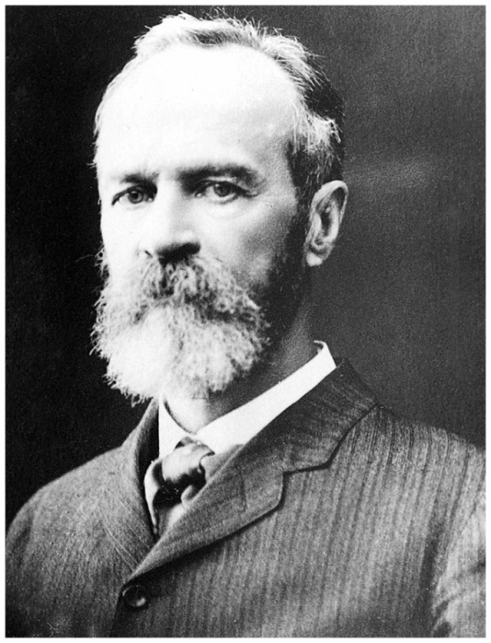
Functionalism
Functionalism
  Founded by William James
    American psychologist
    Interested in practical applications of psychology
    Influenced by Charles Darwin’s theory of natural selection – how our individual qualities help us to survive in the world
  Focuses on practical applications of psychology and how they come from studying the function of behavior and cognition – how are these things helping us to survive and live our lives?
Chapter 1-2b: Functionalism

Slide 9
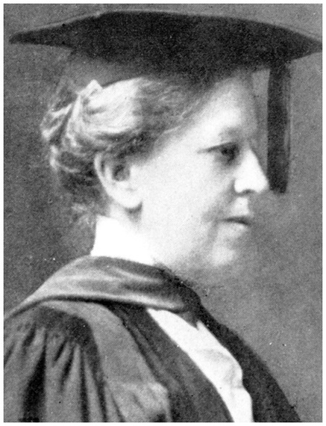
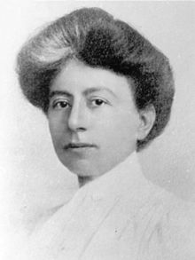
Pioneering Female Psychologists
Mary Calkins
  1890: William James admitted her to his graduate seminar in psychology
    She was allowed to attend as a “guest” since Harvard was all-male at the time
  Fulfilled all requirements for Ph.D. but denied degree from Harvard since it was all-male.
  Still, she had a distinguished career!
    First psychology lab founded by a female (1891)
    Renowned memory researcher
    First female president of the American Psychological Association (1905)
Margaret Floy Washburn
  First female psychology Ph.D. (1894)
  Studied with Titchener (Cornell)
  2nd female president of APA (1921)
Chapter 1-2b: Functionalism

Slide 10
The Scientific Method
Scientific method – an orderly, systematic process for investigating phenomena and acquiring new knowledge
Basic Process:
1. Observe some phenomenon that we would like to understand
2. Form theory to explain phenomenon and predict results
3. Generate a testable hypothesis
4. Conduct research to test hypothesis
5. Refine theory
theory – an explanation of some phenomenon
hypothesis – a specific, testable prediction based on a theory
Chapter 1-4a: The Scientific Method

Slide 11

The Scientific Method (Example)
Example: Meditation
Our friend tells us he feels great (e.g. less anxious) after meditating. Interesting!
Form theory: Meditation reduces anxiety
Generate a testable hypothesis: People who meditate four hours per week should score lower on the Taylor Manifest Anxiety Scale than similar people who do not meditate. We can test this prediction!
Conduct research to test hypothesis
Collect and analyze data
5. Did “meditation” group show less anxiety on the Taylor Manifest Anxiety Scale than the “non-meditation” group? If so, we have supporting evidence for our theory. If not, refine theory!
Chapter 1-4a: The Scientific Method

Slide 12
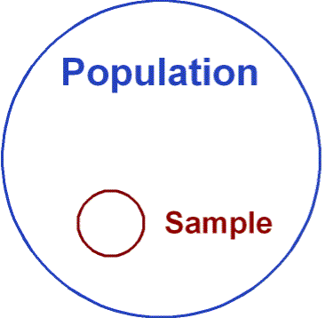
Samples and Populations
In research, we are interested in finding out something about a group of people (our population of interest)
population – complete group of interest to researchers
Since this group is usually very large, researchers instead collect data from a smaller sub-group of the population (a sample), hoping to be able to legitimately say that what we found in our sample is what we would have found in our population if we could have collected data from all of them
sample – the smaller group of actual subjects (chosen from the population) from whom we actually collect data
To generalize our sample findings to the population, we must have a sample that is representative of the population (similar in gender, age, intelligence level, etc)
Chapter 1-4b: Samples and Populations

Slide 13
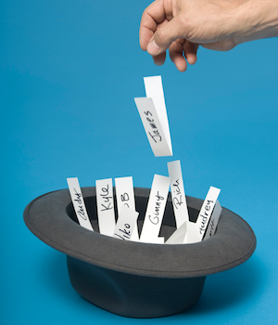

Random and Stratified Sampling
Representative samples can be obtained through:
random sampling – everyone in population has an equal chance at being included in the study
stratified sampling – sample drawn so that identified subgroups in population are represented proportionately in the sample
Researchers must be careful of volunteer bias
Volunteer bias – people who volunteer to participate in a certain study may systematically differ from those who do not – they are likely not representative of the overall population
Chapter 1-4c: Problems in Generalizing from Psychological Research

Slide 14
Research Methods
Observational (Descriptive) Methods
  Case studies
  Surveys
  Naturalistic observation
  Correlational studies
  Data is gathered, but no variables are manipulated by the researcher
Experimental Methods
  Variables are manipulated and controlled by the experimenter
  Allows researcher to probe cause and effect relationships between variables
Chapter 1-5: Methods of Research

Slide 15
The Case Study
Psychologist studies a single individual in great depth
  Interviews (with subject, family, friends, etc)
  Psychological tests (intelligence, personality, etc)
  Observation of behaviors (at home, at work, etc)
  The hope is that this person’s information can reveal things about the overall population
Advantages
  More detailed data gathered than with other methods
  Suggests areas for further (more general) study
Disadvantages/Limitations
  Only studies one person – there’s no guarantee data will relate to the general population
  Subject’s memory of their lives/experiences may be faulty
  Doesn’t tell us why anything is occurring
Chapter 1-5a: Methods of Observation

Slide 16
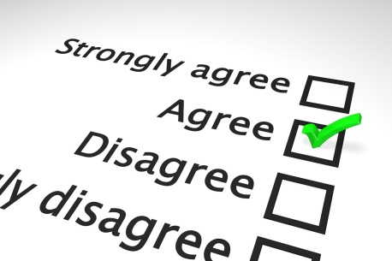
The Survey
Ask large numbers of people about their attitudes, behaviors, opinions
Advantages
  Data from MANY subjects – increases likelihood we can generalize our results to the population
Disadvantages/Limitations
  Socially-desirable responding (aka “faking good”)
    People are sometimes hesitant to reveal honest personal information that might make them look bad
    People sometimes answer questions in ways that make them look better than they are
    People may be hesitant to truthfully answer potentially embarrassing questions
  Wording effects – wordings of questions can affect results
Chapter 1-5a: Methods of Observation

Slide 17

Example of Survey Wording Effects
Even subtle changes in the wording of a question can have a major effect on responses
Example: Censorship of sex and violence in media
  Only 27% approve of “government censorship” of what’s shown on TV
  66% approve of “more restrictions on what is shown on TV”
Be sure to take into account how questions were phrased when looking at the results of surveys!
Chapter 1-5a: Methods of Observation

Slide 18
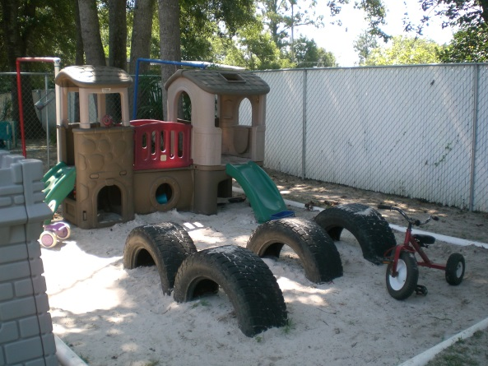
Naturalistic Observation
Observe behavior of organisms in their natural environment
Example: Main & George (1985)
  Research question: are young children who have been battered less likely to show concern for a distressed child?
  Subjects: 2 groups of 1-3 year-old children (one abused, one not)
  Observed children’s behavior during recess at their day-care center (children were not aware that they were being observed)
  Child’s behavior recorded whenever he/she was confronted with a distressed child (crying, showing signs of fright or panic)
  RESULTS: Abused children often responded aggressively to distressed child, while non-abused children rarely responded that way
Chapter 1-5a: Methods of Observation

Slide 19
Naturalistic Observation (Pros/Cons)
Advantages
  Behavior of subjects likely to reflect their true behavior, as it takes place in a natural setting where subjects don’t realize they are being observed.
  Good source of ideas for future research
  It’s the only way certain behavior can be studied
Disadvantages/Limitations
  Researcher has no control over the setting, so they may not be able to observe the behavior of interest (i.e. the behavior might not occur while observation is occurring)
  Can only look at observable behavior, not attitudes, thoughts, or feelings of subjects
Chapter 1-5a: Methods of Observation

Slide 20
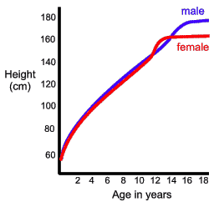
Correlational Studies
Look for relationships between variables
correlation
  the extent to which two variables vary together
  Correlations occur when two variables vary together in some systematic way
Simple Example: Children’s ages and heights
  These are correlated because there is a systematic relationship between them (low values for age correspond to low values for height and vice versa)
positive correlation: variables tend to move in same direction (when one variable increases, so does the other; when one decreases, so does the other
negative correlation: variables tend to move in opposite directions (when one variable increases, the other decreases)
Chapter 1-5b: Correlation

Slide 21
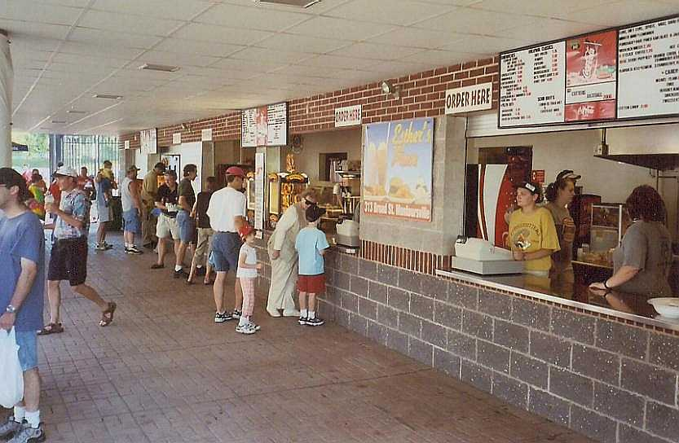
Correlation Example: Drink Sales
Example: Running drink concession at football stadium
  When temperature is high, you tend to sell a lot of soft drinks; when temperature is low, you tend to sell relatively few soft drinks
  This is a positive correlation – as temperature increases, so do soft drink sales (and vice-versa)
  When temperature is low, you tend to sell a lot of coffee; when temperature is high, you tend to sell relatively little coffee
  This is a negative correlation – as temperature increases, coffee sales decrease; when temperature decreases, coffee sales increase
Chapter 1-5b: Correlation

Slide 22
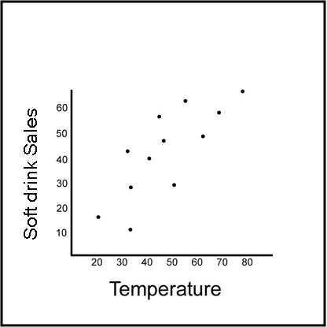
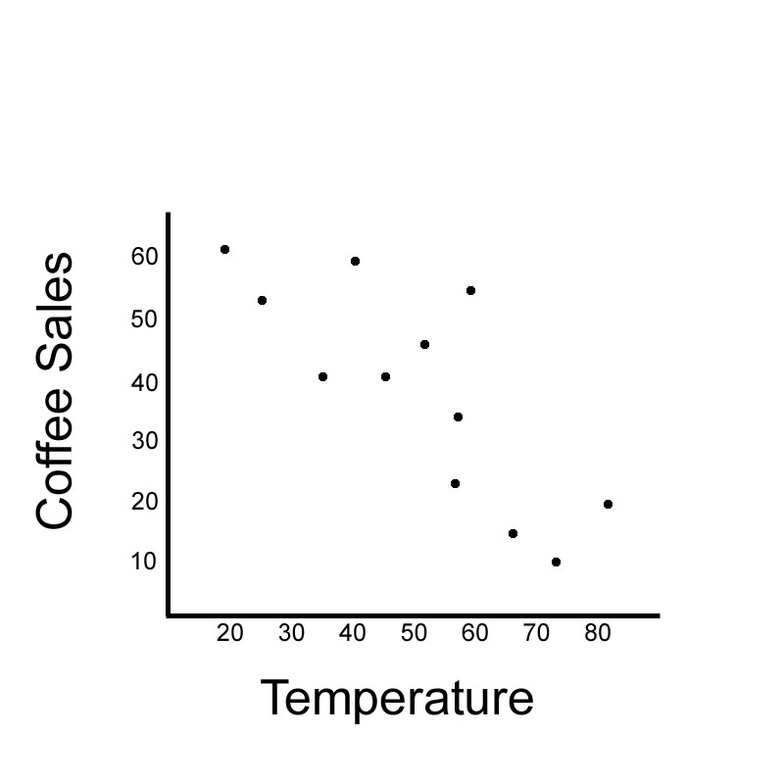
Scatterplots: Drink Sale Example
positive correlation
negative correlation
Chapter 1-5b: Correlation

Slide 23
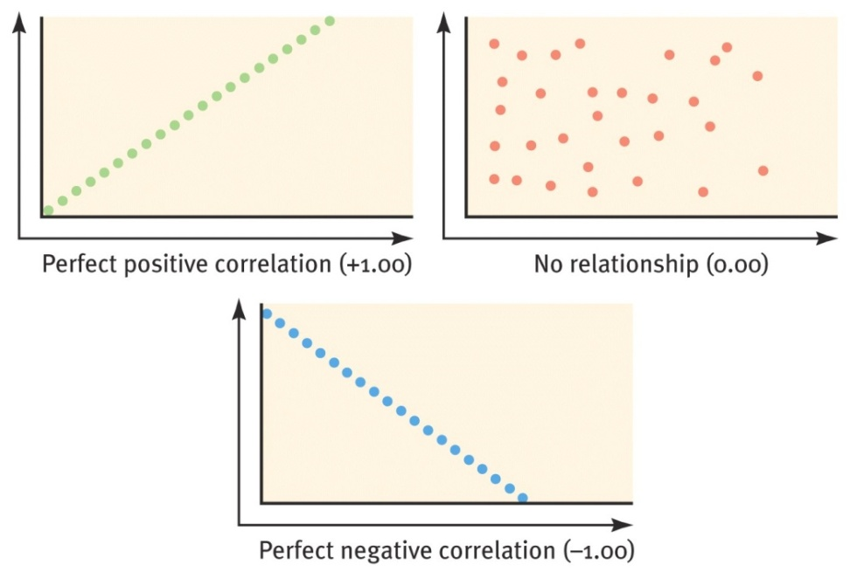
Correlation Coefficient
Correlation coefficient
  Describes strength and direction of correlation
  positive correlations have positive correlation coefficients
  negative correlations have negative correlation coefficients
  Variables that are completely uncorrelated have a correlation coefficient of 0
  strongest positive correlation coefficient = +1.00 (perfect positive correlation)
  strongest negative correlation coefficient = -1.00 (perfect negative correlation)
  Weakest possible correlation has correlation coefficient of 0
  Perfect correlations give perfect predictability – if we know one variable, we absolutely know what the other one will be!
Chapter 1-5b: Correlation

Slide 24
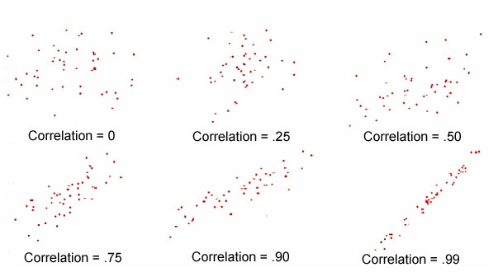
Correlation Coefficient (examples)
Chapter 1-5b: Correlation

Slide 25
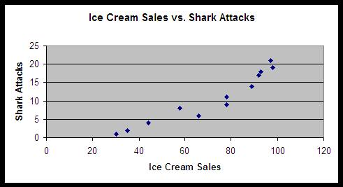
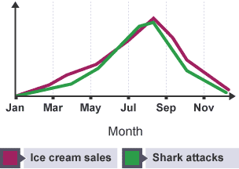
Correlation and Causation
  Correlations help us predict values, but they DO NOT tell us about cause and effect
  Example: Battered children
    Main & George (1985) finding: Battered children tend to respond to other children’s distress in an aggressive, non-supportive way
    Does that mean that battering CAUSES children to respond aggressively to others’ distress?
    NO!
  Example: Shark attacks
    There is a large positive correlation between ice cream sold and number of shark attacks
    Does this mean that eating ice cream CAUSES shark attacks?
    NO!
Chapter 1-5b: Correlation

Slide 26
Directionality and Third Variable Problems
Directionality Problem
  If two variables are varying together, we can’t say with certainty whether the first variable is causing the change in the second or the second is causing the change in the first
  Example: Stress levels and sleeping habits
    People who sleep less tend to report higher stress levels
    Does sleeping less cause more stress or does higher stress cause people to sleep less?
    Simply knowing that they are correlated doesn’t tell us!
Third Variable Problem
  Even though we find that two variables are correlated, it’s possible that neither is affecting the other
  It could be that a third variable (that we didn’t even measure) is actually causing changes in BOTH correlated variables
  Example: Children being overweight and watching lots of TV
Chapter 1-5b: Correlation (these terms not mentioned in text)

Slide 27
Experimentation
Manipulate the variable(s) of interest while holding other factors constant
Goal: see how manipulating one variable affects some other variable (i.e. look for cause and effect)
Chapter 1-5c: The Experimental Method

Slide 28
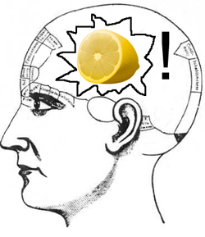
Example: Visual Imagery in Word Recall
Example: Does visual imagery aid memory?
  Gather subjects and randomly assign them to either:
    experimental group – the group that receives the treatment (i.e. has the variable manipulation of interest applied)
    control group – the group that does not receive the treatment (i.e. our baseline group for comparison)
  Random assignment
    each subject has an equal chance at being assigned to the experimental/control group
    The statistics of randomness make it very likely that neither group will start out systematically different from the other
Chapter 1-5c: The Experimental Method

Slide 29
Example: Visual Imagery in Word Recall
Example: Does visual imagery aid memory?
  Apply the manipulation and collect data
    Subjects’ task: listen to a list of words and try to memorize
    Record how many words each subject recalls
    Variable manipulation: Have experimental group use visual imagery to remember lists of words; have control group use whatever method they normally use to remember lists of words (otherwise, the groups are statistically similar overall)
    By comparing the number of words recalled by each group, we can determine if mental imagery CAUSES an increase in recall (i.e. since the groups are otherwise the same, mental imagery would be the only explanation for a difference)
Chapter 1-5c: The Experimental Method

Slide 30
Independent and Dependent Variables
independent variable– the variable that is manipulated in an experiment (i.e. the difference between experimental and control groups)
dependent variable– the variable being measured in an experiment (to check whether the independent variable caused an effect)
confounds – factors other than the independent variable that may affect our results (i.e. an unintended difference between our experimental and control groups)
Chapter 1-5c: The Experimental Method

Slide 31
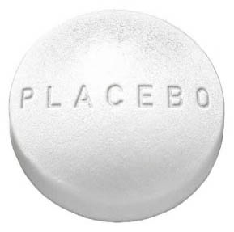
Placebo Effect
Sometimes factors internal to the subject – like their beliefs or expectations - can affect results.
People’s symptoms can improve (or their behaviors can change) simply from the belief that they are being given a treatment or medication.
Placebo effect – experimental results are caused by subject’s expectations or beliefs alone.
Placebo – a bogus treatment that has the appearance of being genuine (with medications, typically a sugar pill) and that the patient believes will help him/her.
Chapter 1-5c: The Experimental Method

Slide 32
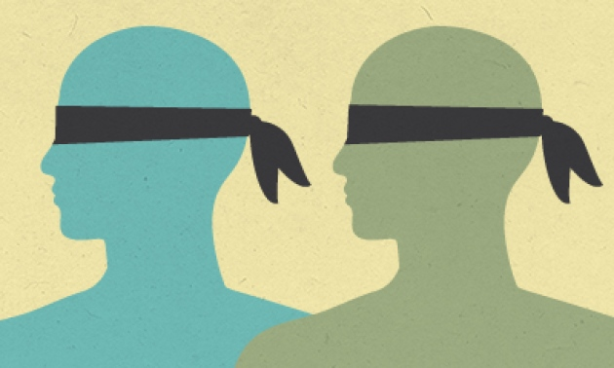
Blind and Double-Blind Studies
Blind study – subjects don’t know what, if any, treatment they are receiving
Double-blind study – neither the subject nor the researcher knows whether the subject has received the treatment
Chapter 1-5c: The Experimental Method

Slide 33
Chapter 1 Readings
SECT TITLE PAGES
READ: 1-1. Psychology as a Science 4-5
READ: 1-1a. What Psychologists Do 5
SKIP: 1-1b. Fields of Psychology 5-7
READ: 1-2. Historical Foundations of Psychology 7-8
READ: 1-2a. Structuralism 8-9
READ: 1-2b. Functionalism 9
SKIP: 1-2c. Behaviorism 9-10
SKIP: 1-2d. Gestalt Psychology 10-11
SKIP: 1-2e. Psychoanalysis 11
SKIP: 1-3 (all) Contemporary Perspectives in Psychology 11-15
READ: 1-4 (all) How Psychologists Study Behavior and Mental Processes 15-18
READ: 1-5 (all) Methods of Research 18-23
SKIP: 1-6 (all) Ethics in Psychological Research 23-24
SKIP: 1-7 (all) Critical Thinking 24-25
Chapter 1: What is Psychology?

