Slide 1
ICS 51 Study Guide
By Jean-Paul Nguyen

Slide 2
I. Structured Computer Organization

Slide 3
Languages
Machine Language – the language for instructions in programs
General Architecture – large, complex components that allow for multiple programs
• this is too complicated to write in just machine code alone!
• people want to do X, but computers want to do Y

Slide 4
Levels
The main way to fix this is to create a new, higher-level language that’s easier to use. Machine Level Language is level 0, and the other language is level 1.
However, since the machine computer only does instructions in L0, there are two ways to deal with this:
Translation – take a file of L1 instructions and convert to L0
Interpretation – in runtime, translate incoming L1 instructions to L0

Slide 5
Virtual Machines
We can now imagine a hypothetical virtual machine that has a higher-level language as its machine language. This now allows us to write programs for that virtual machine in that language, which is then translated or interpreted into the lower-level machine language:
Layer 1
Language: L1
Machine: M1
Interpret Translate
Layer 0
Language: L0
Machine: M0

Slide 6
Multilevel Machines
Layer n
Language: Ln
Machine: Mn
We can now make a machine that has multiple levels of translation/interpretation, with the bottom level being the simplest and the top level being the most sophisticated.
For a machine with n levels, we can imagine n virtual machines:
Interpret Translate
...
Interpret Translate
Layer 1
Language: L1
Machine: M1
Interpret Translate
Layer 0
Language: L0
Machine: M0

Slide 7
Contemporary Multilevel Machines
Level 5
Problem-Oriented Language Level
Translation (compiler)
Level 4
Assembly Language Level
Translation (assembler)
Level 3
Operating System Machine Level
manages computer’s resources
Partial Interpretation (operating system)
Level 2
Instruction Set Architecture Level
holds instructions to use with data
Interpretation (microprogram) / Direct Execution
Level 1
Microarchitecture Level
holds the data like variables
Hardware
Level 0
Digital Logic Level
contains the logic to build hardware i.e. boolean gates

Slide 8
II. Computer Systems

Slide 9
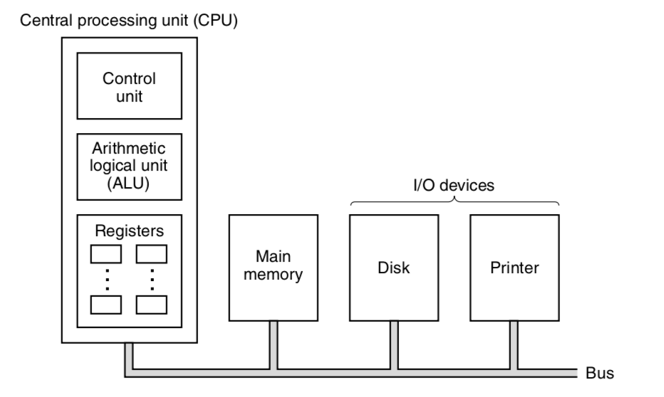
CPU Organization
Computer = CPU + Memory + I/O
bus – a series of parallel wires used to transmit data

Slide 10
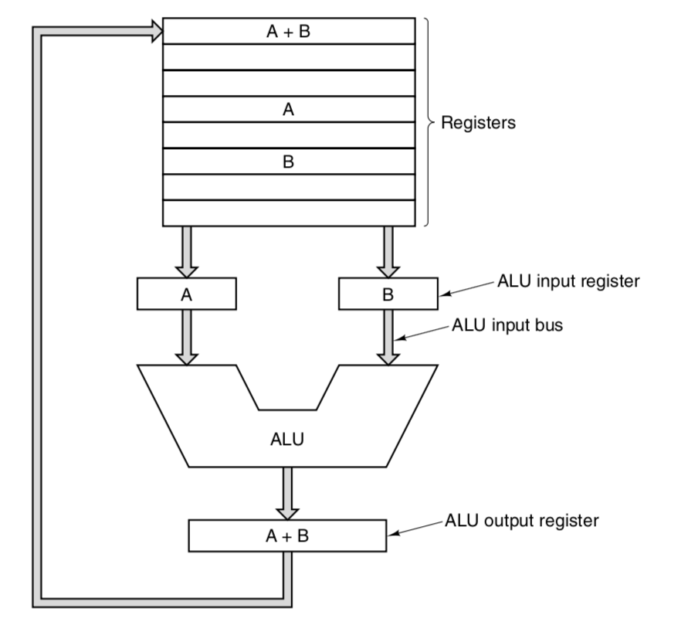
Instructions and Datapath
There are two types of instructions that the CPU can execute:
Register-Memory
can load words into registers
store words back into memory
Register-Register
The datapath consists of the ALU and registers. This datapath usually goes through the following cycle (called, appropriately, a datapath cycle) for a register-register instruction:
Run two operands on ALU
Store the result back into the registers
This process determines the speed of the processor.

Slide 11
Instruction Execution
All instructions are executed like so:
Fetch next instruction to Instruction Register
Change Program Counter to point to the next instruction
Determine instruction type (decode)
[If needed] Calculate memory address
[If needed] Fetch word into CPU register
Execute Instruction
Repeat
Note: the instructions and addresses must already be in the registers of the CPU in order for the ALU to do calculations, particularly in steps 2, 3, and 4.

Slide 12
RISC vs. CISC
Reduced Instruction Set Computer
make the common case fast; small and simple instruction set
more instructions needed to do something
all instructions can execute in one clock cycle
Complex Instruction Set Computer
large and varied instruction set
fewer instructions needed to do something
takes longer because of interpretation; multiple clock cycles

Slide 13
Design Principles for Modern Computers
For general-purpose modern CPUs that follow RISC, these are the design principles which are desired:
All instructions are directly executed by hardware.
eliminating a level of interpretation allows for higher speeds
Maximize the rate at which instructions are issued.
execute instructions in parallel to make the computer faster and efficient
Instructions should be easy to decode.
instructions represent control signals for datapath units; the simpler, the better
Only LOAD and STORE instructions should reference memory.
referencing memory takes a long time, so only few instructions should
everything else is through registers
Provide plenty of registers.
if all registers are used, flushing out to memory and then reloading is expensive!

Slide 14
Parallelism
There are two types of parallelism for faster computers:
Instruction-Level Parallelism
Processor-Level Parallelism

Slide 15
Instruction-Level Parallelism
Instruction-Level Parallelism aims to do more instructions per second. This is mostly achieved through pipelining and superscalar architecture.
pipelining – overlapping different processes
improving latency (how long it takes to execute an instruction) and throughput (how often an instruction is completed)
superscalar architecture – issue multiple instructions in one clock cycle

Slide 16
Processor-Level Parallelism
Processor-Level Parallelism aims to use more CPUs for the same problem. There are a couple of ways to achieve this:
SIMD Processor – many identical processors perform the same sequence of instructions on different sets of data
Vector Processor – all operations are performed in a single, pipelined unit
Multiprocessor – a system with more than one CPU sharing a memory
Multicomputers – a system with multiple CPUS, each with own local memory

Slide 17
Memory and Memory Addresses
A memory consists of a number of cells m, each with an address from 0 to m – 1. Each cell has n bits.
Address
0
1
..................
An m × n memory
needs log₂m addresses
m cells
m – 2
Standard is usually an 8-bit cell, or a byte.
m – 1
n-bits per cell

Slide 18
Byte Ordering
Outside of registers, this is how bytes are stored in hardware/memory.
Big Endian | stores most significant byte in | smallest | address
Little Endian |  | largest
Big Endian
Little Endian
address | memory
a | 0A
a + 1 | 0B
a + 2 | 0C
... | ...
memory | address
0C | a
0B | a + 1
0A | a + 2
... | ...
Register
0A | 0B | 0C

Slide 19
Memory Hierarchy
CPUs are faster than memory, so if the memory is really slow, the CPU has to wait for a lot of cycles. Thus, we want a lot of memory to store information, and we want it to be fast. However, fast memory is expensive!
How do we make it so that memory is big, fast, and cheap? A memory hierarchy:
Registers
Primary Memory
fast, small, expensive,
close to CPU
volatile
Cache
As you go down,
three factors increase:
access time
storage capacity
bits per dollar
RAM and Virtual Memory
Hard Disks
Secondary Memory
slow, large, cheap,
far from CPU,
permanent/non-volatile besides RAM
Input Sources

Slide 20
Caches
This is the solution: combine a small amount of fast memory with a large amount of slow memory. In the cache, the most heavily used memory words are kept; when the CPU needs a word, it will look here BEFORE it looks at main memory.
locality principle – when a word is referenced, it and some of its neighbors are brought into the cache
cache lines – fixed-size blocks in the cache; a miss means a whole cache line is taken in from main memory
Unified Cache | stores instructions and data in | same | cache
Split Cache |  | separate

Slide 21
III. The Digital Logic Level

Slide 22
Boolean Algebra
I’m not wasting my time on this. You guys should’ve taken ICS 6B.
Know the AND and OR gates, truth tables, and sum of products form.

Slide 23
Combinational Circuits
A combinational circuit is a circuit with multiple inputs and outputs in which the outputs are uniquely determined by the current input values
these circuits flow only in one direction
as such, no value is remembered
e.g. Selectors/Multiplexers, Encoders/Decoders, Full-Adders

Slide 24
Selectors/Multiplexers
Given multiple inputs, how do we get only one through to output?
We use select lines!
2^{n} data inputs
...
2^{n}-to-1 Multiplexer
n control bits or
select lines
1 output

Slide 25
Encoders
Given 2^{n} inputs, creates an n-bit binary number as output along with a valid output which says whether there is at least one input of 1 (otherwise, all are 0).
2^{n} data inputs
...
2^{n}-to-n Encoder
Note: inputs with higher position
have encoding priority
...
V
n-bit binary number

Slide 26
Decoders
Given an n-bit binary number, decodes into 2^{n} outputs, with only one output being asserted at any time (i.e. only one output is 1).
n-bit binary number
...
n-to-2^{n} Decoder
...
2^{n} outputs

Slide 27
Full-Adders
Takes in three inputs: two 1-bit integers to add and a carry-in. This, in turn, produces two outputs: one 1-bit sum and a carry-out.
1-bit
Full-Adder
3-bit
Full-Adder
A
A₂:A₀
sum
S₂:S₀
B₂:B₀
B
carry-out
carry-out
carry-in
carry-in
carry-in
A₀
1-bit FA
S₀
Note: can combine n 1-bit Full-Adders to
create an n-bit Full-Adder
B₀
carry
1-bit FA
S₁
A₁
carry
B₁
A₂
1-bit FA
S₂
B₂
carry-out

Slide 28
Clocks
A clock is a circuit that emits a series of pulses with a precise pulse width and precise interval – which is the clock cycle time – between consecutive pulses. This interval is constant, which makes clocks symmetric (i.e. time spent on = time spent off).
Pulse Frequencies are measured in Megahertz (MHz) or Gigahertz (GHz), which correspond to clock cycle times (usually in nanoseconds). These units refer to the speeds of the processor
Clock = 1 (ON)
rising edge
falling edge
Clock = 0 (OFF)

Slide 29
Sequential Circuits and Memory
A sequential circuit combines a combinational circuit with a clock, which allows the circuit to “remember” what the previous value was. This is achieved so that we can make memory, which is used to store data in computers.
To make memory, we need to do the following:
Build a 1-bit memory component
Combine memory components for a register
Combine registers for a register file

Slide 30
1. Build a 1-bit memory component
This requires the following steps:
Create an SR Latch
Create a D-Latch
Create a Clocked D-Latch
Create a D-Flip-Flop
Note that, with regards to clocks, latches are level-triggered whereas flip-flops are edge-triggered.

Slide 31
A. Create an SR Latch
1-bit storage component that stores a value using a feedback loop
inputs:
S (set) – returns if Q is 1
R (reset) – returns if Q is 0
outputs are Q and Q’
 | S | R | Q_{prev} | Q | Q’
hold old value of Q is saved | 0 | 0 | 0 | 0 | 1
 | 0 | 0 | 1 | 1 | 0
reset Q = 0 | 0 | 1 | 0 | 0 | 1
 | 0 | 1 | 1 | 0 | 1
set Q = 1 | 1 | 0 | 0 | 1 | 0
 | 1 | 0 | 1 | 1 | 0
invalid cannot happen! | 1 | 1 | 0 | 0 | 0
 | 1 | 1 | 1 | 0 | 0

Slide 32
B. Create a D-Latch
1-bit asynchronous storage component
asynchronous – output changes as soon as input changes
input is 1-bit data input D
outputs are Q and Q’ (Q is the value of D)
Note: guaranteed valid input with the NOT gate
SR Latch
S
Q
D
R
Q’

Slide 33
C. Create a Clocked D-Latch
1-bit synchronous storage component
synchronous – output changes based on a clock signal
level-triggered – Q is updated during the level of the clock
Q = D
Q = D
Q = D
Q = D
SR Latch
D
S
Q
Q = Q
Q = Q
Q = Q
R
Q’

Slide 34
D. Create a Clocked D-Flip-Flop
1-bit asynchronous storage component
storage happens in an instant!
edge-triggered – Q is updated during the clock transitions (i.e. edges)
for this flip-flop, it will only happen at the rising edge since there is a delay on the gates!
Clocked D-Latch
D
D
Q
Q = D
Q = D
Q = D
Q = D
Clock
Q’

Slide 35
2. Combine memory components for a register
A register is an n-bit storage component which can be made out of D-Flip-Flops, like so:
An n-bit register
D_{n – 1}
D₁
D₀
D-Flip-Flop
D-Flip-Flop
D-Flip-Flop
D
Q
D
Q
D
Q
...
clock signal
Clock
Clock
Clock
Q_{n – 1}
Q₁
Q₀
Note: All the clocks are synchronized to one clock signal in a register!

Slide 36
3. Combine registers for a register file
A register file holds a number of registers inside it, each which take in the same number of bits (called the register width).
An m × n register file, where m is the number of registers and n is the width, is organized as such:
...
D
Q
D
Q
D
Q
Register 0
Clk
Clk
Clk
..................
An m × n register file
m registers
...
D
Q
D
Q
D
Q
Register m – 1
Clk
Clk
Clk
n-bits per register

Slide 37
Memory Organization
How do you choose what registers to read/write in for a register file, especially if for reading, we want just one output? We use signals!
Address of Registers, given as a log₂m-bit number; this will be decoded to m outputs which signify which register is used.
I_{n – 1}:I₀
A_{log m – 1}:A₀
Chip Select signals whether a register
is to be used (either reading or writing); 1 means yes, 0 means no.
An m × n register file
Chip Select
Read/!Write
Read/!Write signals whether a register, if selected, is to be read (1) or written (0).
Output Enable
Note: enabling output requires a
non-inverting buffer, like so:
Output Enable signals whether output will be given; will give output if chip select and read are also 1.
O_{n – 1}:O₀
input
output
enable; will send output only if 1

Slide 38
IV. Microarchitecture

Slide 39
Microarchitecture Design and IJVM
Every Instruction Set Architecture (ISA) requires a different microarchitecture – meaning there aren’t any general principles.
As such, we can study a specific microarchitecture called the Integer Java Virtual Machine (IJVM), which contains a microprogram that does the following for IJVM instructions:
fetch
decode
execute
The microprogram also has a set of variables (state), accessible by all functions.

Slide 40
IJVM Instructions
IJVM instructions usually have these two fields:
These are executed by the microprogram through a series of microinstructions. In general,
Opcode • identifies the instruction | Operand • identifies register location, variable, etc.
High-Level Instruction
IJVM ISA Instructions
Microinstructions
a = 10
compiler
BIPUSH 10
ISTORE a
microprogram
bipush1
bipush2
...

Slide 41
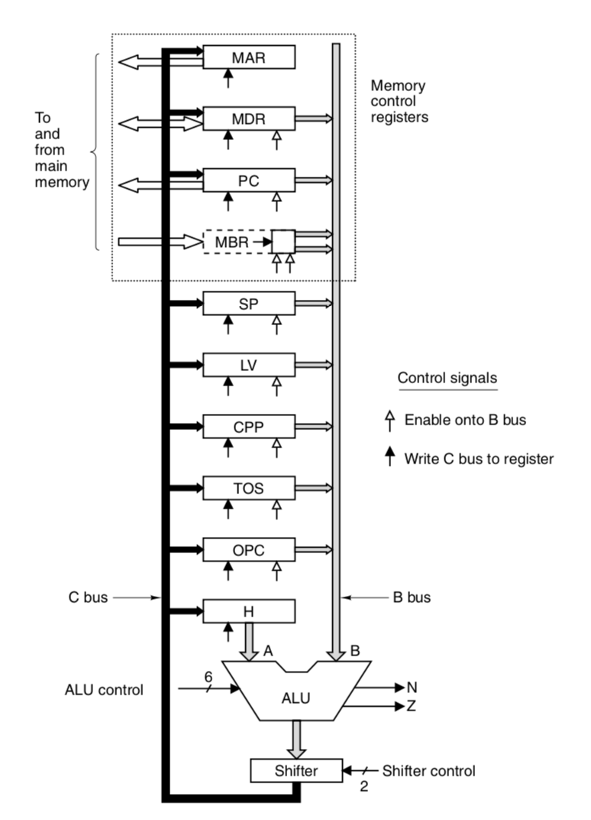
IJVM Datapath
The datapath of an IJVM processor consists of the following:
32-bit registers
B-Bus – contents of the registers
C-Bus – output of the ALU; can write to multiple registers
ALU – contains two inputs:
A (register H; 1 source)
B (bus B; 9 possible sources)

Slide 42
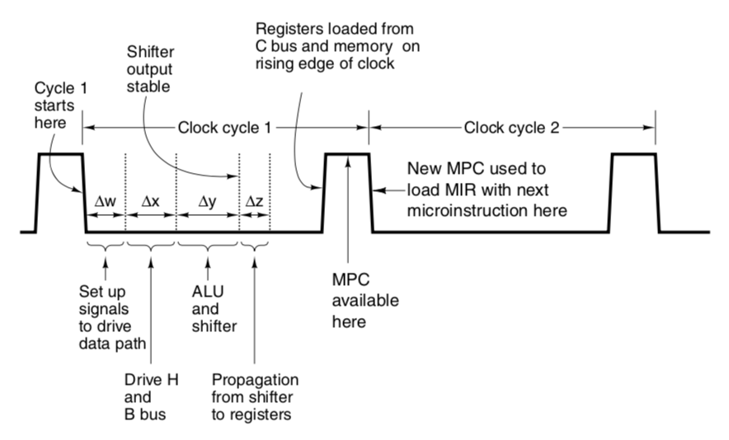
IJVM Datapath Timing
Starting from the falling edge of the clock and ending at the rising edge of the clock, the bus clock cycle follows the diagram below:
This allows for a register to be read
AND written in the same cycle; 1st half
of cycle you read (with B bus), and 2nd half
you write (with C bus).
The implementation requires
rigid timing
long clock cycles
known minimum propagation delay
fast load of registers from C-Bus

Slide 43
IJVM Memory Registers
MAR – contains the word address for MDR
MDR – contains the word itself
PC – contains the byte address for MBR
MBR – contains the byte itself
Note: the MBR has additional signals to tell the bus if its value is positive or negative!
32-bit registers to read/write
ISA-level data words
8-bit registers to read only
the executable ISA program

Slide 44
IJVM Microinstruction Signals
Controlling the datapath in one cycle needs 29 signals, split into five:
9 Signals to write C bus –> registers | 9 Signals to enable registers –> B bus for ALU | 8 Signals to control ALU and shifter | 2 Signals to indicate memory read/write | 1 Signal to indicate memory fetch
We can write into multiple registers with C-Bus, but we CANNOT read into multiple registers with B-Bus. As such, we can decrease the number of signals for the B-Bus to 4 and use a decoder instead.

Slide 45
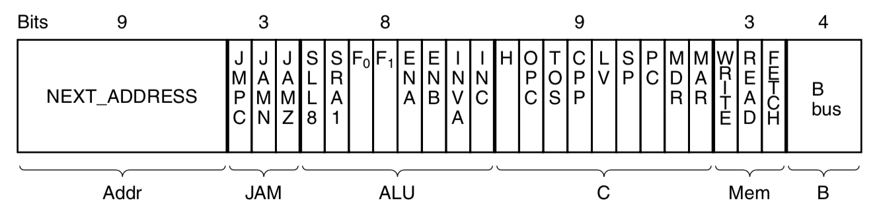
IJVM Microinstruction Signals (Continued)
Adding 9 more signals for the address of the next microinstruction and 3 more signals for how to select the next microinstruction, we have 36 total signals to format into a microinstruction:
Memory:
Each function takes 3 bus cycles.
get address
read, write, fetch on memory
now usable
JAM:
N = is ALU result negative
Z = is ALU result 0

Slide 46
IJVM Sequencer and Control Store
These microinstructions are fetched by the sequencer from the control store ( a read-only memory), which holds a microprogram along with the Microinstruction Register (MIR) and the Microprogram Counter (MPC). Every cycle, this happens:
MIR is loaded from the word pointed by MPC in the control store (∆w)
NEXT_ADDRESS is copied to MPC while JAM is examined
If JAMZ or JAMN is set (1), then the respective flip-flop (which saves whether the ALU output is 0/negative) is ORed into the high-order bit of MPC
MPC now has NEXT_ADDRESS with the high-order bit either 0 (no jams) or 1 (jams)
This allows for jumps/conditionals
Now, MPC has the next instruction to do.
Note that the sequencer produces two types of information: the state of every signal in the system and the address of the next instruction.

Slide 47
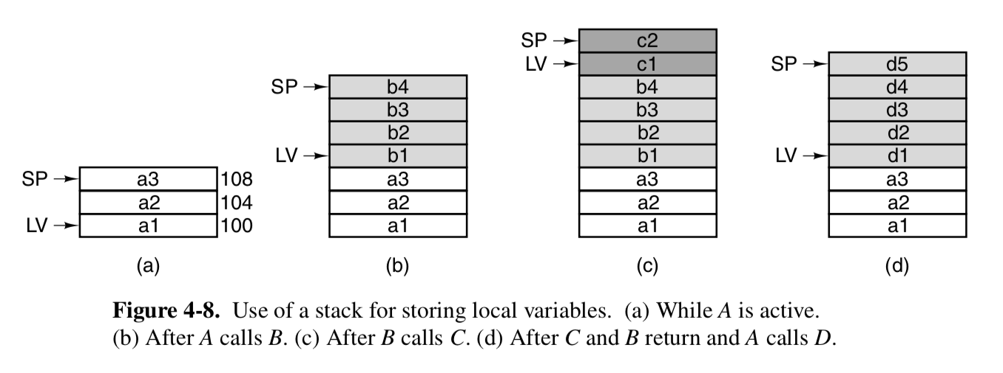
IJVM Stack-Based Machine
There are two more registers that are used to hold the local variables of a procedure/IJVM instruction:
SP – pointer to top of the stack
changes anytime something is pushed/popped
LV – pointer to local variables
changes when another procedure is called; otherwise, does not change!
The stack is also used to hold operands during computation of arithmetic expressions, which are usually done through IJVM instructions.

Slide 48
Example MIC-1 Simulation
 |  |  | 0x18 |  | ← PC
0xC80 |  | ← SP | 0x19
0xC84 |  |  | 0x1A
0xC88 |  |  | 0x1B
 |  |  | 0x1C
 |  |  | 0x1D
 |  |  | 0x1E
 |  |  | 0x1F
 |  |  | 0x20
0xE10 | a: 6 | ← LV | 0x21
0xE14 | b: 10 |  | 0x22
0xE18 | c: 8 |  | 0x23
 |  |  | 0x24
 |  |  | 0x25
 |  |  | 0x26
For the high level code
c = a + b
Do the following:
Create the corresponding IJVM hex code.
Store it into appropriate cells.
Simulate each instruction.
Show changing contents of the data cell.

Slide 49
1. Create the corresponding IJVM hex code.
Hex | Mnemonic | Meaning
0x60 | IADD | Pop two words from stack; push their sum
0x15 | ILOAD varnum | Push local variable onto stack
0x36 | ISTORE varnum | Pop word from stack and store in local variable
c = a + b
From the IJVM MIC-1 Instructions, we can deconstruct the high-level code to the following:
IJVM Instruction | Hex Codes
ILOAD a | 0x15 0x00
ILOAD b | 0x15 0x01
IADD | 0x60
ISTORE c | 0x36 0x02
The italicized hex codes represent the offset from LV.

Slide 50
2. Store it into appropriate cells.
With the hex codes from the previous step, we can now fill out the method area (which the PC points to) with the program, like so:
0x18 | 0x15 | ← PC
0x19 | 0x00
0x1A | 0x15
0x1B | 0x01
0x1C | 0x60
0x1D | 0x36
0x1E | 0x02
0x1F
0x20
0x21
0x22
0x23
0x24
0x25
0x26
IJVM Instruction | Hex Codes
ILOAD a | 0x15 0x00
ILOAD b | 0x15 0x01
IADD | 0x60
ISTORE c | 0x36 0x02

Slide 51
3. Simulate each instruction.
Note:
read – MDR = MEM[MAR]₃₂
write – MEM[MAR]₃₂ = MDR
fetch – MBR = MEM[PC]₈
Label | Operations
Main1 | PC = PC + 1; fetch; goto (MBR)
iadd1 | MAR = SP = SP – 1; rd
iadd2 | H = TOS
iadd3 | MDR = TOS = MDR + H; wr; goto Main1
iload1 | H = LV
iload2 | MAR = MBRU + H; rd
iload3 | MAR = SP = SP + 1
iload4 | PC = PC + 1; fetch; wr
iload5 | TOS = MDR; goto Main1
istore1 | H = LV
istore2 | MAR = MBRU + H
istore3 | MDR = TOS; wr
istore4 | SP = MAR = SP – 1; rd
istore5 | PC = PC + 1; fetch
istore6 | TOS = MDR; goto Main1
We can now simulate each instruction with the information we have.
With the given IJVM instructions, we can examine the microprogram for MIC-1 and see what microinstructions we have to carry out.

Slide 52
Here is the order of the microinstructions based on our method area:
Main1
iload1
iload2
iload3
iload4
iload5
Main1
iload1
iload2
iload3
iload4
iload5
Main1
iadd1
iadd2
iadd3
Main1
istore1
istore2
istore3
istore4
istore5
istore6
0x18 | 0x15 | ← PC
0x19 | 0x00
0x1A | 0x15
0x1B | 0x01
0x1C | 0x60
0x1D | 0x36
0x1E | 0x02
0x1F
0x20
0x21
0x22
0x23
0x24
0x25
0x26

Slide 53
All of the registers and cells before the simulation begins:
 |  |  | 0x18 | 0x15 | ← PC
0xC80 |  | ← SP | 0x19 | 0x00
0xC84 |  |  | 0x1A | 0x15
0xC88 |  |  | 0x1B | 0x01
 |  |  | 0x1C | 0x60
 |  |  | 0x1D | 0x36
 |  |  | 0x1E | 0x02
 |  |  | 0x1F
 |  |  | 0x20
0xE10 | a: 6 | ← LV | 0x21
0xE14 | b: 10 |  | 0x22
0xE18 | c: 8 |  | 0x23
 |  |  | 0x24
 |  |  | 0x25
 |  |  | 0x26
REGISTER FILE CONTENTS
MAR | ?
MDR | ?
PC | 0x18
MBR | 0x15
SP | 0xC80
TOS | ?
LV | 0xE10
H | ?

Slide 54
1. Main1: PC = PC + 1; fetch; goto (MBR)
 |  |  | 0x18 | 0x15
0xC80 |  | ← SP | 0x19 | 0x00 | ← PC
0xC84 |  |  | 0x1A | 0x15
0xC88 |  |  | 0x1B | 0x01
 |  |  | 0x1C | 0x60
 |  |  | 0x1D | 0x36
 |  |  | 0x1E | 0x02
 |  |  | 0x1F
 |  |  | 0x20
0xE10 | a: 6 | ← LV | 0x21
0xE14 | b: 10 |  | 0x22
0xE18 | c: 8 |  | 0x23
 |  |  | 0x24
 |  |  | 0x25
 |  |  | 0x26
REGISTER FILE CONTENTS
MAR | ?
MDR | ?
PC | 0x18/0x19
MBR | 0x15
SP | 0xC80
TOS | ?
LV | 0xE10
H | ?

Slide 55
2. iload1: H = LV
 |  |  | 0x18 | 0x15
0xC80 |  | ← SP | 0x19 | 0x00 | ← PC
0xC84 |  |  | 0x1A | 0x15
0xC88 |  |  | 0x1B | 0x01
 |  |  | 0x1C | 0x60
 |  |  | 0x1D | 0x36
 |  |  | 0x1E | 0x02
 |  |  | 0x1F
 |  |  | 0x20
0xE10 | a: 6 | ← LV | 0x21
0xE14 | b: 10 |  | 0x22
0xE18 | c: 8 |  | 0x23
 |  |  | 0x24
 |  |  | 0x25
 |  |  | 0x26
REGISTER FILE CONTENTS
MAR | ?
MDR | ?
PC | 0x18/0x19
MBR | 0x15/0x00
SP | 0xC80
TOS | ?
LV | 0xE10
H | ?/0xE10

Slide 56
3. iload2: MAR = MBRU + H; rd
 |  |  | 0x18 | 0x15
0xC80 |  | ← SP | 0x19 | 0x00 | ← PC
0xC84 |  |  | 0x1A | 0x15
0xC88 |  |  | 0x1B | 0x01
 |  |  | 0x1C | 0x60
 |  |  | 0x1D | 0x36
 |  |  | 0x1E | 0x02
 |  |  | 0x1F
 |  |  | 0x20
0xE10 | a: 6 | ← LV | 0x21
0xE14 | b: 10 |  | 0x22
0xE18 | c: 8 |  | 0x23
 |  |  | 0x24
 |  |  | 0x25
 |  |  | 0x26
REGISTER FILE CONTENTS
MAR | ?/0xE10
MDR | ?
PC | 0x18/0x19
MBR | 0x15/0x00
SP | 0xC80
TOS | ?
LV | 0xE10
H | ?/0xE10

Slide 57
4. iload3: MAR = SP = SP + 1
 |  |  | 0x18 | 0x15
0xC80 |  |  | 0x19 | 0x00 | ← PC
0xC84 |  | ← SP | 0x1A | 0x15
0xC88 |  |  | 0x1B | 0x01
 |  |  | 0x1C | 0x60
 |  |  | 0x1D | 0x36
 |  |  | 0x1E | 0x02
 |  |  | 0x1F
 |  |  | 0x20
0xE10 | a: 6 | ← LV | 0x21
0xE14 | b: 10 |  | 0x22
0xE18 | c: 8 |  | 0x23
 |  |  | 0x24
 |  |  | 0x25
 |  |  | 0x26
REGISTER FILE CONTENTS
MAR | ?/0xE10/0xC84
MDR | ?/6
PC | 0x18/0x19
MBR | 0x15/0x00
SP | 0xC80/0xC84
TOS | ?
LV | 0xE10
H | ?/0xE10

Slide 58
5. iload4: PC = PC + 1; fetch; wr
 |  |  | 0x18 | 0x15
0xC80 |  |  | 0x19 | 0x00
0xC84 |  | ← SP | 0x1A | 0x15 | ← PC
0xC88 |  |  | 0x1B | 0x01
 |  |  | 0x1C | 0x60
 |  |  | 0x1D | 0x36
 |  |  | 0x1E | 0x02
 |  |  | 0x1F
 |  |  | 0x20
0xE10 | a: 6 | ← LV | 0x21
0xE14 | b: 10 |  | 0x22
0xE18 | c: 8 |  | 0x23
 |  |  | 0x24
 |  |  | 0x25
 |  |  | 0x26
REGISTER FILE CONTENTS
MAR | ?/0xE10/0xC84
MDR | ?/6
PC | 0x18/0x19/0x1A
MBR | 0x15/0x00
SP | 0xC80/0xC84
TOS | ?
LV | 0xE10
H | ?/0xE10

Slide 59
6. iload5: TOS = MDR; goto Main1
 |  |  | 0x18 | 0x15
0xC80 |  |  | 0x19 | 0x00
0xC84 | 6 | ← SP | 0x1A | 0x15 | ← PC
0xC88 |  |  | 0x1B | 0x01
 |  |  | 0x1C | 0x60
 |  |  | 0x1D | 0x36
 |  |  | 0x1E | 0x02
 |  |  | 0x1F
 |  |  | 0x20
0xE10 | a: 6 | ← LV | 0x21
0xE14 | b: 10 |  | 0x22
0xE18 | c: 8 |  | 0x23
 |  |  | 0x24
 |  |  | 0x25
 |  |  | 0x26
REGISTER FILE CONTENTS
MAR | ?/0xE10/0xC84
MDR | ?/6
PC | 0x18/0x19/0x1A
MBR | 0x15/0x00/0x15
SP | 0xC80/0xC84
TOS | ?/6
LV | 0xE10
H | ?/0xE10

Slide 60
7. Main1: PC = PC + 1; fetch; goto (MBR)
 |  |  | 0x18 | 0x15
0xC80 |  |  | 0x19 | 0x00
0xC84 | 6 | ← SP | 0x1A | 0x15
0xC88 |  |  | 0x1B | 0x01 | ← PC
 |  |  | 0x1C | 0x60
 |  |  | 0x1D | 0x36
 |  |  | 0x1E | 0x02
 |  |  | 0x1F
 |  |  | 0x20
0xE10 | a: 6 | ← LV | 0x21
0xE14 | b: 10 |  | 0x22
0xE18 | c: 8 |  | 0x23
 |  |  | 0x24
 |  |  | 0x25
 |  |  | 0x26
REGISTER FILE CONTENTS
MAR | ?/0xE10/0xC84
MDR | ?/6
PC | 0x18/0x19/0x1A/0x1B
MBR | 0x15/0x00/0x15
SP | 0xC80/0xC84
TOS | ?/6
LV | 0xE10
H | ?/0xE10

Slide 61
8. iload1: H = LV
 |  |  | 0x18 | 0x15
0xC80 |  |  | 0x19 | 0x00
0xC84 | 6 | ← SP | 0x1A | 0x15
0xC88 |  |  | 0x1B | 0x01 | ← PC
 |  |  | 0x1C | 0x60
 |  |  | 0x1D | 0x36
 |  |  | 0x1E | 0x02
 |  |  | 0x1F
 |  |  | 0x20
0xE10 | a: 6 | ← LV | 0x21
0xE14 | b: 10 |  | 0x22
0xE18 | c: 8 |  | 0x23
 |  |  | 0x24
 |  |  | 0x25
 |  |  | 0x26
REGISTER FILE CONTENTS
MAR | ?/0xE10/0xC84
MDR | ?/6
PC | 0x18/0x19/0x1A/0x1B
MBR | 0x15/0x00/0x15/0x01
SP | 0xC80/0xC84
TOS | ?/6
LV | 0xE10
H | ?/0xE10/0xE10

Slide 62
9. iload2: MAR = MBRU + H; rd
 |  |  | 0x18 | 0x15
0xC80 |  |  | 0x19 | 0x00
0xC84 | 6 | ← SP | 0x1A | 0x15
0xC88 |  |  | 0x1B | 0x01 | ← PC
 |  |  | 0x1C | 0x60
 |  |  | 0x1D | 0x36
 |  |  | 0x1E | 0x02
 |  |  | 0x1F
 |  |  | 0x20
0xE10 | a: 6 | ← LV | 0x21
0xE14 | b: 10 |  | 0x22
0xE18 | c: 8 |  | 0x23
 |  |  | 0x24
 |  |  | 0x25
 |  |  | 0x26
REGISTER FILE CONTENTS
MAR | ?/0xE10/0xC84/0xE14
MDR | ?/6
PC | 0x18/0x19/0x1A/0x1B
MBR | 0x15/0x00/0x15/0x01
SP | 0xC80/0xC84
TOS | ?/6
LV | 0xE10
H | ?/0xE10/0xE10

Slide 63
10. iload3: MAR = SP = SP + 1
 |  |  | 0x18 | 0x15
0xC80 |  |  | 0x19 | 0x00
0xC84 | 6 |  | 0x1A | 0x15
0xC88 |  | ← SP | 0x1B | 0x01 | ← PC
 |  |  | 0x1C | 0x60
 |  |  | 0x1D | 0x36
 |  |  | 0x1E | 0x02
 |  |  | 0x1F
 |  |  | 0x20
0xE10 | a: 6 | ← LV | 0x21
0xE14 | b: 10 |  | 0x22
0xE18 | c: 8 |  | 0x23
 |  |  | 0x24
 |  |  | 0x25
 |  |  | 0x26
REGISTER FILE CONTENTS
MAR | ?/0xE10/0xC84/0xE14/0xC88
MDR | ?/6/10
PC | 0x18/0x19/0x1A/0x1B
MBR | 0x15/0x00/0x15/0x01
SP | 0xC80/0xC84/0xC88
TOS | ?/6
LV | 0xE10
H | ?/0xE10/0xE10

Slide 64
11. iload4: PC = PC + 1; fetch; wr
 |  |  | 0x18 | 0x15
0xC80 |  |  | 0x19 | 0x00
0xC84 | 6 |  | 0x1A | 0x15
0xC88 |  | ← SP | 0x1B | 0x01
 |  |  | 0x1C | 0x60 | ← PC
 |  |  | 0x1D | 0x36
 |  |  | 0x1E | 0x02
 |  |  | 0x1F
 |  |  | 0x20
0xE10 | a: 6 | ← LV | 0x21
0xE14 | b: 10 |  | 0x22
0xE18 | c: 8 |  | 0x23
 |  |  | 0x24
 |  |  | 0x25
 |  |  | 0x26
REGISTER FILE CONTENTS
MAR | ?/0xE10/0xC84/0xE14/0xC88
MDR | ?/6/10
PC | 0x18/0x19/0x1A/0x1B/0x1C
MBR | 0x15/0x00/0x15/0x01
SP | 0xC80/0xC84/0xC88
TOS | ?/6
LV | 0xE10
H | ?/0xE10/0xE10

Slide 65
12. iload5: TOS = MDR; goto Main1
 |  |  | 0x18 | 0x15
0xC80 |  |  | 0x19 | 0x00
0xC84 | 6 |  | 0x1A | 0x15
0xC88 | 10 | ← SP | 0x1B | 0x01
 |  |  | 0x1C | 0x60 | ← PC
 |  |  | 0x1D | 0x36
 |  |  | 0x1E | 0x02
 |  |  | 0x1F
 |  |  | 0x20
0xE10 | a: 6 | ← LV | 0x21
0xE14 | b: 10 |  | 0x22
0xE18 | c: 8 |  | 0x23
 |  |  | 0x24
 |  |  | 0x25
 |  |  | 0x26
REGISTER FILE CONTENTS
MAR | ?/0xE10/0xC84/0xE14/0xC88
MDR | ?/6/10
PC | 0x18/0x19/0x1A/0x1B/0x1C
MBR | 0x15/0x00/0x15/0x01/0x60
SP | 0xC80/0xC84/0xC88
TOS | ?/6/10
LV | 0xE10
H | ?/0xE10/0xE10

Slide 66
13. Main1: PC = PC + 1; fetch; goto (MBR)
 |  |  | 0x18 | 0x15
0xC80 |  |  | 0x19 | 0x00
0xC84 | 6 |  | 0x1A | 0x15
0xC88 | 10 | ← SP | 0x1B | 0x01
 |  |  | 0x1C | 0x60
 |  |  | 0x1D | 0x36 | ← PC
 |  |  | 0x1E | 0x02
 |  |  | 0x1F
 |  |  | 0x20
0xE10 | a: 6 | ← LV | 0x21
0xE14 | b: 10 |  | 0x22
0xE18 | c: 8 |  | 0x23
 |  |  | 0x24
 |  |  | 0x25
 |  |  | 0x26
REGISTER FILE CONTENTS
MAR | ?/0xE10/0xC84/0xE14/0xC88
MDR | ?/6/10
PC | 0x18/0x19/0x1A/0x1B/0x1C/0x1D
MBR | 0x15/0x00/0x15/0x01/0x60
SP | 0xC80/0xC84/0xC88
TOS | ?/6/10
LV | 0xE10
H | ?/0xE10/0xE10

Slide 67
14. iadd1: MAR = SP = SP – 1; rd
 |  |  | 0x18 | 0x15
0xC80 |  |  | 0x19 | 0x00
0xC84 | 6 | ← SP | 0x1A | 0x15
0xC88 | 10 |  | 0x1B | 0x01
 |  |  | 0x1C | 0x60
 |  |  | 0x1D | 0x36 | ← PC
 |  |  | 0x1E | 0x02
 |  |  | 0x1F
 |  |  | 0x20
0xE10 | a: 6 | ← LV | 0x21
0xE14 | b: 10 |  | 0x22
0xE18 | c: 8 |  | 0x23
 |  |  | 0x24
 |  |  | 0x25
 |  |  | 0x26
REGISTER FILE CONTENTS
MAR | ?/0xE10/0xC84/0xE14/0xC88/0xC84
MDR | ?/6/10
PC | 0x18/0x19/0x1A/0x1B/0x1C/0x1D
MBR | 0x15/0x00/0x15/0x01/0x60/0x36
SP | 0xC80/0xC84/0xC88/0xC84
TOS | ?/6/10
LV | 0xE10
H | ?/0xE10/0xE10

Slide 68
15. iadd2: H = TOS
 |  |  | 0x18 | 0x15
0xC80 |  |  | 0x19 | 0x00
0xC84 | 6 | ← SP | 0x1A | 0x15
0xC88 | 10 |  | 0x1B | 0x01
 |  |  | 0x1C | 0x60
 |  |  | 0x1D | 0x36 | ← PC
 |  |  | 0x1E | 0x02
 |  |  | 0x1F
 |  |  | 0x20
0xE10 | a: 6 | ← LV | 0x21
0xE14 | b: 10 |  | 0x22
0xE18 | c: 8 |  | 0x23
 |  |  | 0x24
 |  |  | 0x25
 |  |  | 0x26
REGISTER FILE CONTENTS
MAR | ?/0xE10/0xC84/0xE14/0xC88/0xC84
MDR | ?/6/10/6
PC | 0x18/0x19/0x1A/0x1B/0x1C/0x1D
MBR | 0x15/0x00/0x15/0x01/0x60/0x36
SP | 0xC80/0xC84/0xC88/0xC84
TOS | ?/6/10
LV | 0xE10
H | ?/0xE10/0xE10/10

Slide 69
16. iadd3: MDR = TOS = MDR + H; wr; goto Main1
 |  |  | 0x18 | 0x15
0xC80 |  |  | 0x19 | 0x00
0xC84 | 6 | ← SP | 0x1A | 0x15
0xC88 | 10 |  | 0x1B | 0x01
 |  |  | 0x1C | 0x60
 |  |  | 0x1D | 0x36 | ← PC
 |  |  | 0x1E | 0x02
 |  |  | 0x1F
 |  |  | 0x20
0xE10 | a: 6 | ← LV | 0x21
0xE14 | b: 10 |  | 0x22
0xE18 | c: 8 |  | 0x23
 |  |  | 0x24
 |  |  | 0x25
 |  |  | 0x26
REGISTER FILE CONTENTS
MAR | ?/0xE10/0xC84/0xE14/0xC88/0xC84
MDR | ?/6/10/6/16
PC | 0x18/0x19/0x1A/0x1B/0x1C/0x1D
MBR | 0x15/0x00/0x15/0x01/0x60/0x36
SP | 0xC80/0xC84/0xC88/0xC84
TOS | ?/6/10/16
LV | 0xE10
H | ?/0xE10/0xE10/10

Slide 70
17. Main1: PC = PC + 1; fetch; goto (MBR)
 |  |  | 0x18 | 0x15
0xC80 |  |  | 0x19 | 0x00
0xC84 | 16 | ← SP | 0x1A | 0x15
0xC88 | 10 |  | 0x1B | 0x01
 |  |  | 0x1C | 0x60
 |  |  | 0x1D | 0x36
 |  |  | 0x1E | 0x02 | ← PC
 |  |  | 0x1F
 |  |  | 0x20
0xE10 | a: 6 | ← LV | 0x21
0xE14 | b: 10 |  | 0x22
0xE18 | c: 8 |  | 0x23
 |  |  | 0x24
 |  |  | 0x25
 |  |  | 0x26
REGISTER FILE CONTENTS
MAR | ?/0xE10/0xC84/0xE14/0xC88/0xC84
MDR | ?/6/10/6/16
PC | 0x18/0x19/0x1A/0x1B/0x1C/0x1D/0x1E
MBR | 0x15/0x00/0x15/0x01/0x60/0x36
SP | 0xC80/0xC84/0xC88/0xC84
TOS | ?/6/10/16
LV | 0xE10
H | ?/0xE10/0xE10/10

Slide 71
18. istore1: H = LV
 |  |  | 0x18 | 0x15
0xC80 |  |  | 0x19 | 0x00
0xC84 | 16 | ← SP | 0x1A | 0x15
0xC88 | 10 |  | 0x1B | 0x01
 |  |  | 0x1C | 0x60
 |  |  | 0x1D | 0x36
 |  |  | 0x1E | 0x02 | ← PC
 |  |  | 0x1F
 |  |  | 0x20
0xE10 | a: 6 | ← LV | 0x21
0xE14 | b: 10 |  | 0x22
0xE18 | c: 8 |  | 0x23
 |  |  | 0x24
 |  |  | 0x25
 |  |  | 0x26
REGISTER FILE CONTENTS
MAR | ?/0xE10/0xC84/0xE14/0xC88/0xC84
MDR | ?/6/10/6/16
PC | 0x18/0x19/0x1A/0x1B/0x1C/0x1D/0x1E
MBR | 0x15/0x00/0x15/0x01/0x60/0x36/0x02
SP | 0xC80/0xC84/0xC88/0xC84
TOS | ?/6/10/16
LV | 0xE10
H | ?/0xE10/0xE10/10/0xE10

Slide 72
19. istore2: MAR = MBRU + H
 |  |  | 0x18 | 0x15
0xC80 |  |  | 0x19 | 0x00
0xC84 | 16 | ← SP | 0x1A | 0x15
0xC88 | 10 |  | 0x1B | 0x01
 |  |  | 0x1C | 0x60
 |  |  | 0x1D | 0x36
 |  |  | 0x1E | 0x02 | ← PC
 |  |  | 0x1F
 |  |  | 0x20
0xE10 | a: 6 | ← LV | 0x21
0xE14 | b: 10 |  | 0x22
0xE18 | c: 8 |  | 0x23
 |  |  | 0x24
 |  |  | 0x25
 |  |  | 0x26
REGISTER FILE CONTENTS
MAR | ?/0xE10/0xC84/0xE14/0xC88/0xC84/0xE18
MDR | ?/6/10/6/16
PC | 0x18/0x19/0x1A/0x1B/0x1C/0x1D/0x1E
MBR | 0x15/0x00/0x15/0x01/0x60/0x36/0x02
SP | 0xC80/0xC84/0xC88/0xC84
TOS | ?/6/10/16
LV | 0xE10
H | ?/0xE10/0xE10/10/0xE10

Slide 73
20. istore3: MDR = TOS; wr
 |  |  | 0x18 | 0x15
0xC80 |  |  | 0x19 | 0x00
0xC84 | 16 | ← SP | 0x1A | 0x15
0xC88 | 10 |  | 0x1B | 0x01
 |  |  | 0x1C | 0x60
 |  |  | 0x1D | 0x36
 |  |  | 0x1E | 0x02 | ← PC
 |  |  | 0x1F
 |  |  | 0x20
0xE10 | a: 6 | ← LV | 0x21
0xE14 | b: 10 |  | 0x22
0xE18 | c: 8 |  | 0x23
 |  |  | 0x24
 |  |  | 0x25
 |  |  | 0x26
REGISTER FILE CONTENTS
MAR | ?/0xE10/0xC84/0xE14/0xC88/0xC84/0xE18
MDR | ?/6/10/6/16/16
PC | 0x18/0x19/0x1A/0x1B/0x1C/0x1D/0x1E
MBR | 0x15/0x00/0x15/0x01/0x60/0x36/0x02
SP | 0xC80/0xC84/0xC88/0xC84
TOS | ?/6/10/16
LV | 0xE10
H | ?/0xE10/0xE10/10/0xE10

Slide 74
21. istore4: SP = MAR = SP – 1; rd
 |  |  | 0x18 | 0x15
0xC80 |  | ← SP | 0x19 | 0x00
0xC84 | 16 |  | 0x1A | 0x15
0xC88 | 10 |  | 0x1B | 0x01
 |  |  | 0x1C | 0x60
 |  |  | 0x1D | 0x36
 |  |  | 0x1E | 0x02 | ← PC
 |  |  | 0x1F
 |  |  | 0x20
0xE10 | a: 6 | ← LV | 0x21
0xE14 | b: 10 |  | 0x22
0xE18 | c: 8/16 |  | 0x23
 |  |  | 0x24
 |  |  | 0x25
 |  |  | 0x26
REGISTER FILE CONTENTS
MAR | ?/0xE10/0xC84/0xE14/0xC88/0xC84/0xE18/0xC80
MDR | ?/6/10/6/16/16
PC | 0x18/0x19/0x1A/0x1B/0x1C/0x1D/0x1E
MBR | 0x15/0x00/0x15/0x01/0x60/0x36/0x02
SP | 0xC80/0xC84/0xC88/0xC84/0x80
TOS | ?/6/10/16
LV | 0xE10
H | ?/0xE10/0xE10/10/0xE10

Slide 75
22. istore5: PC = PC + 1; fetch
 |  |  | 0x18 | 0x15
0xC80 |  | ← SP | 0x19 | 0x00
0xC84 | 16 |  | 0x1A | 0x15
0xC88 | 10 |  | 0x1B | 0x01
 |  |  | 0x1C | 0x60
 |  |  | 0x1D | 0x36
 |  |  | 0x1E | 0x02
 |  |  | 0x1F |  | ← PC
 |  |  | 0x20
0xE10 | a: 6 | ← LV | 0x21
0xE14 | b: 10 |  | 0x22
0xE18 | c: 8/16 |  | 0x23
 |  |  | 0x24
 |  |  | 0x25
 |  |  | 0x26
REGISTER FILE CONTENTS
MAR | ?/0xE10/0xC84/0xE14/0xC88/0xC84/0xE18/0xC80
MDR | ?/6/10/6/16/16/?
PC | 0x18/0x19/0x1A/0x1B/0x1C/0x1D/0x1E/0x1F
MBR | 0x15/0x00/0x15/0x01/0x60/0x36/0x02
SP | 0xC80/0xC84/0xC88/0xC84/0x80
TOS | ?/6/10/16
LV | 0xE10
H | ?/0xE10/0xE10/10/0xE10

Slide 76
23. istore6: TOS = MDR; goto Main1... DONE!
 |  |  | 0x18 | 0x15
0xC80 |  | ← SP | 0x19 | 0x00
0xC84 | 16 |  | 0x1A | 0x15
0xC88 | 10 |  | 0x1B | 0x01
 |  |  | 0x1C | 0x60
 |  |  | 0x1D | 0x36
 |  |  | 0x1E | 0x02
 |  |  | 0x1F |  | ← PC
 |  |  | 0x20
0xE10 | a: 6 | ← LV | 0x21
0xE14 | b: 10 |  | 0x22
0xE18 | c: 8/16 |  | 0x23
 |  |  | 0x24
 |  |  | 0x25
 |  |  | 0x26
REGISTER FILE CONTENTS
MAR | ?/0xE10/0xC84/0xE14/0xC88/0xC84/0xE18/0xC80
MDR | ?/6/10/6/16/16/?
PC | 0x18/0x19/0x1A/0x1B/0x1C/0x1D/0x1E/0x1F
MBR | 0x15/0x00/0x15/0x01/0x60/0x36/0x02
SP | 0xC80/0xC84/0xC88/0xC84/0x80
TOS | ?/6/10/16
LV | 0xE10
H | ?/0xE10/0xE10/10/0xE10

Slide 77
4. Show changing contents of the data cell.
 |  |  | 0x18 | 0x15
0xC80 |  | ← SP | 0x19 | 0x00
0xC84 | 16 |  | 0x1A | 0x15
0xC88 | 10 |  | 0x1B | 0x01
 |  |  | 0x1C | 0x60
 |  |  | 0x1D | 0x36
 |  |  | 0x1E | 0x02
 |  |  | 0x1F |  | ← PC
 |  |  | 0x20
0xE10 | a: 6 | ← LV | 0x21
0xE14 | b: 10 |  | 0x22
0xE18 | c: 8/16 |  | 0x23
 |  |  | 0x24
 |  |  | 0x25
 |  |  | 0x26
REGISTER FILE CONTENTS
MAR | ?/0xE10/0xC84/0xE14/0xC88/0xC84/0xE18/0xC80
MDR | ?/6/10/6/16/16/?
PC | 0x18/0x19/0x1A/0x1B/0x1C/0x1D/0x1E/0x1F
MBR | 0x15/0x00/0x15/0x01/0x60/0x36/0x02
SP | 0xC80/0xC84/0xC88/0xC84/0x80
TOS | ?/6/10/16
LV | 0xE10
H | ?/0xE10/0xE10/10/0xE10

Slide 78
Design Optimizations
The MIC-1 works, but what we want to do is improve on the existing design to optimize the design metrics of a system. Those of which include:
speed
cost
size
power consumption
These will often have trade-offs! We will focus on speed and cost here.

Slide 79
Speed vs. Cost
Given a circuit technology and an ISA, we have two main methods of gaining speed:
Hardware: speeding up through new hardware
Organization: speeding up by reorganizing. There are three ways.
reducing the number of clock cycles needed to execute an instruction
simplify organization so clock cycle can be shorter
overlap execution of instructions
These come with their own costs (e.g. complex and faster means $$). Similar to a memory hierarchy, we can use a small amount of fast parts.

Slide 80
Reducing Execution Path Length
To reduce the number of micro-instructions per ISA instruction, we could do the following to our MIC-1 Processor to make it a MIC-2 Processor:
merge the interpreter loop with microcode
Main1 is called in every instruction, so we can merge the instructions of Main1 into each one
trade-off: some instructions could be made longer!
add another bus
H is the only register that can be used in the ALU with the B-Bus in Mic-1, so we can add the A-Bus to allow all registers to be an input for ALU
trade-off: bigger bus = bigger microinstructions = bigger control store
add an instruction fetch unit
PC has to be incremented (using the ALU) and the next instruction is fetched every instruction, so we make a unit that pre-fetches the bytes and independently increments PC
trade-off: a new unit is made, taking up space and costing more

Slide 81
Splitting the Datapath
Recall that for our clock cycle in MIC-1, we had to wait for signals to propagate through the whole datapath, i.e. our Registers, A-Bus, and B-Bus + ALU + C-Bus. We can break our datapath into these three steps by adding latches/flip-flops to break each part!
We can now speed up the clock by decreasing the minimum delay and giving access to all parts of the datapath during a cycle.
This splits the 1 microinstruction into 3 steps:
A-Bus and B-Bus = Registers
C-Bus = ALU Result
Registers = C-Bus; Memory Operations

Slide 82
Pipelining
By splitting up the datapath, we have allowed the processor to run each part of the datapath cycle in conjunction with each other! Along with the pre-fetched instructions from MIC-2, adding registers to split the datapath means we can make the MIC-3 processor.
Every cycle, we will try to issue a new microinstruction, making the total amount of time for a pipelined instruction to be smaller than or equal (never greater) than an un-pipelined instruction.
There are cases in which some microinstructions depend on the results of other microinstructions – this is called Read-After-Write Dependence and happens when a write is initiated but MDR is needed in another microinstruction before the write completes, so that microinstruction has to wait until the write finishes before reading.

Slide 83
Example MIC-3 Simulation
For the following IJVM instruction, show the pipelined sequences and stages:
ILOAD a

Slide 84
For pipelining, since we’re now using the MIC-3 (and thus MIC-2) microprogram, we can focus on these microinstructions for our pipeline sequence.
Label | Operations
iload1 | MAR = LV + MBR1U; rd
iload2 | MAR = SP = SP + 1
iload3 | TOS = MDR; wr; goto MBR1
Note:
read – MDR = MEM[MAR]₃₂
write – MEM[MAR]₃₂ = MDR

Slide 85
Here is the order of the microinstructions based on our IJVM instructions:
iload1
iload2
iload3
ILOAD a

Slide 86
1. iload1: MAR = LV + MBR1U; rd
Cycle | iload1
1 | A = LV; B = MBR1U
2 | C = A + B;
3 | MAR = C; rd
4 | MDR = MEM

Slide 87
2. iload2: MAR = SP = SP + 1
Cycle | iload1 | iload2
1 | A = LV; B = MBR1U
2 | C = A + B; | B = SP
3 | MAR = C; rd | C = B + 1;
4 | MDR = MEM | MAR = SP = C

Slide 88
3. iload3: TOS = MDR; wr; goto MBR1... DONE!
Cycle | iload1 | iload2 | iload3
1 | A = LV; B = MBR1U
2 | C = A + B; | B = SP
3 | MAR = C; rd | C = B + 1;
4 | MDR = MEM | MAR = SP = C
5 |  |  | B = MDR
6 |  |  | C = B
7 |  |  | TOS = C; wr
8 |  |  | MEM = MDR
Notice the RAW
Dependency here

Slide 89
Improving Performance
We can also work on improving the memory of the processor to make the system better. Main memory itself is big but slow, which means the CPU could be waiting for a while even if its fast. Processors put a lot of demands on a memory system in terms of
latency – the delay in supplying an operand
bandwidth – the amount of data supplied per unit of time
We can fix this dynamic by adding extra memory on the processor, which would be a cache.

Slide 90
Cache Properties
inclusive – lower-level/smaller caches are fully contained in higher-level/bigger caches
predictive – brings in data to memory based on
temporal locality (a location may be accessed soon)
determines what gets flushed and written; least-recently-used cache line
spatial locality (neighboring locations may be accessed soon)
determines block size
associativity – how many places a piece of data can go
depends on type of cache
hit/misses – whether an address can be used from cache
is a hit if address is found in the cache AND valid is on

Slide 91
Types of Caches
Fully Associative – any location in memory –> any location in cache
slow and costly
Direct Mapped – any location in memory –> one location in cache
fast, but risk lots of overwriting
k-way Set Associative – any location in memory –> any location in set
Note: to find an address in a cache, the address is compared to every block in the cache. This is expensive and slow, especially with a fully-associative cache.

Slide 92
Addresses for Caches
For a cache with n-byte blocks, the 8-bit address will be partitioned based on the type of cache as well as the size of the blocks:
offset = log₂n bits – describes the offset in the cache line
associativity = log₂(# of entries) bits – describes where to look for the hits
tag = dependent – the part of the address that is searched
For an 8-bit address, this is how the address is partitioned:
fully associative
tag (8 – offset) | offset (log₂n bits)
direct mapped
tag (8 – cache line – offset) | cache line (log₂m bits) | offset (log₂n bits)
k-way associative
tag (8 – set– offset) | set (log₂m/k bits) | offset (log₂n bits)

