Slide 1

Scheme
Names
CS 408

Slide 2
Brief Introduction
Strongly-typed language
Language was designed to have few, regular constructs which compose well to support a variety of programming styles including functional, object-oriented, and imperative
Scheme is based on lambda calculus
Scheme has lexical scoping, uniform evaluation rules, and uniform treatment of data types
Does not support pointer, uninitialized variables, specialized looping constructs (for, while, do while, etc.) or explicit storage management

Slide 3
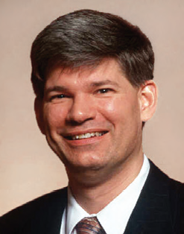
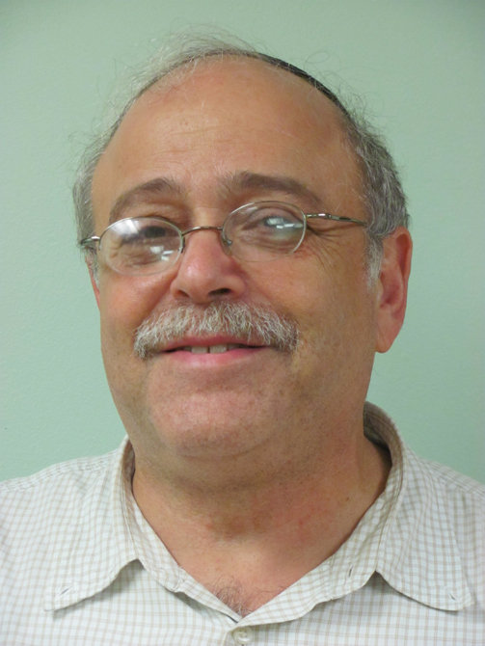
Brief History
Created at the MIT AI Lab in 1975, designed by Guy Steele and Gerald Sussman
Scheme is one of the two dialects of Lisp, introduced in 1958, and focus was to optimize and improve functional programming feature

Slide 4
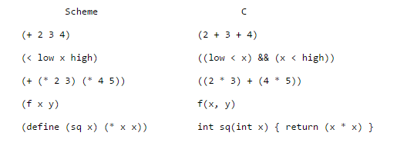
Difference in syntax
Compared with C programming language

Slide 5

Hello, World!
Semi-colon in scheme is used for commenting purposes, it ignores all the following text on the line
This line of codes, obviously, prints out Hello, World! On the console

Slide 6
Data Types
Boolean
#t -> true
#f -> false
Name of the data type followed by the question mark checks if the following statement is that of the same data type, then prints out the result in a Boolean value, as shown above

Slide 7
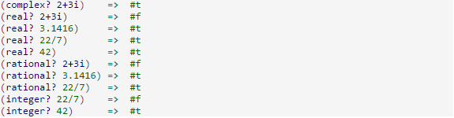
Data Types
Numbers
Scheme does not have a numeric data types such as short, long, float, double like in C++, Java, etc.

Slide 8

Data Types
Numbers (Arithmetic Operators)
Operator comes in front of all operands
If there is only one operand, subtraction and division operators act as a unary operators, and return the negation and the reciprocal respectively

Slide 9

Data Types
Characters
Characters must be followed by the sharp-backslash
Can be compared using (char=?) , (char<?), (char>=?), etc. and can be converted to upper/lower case by using (char-downcase #\A) or (char-upcase #\a)

Slide 10
Data Types
Strings
Strings can be either defined in a double quotation marks or a apostrophe followed by the desired string value

Slide 11
Procedures
Users may create procedures using the special form lambda
add2 -> procedure name
x -> parameter
+ x 2 -> procedure body, which adds 2 to the x

Slide 12

Recursion
Scheme has no specific “loop” constructs such as for, while, do while, etc., and looping has to be simulated by the use of recursion
In other languages, such as Java, factorial function can be written with for loop, but it HAS to be done with recursion with scheme because for loop is not supported

Slide 13
Objects and classes
Object Oriented Programming is supported in scheme by the use of objects and classes.

Slide 14
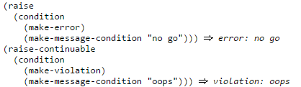
Error Detection
Exceptions can be “raised” by the user code via the raise or raise-continuable procedures. Condition has to be defined if user wants to raise an exception.

