Slide 1
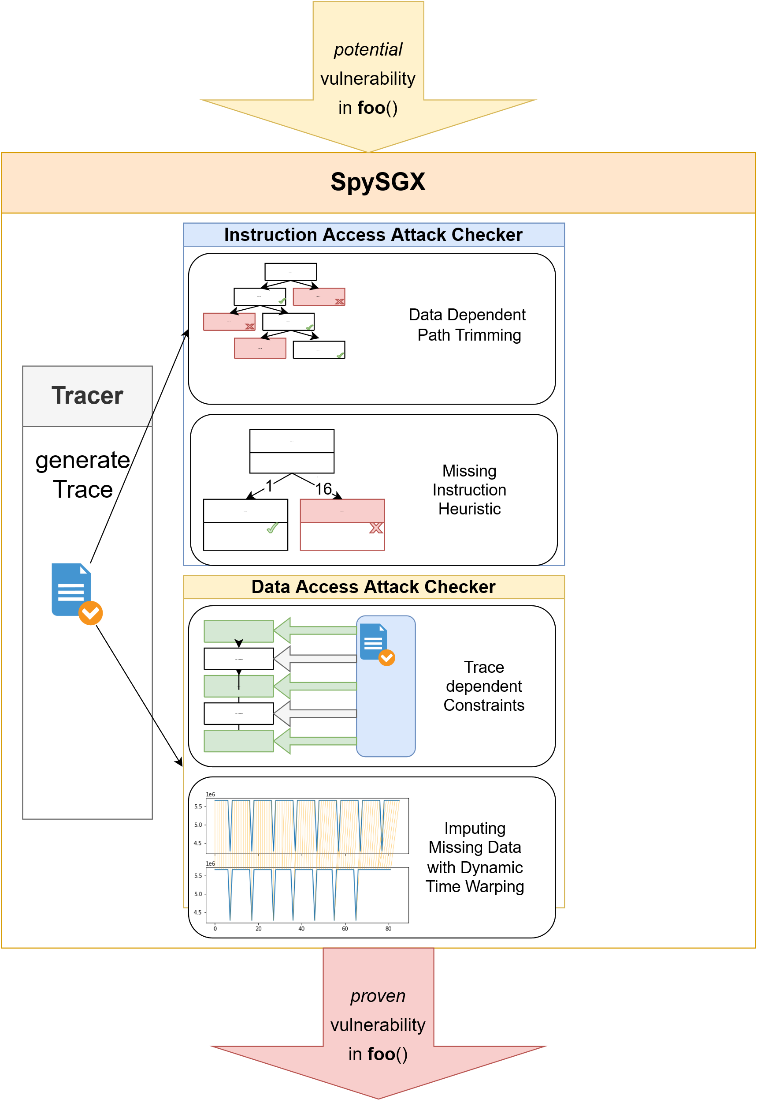
SpySGX: Automatic Reversing of Secrets from Memory Traces in SGX-Enclaves
Youheng Lü h21youlu@du.se
Supervisors:
Ilias Thomas (HDa) ith@du.se
Michael Schwarz (CISPA) michael.schwarz@cispa.de

Slide 2
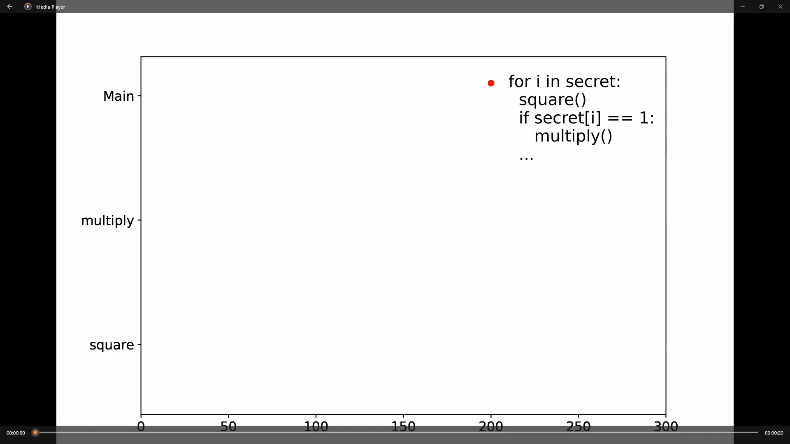
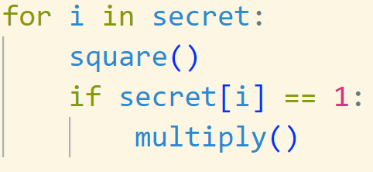
Reversing secret from memory traces
Memory trace
Square and multiply
SECRET
MEMORY ACCESS

Slide 3
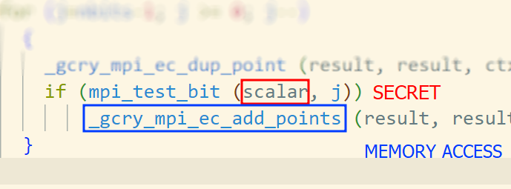
Intel – Software Guard Extension (SGX)
SGX-Library = Library code i.e used of secure cloud computing
In SGX: Assume attacker has access to memory accesses [2]
Vulnerable Code in Libgcrypt, a major cryptographic library [1]

Slide 4
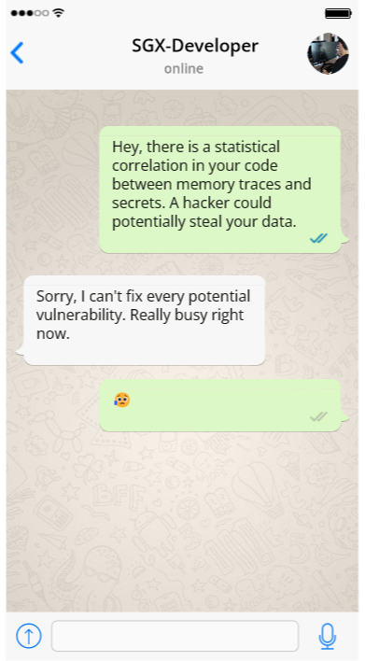
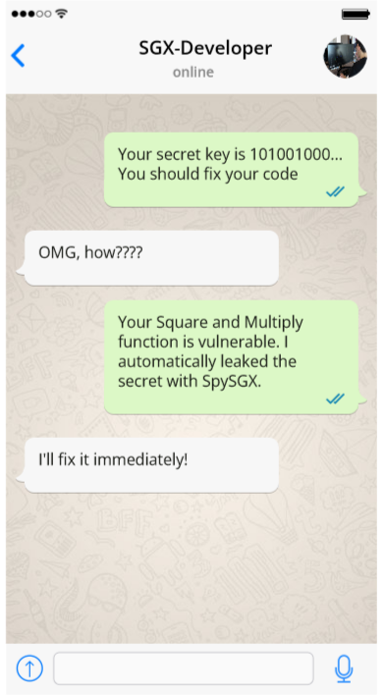
Main idea
Correlation Approaches.
Not our work.
Break-In
Approach
We do this.

Slide 5
Our contribution
Emulation-based Data Collection
Novel Method for reversing secrets: Combining Symbolic Execution with Data Analysis
Strategies for Missing Data

Slide 6
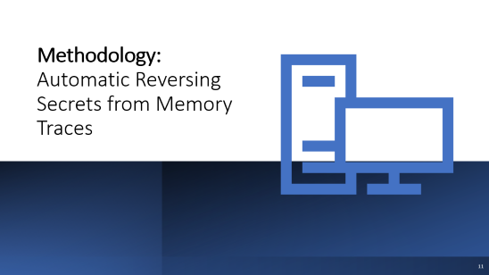



Presentation Outline

Slide 7

Data Collection

Slide 8
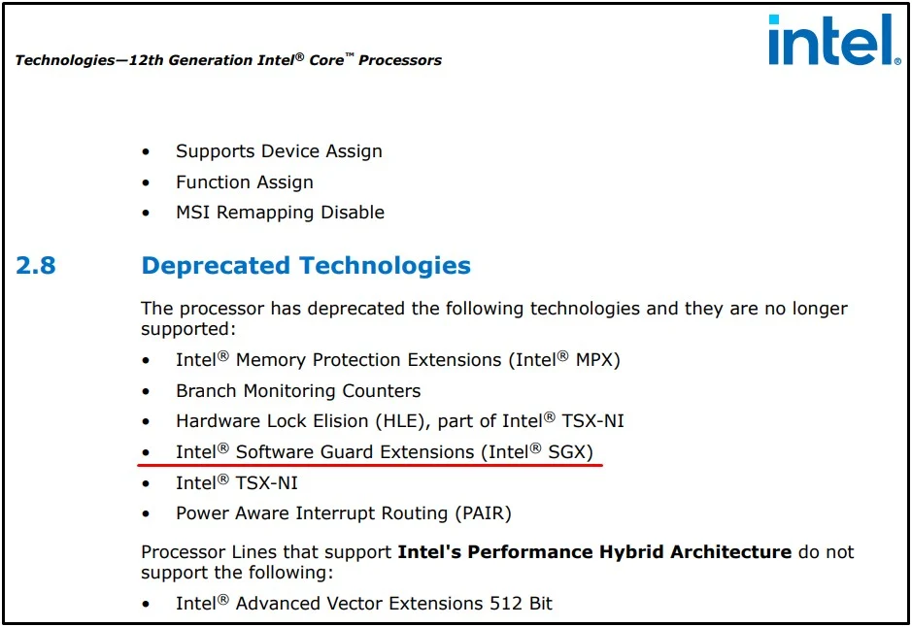
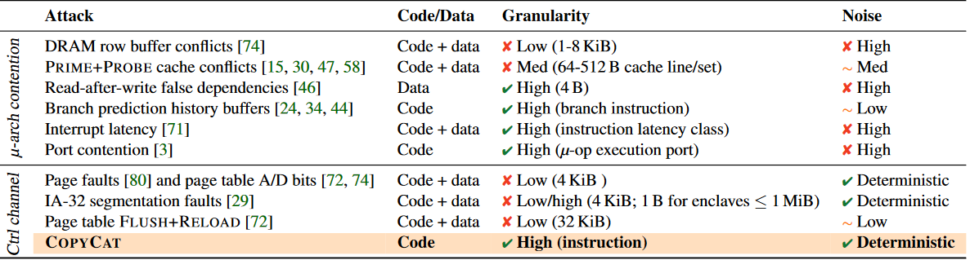
Data Collection: Challenges
A) Collecting data requires special CPU
B) Collection on Real hardware:
Noise or other limitations [2]

Slide 9
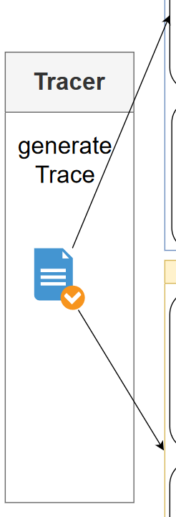
Emulation-based Data Collection
SGX-Emulator [3]: Software that simulates SGX – environment
Collect accesses in most SGX libraries without specialized hardware
Accurate data without noise or missing values
Requirement for symbolic execution

Slide 10
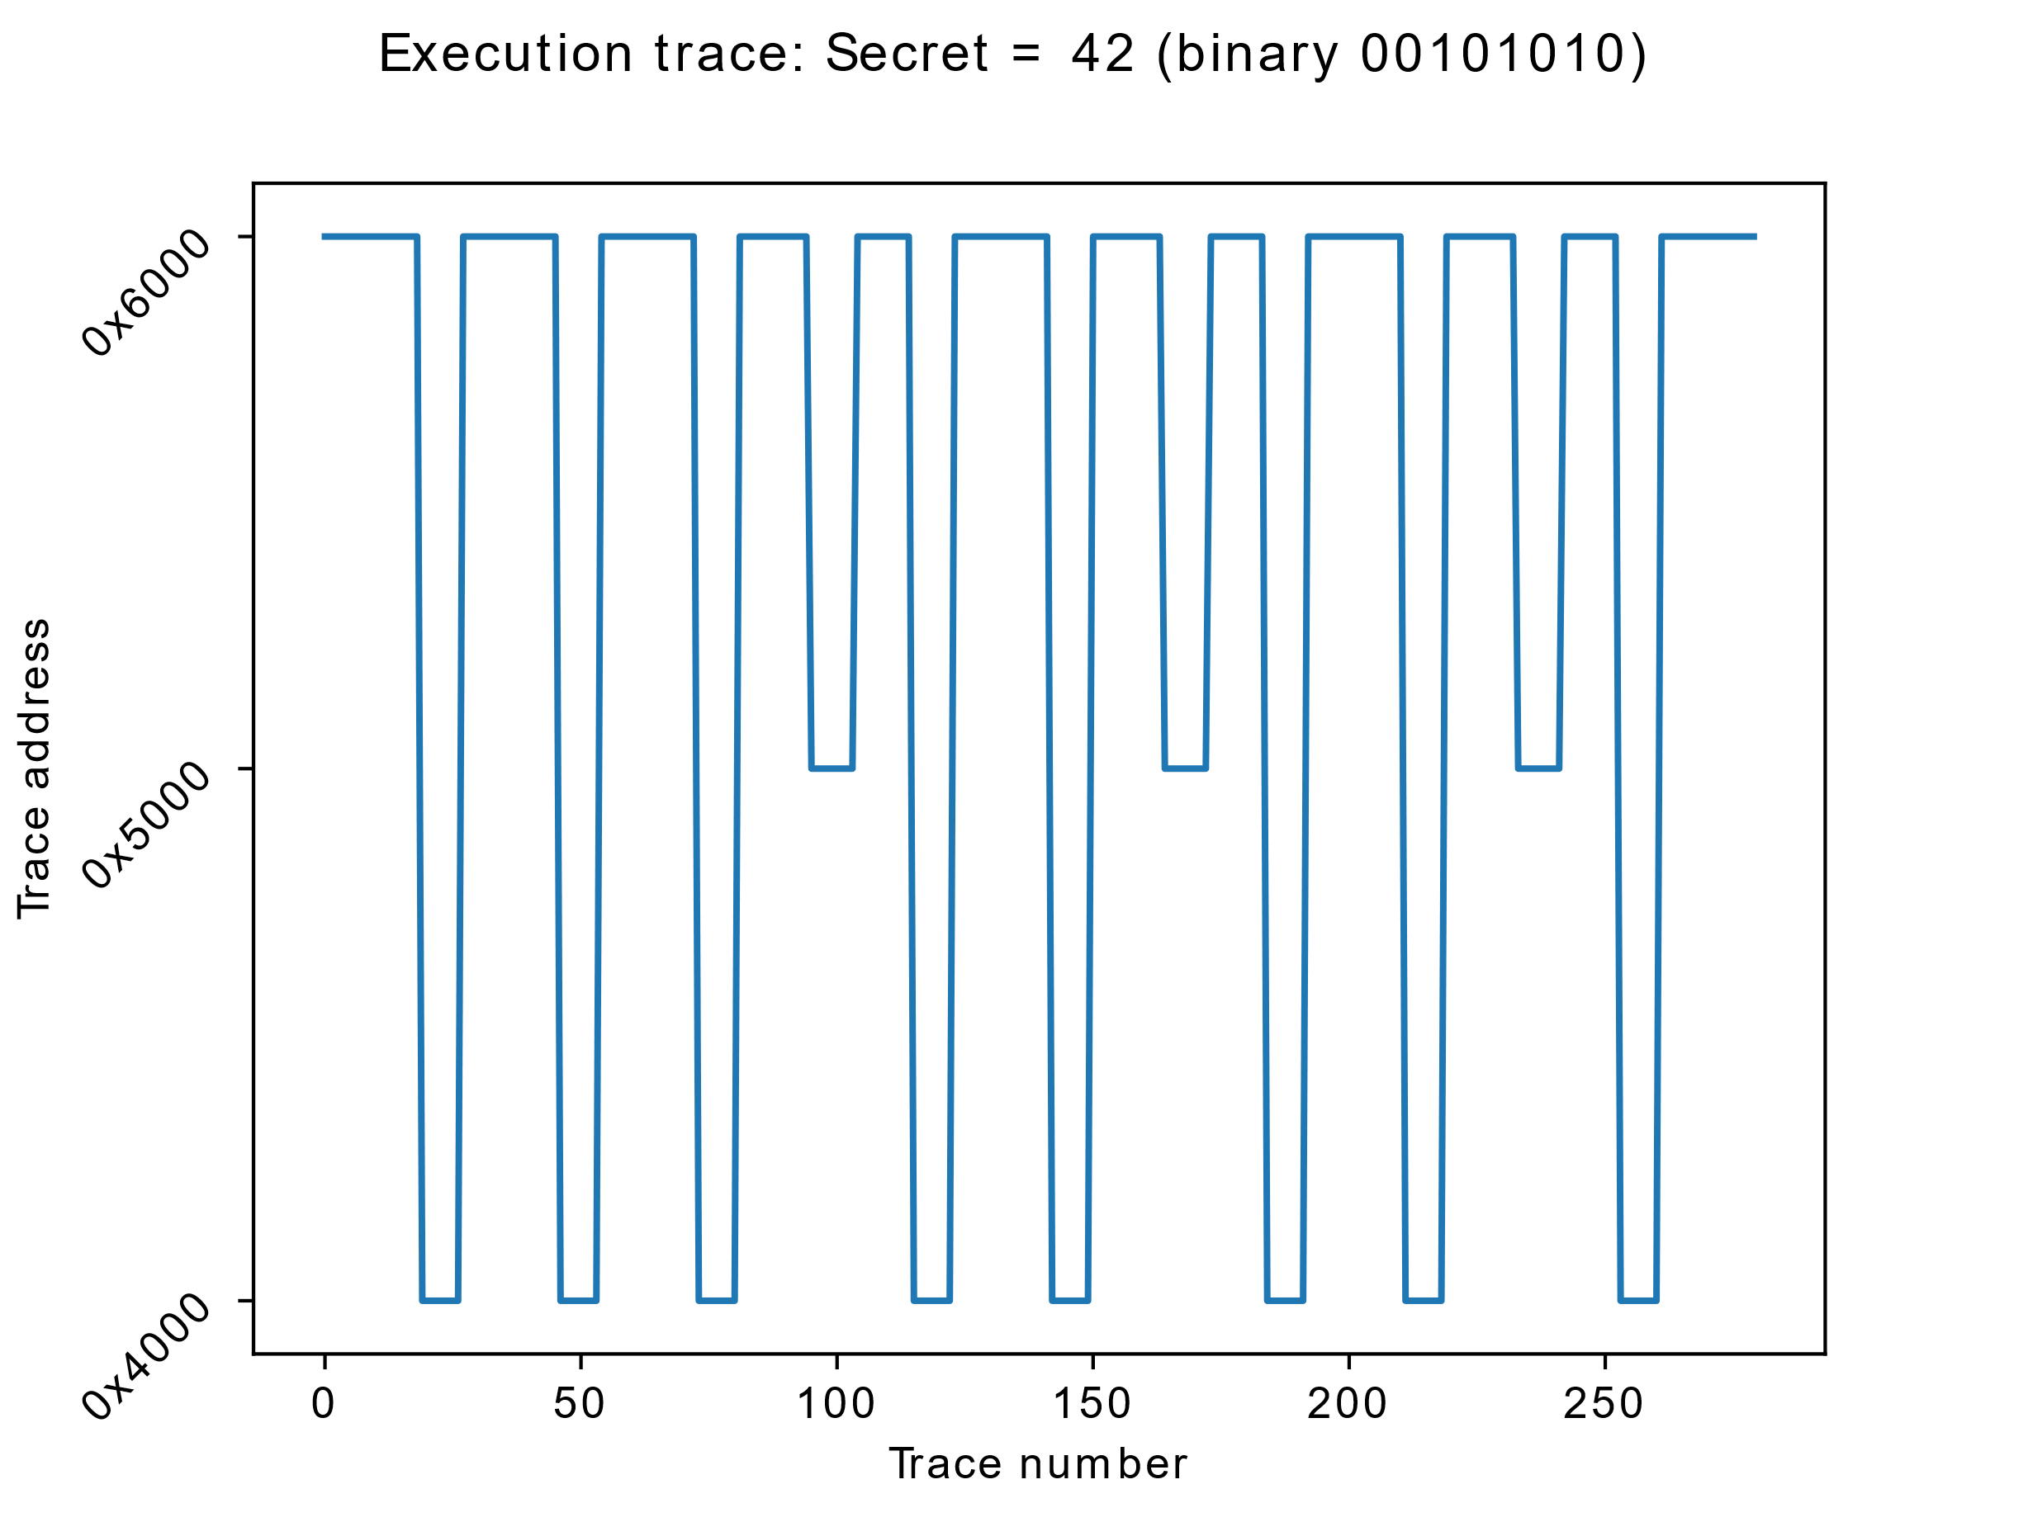
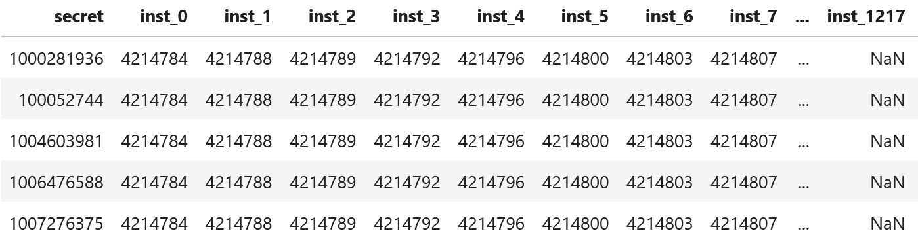
Data Description
Target: secret key: integer
Features: Memory-accesses: integer
Visualization with tiny secret
Target SGX Library
First five memory traces

Slide 11

Methodology: Automatic Reversing Secrets from Memory Traces

Slide 12
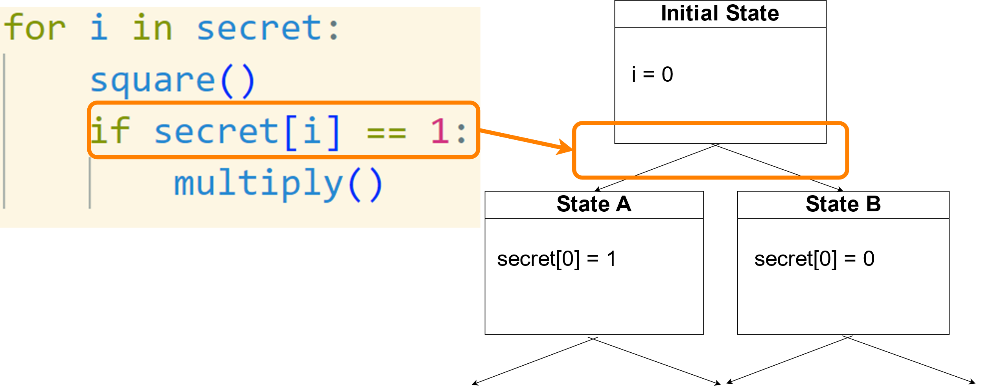
Symbolic execution
Run program with secret as symbolic variable
Secret dependent If-condition: Create 2 states
Information Gain

Slide 13
Why symbolic execution?
One of final states will contain 100% accurate solution
Generalizes to any code it can emulate
No training required, can revert secret with one trace + enclave library

Slide 14
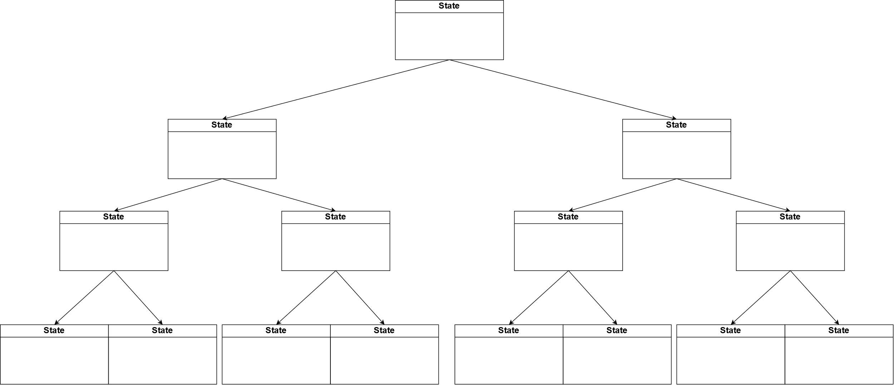
Challenge: Path Explosion
Number of possible paths grows exponentially
4 If-Conditions = 16 paths
1024 If-Conditions > 10^308 paths

Slide 15
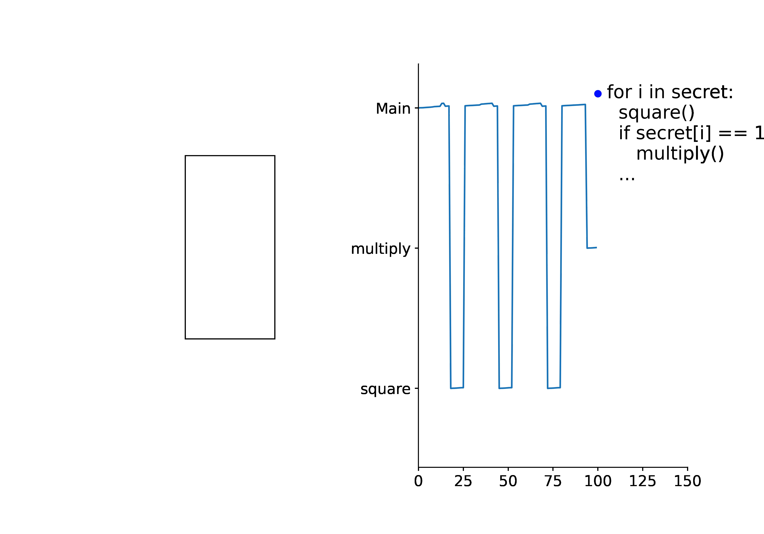

Slide 16
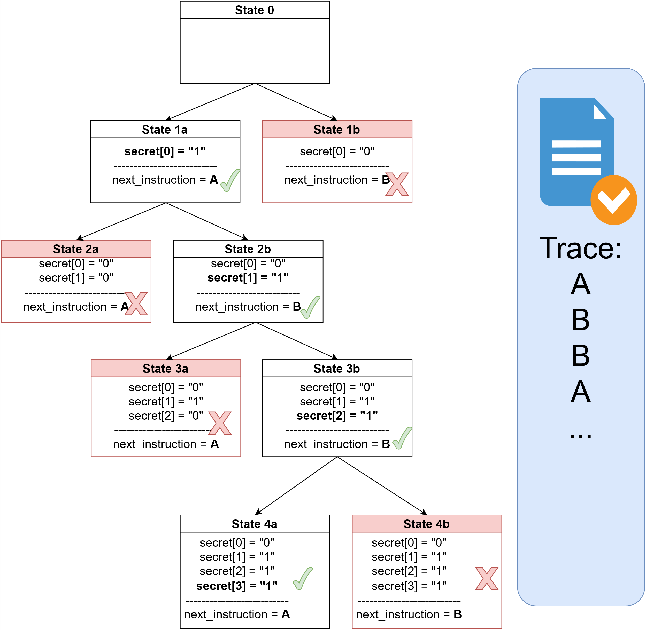
Novel approach: Data-Dependent Path Trimming
Discard all paths that do not match trace
At the end: Calculate secret

Slide 17

Dealing with Missing Data

Slide 18
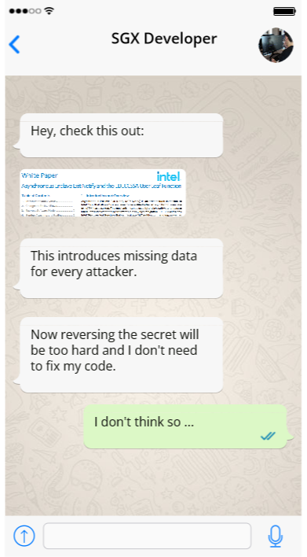
Motivation: Missing data [4]

Slide 20
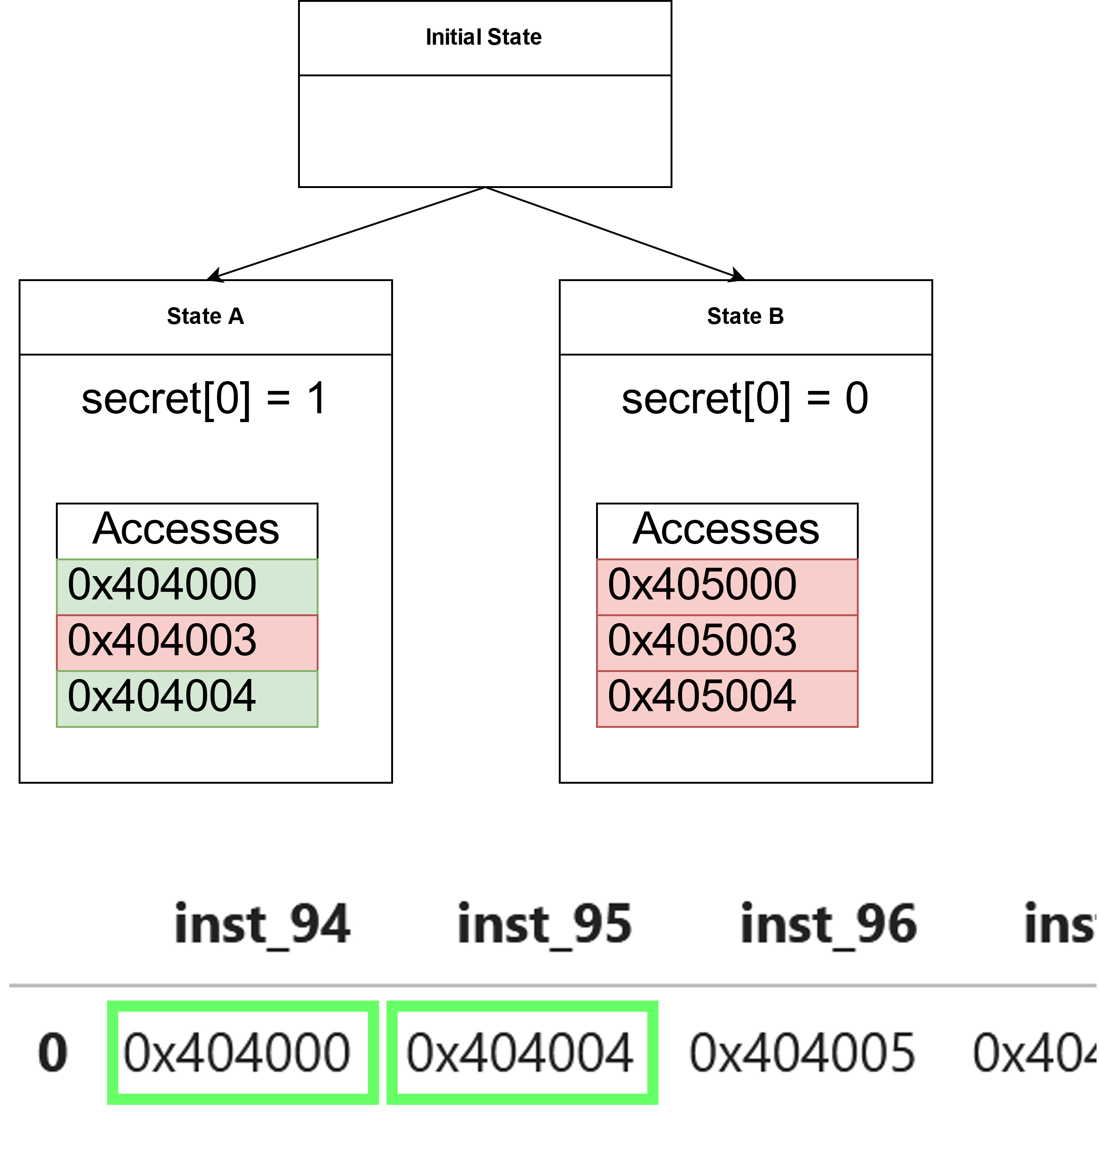
Instruction Access enclave Missing Instruction Heuristic
Trace contains redundant information.
Check which path least missing instructions
Discard all other paths

Slide 21

Results + Discussion

Slide 22
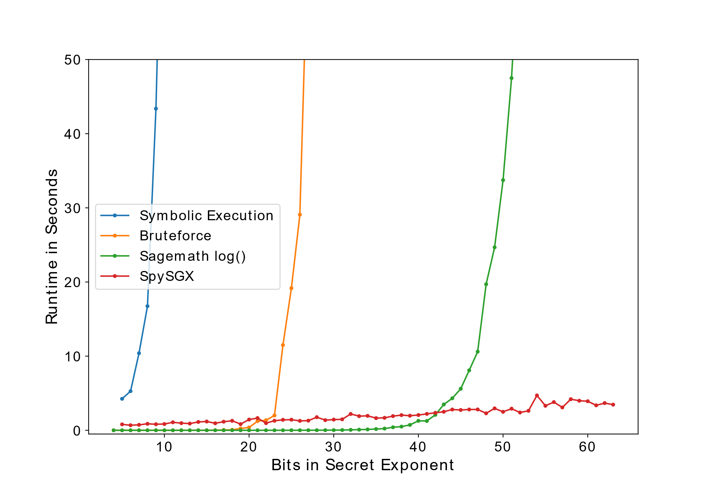
Reversing Secret from full trace
1000/1000 secrets reversed correctly
Other approaches: exponential time
SpySGX: linear time

Slide 23
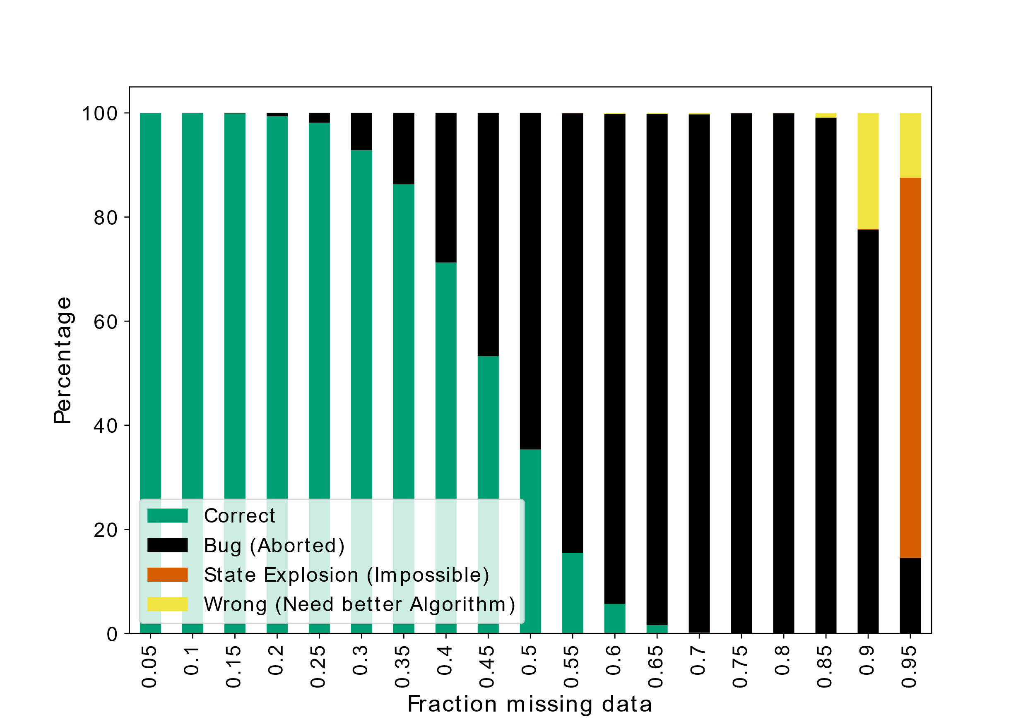
Missing Data
25% Missing data:
98% Secrets reversed correctly
70% Missing data:
<1% Secrets reversed correctly

Slide 24
Skipped in presentation
Reversing secret in Data Access attack
Dealing with missing data in Data Access attack
Skipped

Slide 25
Limitations
Experimental limitation (possible)
Design limitation (very hard)
Not tested on real-world SGX libraries
➔ Future work: libgcrypt
Analysis very hard on Hardware-based functions

Slide 26
Impact
Generic approach to analyze any SGX-Library (Limitation: Emulator)
Proven vulnerabilities ➔ More urgent fixes
Novel approach applicable to other fields: Side-Channel analysis

Slide 27
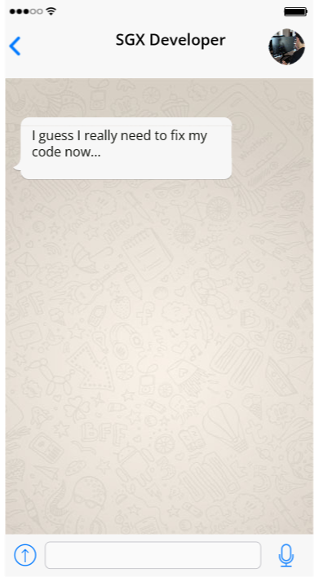
Thank you!

Slide 28
References
[1] Wang, Wenhao, et al. "Leaky cauldron on the dark land: Understanding memory side-channel hazards in SGX." Proceedings of the 2017 ACM SIGSAC Conference on Computer and Communications Security. 2017.
[2] Moghimi, Daniel, et al. "CopyCat: Controlled instruction-level attacks on enclaves." Proceedings of the 29th USENIX Conference on Security Symposium. 2020.
[3] Antonino, Pedro, Wojciech Aleksander Woloszyn, and A. W. Roscoe. "Guardian: Symbolic validation of orderliness in SGX enclaves." Proceedings of the 2021 on Cloud Computing Security Workshop. 2021.

Slide 29
References
[4] Asynchronous Enclave Exit Notify and the EDECCSSA User Leaf Function [White Paper], 2022, https://cdrdv2-public.intel.com/736463/aex-notify-white-paper-public.pdf [accessed: 24.04.2023]
[5] L. Hu, F. Zhang, Z. Liang, R. Ding, X. Cai, Z. Wang, and W. Jin, “Faultmorse: An automated controlled-channel attack via longest recurring sequence,” Computers & Security, vol. 124, p. 103003, 2023.
[6] E. P. Caillault, A. Lefebvre, A. Bigand et al., “Dynamic time warping-based imputation for univariate time series data,” Pattern Recognition Letters, vol.139, pp. 139–147, 2020

Slide 30
Image Sources
Fake Whatsapp Messages: https://commons.wikimedia.org/wiki/Category:Web_developers#/media/File:Kama_it_01.png
https://www.fakewhats.com/generator
SGX Deprecated on specific CPUs:
https://www.bleepstatic.com/images/news/u/1220909/devices/deprecated.jpg

Slide 31

Backup slides

Slide 32
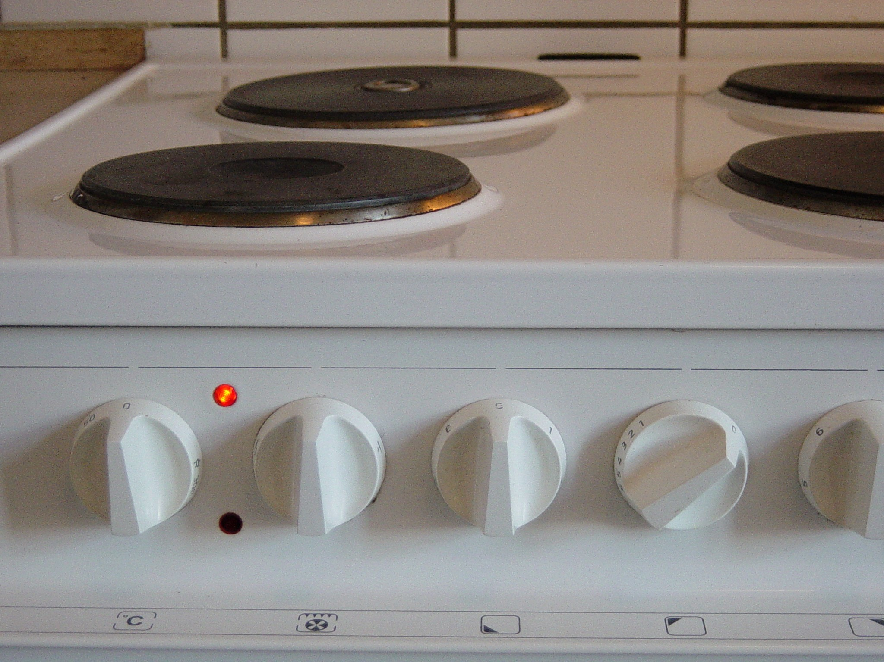
Memory-Access Side-Channel Attacks
“… Intel® SGX is not specifically designed to protect against side-channel attacks, ...”
Data Inference to steal secrets
Our Focus
Side Effect
Memory Access
Secret
Someone used
the stove
Roommate cooked and skipped diet

Slide 33
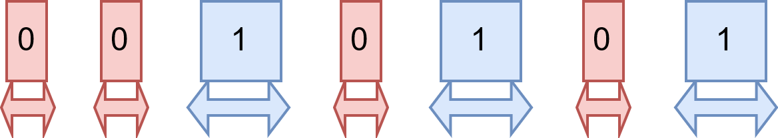
Related Work: FaultMorse[5]
Published Jan. 2023
Approach: Longest Recurring sequence
Limitations:
Requires very specific pattern
Only Instruction-Access attack
No strategy for missing data

Slide 34
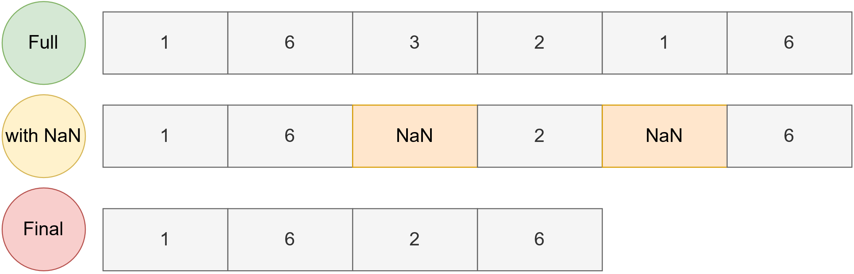
Missing Data
Challenge: Unknown which index is missing
Standard methods (Linear Interpolation, Mean Imputation…) won’t work

Slide 35
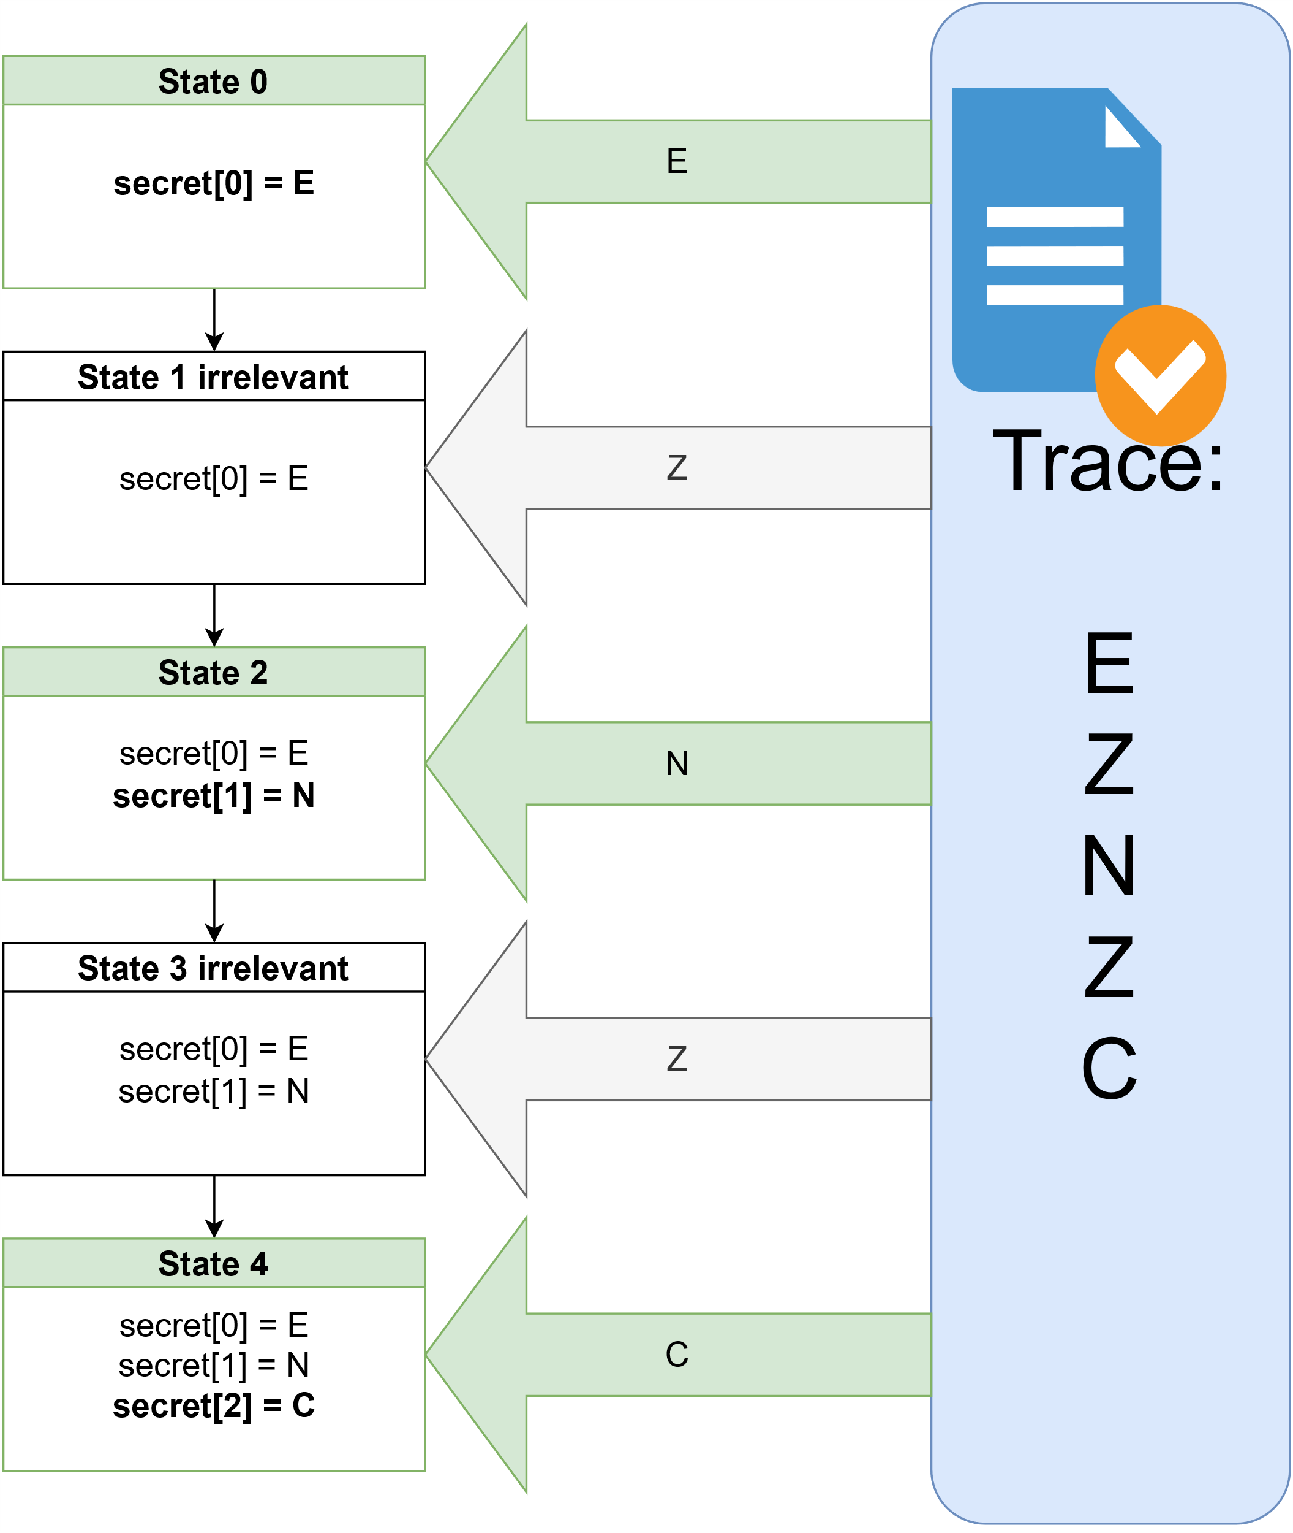
Data-Access: Trace-dependent Helper Constraints
Whenever the enclave does a data-access:
Add information from the trace
Irrelevant information will not affect calculation
Expectation: Information is helpful and simplifies the equation

Slide 36
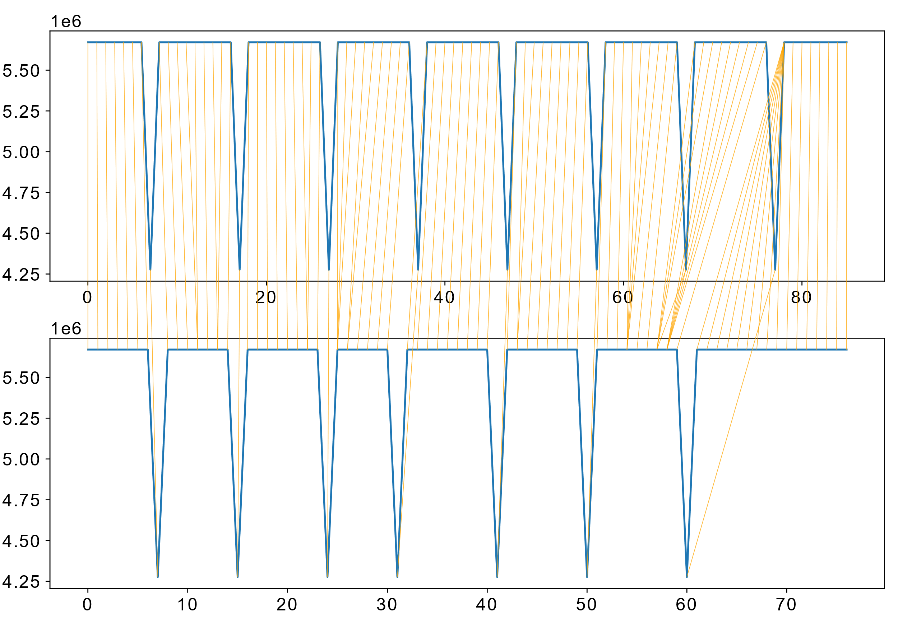
Data Access enclave Dynamic Time warping [6]
Calculates Matching between two time-series
Hyperparameter: Window Size
Imputation Method:
Matching: incomplete trace and complete trace
Double matches: Assume NaN
Impute NaN with complete trace

Slide 37
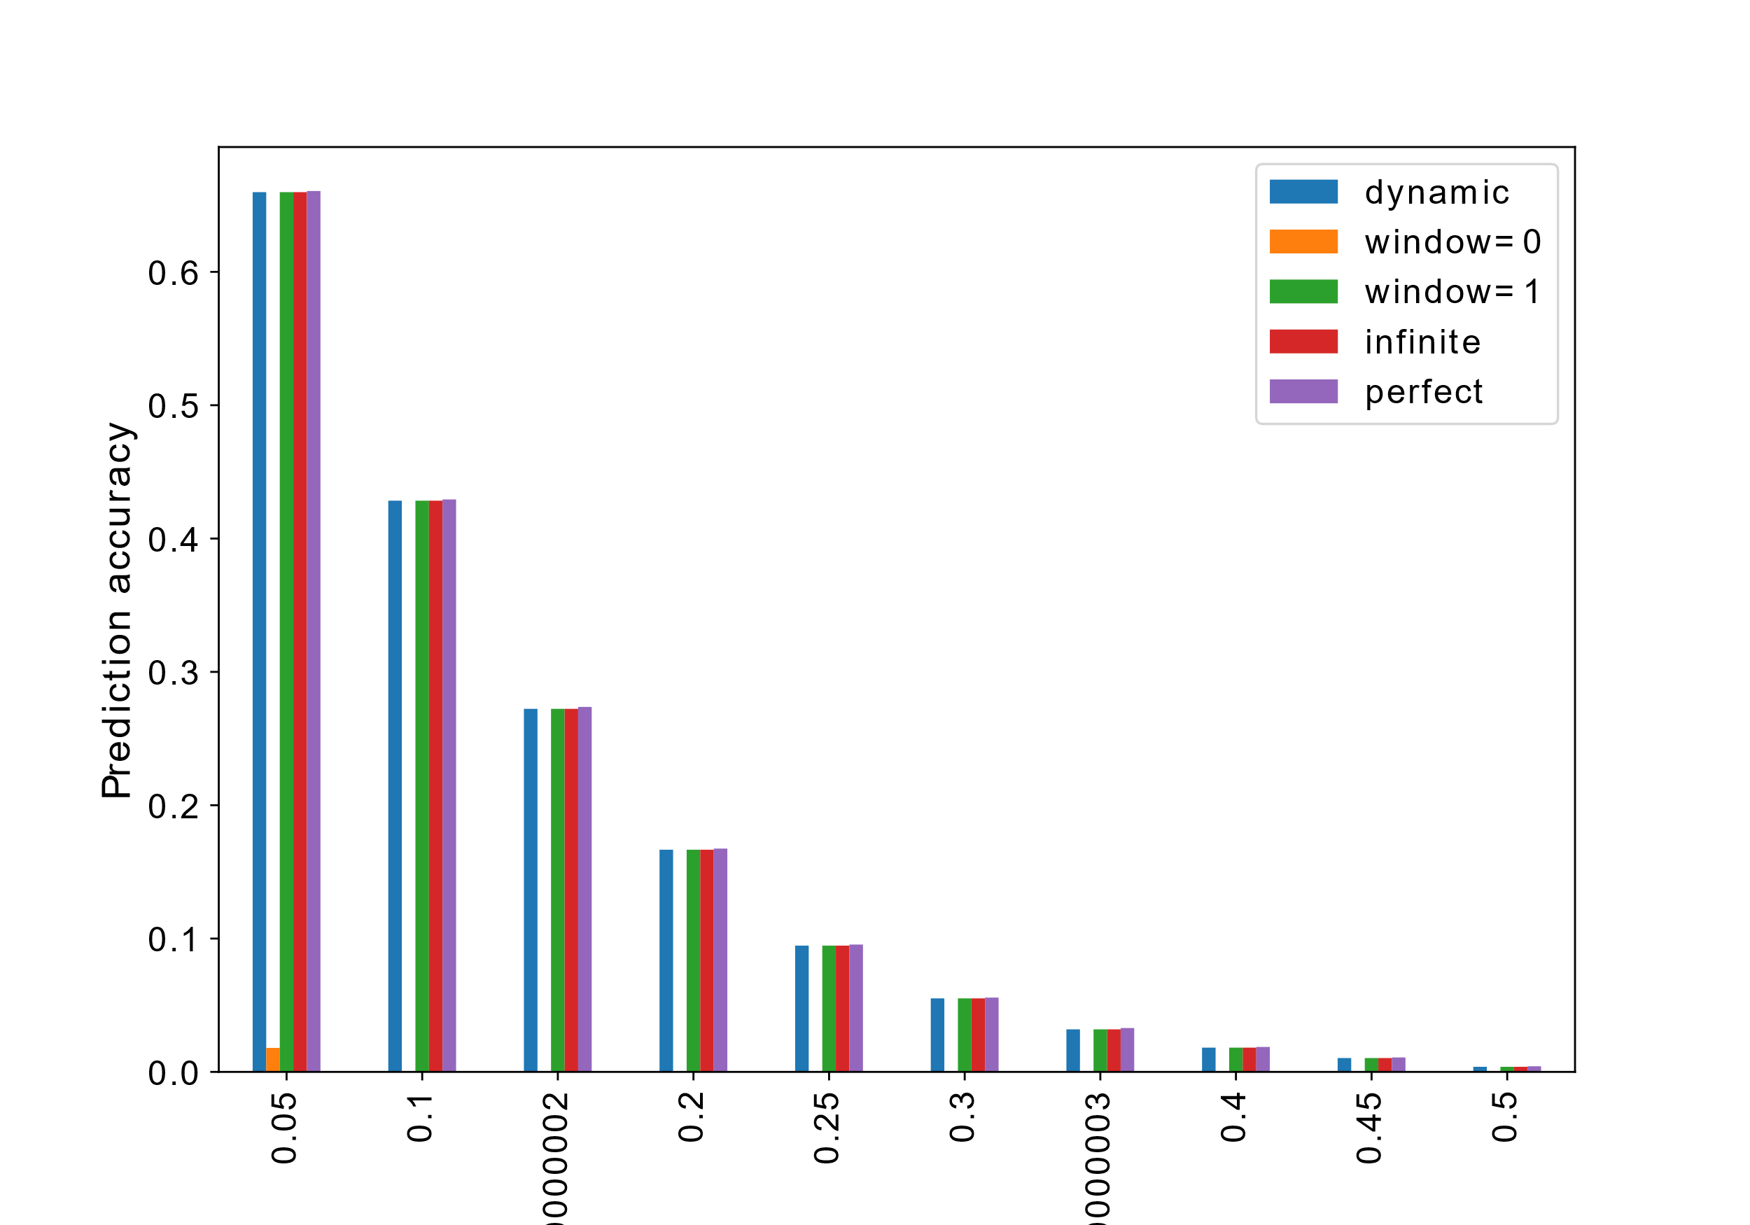
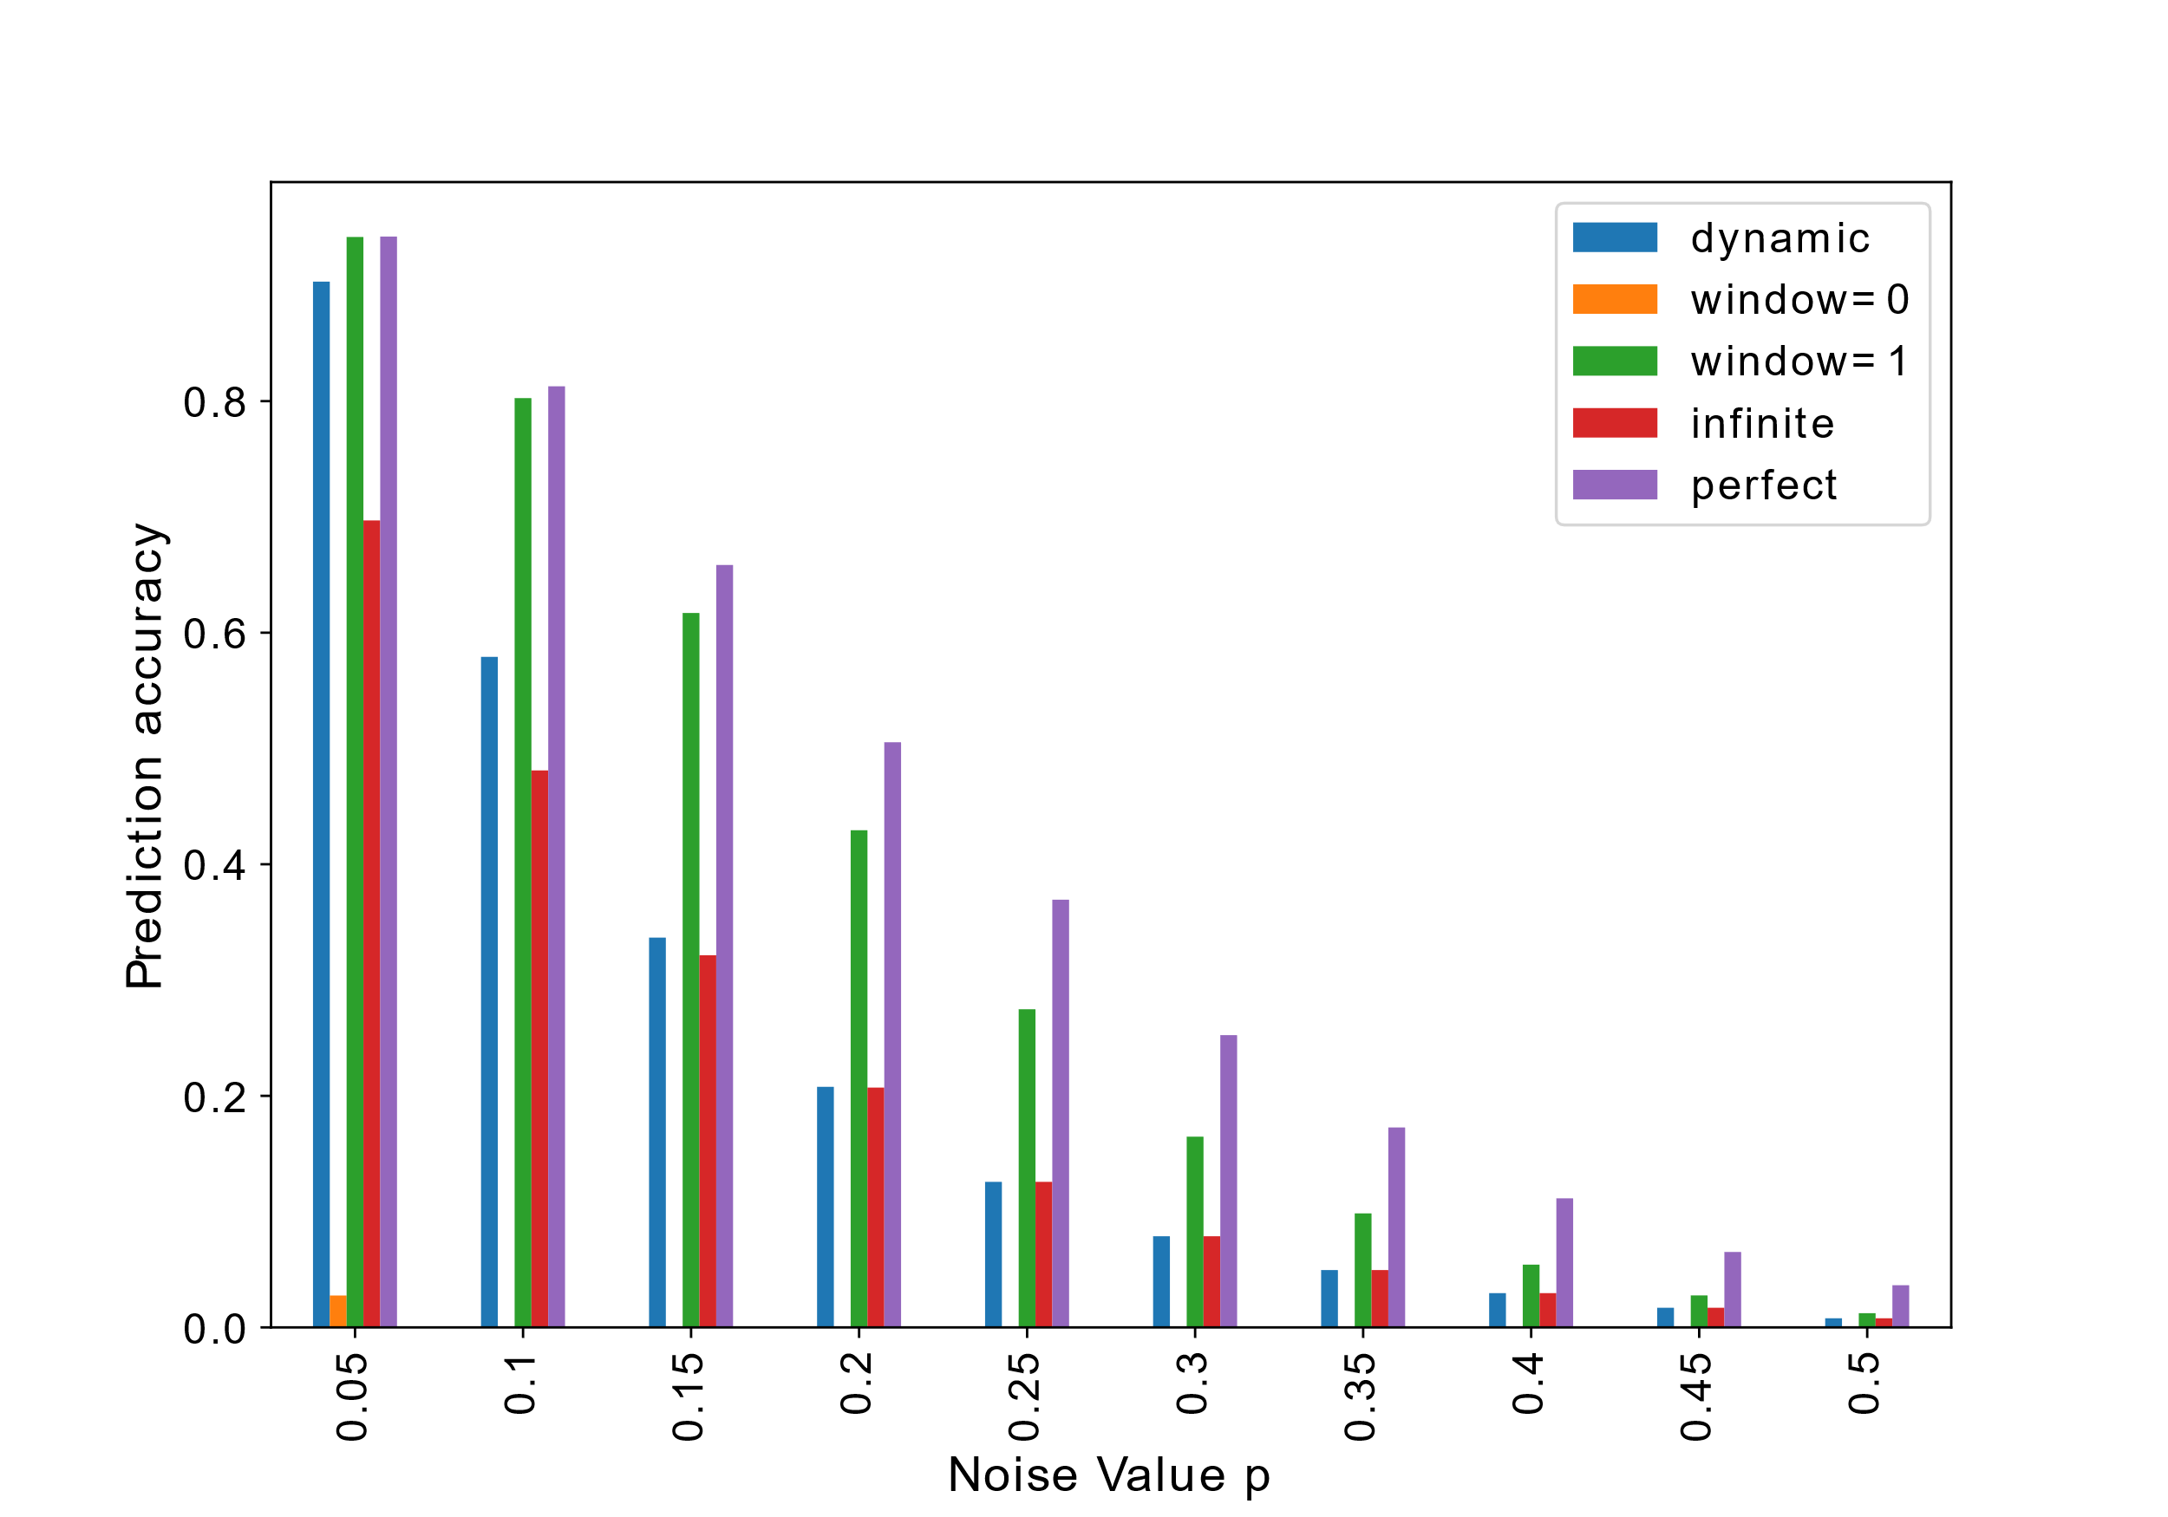
Missing Data Access – Dynamic Time Warping
8 of 8 bytes of secret correct:
Purple = perfect imputation as comparison
DTW has same accuracy as Perfect imputation
7 of 8 bytes of secret correct:
Window size = 1 within 0.1 of perfect imputation

