Slide 1
INVENTORY MANAGEMENT SYSTEM

Slide 2
INTRODUCTION TO INVENTORY MANAGEMENT
Inventory management system is a system for tracking inventory levels, orders, sales and deliveries. It can also be used in the manufacturing industry to create a work order, bill of materials and other production-related documents. Companies use inventory management system to avoid product overstock and outages. It is a tool for organizing inventory data that before was generally stored in hard-copy form or in spreadsheets.
Inventory management software is used for a variety of purposes, including:
Maintaining a balance between too much and too little inventory.
Tracking inventory as it is transported between locations.
Receiving items into a warehouse or other location.
Picking, packing and shipping items from a warehouse.
Keeping track of product sales and inventory levels.
Avoiding missing out on sales due to out-of-stock situations.

Slide 3
PROPOSED SYSTEM FUNCTIONALITY
The proposed system has a user friendly Interface for porting of data to server.
The proposed system provides the facility to pull the data from the server of the specified Supply order number and get the respective report.
The proposed system provides the no replication of data.
User can get the desired output according to their queries .This is an added advantage.

Slide 4
METHODODLOGY
Incremental Build Model :
The incremental build model is a method of software development where the product is designed, implemented and tested incrementally (a little more is added each time) until the product is finished. It involves both development and maintenance. The product is defined as finished when it satisfies all of its requirements. This model combines the elements of the waterfall model with the iterative philosophy of prototyping.
The product is decomposed into a number of components, each of which is designed and built separately (termed as builds). Each component is delivered to the client when it is complete. This allows partial utilization of the product and avoids a long development time. It also avoids a large initial capital outlay and subsequent long waiting period. This model of development also helps ease the traumatic effect of introducing a completely new system all at once.

Slide 5
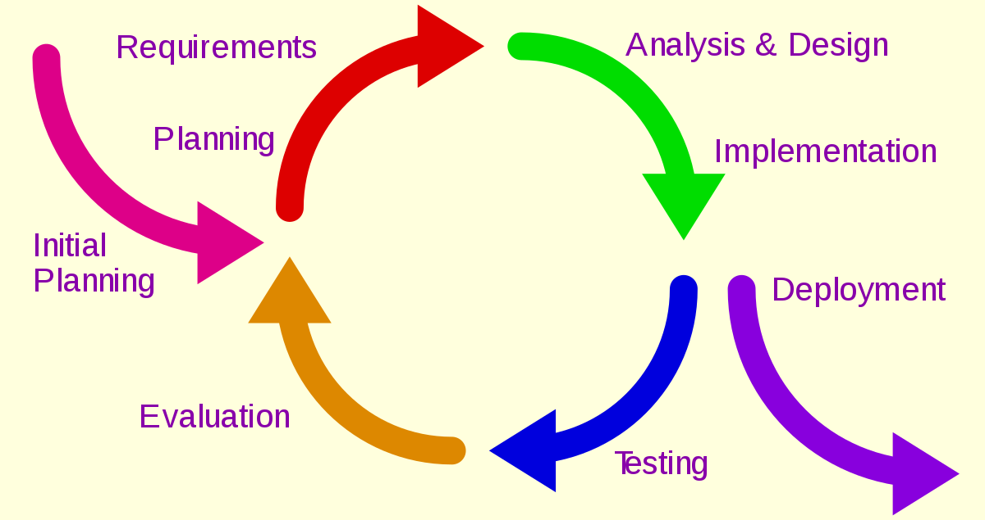
WATERFALL MODEL

Slide 6
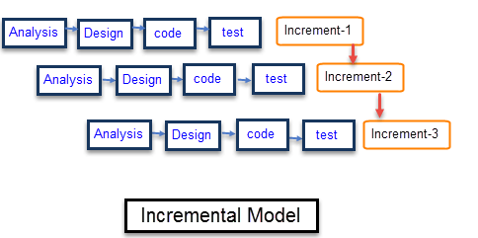
INCREMENTAL MODEL

Slide 7
COMPONENTS OF INVENTORY MANAGEMENT SYSTEM
Client Side Components:
Javascript
HTML
jQuery AJAX
CSS
Server Side Components :
Apache
PHP
MySQL

Slide 8
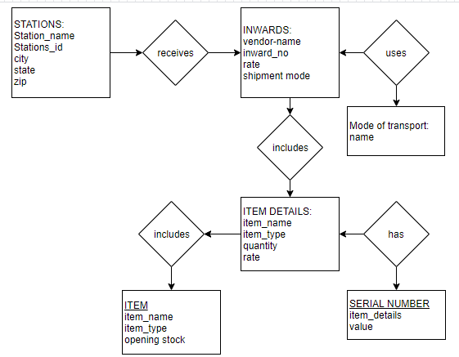
ER DIAGRAM

Slide 9
SYSTEM REQUIREMENTS
Software Requirments:
Web server (WAMP)
GitHub
Brackets
Database server (MySQL)
Hardware Requirments:
Processor : i3
RAM : 4 GB
Hard Disk : 20 GB

Slide 10
SCOPE AND LIMITATIONS
The “Inventory Management System” software is being developed as an accurate and efficient system for the user . In this system the record of the each request details are preserved along with their transaction related to them. The system is also made secured as all the updation and transaction can be done by the authorized person .
Databased used is SQL Server and every database have a stack limit.
Manual Errors at the time of entering the data can’t be check, only the validation required w.r.t proposed system is checked.

Slide 11
IMPLEMENTATION
Once the system was tested, the implementation phase started. A crucial phase in the system development life cycle is successful implementation of new system design. Implementations simply mean converting new system design into operation. This is the moment of truth the first question that strikes in every one’s mind that whether the system will be able to give all the desires results as expected from system.
The term implementation has different meanings, ranging from the conversion of a basic application to a complete replacement of computer system Implementation is used here to mean the process of converting a new or revised system design into an operational one. Conversion is one aspect of implementation. The other aspects are the post implementation review and software maintainence

Slide 12
CONCLUSION
The objective of this project was to build a program for maintaining the details of all Supply Order .
The system developed is able to meet all the basic requirements. It will provide the facility to the user so that they can keep tracks of all the equipments being supplied.
The management of the Inventory will be also benefited by the proposed system, as it will automate the whole supply procedure, which will reduce the workload. The security of the system is also one of the prime concerns.

Slide 13
THANK YOU!

