Slide 1
INVENTORY MANAGEMENT SYSTEM

Slide 2
OPERATIONAL CONCEPTS
Real-time inventory management
Provides notification of low stock to managers
Helps ensure that popular items remain in stock

Slide 3
ARCHITECTURE
Client-Server (2 different clients)
All data at the server
Stock Manager Client web interface

Slide 4
INTRODUCTION TO INVENTORY MANAGEMENT
Inventory Management System:
Inventory management system is a system for tracking inventory levels, orders, sales and deliveries. It can also be used in the manufacturing industry to create a work order, bill of materials and other production-related documents. Companies use inventory management system to avoid product overstock and outages. It is a tool for organizing inventory data that before was generally stored in hard-copy form or in spreadsheets.

Slide 5
COMPONENTS OF INVENTORY MANAGEMENT SYSTEM
Client Side Components:
Javascript
HTML
jQuery AJAX
CSS
Server Side Components :
Apache
PHP
MySQL

Slide 6
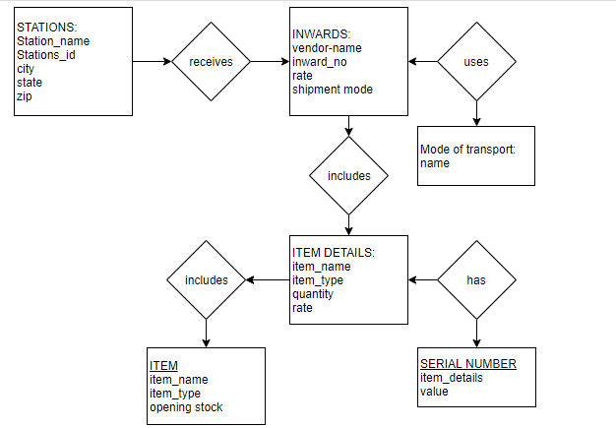
ER DIAGRAM

Slide 7
SYSTEM REQUIREMENTS
Database server (MySQL)
Web server (WAMP)
GitHub
Brackets

Slide 8
SCOPE AND LIMITATIONS
The “Inventory Management System” software is being developed as an accurate and efficient system for the user . In this system the record of the each request details are preserved along with their transaction related to them. The system is also made secured as all the updation and transaction can be done by the authorized person .
Databased used is SQL Server and every database have a stack limit.
Manual Errors at the time of entering the data can’t be check, only the validation required w.r.t proposed system is checked.

Slide 9
CONCLUSION
The objective of this project was to build a program for maintaining the details of all Supply Order .
The system developed is able to meet all the basic requirements. It will provide the facility to the user so that they can keep tracks of all the equipments being supplied.
The management of the Inventory will be also benefited by the proposed system, as it will automate the whole supply procedure, which will reduce the workload. The security of the system is also one of the prime concerns.

