Slide 1
Short-term forecasting of near shore
Davoud Ataee Tarzanagh
Zheming Gao
Li Liu
Angelo Marney
Chathurangi H. K Pathiravasan
David Robinson
Caoxin Sun
Mentors: Ty Hesser Matthew Farthing
USACE-Engineer Research and Development Center
Lea Jenkins (Clemson University)

Slide 2
(Add motivation 4 slides)
What is the problem?
Good reason to solve the problem
What do we need?
What shall we get?

Slide 3
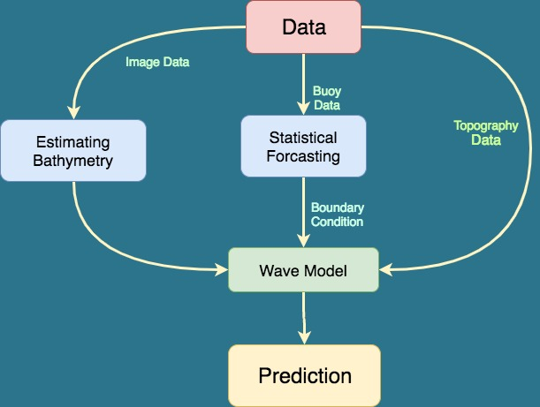
Workflow

Slide 4
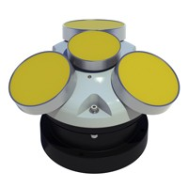
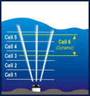
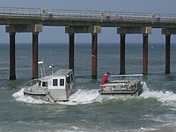
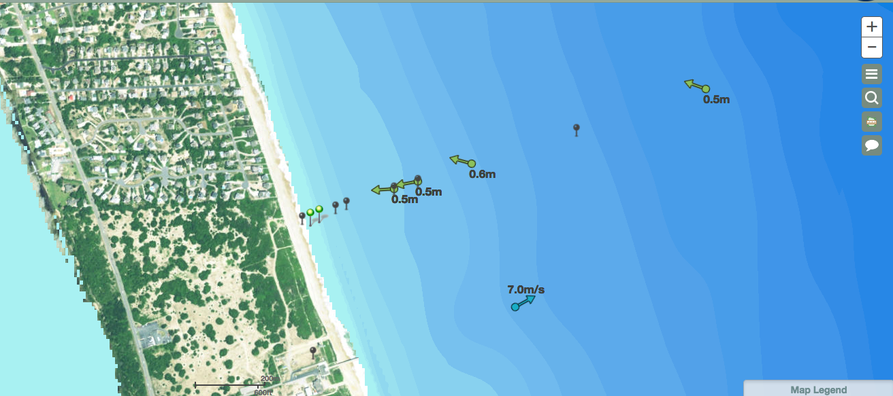
Data Resources
Offshore-direction array Data
Forecasts
Topography Data
Wave
Model
Image
Data
cBathy

Slide 5
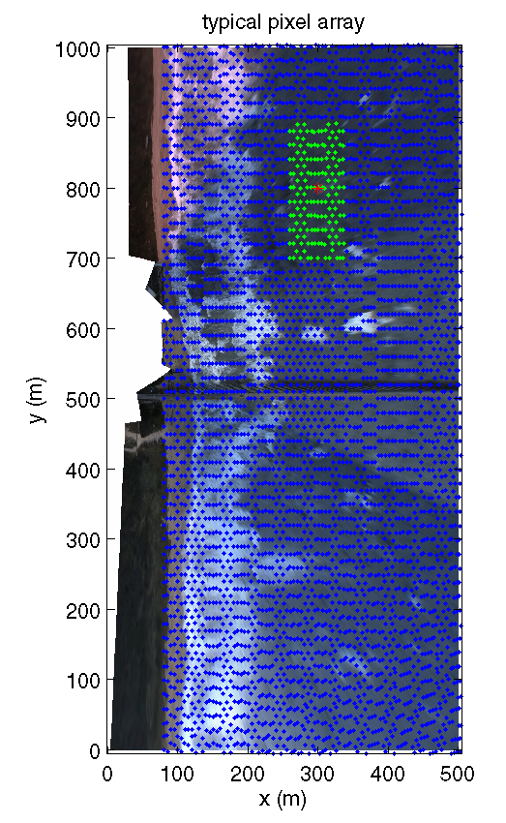

Robust cBathy Software
Compute normalized Fourier Transform, G = FT(I)/|FT(I)|
Compute the cross-spectral matrix,
for a number of f-bands
3. Model the phase of C as
Solve $\min_{\{L,E\}}{\text{ ||}\text{C}\text{− (}\text{L}\text{+}\text{E}\text{)||+ }\text{f}\text{(}\text{L}\text{)+}\text{g}\text{(}\text{E}\text{)}}$, where E is the corrupted components and L is a low rank estimation of C.
Let C=L and compute weighted cost function,
where w_{ij} is the coherence
Use nonlinear least-squares to find k_{x}, k_{y} that minimize J.
From resulting [f, k_{x}, k_{y}], estimate depth using linear dispersion (or better alternate) using N most coherent f-bands
wavenumber
bathymetry

Slide 6
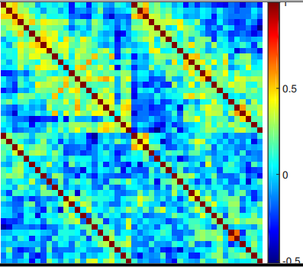
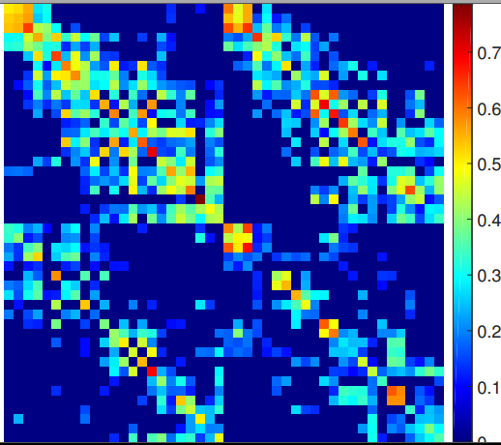
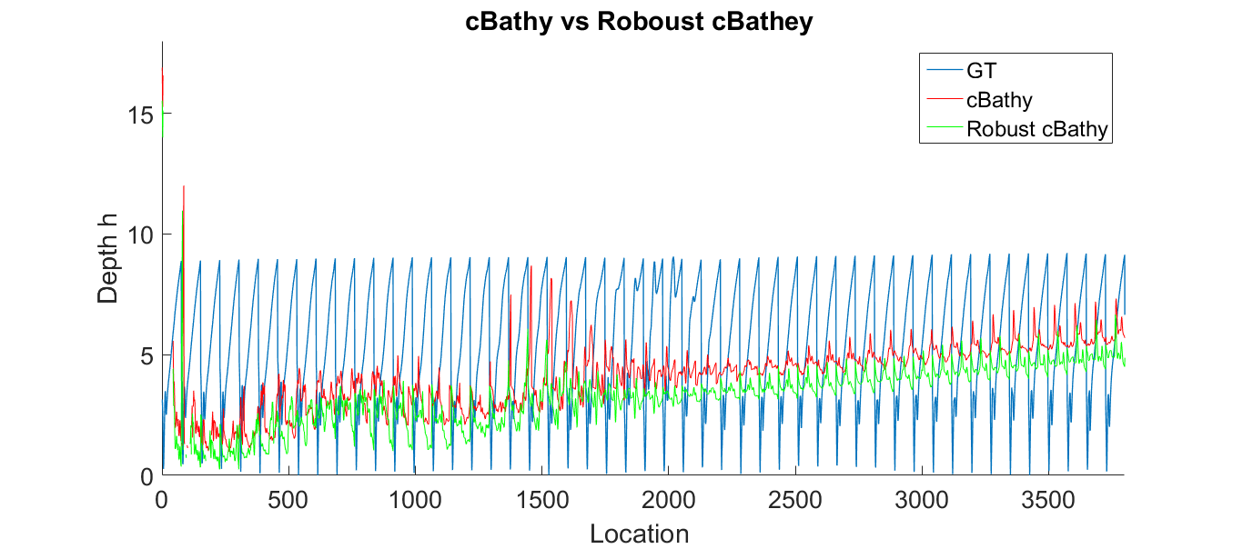
Example of Robust cBathy
Coherent Motion Matrix
cBathy
Robust cBathy
Depth Error
h

Slide 7
(Forecasts slides)
3 slices in total
Describe your model
Plots

Slide 8
(Add prediction slides)
Wave model, sandbar, shoreslope
What do you need
Show your results, plots
Tell

Slide 9
(Add and show Results)
We can talk about some scenarios.
For example: 2010 Haiti earthquake

Slide 10
Thank you

