Slide 1
Gene | Sample | Count
gene_A | sample_1 | 1
gene_A | sample_2 | 6
gene_A | sample_3 | 11
gene_B | sample_1 | 2
gene_B | sample_2 | 7
gene_B | sample_3 | 12
 | sample_1 | sample_2 | sample_3
gene_A | 1 | 6 | 11
gene_B | 2 | 7 | 12

Slide 2
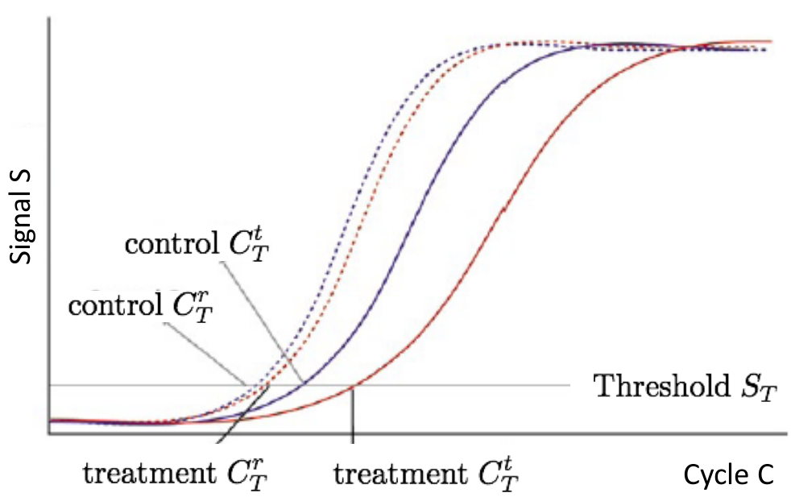




$$C_{P, cnt}^{g}$$
$$C_{P, cnt}^{r}$$
$$C_{P, trt}^{r}$$
$$C_{P, trt}^{g}$$

Slide 3










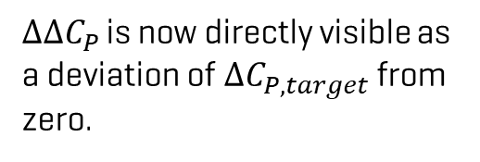









$${ΔΔC_{P}=\text{log}}_{2}(\text{fold}\text{−}\text{change})$$
$$\text{m}\text{ean}$$
$ΔΔC_{P }$is now directly visible as a deviation of $ΔC_{P,target}$ from zero.
$$2$$
$$2$$
$$1$$
$$1$$
$$mean(ΔΔC_{P })$$
$$ΔC_{P}−mean(ΔC_{P,control})$$
$$ΔC_{P}$$
$$0$$
$$0$$
$$−1$$
$$−1$$
$$mean(ΔΔC_{P })$$
$$−2$$
$$−2$$
$$\text{c}\text{ontrol}$$
$$\text{t}\text{arget}$$
$$\text{c}\text{ontrol}$$
$$\text{t}\text{arget}$$

Slide 4
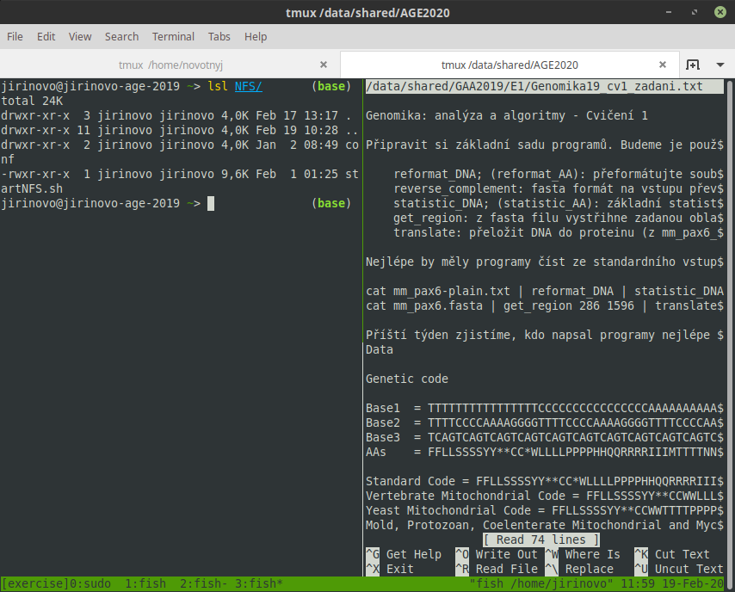
panes
session
windows

