Slide 1
Gene | Sample | Count
gene_A | sample_1 | 1
gene_A | sample_2 | 6
gene_A | sample_3 | 11
gene_B | sample_1 | 2
gene_B | sample_2 | 7
gene_B | sample_3 | 12
 | sample_1 | sample_2 | sample_3
gene_A | 1 | 6 | 11
gene_B | 2 | 7 | 12

Slide 2
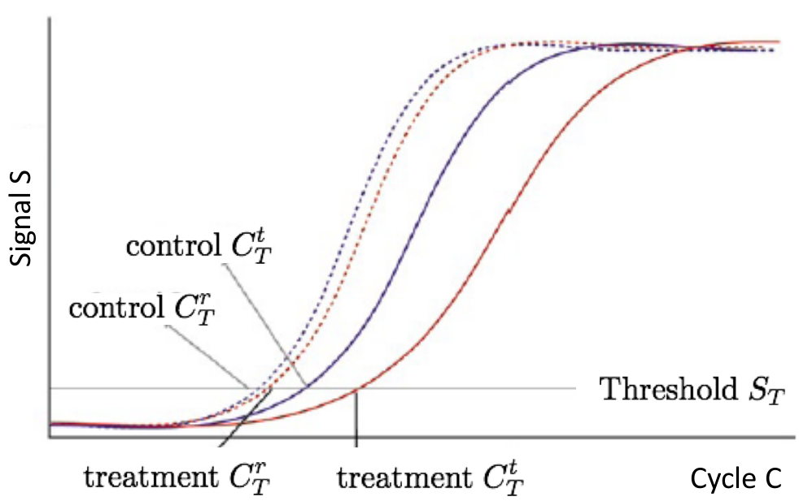




$$C_{P, cnt}^{g}$$
$$C_{P, cnt}^{r}$$
$$C_{P, trt}^{r}$$
$$C_{P, trt}^{g}$$

Slide 3










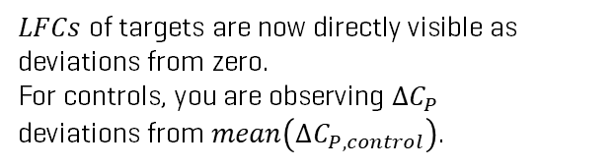

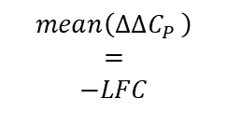









$LFCs$ of targets are now directly visible as deviations from zero. For controls, you are observing $ΔC_{P}$
deviations from $mean\left(ΔC_{P,control}\right)$.
$${−ΔΔC_{P}=\text{log}}_{2}(\text{fold}\text{−}\text{change})$$
$$\text{m}\text{ean}$$
$$2$$
$$2$$
$$1$$
$$mean\left(ΔΔC_{P }\right)$$
$$=$$
$$−LFC$$
$$1$$
$$mean(LFC)$$
$$−(ΔC_{P}−mean\left(ΔC_{P,control}\right))$$
$$ΔC_{P}$$
$$0$$
$$LFC$$
$$0$$
$$−1$$
$$−1$$
$$−2$$
$$−2$$
$$\text{c}\text{ontrol}$$
$$\text{t}\text{arget}$$
$$\text{c}\text{ontrol}$$
$$\text{t}\text{arget}$$

