Slide 1
Gene | Sample | Count
gene_A | sample_1 | 1
gene_A | sample_2 | 6
gene_A | sample_3 | 11
gene_B | sample_1 | 2
gene_B | sample_2 | 7
gene_B | sample_3 | 12
 | sample_1 | sample_2 | sample_3
gene_A | 1 | 6 | 11
gene_B | 2 | 7 | 12

Slide 2
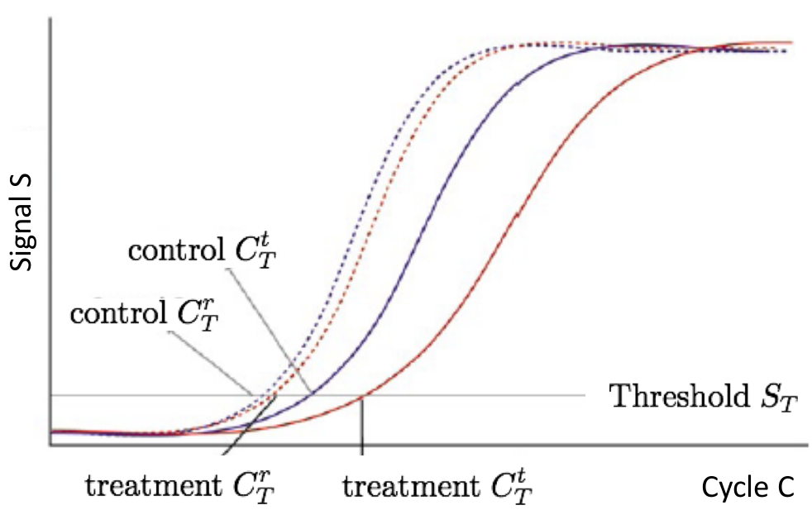




$$C_{P, cnt}^{g}$$
$$C_{P, cnt}^{r}$$
$$C_{P, trt}^{r}$$
$$C_{P, trt}^{g}$$

