Slide 1
Operating Systems for
Privacy and Performance
Nick Gordon
09/28/2022

Slide 2


Background
BS in Computer Science at University of Memphis
Did ~1.5 years of post-bachelor’s research on networking
  Named Data Networking (NDN)/Content-Centric Networking (CCN)
  Worked as a research programmer on several ongoing projects
  Main contributions: routing protocol and DARPA SHARE project to use NDN as a network backbone for low-reliability networks in the field
Started PhD at Pitt in 2018
  Initial work with Jack was on Seabrook project using SGX to secure data in the cloud

Slide 3

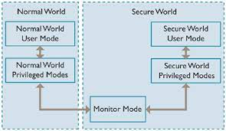

Main Interests
My main areas of focus and work are:
  Operating systems/kernels
  Privacy/security
  Distributed systems/networking

Slide 4
Main Interests: System Software and kernels
The reason I left my old work: I wanted to work on operating systems and with interesting hardware.
I like to “explore” the possibilities of how to use hardware
Persistent obsession with alternative kernels: microkernels, exokernels, distributed kernels, etc.

Slide 5
Covirt: The First Thing (IPDPS 2021)
Covirt is a thin hypervisor targeting high-performance computing with co-kernels.
  Co-kernels: space-sharing resources on a machine instead of time-sharing them. Kernels are given bare-metal access to their resources.
The research angle: is hardware virtualization fast enough to do the heavy lifting?
  Can a hypervisor be reduced all the way to a shim and provide near-native performance even to HPC workloads?

Slide 6
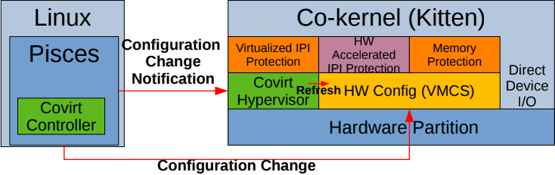

Slide 7
VM Lifting (HPDC 2022)
With Covirt in the Leviathan co-kernel software stack, some opportunities arise from a cool thought:
Exploit the fact that Covirt is actually a hypervisor and migrate VMs between the Linux-integrated hypervisor Palacios and Covirt itself
Research angle: enable HPC clusters to oversubscribe compute resources to respond to high data-volume sensor workloads
  They have to be dealt with now, and the systems they are directly connected to aren’t capable of handling all the work
Under normal use, the system uses Pisces (co-kernel driver) with Covirt as a bare-metal hypervisor.
When workloads come in, shunt (but don’t freeze) workloads onto Palacios VMs and time-share them instead

Slide 8
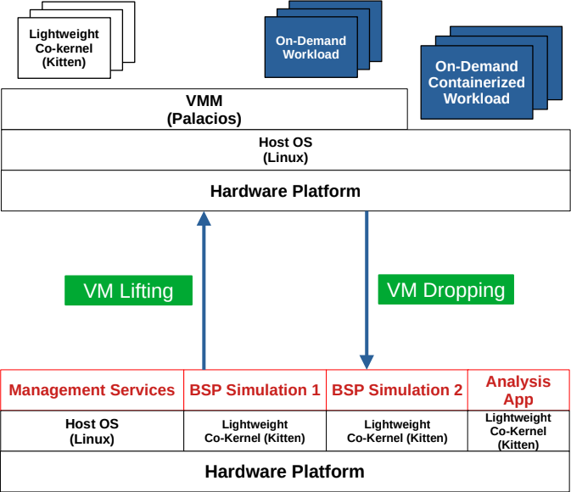

Slide 9
Main Interests: Privacy
As we here know, hardware security is becoming more important and more difficult
The security model on regular desktop-class systems is fully figured out, but full of holes.
  Various vulnerabilities resulting in key leaks and such have ended the story of secure compute on x86 platforms.
But ubiquitous, IoT computing is increasing, where hardware topologies are more interesting
  ARM64 with TrustZone and complex SoCs/chiplets
  RISC-V with ISA extensions and above also

Slide 10
Kitten on ARM64 (ROSS 2021, with Jack)
Motivated by the current project, we ported Kitten to ARM64 to explore using Hafnium on the Pine64 boards.
The Hafnium hypervisor models ARM’s TrustZone as a way to provide secure container-like computing
  Primary VM acts as the scheduler for the whole system, with permissions and privileges retained by the hypervisor
  Secondary VMs are given resources and permissions at boot time by manifests
We wanted Kitten to be able to be:
  The scheduler to leverage its improved scheduling properties as a lightweight kernel
  The kernel inside the containers for development simplicity, security, and performance

Slide 11
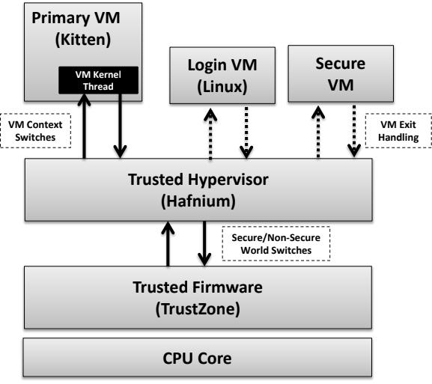

Slide 12
Kitten on RISC-V (accepted at ROSS 2022, with Sandia Labs)
RISC-V’s open-source ISA has given it a niche in research because it’s easy to extend and develop experimental hardware for.
Sandia is exploring RISC-V as a co-design platform
  The big reduction in development cycle times has made it possible to design kernels and hardware together, instead of independently
  But Linux is huge and unwieldy; use Kitten for development instead.
Kitten’s simple memory model and small source size make it especially suitable for RISC-V system development.
  Linux expects a relatively full-featured system in most cases
  Unlike many other research OSes, Kitten is a base of “production-ready” software

Slide 13
Main Interest: Distributed Systems and Networking
These days systems research is heavily perfumed with distributed systems and networking:
  Chiplets and network-on-chip systems make even the local machine look like a network
  Cache coherence turns many-core systems (AMD’s 64-core machine) into distributed systems

Slide 14
Proof of concept project: secure barcode scanner
Inspired by the current project and scaled down for a class
Given the situation of Amazon’s “no-staff store”, how can you own the data about what you are buying?
System architecture:
  Barcode scanner connected to ESP32-S2 chip
  Contents of cart are encrypted on ESP32, with PKI acquired via scanner
  The register associated with the key receives the encrypted blob, hands it off to an OP-TEE enclave, which is attestable
  Cartblobs are associated with a user ID and policy
  Queries about cart contents are checked against policy by the OP-TEE enclave

Slide 15
Research questions and assumptions with barcode scanner
Assumption: barcode scanner acts in Good Faith
How much encryption can be done on the device?
  Want data to be secured on-device (since we assume it is secure) first
What kinds of policies are appropriate for this kind of data?
  I modeled a simple set: items have category, brand, and cost.
  Policies are simple: you can zero out one or more of these properties on your cart
How to efficiently do inventory analytics on encrypted data in a slow enclave with varying amounts of policy control
  ???

Slide 16
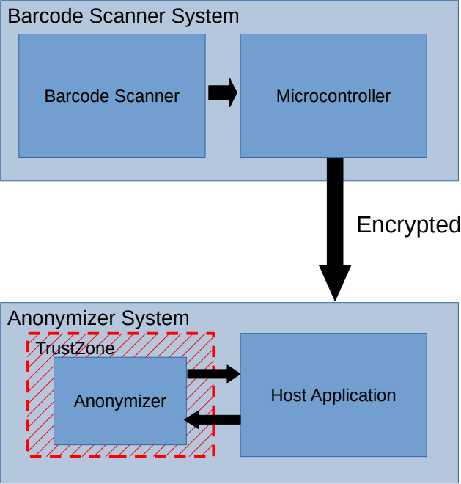
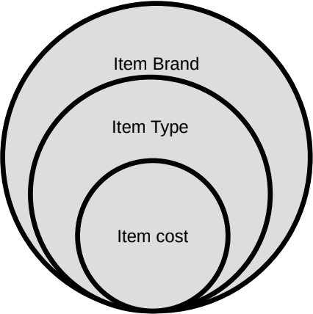

Slide 17
Thanks and Questions

