Slide 1
The RIOT Operating System
As presented by Nick Gordon

Slide 2
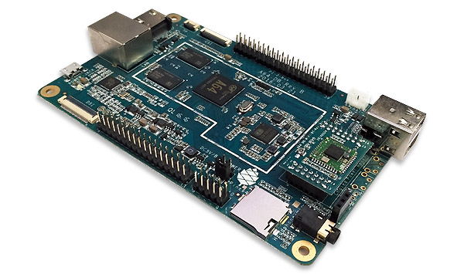
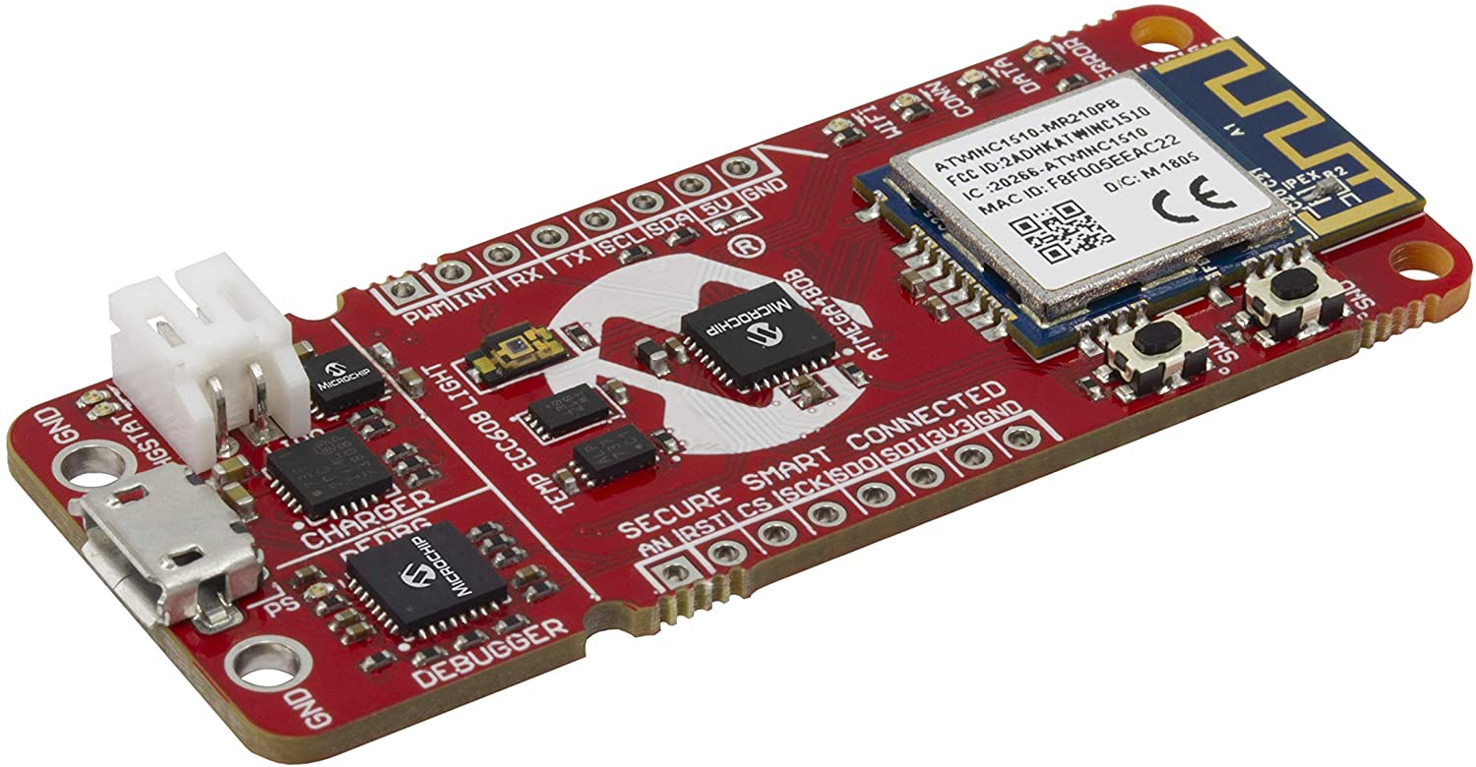
Motivation and what is RIOT?
IOT Hardware is super diverse, ranging from competent to “barely a computer”
  Pine64/RPi to ATmega4808
A large variety of sensors/actuators complicate I/O
  UART, SPI, I2C, etc.
Many, many network protocols complicate connectivity
  WIFI, LORA, BLE, etc.

Slide 3
Motivation and what is RIOT?
OS Support for IOT devices ranges widely
  Most have specific niches: e.g. FreeRTOS and Arduino
  Some are even proprietary or “proprietary”: FreeRTOS ties into Amazon, Windows 10 IOT
Makes a common platform experience hard

Slide 4
What RIOT aims to do
Modularity
  Allows targeting diverse platforms ranging from single-task to full-stack solutions
Independent
  No lock-in
Standards-compliant
  No proprietary solutions or “we do it our own way”
Unified APIs across hardware
  No matter what hardware you use, RIOT smooths it out

Slide 5
Code Organized Linux-ish
core
  The kernel
cpu, boards, drivers, periph
  Hardware abstractions
sys
  Kernel-level libraries: networking, crypto
pkg
  Third-party stuff: other people’s libraries
application
  Your code goes here

Slide 6


Multithreading
Multi-threading (or not)
  Threading works very similarly to Linux, but with smaller data types and less fancy stuff
  Per-thread overhead is 12 bytes if you don’t have IPC
    vs. Linux: ~750 LOC for the task_struct
  Or not. Turn it off if you don’t need it, and trim down the scheduler even more
    Basically Arduino at that point!
Process Synchronization
  Standard stuff: mutexes, semaphores, messages
Single address space
  Not mentioned in the paper. You probably don’t want this in IoT, anyway.

Slide 7
Scheduling
Linux has a very complex scheduler, RIOT has fixed task priorities
Run-to-completion policy with interrupts
  E.g. your processing loop, interrupted by sensors reporting data
Gets you deterministic scheduling characteristics
Tickless scheduling: No repeating OS timer (tick-tick-tick) that continually interrupts tasks
  Sleep when stuff isn’t actually happening

Slide 8
Hardware Abstractions
Can be a pretty big headache for IOT
  How much memory? Where does it start? Do you have an MMU? An MPU? How is the board initialized?
RIOT strongly decomposes these pieces in a similar way to modern Linux on ARM with its device tree system
This hardware decomp is basically necessary for ARM hardware.
  Two boards can have the same CPU and peripherals but still need specific code (address ranges are different, e.g.)
Thanks to unified APIs, drivers can be re-used

Slide 9

CPUs
The top-level decomposition is reflected here:
  STM32 family of CPUs:
    Includes Cortex-M:
    Pulls in all STM32 specific CPU code:
  E.g. the STM32F1

Slide 10
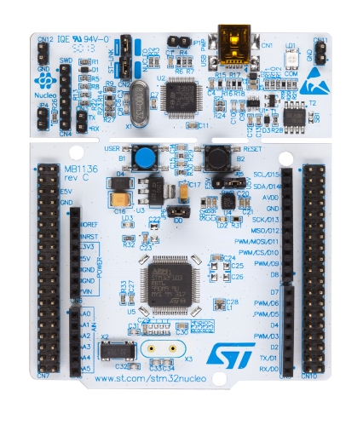

Boards
Similar to CPUs, but these are the specific instances of CPUs.
  They have a similar decomposition. The Nucleo F030R8:
    And that points back to the last slide

Slide 11
Drivers (or, the stuff connected to the board)
There are three main design points:
  Implementations should not be tied to a board or CPU
  Drivers should allow multiple active instances
    Drivers in this space often have state, but a robot can have two cameras!
    Subtly different from Linux, where state is managed more complexly
  Common APIs
    netdev
    SAUL (more on that soon)
    MTD (memory technology device) – or, as we humans call it: storage

Slide 12
SAUL (Sensor Actuator Uber Layer)
4/5 authors of this paper are German and it shows
Anyway, sensors and actuators are very important to IOT and as such get their own kernel abstraction layer
  Physical values that are compactly and portable represented with a common data structure and functions
A registry of all SAUL devices allows iteration over devices
  System autoconfig, discovery, or even remote access

Slide 13
System Boot in four steps
Memory
  data and bss section init
Board and CPU init
  CPU state, various peripherals
C library init
  Creates mapping of RIOT syscalls to libc functions
Kernel init
  Data structures, etc.
  init

Slide 14
Power
Different devices need different responsiveness, deadlines.
  Power state transition may take too long, risking missing deadlines.
  Certain interrupts may not be delivered at all
Resolved with the Cascade protocol: the lowest power state we can go to is the highest minimum power state of all devices

Slide 15
Timers
RIOT is tickless – if nothing is happening, no need for periodic wake-ups draining power and wasting cycles
Tick conversion
  Needed by all Oses to relate timer ticks to physical time
Multiplexing
  Maps many software timers to few hardware timers
Range extension
  Uses e.g. overflow count to allow timers larger than hardware

Slide 16
Networking
netdev – hardware-agnostic. Single send/recv. Single get/set for configuration. Events layer for packet delivery.
sock – Similar to the POSIX sockets. Supports raw IP, TCP, UDP.
  create, send, receive
  Protocol specific actions

Slide 17
Examples of what you can do with RIOT
Basic RTOS
  3.2 kB ROM, 2.8 kb RAM
With IP Support
  38.5 kB ROM, 10.0 kb RAM
With JavaScript
  166.2 kB ROM, 29.1 kB RAM
With secure OtA updates
  111 kB ROM, 17.5 kB RAM

Slide 18
Etc.
Shell for debugging
RIOT native – Runs on a host OS to allow virtualization of simple IOT hardware.
Straightforward development workflow: tests, remote IOT debugging, real deployment.

Slide 19
Conclusion
This is the part where you ask me questions

