Slide 1
Respecting Shopper’s Privacy with Trusted Computing
I upgraded LibreOffice and my red presentation template is gone :(
Nick Gordon
04/28/2022

Slide 2
Privacy about shopping habits is decreasing
In “ye olden days” shopping was: hand the grocer a list, pay for stuff
Computerized cash registers accelerate this process
  Still no problem, still anonymous (mostly, unless Gertie recognizes you buy a large jar of Nutella each week)
Corporations: “Hey, we could make a lot of money selling this data to companies for ads”
  Result: “Would you like to sign up for Giant Eagle rewards? You’ll get $0.01 off your gas!”
  It “improves customer experience”
Online shopping is even worse
  You searched for a squatty potty once on Amazon? Enjoy seeing toilets on your front page forever

Slide 3
Can we claw back privacy about what kind of mayo we like?
Reality: a store is fully controlled by the business. You can’t trust anything fully.
  Maybe some elaborate audit and trust hierarchy? More probably legislation could enforce this
Simplify: Assume a store must not lie about software and hardware
  Can shoppers control what details of their shopping is known?
  Yes, with 1) trusted computing, 2) small programs, and 3) open-source

Slide 4
First, what this project does not solve
A large, complex problem can’t be solved by one grad in one semester.
Can’t use a phone to shop: store can’t control your phone, too many security risks, too complex to implement app.
Must assume item analytics are separate from transaction processing
  How to solve this? I have some ideas, later
Must assume trusted out-of-band security
  Also some ideas later

Slide 5
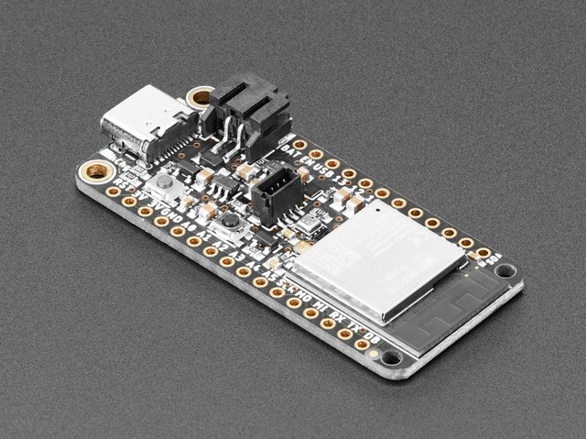
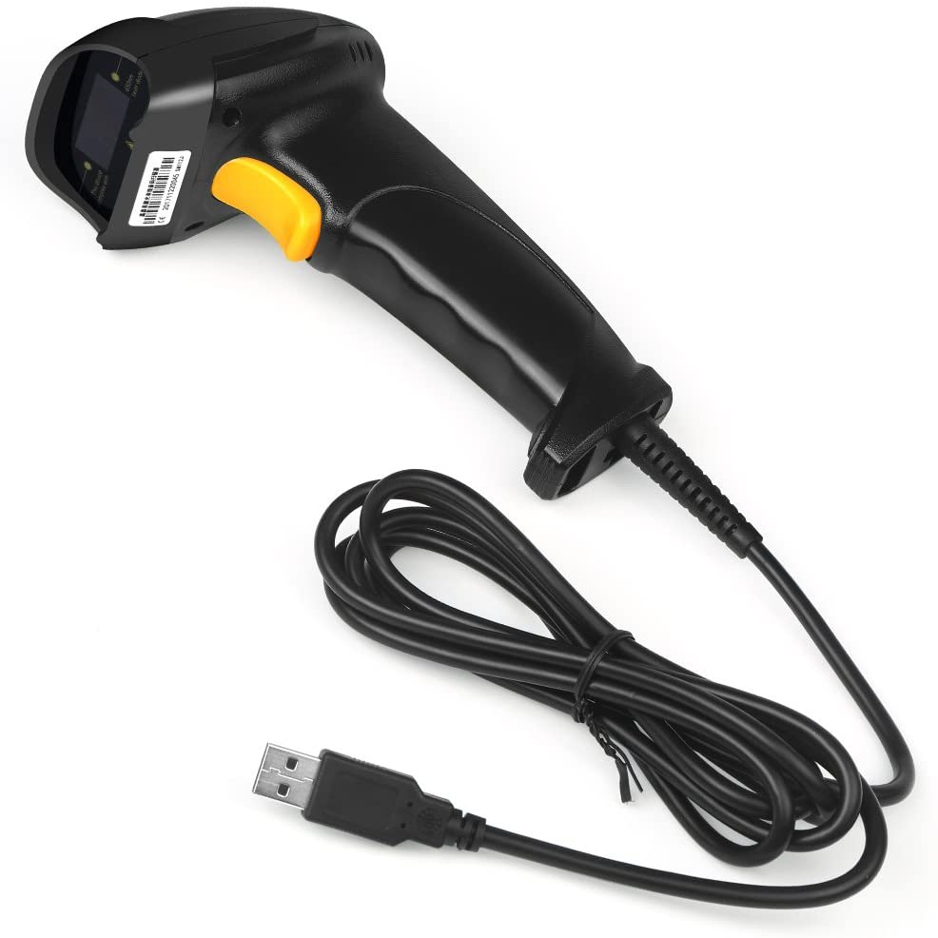
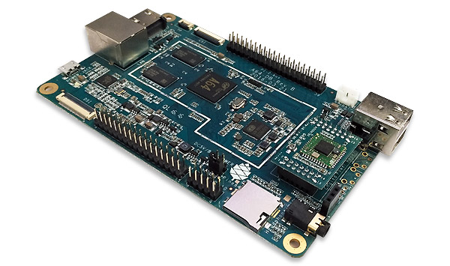
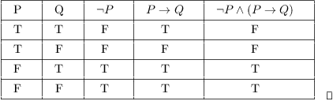
System outline
In a nutshell: a microcontroller driven by a barcode scanner encrypts your shopping cart and sends it to a trusted anonymizer who can decrypt it and remove what you don’t want them to know
+
+
+

Slide 6
The challenges we need to overcome
Microcontroller computation/power balance
How to securely send cart to anonymizer?
What kind of security policies to provide users?
How to provide input and configuration to microcontroller?

Slide 7
Starting from the end, working back: Trusted Computing
Many trusted computing platforms to pick from: Intel SGX, AMD PSP, ARM TrustZone, IBM Secure Service Container.
But what kind of performance do we need? Two options:
  Centralized, company-wide anonymizer → Intel/AMD, IBM
  Decentralized, per-store anonymizer → ARM
  Which hardware I already have
    ARM
Pine64 LTS. Careful: not all boards have TrustZone

Slide 8
How to actually run a trusted environment?
The hardware supports it, but does the software? How and where does the actual anonymizer application run?
For ARM64, a few options.
Hafnium
  A hypervisor that runs VMs in an arbitrary security context. Up to you to make sure it works
  Targeted use-case is container-y
  I have done research on it (a good sign, right?)
  The OS we have has uncertain driver support, Hafnium has poor interrupt model
  Unknown amount of work to make it work 😞
OP-TEE
  Included by-default in mainline Linux
  Documented, maintained
  Know it works 😃

Slide 9
The OP-TEE environment and Trusted App (TA)
OP-TEE provides access to trusted computing through an RPC interface.
  Secure world: specialized, secure OP-TEE OS. Trusted applications are loaded and run here. TAs can be stored in a variety of places, incl. signed on regular filesystem.
  Non-secure world: “rich” OS runs here. A “supplicant” program exists to provide the RPC channel, among other stuff. Host applications run here and interface with TAs through the supplicant.
How get data into the anonymizer TA?
  OP-TEE provides sockets to TA via the supplicant and a few “pseudo-TAs”
  TCP/TLS? TA sockets can’t accept() or listen(). Client-only socket interface!
Host application must hand-off all data to TA
  “Split” TLS server implementation with socket in host app would require many RPC calls and small data copies, probably terrible performance
  Host application is untrusted, possibly adversarial. Can’t negotiate session key, etc. since it controls socket.
Solution: Use public key cryptography
  Allows arbitrary senders to securely send messages to anonymizer TA
  Doesn’t assume anything about intermediate infrastructure
  Already included in all TLS/SSL implementations!

Slide 10
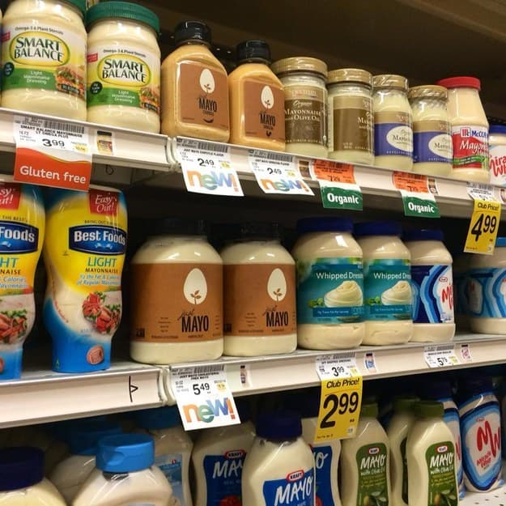
Anonymizer has the data. Now what?
Provide a configurable degree of privacy to the contents of the user’s cart.
Let’s look at the components of an item in the grocery store:
  Price
  Item type
  Item brand

Slide 11
What kind of information to let out?
For n points of data, there are C(n, k) ways to let r pieces of information out. Even with only three points there’s:
  C(3, 1) + C(3, 2) + C(3, 3) = 7 policies to pick from
Is this very user-friendly? Is this practical to compute? What if there are more points, e.g. organic, local, generic or not?
We make a simplifying observation here: if enough points of data are allowed, the others can be inferred.
  E.g. I bought some jar of mayonnaise that costs $5.49. What’s the brand? → Just Mayo
  I bought some Hellman’s product that cost $2.99. What is it? → Probably may
But not always!
  I bought some Newman’s Own product that cost $3.99. What is it? → Pasta sauce? Salad dressing? Cookies??

Slide 12
Item information should be viewed as hierarchical
Item Brand
Intuitively (and on nothing else) we apply security policies from outside-in.
E.g. blinding the item’s type also requires blinding the item’s brand.
Other options are possible, but not explored here
N.B.: The total cart cost is always allowed
Item Type
Item cost

Slide 13
Securely sending the cart
Using RSA as the PKC to send the cart, there is a big problem:
How to establish trust?
  Obvious: Use X509 certs and a CA to establish identity.
  Problem: Certs only establish identity, not function.
  An idea: at cert issuance time, CA requires hash of TA binary and includes it in the cert.
  Problem: When asking for TA hash, how to establish that running TA’s hash is one you got (and not a MITM attack by host?)
  For now, assume an out-of-band establishment of a valid X509 cert that will correspond to the running TA.
RSA has a message size limit: the length of the key minus some overhead
  Even for a 4096-bit RSA key that’s only a maximum message size of ~512 bytes.
  Solution: “Chunk” the message
What size of key to choose? Will discuss in a second

Slide 14
Microcontroller Selection and Capabilities
Considerably important to a real-world application: cost
  Stores can easily have >100 customers at any time, making fleet costs high
  Charging cycle requirements inflate the needed number by some factor, maybe need 25% more than full occupancy to allow charging?
How to get data off the scanner? Bluetooth, wifi?
  Consider store setting: checkout points are all near each-other, maybe there’s free WiFi, want to minimize latency of transfers
How much power does the microcontroller need? Not much?
  Scan barcodes
  Encrypt
  Send off

Slide 15
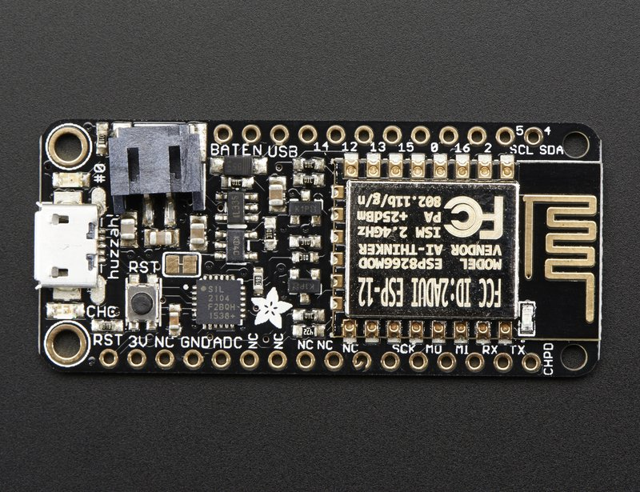
Microcontroller Selection
Initial choice (because I already had one), the →
ESP8266.
  Terrible specs: 32KB iRAM, 80KB userdata, 80MHz
  Terrible programming experience:
    The included SSL library is poorly-documented, there are no examples, and broke when the encryption function call was moved around.
    There’s watchdog timers that reset the board if you forget to feed them routinely enough.
      Encrypting a message takes too long? Reset
      Connecting to wifi takes too long? Right to reset, right away
      Scanning a code takes too long? Believe it or not, reset.
    Nobody even really knows how to disable the watchdogs, either

Slide 16
Microcontroller Selection
After a few days of panick, I remembered that Past Nick anticipated this and ordered a Newer, Better board, the ESP32-S2
  Better specs: 128KB ROM, 320KB RAM, 240MHz
  Better programming experience: included SSL library is mbedTLS, which has error codes, examples, documentation, etc.
  Just had to port the scanner HID driver I wrote because the library hasn’t heard of C++ namespaces
  Who could imagine that the Arduino core would have a class called USB? Outrageous!
Moral of the story: we aren’t John Carmack, so just use better hardware if it’s already the same cost if you can

Slide 17
Microcontroller Code
The scanner connects to the ESP32 via a USB host daughter board.
Scanner completely drives program via QR codes and Code 39 barcodes:
  User configuration is loaded via two QR codes
  Barcodes are scanned, filling up the cart
  The entire X509 cert is scanned as a QR code, which triggers cert decoding, cart encryption, connection to the anonymizer, and transmission of the cart.
The board connects to the anonymizer over standard WiFi using a TCP socket.

Slide 18
Anonymizer Code
At start, the host application loads an item database into the anonymizer TA. This database is copied into secure memory.
Upon receiving a cart blob, the host application invokes the TA to decrypt the cart. The encrypted cart contains the user ID, security policy, and the barcodes
The TA translates each barcode into the item details mentioned before. The details are blinded according to the security policy.
The cart details are given back to the host application to give to an analytics program

Slide 19
Barcode Database
UPC, the “standard barcode,” is 12 digits long and may have leading zeroes. As a result, it can’t easily be represented with a numeric type.
Each entry in the database must be at least 12 bytes, and
12^10 ≈ 62 billion, so ≈ 700GB just to store all the barcodes this way.
Most stores do not sell 62 billion different items, though.
The TA can have ~30MB of heap allocated, giving a maximum database size of ~400,000 entries with the current schema.
For translation, a linear search is probably not performant enough for a typical cart of ~20 barcodes.
Database is set-associative. Hash the barcode string for a database index. At each index there’s 3 slots for item details. Check each slot for a barcode match and return the details.

Slide 20
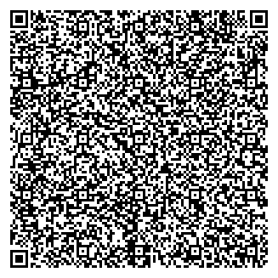
X509 QR Code

Slide 21
Evaluation and Current State
Not much quantitative evaluation done
The “finish cart” process takes around 3 seconds once the scanner beeps that the code has been read, from code input to anonymizer receiving it.
The cart payload is 512 bytes. Currently the cart item limit is 32. Each chunk after the first allows for an additional ~10 barcodes to be scanner.
Decrypting and translating a cart of 512 bytes in size takes around 5 seconds on the anonymizer. The majority of the time spent is syscalls made to OP-TEE OS for decryption.

Slide 22
Limitations and Future Work
Database may fail to locate. On database generation, if >3 items have the same hash value then the number of set lines must be increased. This creates wasted space in whole DB.
  Improve database structure so that each set knows how many lines are present. Or, replace database entirely with pre-built solution to do the same?
The largest size QR that would reliably scan is only 1024-bit. For this application that’s “probably” good enough
  Could make QR codes an indirection to some server to retrieve the appropriate X509 cert.
Performance is not very high. If the volume of transactions is too high then the anonymizer may not be able to keep up.
  Maybe switch to using elliptic curve cryptography? In general private-key operations are faster than public operations, which shifts load to the microcontroller.
  Also possible to source dramatically faster TrustZone-capable hardware: ThunderX2 server-class chip has TrustZone, ~100x faster
Some microcontroller configuration is static: SSID, password, anonymizer host and port
  Could expand QR code interface to provide these, too.
Trust is assumed out-of-band
  Could include trust anchors for various cert authorities, improve verification of X509 certs, expand aforementioned functionality-based X509 cert.
Assumes that store analytics are separate from transaction processing. Creates a potential for “accidental” information leakage
  Not sure how to address this since this is an anonymity problem
Could define security policy on a per item category basis, instead of cart-wide

Slide 23
Conclusions and Q&A
Don’t use the ESP8266!

