Slide 1

Lifting and Dropping: Dynamically Transitioning VMs for HPC Systems
Nicholas Gordon, University of Pittsburgh
Jack Lange, Oak Ridge National Laboratory

Slide 2
Motivation: HPC Needs to Acquire Cloudiness
HPC systems suffer from low utilization
Workloads need very high performance → serialized, batch jobs
Available capacity at any given point can be very poor. How to improve?
Virtualization can improve, but costs performance
How do use virtualization to increase apparent capacity smartly?
A job arrives but the system is occupied already. Where do we put the job? Job is time-sensitive and cannot wait.

Slide 3
Job 2 is incoming & high-priority
Time-sensitive job
Job 2 (3 cores)
Job 1 (In progress, long-running)
Node
Core 1
Core 2
Core 3
Core 4

Slide 4
Job 2 is incoming and high-priority. Node doesn’t have enough capacity.
Option 1: Evict job 1, losing progress or forcing a costly checkpoint
Option 2: Lift the job, preserving progress and allowing progress-making

Slide 5
Option 1: Evict
Job 1 (progress lost)
Job 2 (In progress)
Node
Core 1
Core 2
Core 3
Core 4

Slide 6
Option 2: Lift VM
Job 1
V
C
P
U
1
V
C
P
U
2
V
C
P
U
3
V
C
P
U
4
Job 2 (In progress)
Time-sharing
hypervisor
Space-sharing hypervisor
Node
Core 1
Core 2
Core 3
Core 4

Slide 7
What kinds of jobs would require this?
This is a future-looking strategy
Imagine: sensor data jobs that cannot be delayed. The sensors are coming online now
Evicted jobs could be cancelled, but why cancel them?
  Can also hold onto them virtually and resume when the other job is done

Slide 8
Key idea: lightweight checkpoints dominate virtualization
Roadmap from here on:
  Time vs space-sharing hypervisors and their purposes
  The tension of performance and responsivity/capacity.
  The kinds of VMs we can move around
  How we move them around
  What this gets us
Notes:
Remember: this is the advertisement for the burger, the paper is the burger
How do I communicate lightweight checkpoints?

Slide 9
Virtualization and HPC
Why do we virtualize in HPC?
When should we virtualize, when not?
What kinds of approaches are there?
What is the cost/benefit?

Slide 10
Virtualization is a mode
Could just virtualize all jobs, always providing “some” capacity
This costs performance!
Instead, only virtualize jobs when needed
Identify that certain VMs are “independent” of the hypervisor
Switch between multiplexing and high-performance hypervisors
Job now has resources to run on, can be accepted.

Slide 11
What can we move around? What is an eligible VM
Moving CPU execution is important and can be shared with little marginal overhead beyond 1/n of the time
Multiplexing devices/IO not so easy

Slide 12
Moving VMs Around
A VM is some software emulating hardware, some part software emulating hardware
The emulating software, the hypervisor, has many different implementations
The kinds of jobs we need to support: can’t just ship VMs to other nodes, jobs must span nodes in-situ (???)

Slide 13
Actually moving VMs: hypervisors
Hypervisors emulate hardware structures in software
Implementations vary, how to reconcile this?
Limiting to CPU migration: not very hard
Modern CPUs have excellent hardware virtualization → unified representation

Slide 14
Lightweight Checkpoint
Most of the state a modern hypervisor keeps is hardware-defined
An eligible VM x’s state is like 20% hypervisor state, 80% hardware-defined state
Some state can be shared, some state must be transformed; different hypervisors present different platforms and virtualization configurations
The hardware does most of the work; the hypervisors are “configurators” now
Means hypervisors can be composed to get benefits of both
Not just the two we did, but basically any pair of hypervisors

Slide 15
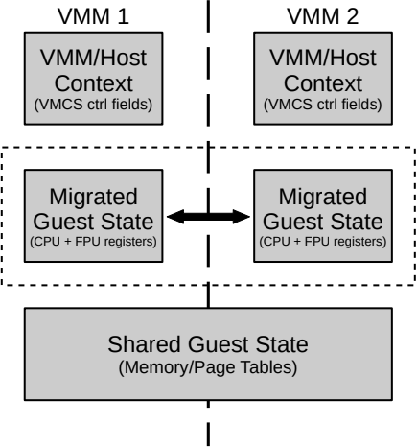

Slide 16
Migration
With an eligible VM and two hypervisors, moving a VM between hypervisors is a lot like switching a VM, or context switching a process
Expensive state that has to be transformed
Cheap state that can be shared

Slide 17
Somewhere in memory
VM Core 1
VM Core 2
Hardware-defined
state
Hardware-defined
state
Hypervisor
state
Hypervisor
state
Hypervisor 1
Local CPU 1

Slide 18
Somewhere in
shared memory
VM Core 1
VM State
VM Core 1
Hardware-defined
state
Hardware-defined
state
Hardware-defined
state
Hypervisor
state
Hypervisor
state
Hypervisor
state
Hypervisor 1
Hypervisor 2
Local CPU 1
Local CPU 2

Slide 19
Migration difficulties
Fundamental difficulties:
  Interrupt ID collision → abstract IDs
  Interrupt reachability → central directory
  Memory context → don’t switch it
  Externally-mapped, dynamic memory → share NPT subtree
  VM-duration static memory is easy
  How to interrupt bare-metal VM?
  On large nodes, where do you send the core? NUMA considerations?
  How to distribute cores hosting time-shared VCPUs?

Slide 20
Migrating on-demand
We can move CPU jobs from bare-metal, dedicated cores to traditional, time-shared cores on-demand
When resources are free, can move the job back to the cores it was on
How much interference does this cause?

Slide 21
First time vs repeated migration
Once established, migration between hypervisors is very fast

Slide 22
Implementation? Results?
Done in the context of Hobbes OS/R: good shared memory facilities and cross-kernel application programming model
We modeled: Palacios vs Pisces/Covirt
Focused on:
  Cross-VM performance (already reasonably well-known)
  Migration times (unknown)

Slide 23
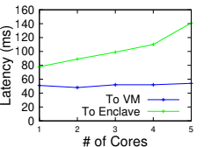
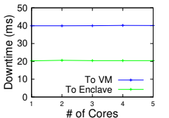
Downtime and Latency: The important parts

Slide 24
