Slide 1
GiggleGuide: Your Jolly Journey Companion
An intelligent Travel Agent Chatbot Ensuring Data Security
Simin Zhang

Slide 2
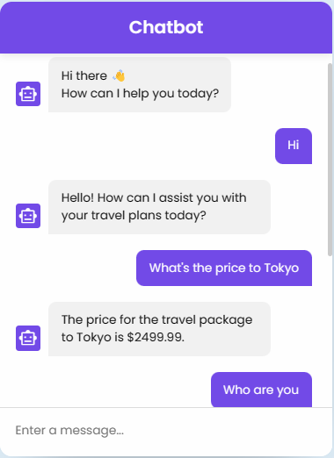
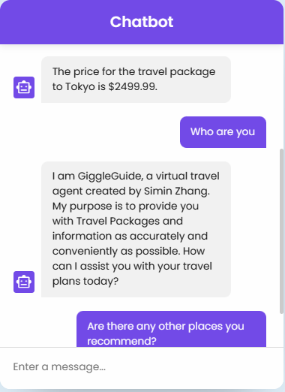
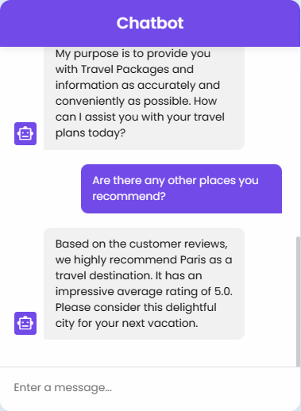

Slide 3
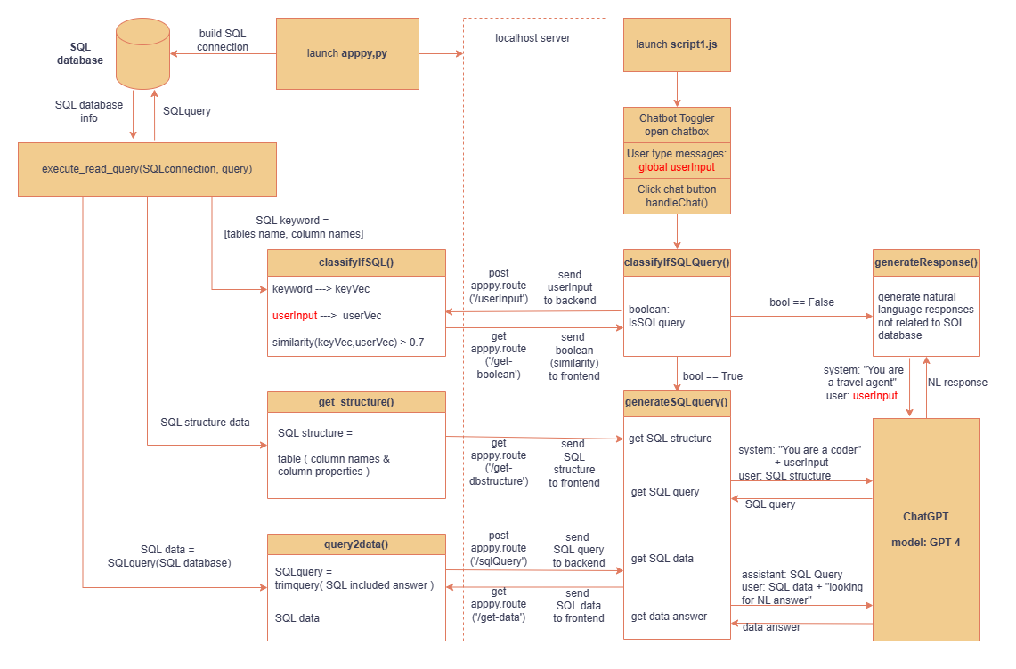

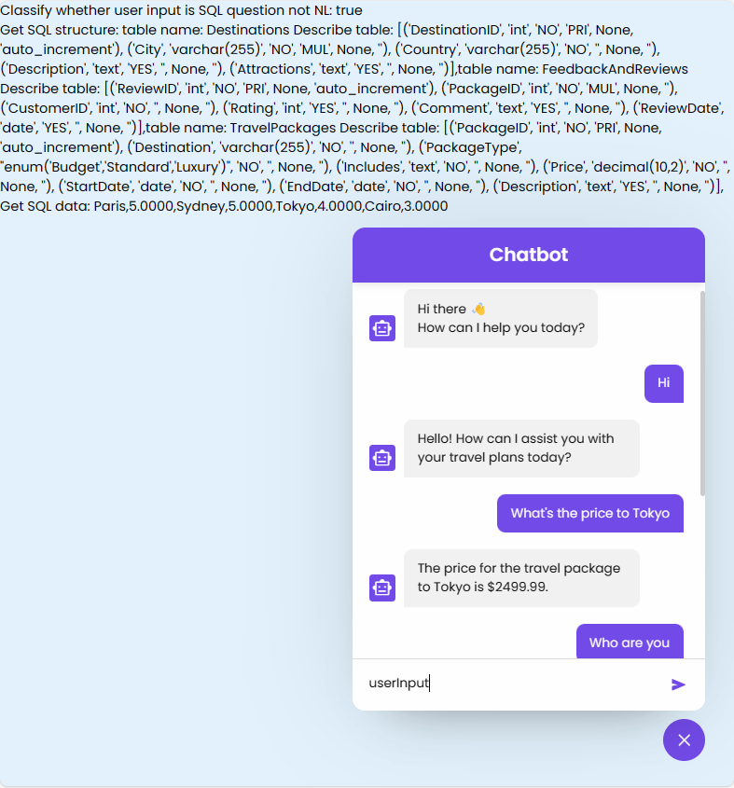
Frontend & UI

Slide 4
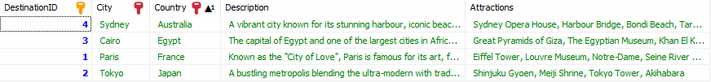
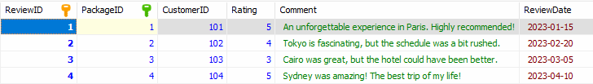
Destinations
TravelPackages
FeedbacksAndReviews

Slide 5
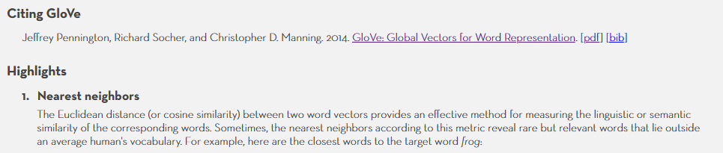
STEP 1:
Classify whether the userInput is database question
STEP 1a:
Word2Vec()
STEP 1b:
CosineSimilarity > Threshold

Slide 6
Remove Functional/Empty Words:
-Article：a, an, the, etc.
-Preposition：in, on, from, etc.
-Conjunctions：and, but, before, etc.
-Interjection: oh, well, hi, hello, etc.
IMPROVE PERFORMANCE
Words
Preprocessing
before Word2Vec()
2. Add Tables' keywords:
-Database that can calculate about the words
-but not show on the table/column name
e.g.
"cheap","expensive","place","recommend"

Slide 7
STEP 2a:
Get SQL structure
(backend)
STEP 2b:
Get SQL query
(chatgpt)
STEP 2c:
Get SQL data
(backend)
STEP 2d:
Get data answer
(chatgpt)

Slide 8
Back End
Build connection SQL database:
Build local server to transfer data with front end:
- POST to backend
- GET to frontend

Slide 9
3. Promote Contextual Understanding Performance
by stacking the {role:..., content:...} messages

