Slide 1
A Client-Server
Communication System
Kevin Belmonte
Tim Goric
Jon Henry
Joe Mirmina
Chris Rindfleisch

Slide 2
Overview
System to allow for text-based messaging in real time
4-part project
  Web app
  Database
  Client application
  Server application

Slide 3
General Details
Web app
  Written primarily in PHP
  AJAX technology on the front end
  Registration page linked from client app
  Offers client app for download
Database
  MySQL
  Stores information when user registers
  Tied to the server application

Slide 4
General Details
Client application
  Written in Java
    With GUI
  Links to the web app for registration
  Interfaces with the server app
Server application
  Written in Java
  Hub for all communication between clients

Slide 5
The Problem
There are many IM programs out there with many features
  But most lack at least one important feature that would be very useful
We propose to offer a general solution by providing an application with all of these features built in.

Slide 6
Solving the Problem
Will include features such as:
  contact notes
  ability to view profiles when contact is offline
No annoying unwanted bots
  If we do add bots, they will be optional
No ads
Our application will be standalone (no installation required)

Slide 7
Primary Design Goals
The final system will have
  A webpage set up to offer the client application for download
  A web-based registration system
  Functionality for client to login and be authenticated by server
  Functionality for client to view list of online users
  One-to-one client communication

Slide 8
Secondary Design Goals
There should be functionality for:
  One-to-many communication (chat room)
  User blocking
  User profiles
  Notes on users
  Contact lists and groups
  Add/remove contacts
  Status messages

Slide 9
Wish List
Tertiary or Long-range goals include:
  Avatars
  Direct-connect for file sharing
  Have last login time for users
  Support ticket submission for bugs/crashes
  Bots for weather / simple games
  Audio / Video communications

Slide 10
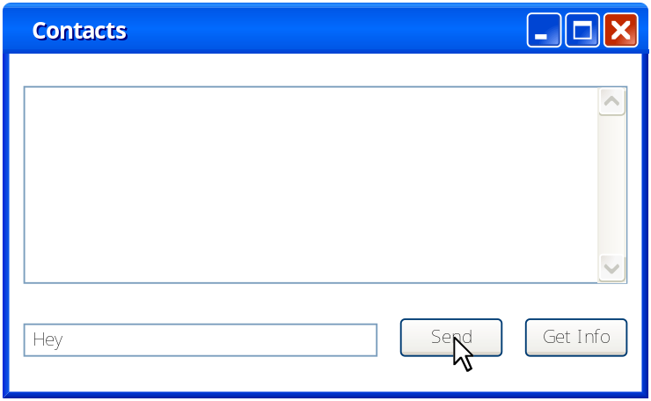
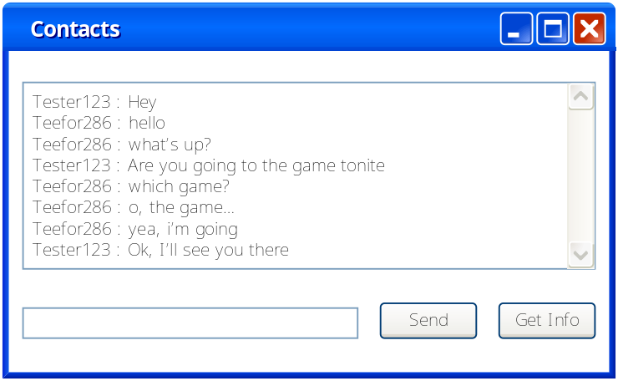
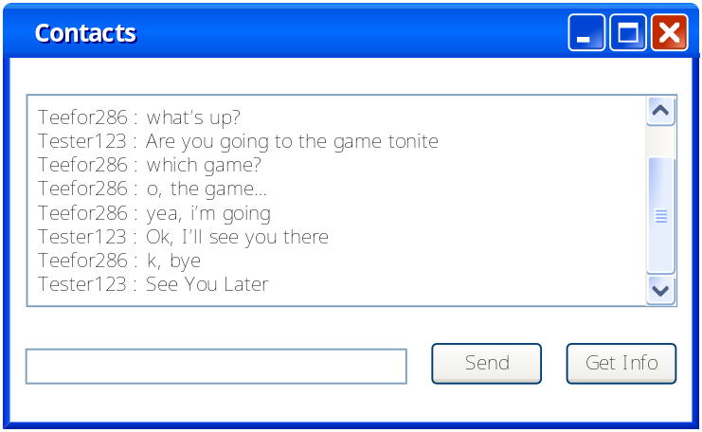
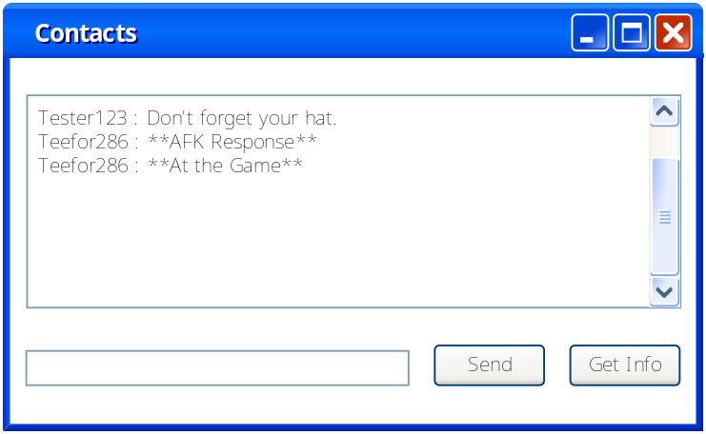
Sample Screens - Conversation

Slide 11
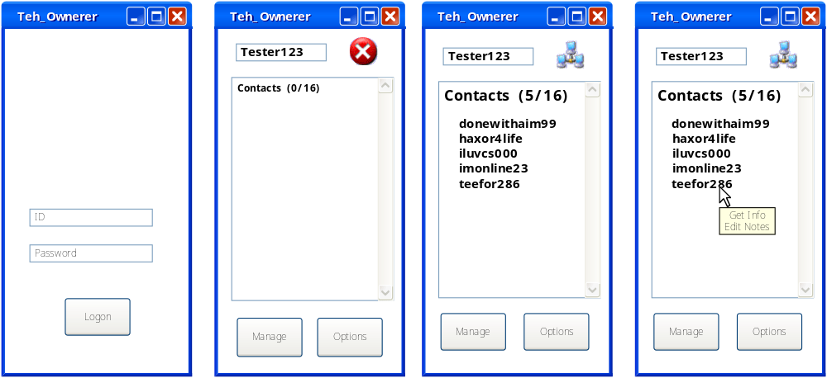
Samples – Main Client Screen

Slide 12
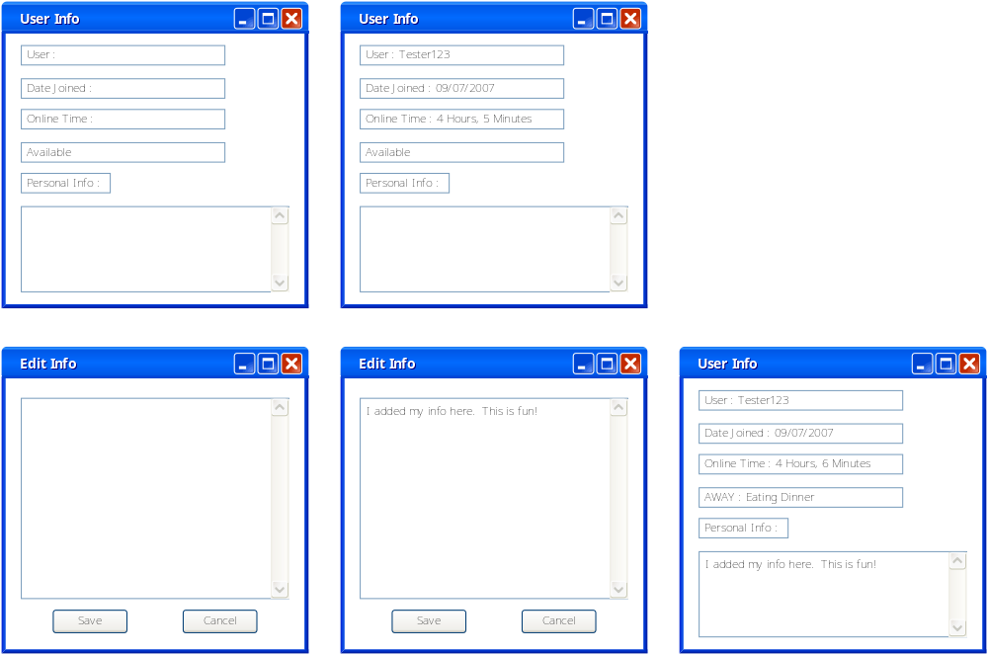
Samples – User Information

Slide 13
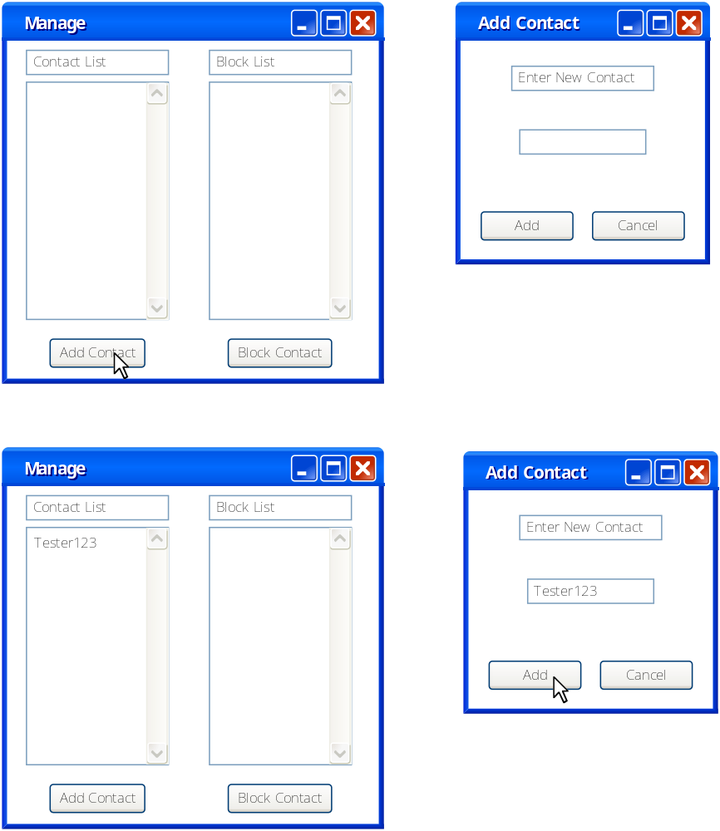
Samples – Manage Lists

Slide 14
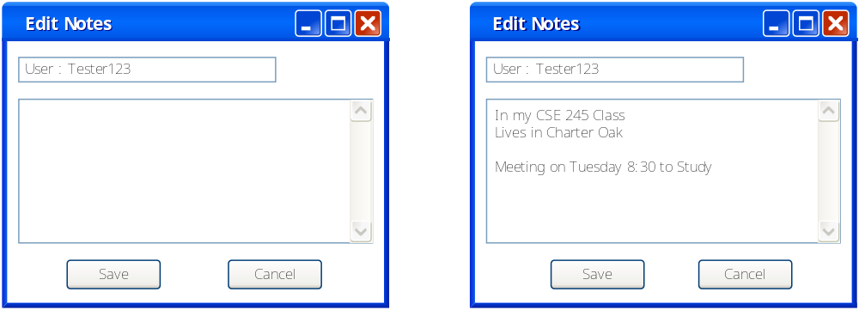
Samples – User Notes

Slide 15
Data Transfer
Registration
  Web-based app enters into database
All other communications go through server application
  Exception is file-sharing if implemented
Simple data-flow model

Slide 16
Client Login and Authentication
Server
Application
Login
Info
DB Query
Access or
error message
DB
Client
Application

Slide 17
One-to-One Communication
Server
Application
Reply
Received
Reply
Sent
Text
Received
Text
Sent
User 1
User 2

Slide 18
One-to-Many Communication
Server
Application
Text
Sent
Text
Received
Text
Received
User 2
Text
Received
Reply
Sent
User 1
User 4
User 3

Slide 19
Feedback
Chris is official tester
  Will test the software extensively at each milestone we reach
  Extensively document any bugs and make on-the-fly suggestions for any technical changes
Non-technical reviewers
  Have friends willing to use software and report back on a ‘common user’ standpoint
  User-friendliness, functionality, etc.

Slide 20
Special Equipment
Someone’s PC to act as server
Two (one-to-one) or more (one-to-many) machines to run the client
Multiple OS?

Slide 21
Milestones
The client application is able to connect to the server. The two are able to communicate and send messages back and forth. Connection remains open until client application terminates.
The registration website is setup and new user information can be entered.
Multiple simultaneous client connections to the server.

Slide 22
Milestones (cont’d)
4. Registration webpage completed with fully functional database behind it.
5. Server can connect to and retrieve any necessary information from the database.
6. Complete the GUI for the client app.
7. Client application can retrieve a list of all the users who are online.

Slide 23
Milestones (cont’d)
8. Two clients both connected to the server can communicate with one another by sending messages.
9. Start working on Wish List items once testing of all functionality up to milestone 8 is completed.

Slide 24
Division of Labor - Web
Joe will be the primary team member working on the website and database
  Create and maintain the database to store the user information
  Communicate with team members working on both the client and server applications
    What information they will be able to access from the database?

Slide 25
Division of Labor - Client
Jon and Kevin will be the primary team members working on the client application
  The GUI design and implementation
  Coding the functionality of the application
Jon will also be the primary liaison between the client and server application groups

Slide 26
Division of Labor - Server
Tim and Chris will be the primary team members working on the server application
  Communication with the client application and user database
Chris will also be the primary tester of the applications during development

