Slide 2
missForestPredict – Missing data imputation for prediction settings
Elena Albu, KU Leuven, Belgium
elena.albu@kuleuven.be

Slide 3
Key points
Why yet another missing data imputation package?
missForestPredict R package
And… is it better?
Final thoughts

Slide 4
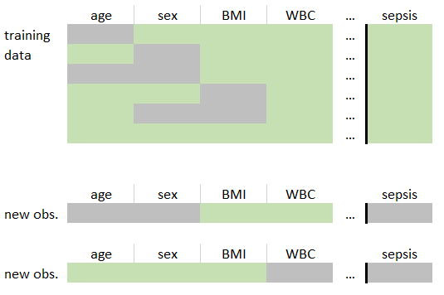
Why yet another missing data imputation package?
Use case: missing data at prediction time

Slide 5
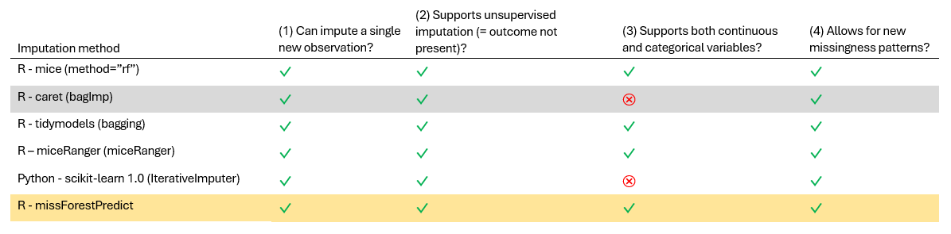
Why yet another missing data imputation package?
RF imputation methods that can impute a new observation at prediction time

Slide 6
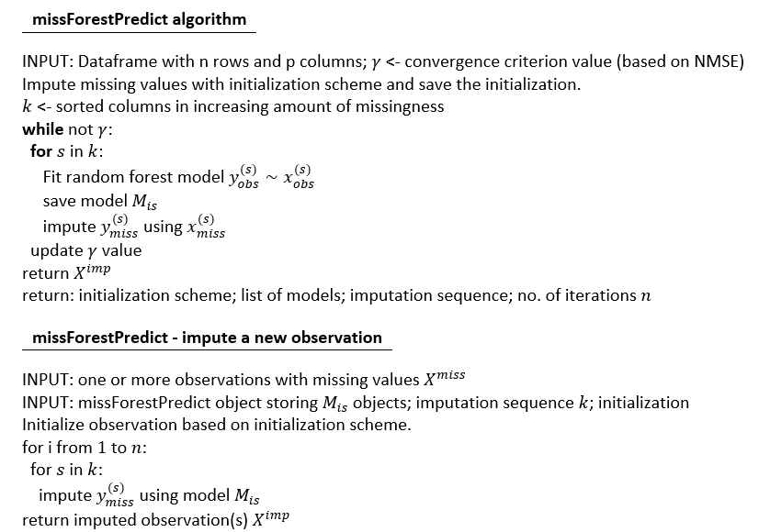
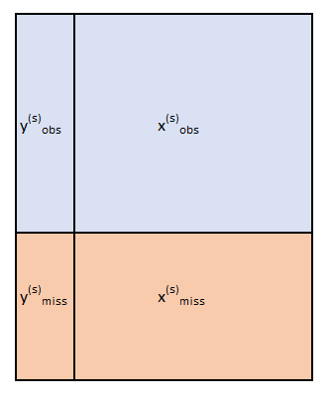
missForestPredict R package
Initialize missing values (mean/mode, median/mode or custom)
Impute iteratively every y^{(s)} until a convergence criterion is met (OOB NMSE)
Save imputation models to apply at test/prediction time

Slide 7
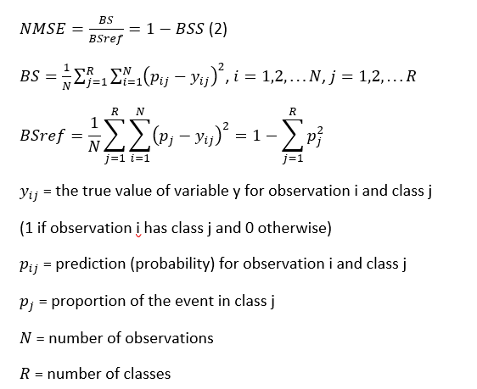
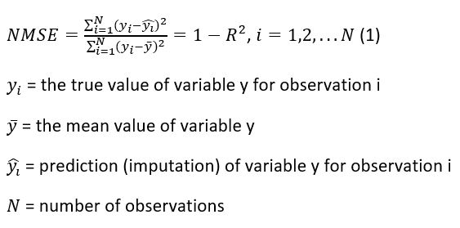

missForestPredict R package
Convergence criterion
Continuous variables:
For continuous variables, the NMSE is equivalent to $1−R^{2}$. Mean imputation has by definition an NMSE of 1.
Categorical variables:
For categorical variables, NMSE is equivalent to 1-BSS (Brier Skill Score) or the Brier Score (BS) divided by the reference Brier Score (BSref).

Slide 8
missForestPredict R package
Fast, based on ranger package ^{[1]}
> missForest_imp_model <- missForestPredict::missForest(data_train_X_miss,
save_models = TRUE,
initialization = "mean/mode",
verbose = TRUE,
max.depth = 10)
Imputation sequence (missing proportion): cigs (0.299991309637612) age (0.299991309637612) diasbp (0.299991309637612) sysbp (0.299991309637612) ht (0.299991309637612) wt (0.299991309637612) chol (0.299991309637612) chd (0.299991309637612) jobgrade (0.299991309637612)
missForest iteration 1 in progress...done!
OOB errors MSE: 91.2142801293, 35.1478684377, 165.1397782691, 372.7086081482, 34.8569964777, 60.144934212, 1.3611233138, 0.1017185115, 0.310066505
OOB errors NMSE: 0.9801756267, 0.8888327436, 0.8798729163, 0.8367756733, 0.7661166929, 0.5519156793, 0.9547294392, 0.800111719, 0.6313492214
diff. convergence measure: 0.1900133654
time: 3.58 seconds
Custom initialization scheme (example in vignettes)
[1] Wright, Marvin N., and Andreas Ziegler. 2017. “Ranger: A Fast Implementation of Random Forests for High Dimensional Data in c++ and r.” Journal of Statistical Software 77 (1): 1–17. https://doi.org/10.18637/jss.v077.i01
The example is based on the Whitehall I dataset: Royston, Patrick, Gareth Ambler, and Willi Sauerbrei. 1999. “The Use of Fractional Polynomials to Model Continuous Risk Variables in Epidemiology.” International Journal of Epidemiology 28 (5): 964–74.

Slide 9
missForestPredict R package
Control over variables to impute
predictor_matrix
> create_predictor_matrix(data_train_X_miss)
proportion_usable_cases
> head(data_train_X_miss, 20)
cigs age diasbp sysbp ht wt chol chd jobgrade
1 0 46 85 121 NA NA 6.201550 1 NA
2 0 55 79 135 NA 67.57 4.909561 1 NA
3 NA NA 70 106 NA 68.93 4.754522 0 2
4 NA 56 87 160 NA 78.46 8.785530 0 NA
6 NA NA 93 133 177.80 NA NA 0 2
9 NA NA 95 125 179.07 79.82 5.167959 0 2
10 0 46 88 164 182.88 97.51 NA 0 3
11 0 54 70 131 177.80 72.56 4.315245 0 2
12 0 NA NA NA 177.80 79.37 4.780362 <NA> 2
13 NA NA 72 131 177.80 95.24 3.875969 0 2
15 NA 47 107 126 NA NA 4.005168 <NA> 2
16 0 NA 71 134 NA NA NA 0 NA
17 NA 64 NA NA 171.45 78.91 4.134367 0 2
18 0 NA NA NA NA 78.91 4.857881 <NA> 2
19 0 41 82 124 179.07 72.11 NA 0 2
21 0 57 103 159 171.45 84.35 5.108119 0 2
22 NA NA 95 143 167.64 68.48 5.348837 <NA> 3
23 0 NA 41 100 176.53 NA 4.677003 0 NA
24 0 55 76 127 185.42 78.46 3.875969 0 3
26 0 49 NA NA NA 74.38 4.470284 <NA> 2
> missForest_imp_model$predictor_matrix
cigs age diasbp sysbp ht wt chol chd jobgrade
cigs 0 1 1 1 1 1 1 1 1
age 1 0 1 1 1 1 1 1 1
diasbp 1 1 0 0 1 1 1 1 1
sysbp 1 1 0 0 1 1 1 1 1
ht 1 1 1 1 0 1 1 1 1
wt 1 1 1 1 1 0 1 1 1
chol 1 1 1 1 1 1 0 1 1
chd 1 1 1 1 1 1 1 0 1
jobgrade 1 1 1 1 1 1 1 1 0
The example is based on the Whitehall I dataset: Royston, Patrick, Gareth Ambler, and Willi Sauerbrei. 1999. “The Use of Fractional Polynomials to Model Continuous Risk Variables in Epidemiology.” International Journal of Epidemiology 28 (5): 964–74.

Slide 10
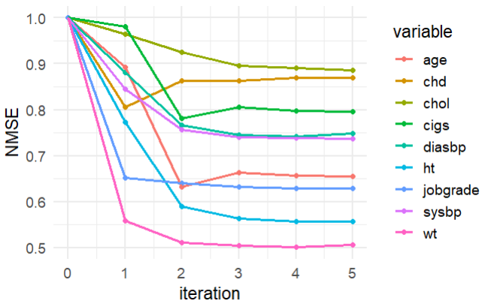
missForestPredict R package
Enhanced error monitoring
> missForest_imp_model$OOB_err
iteration variable MSE NMSE MER macro_F1 F1_score
1 0 cigs NA 1.0000000 NA NA NA
2 0 age NA 1.0000000 NA NA NA
3 0 diasbp NA 1.0000000 NA NA NA
4 0 sysbp NA 1.0000000 NA NA NA
5 0 ht NA 1.0000000 NA NA NA
6 0 wt NA 1.0000000 NA NA NA
7 0 chol NA 1.0000000 NA NA NA
8 0 chd NA 1.0000000 NA NA NA
9 0 jobgrade NA 1.0000000 NA NA NA
10 1 cigs 91.2142801 0.9801756 NA NA NA
11 1 age 35.1478684 0.8888327 NA NA NA
12 1 diasbp 165.1397783 0.8798729 NA NA NA
13 1 sysbp 372.7086081 0.8367757 NA NA NA
14 1 ht 34.8569965 0.7661167 NA NA NA
15 1 wt 60.1449342 0.5519157 NA NA NA
16 1 chol 1.3611233 0.9547294 NA NA NA
17 1 chd 0.1017185 0.8001117 0.1418994 NA 0.13343442
18 1 jobgrade 0.3100665 0.6313492 NA NA NA
19 2 cigs 71.9357190 0.7730110 NA NA NA
20 2 age 24.4405759 0.6180626 NA NA NA
21 2 diasbp 142.5786928 0.7596663 NA NA NA
22 2 sysbp 332.0467760 0.7454850 NA NA NA
23 2 ht 26.0886930 0.5733995 NA NA NA
24 2 wt 54.1728161 0.4971130 NA NA NA
25 2 chol 1.2981982 0.9105920 NA NA NA
26 2 chd 0.1080443 0.8498704 0.1482309 NA 0.04480000
27 2 jobgrade 0.3091879 0.6295603 NA NA NA

Slide 11
missForestPredict R package
Impute a new observation
> data_test_X_miss[1,]
cigs sysbp diasbp age ht wt chol chd jobgrade
NA NA NA NA 176.53 74.83 NA 0 2
> missForestPredict(missForest_imp_model, data_test_X_miss[1,])
cigs sysbp diasbp age ht wt chol chd jobgrade
13021 2.708075 126.3456 78.59877 46.56832 176.53 74.83 4.490664 0 2

Slide 12
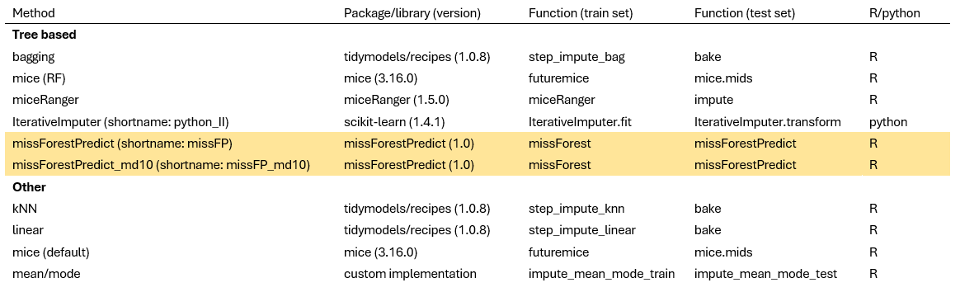
And… is it better?
Compare prediction performance (BSS / R squared)
On different datasets
Simulated datasets with simulated missing values (MCAR, MAR, MNAR)
Real datasets with simulated missing values
Real datasets with missing values
Over 100 train/test splits
Using the imputation models learned on train set and applied to the test set
Using 4 prediction models: Ridge (logistic) regression, restricted cubic splines, RF and XGB

Slide 13
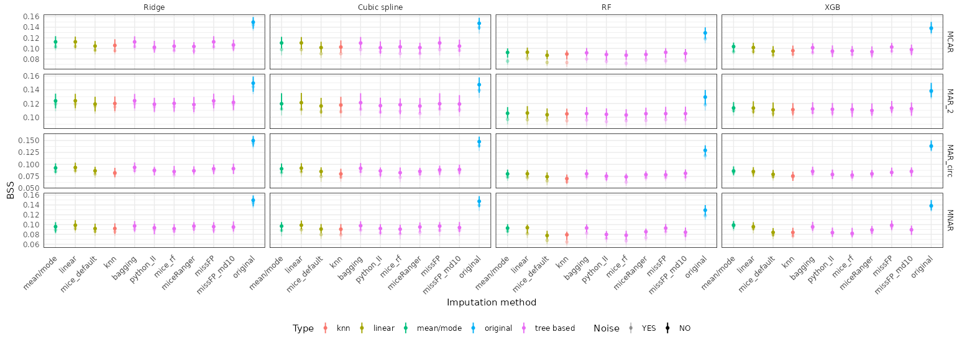
And… is it better?
Simulated data: low correlation (0.1) & low AUROC (0.75)
Simulated missingness: MCAR, MAR (MAR_2, MAR_circ), MNAR

Slide 14
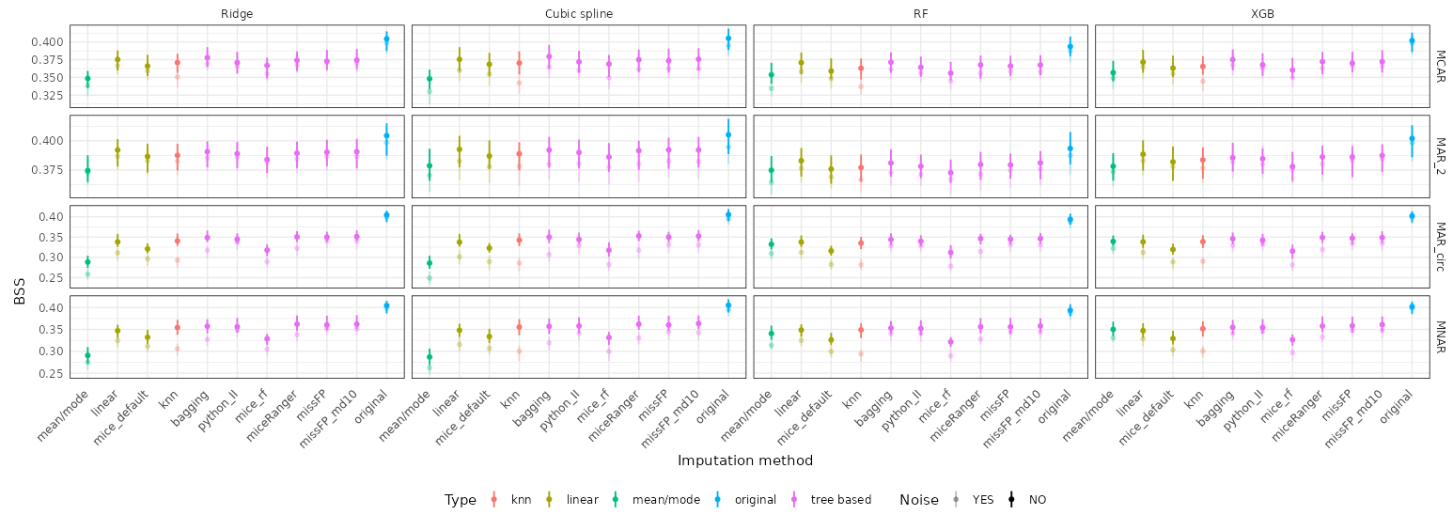
And… is it better?
Simulated data: high correlation (0.7) & high AUROC (0.9)
Simulated missingness: MCAR, MAR (MAR_2, MAR_circ), MNAR

Slide 15
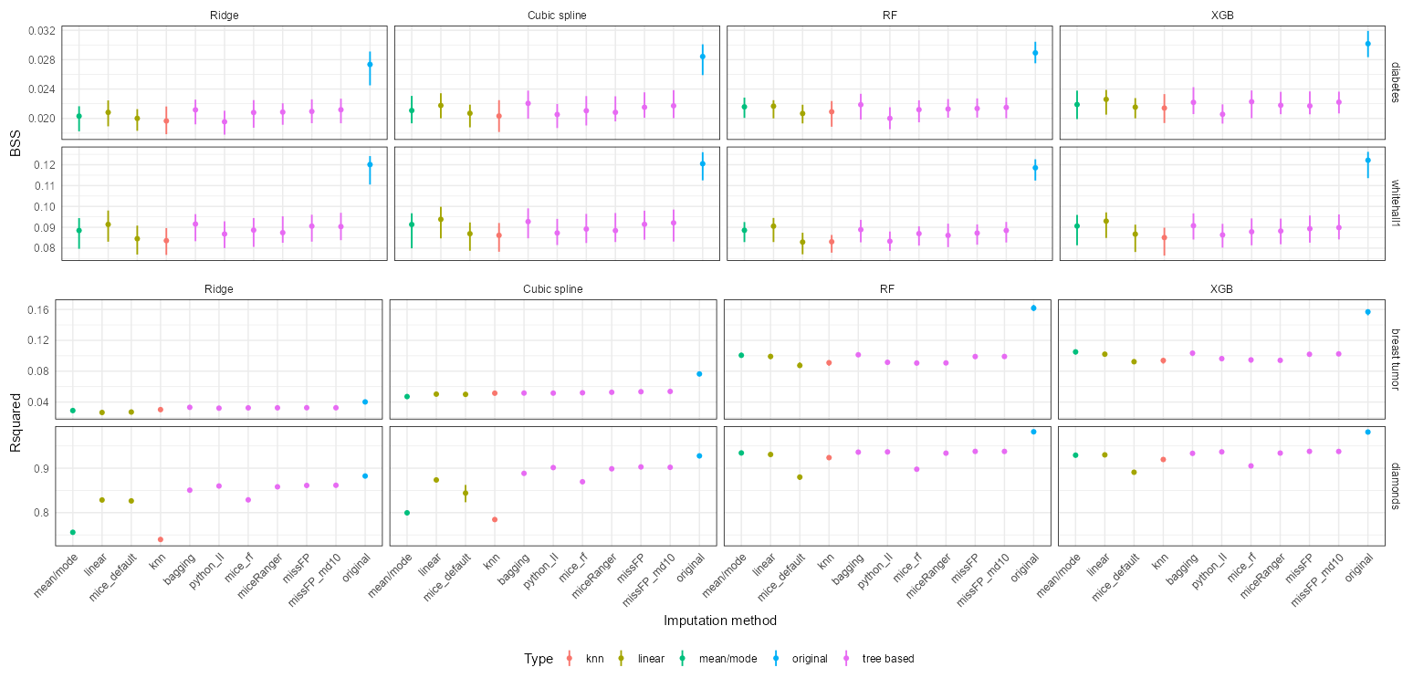
And… is it better?
Real data with simulated missing values (MCAR)

Slide 16
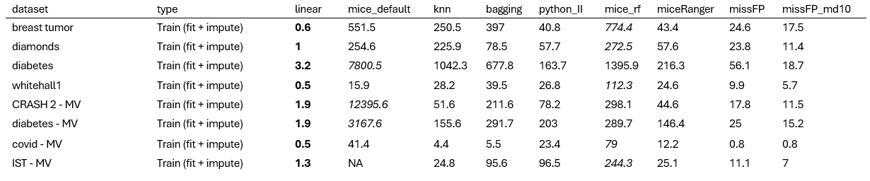
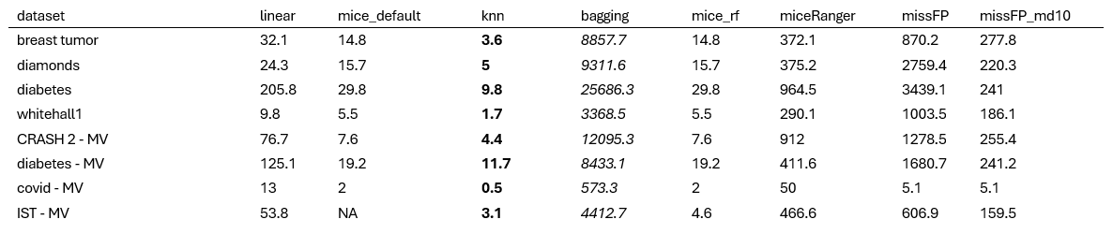
And… is it better?
Median runtime in seconds (over 100 train/test splits)
Median object size of the imputation object in MB (over 100 train/test splits)

Slide 17
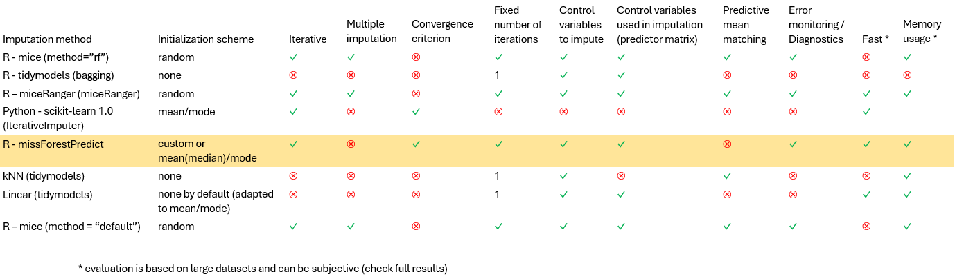
Final thoughts
Functionality comparison

Slide 18
Final thoughts
missForestPredict is competitive in terms of predictive performance, computational runtime and memory utilization
Adjusting the number of trees and/or maximum depth can be helpful on very large datasets
When variables are missing together, consider using proportion_usable_cases or predictor_matrix
Sophisticated imputation methods might overfit (over-impute) in low “imputability” settings
The OOB error of the first iteration of missForestPredict can be inspected to assess such low “imputability” settings
Mean imputation “makes friends” with tree-based prediction models (RF, XGB) – but do you want that?
Many unanswered questions remain for imputation in prediction settings:
Is iterative imputation needed?
Is predictive mean matching useful?
Does the initialization scheme matter?
Is the number of trees or the number of variables tried at each split impacting the imputation or predictive performance?
Is multiple imputation necessary?

Slide 19
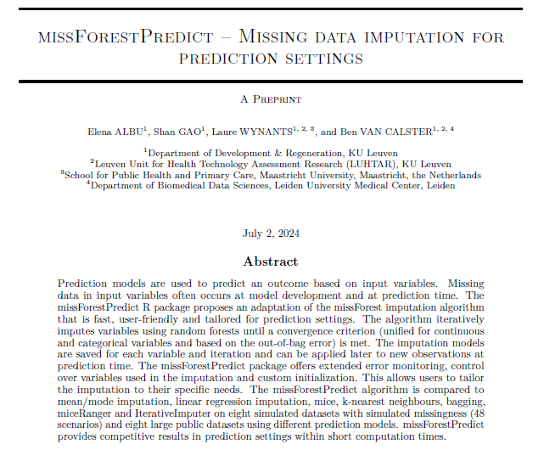
Acknowledgements
Warm thanks to Daniel Stekhoven and Lars Bosshard for the insightful discussions during the early stages of developing the missForestPredict package
… and to my colleagues and mentors at KU Leuven: Shan Gao, Laure Wynants and Ben Van Calster

Slide 20

Thank you!
missForestPredict
https://cran.r-project.org/web/packages/missForestPredict/index.html
https://github.com/sibipx/missForestPredict
Code for comparison study (you can run it on your dataset):
https://github.com/sibipx/comparison_imputation_methods
Complete results for the comparison study in shiny app:
https://sibip.shinyapps.io/Results_imputation_methods/
missForestPredict -- Missing data imputation
for prediction settings
https://arxiv.org/abs/2407.03379

Slide 21
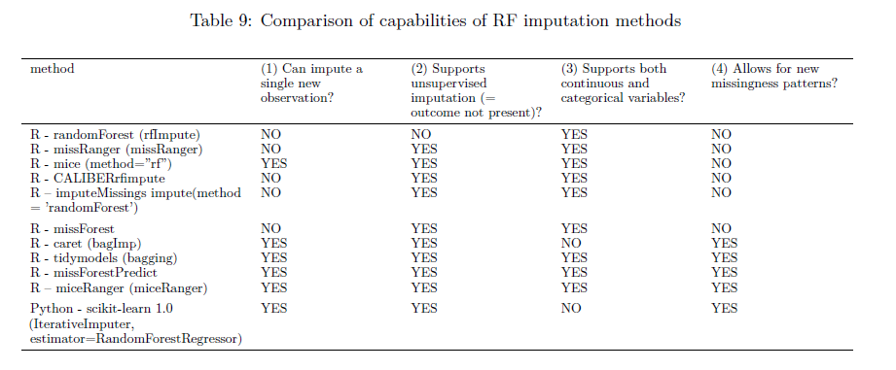
Backup slides

Slide 22
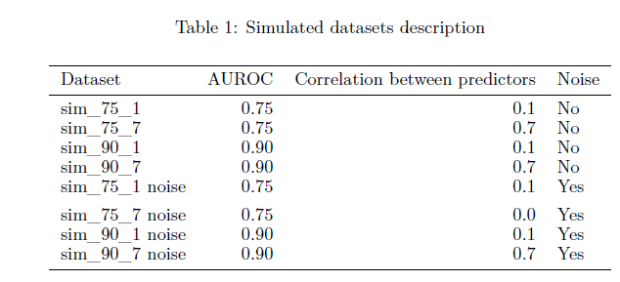
Backup slides

Slide 23
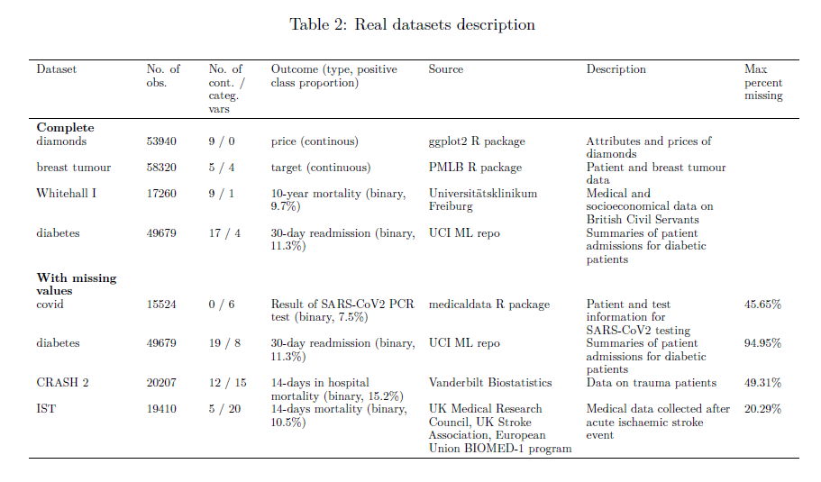
Backup slides

Slide 24
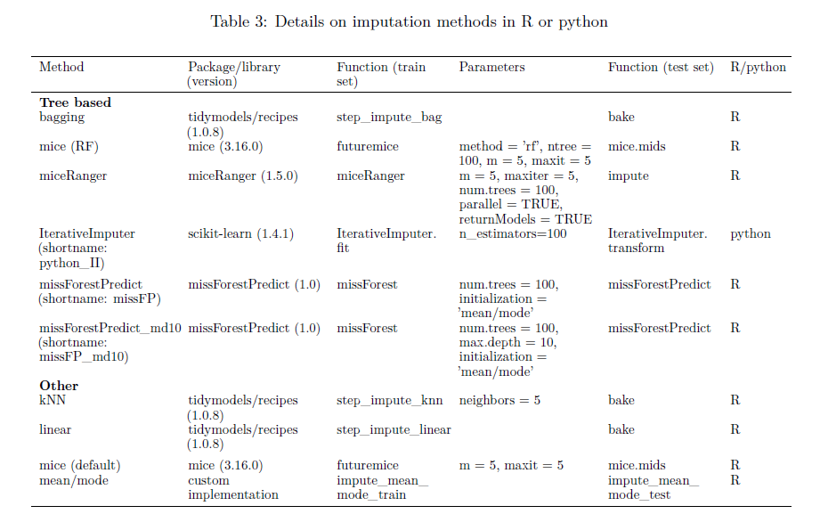
Backup slides

Slide 25
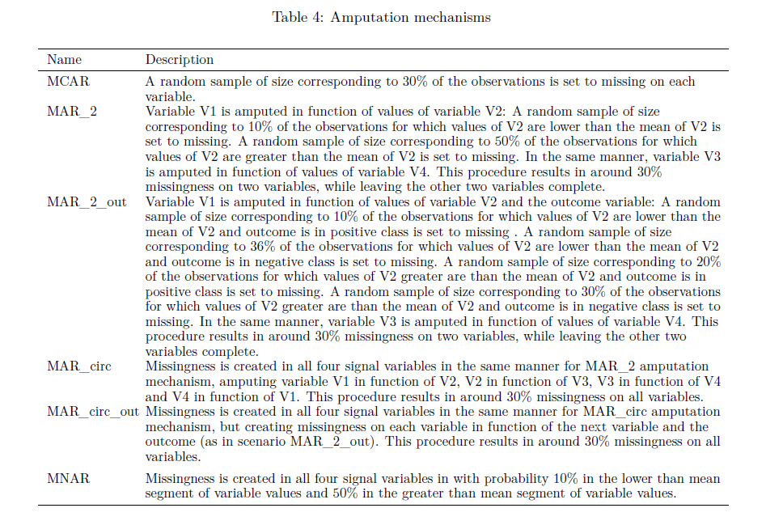
Backup slides

Slide 26
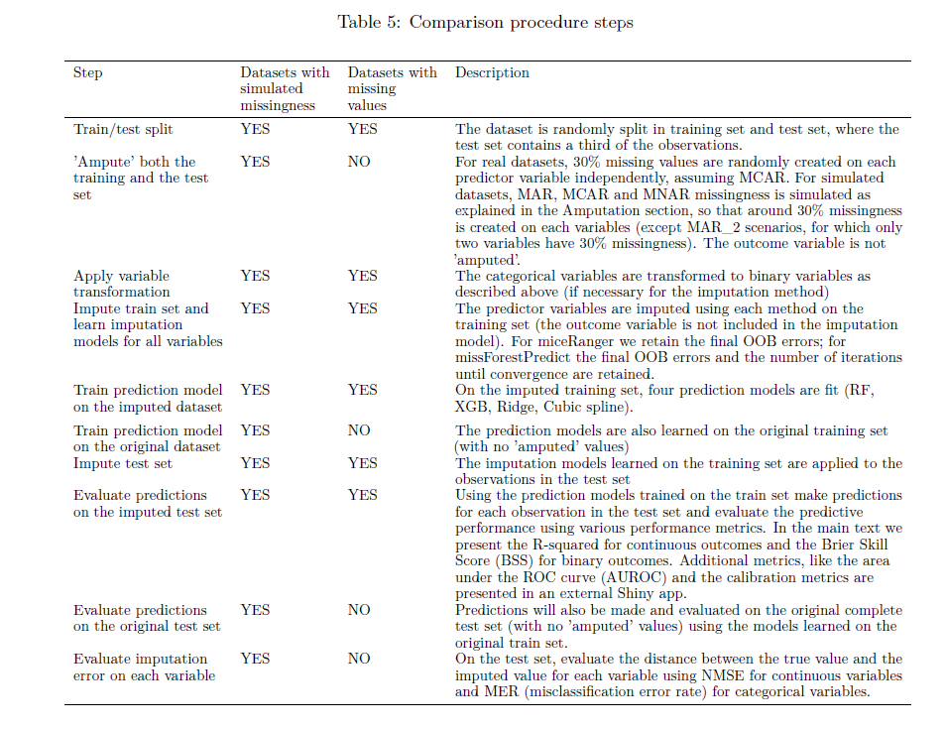
Backup slides

Slide 27
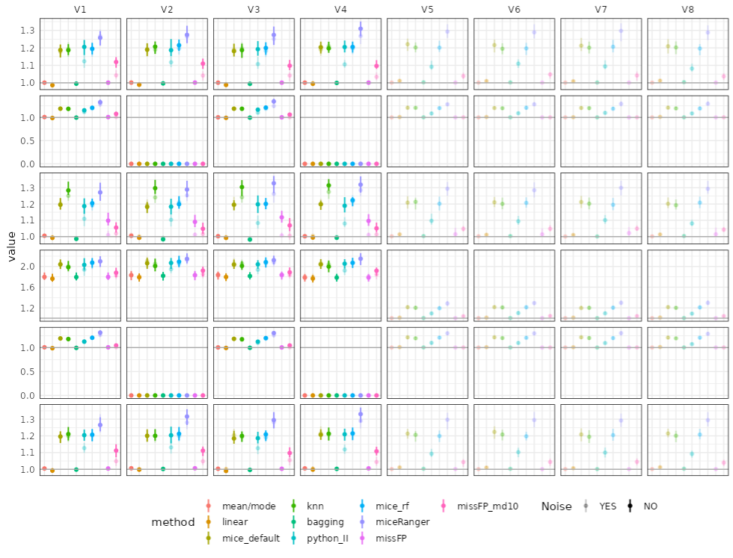
Backup slides
Simulated data: low correlation (0.1) & low AUROC (0.75)

Slide 28
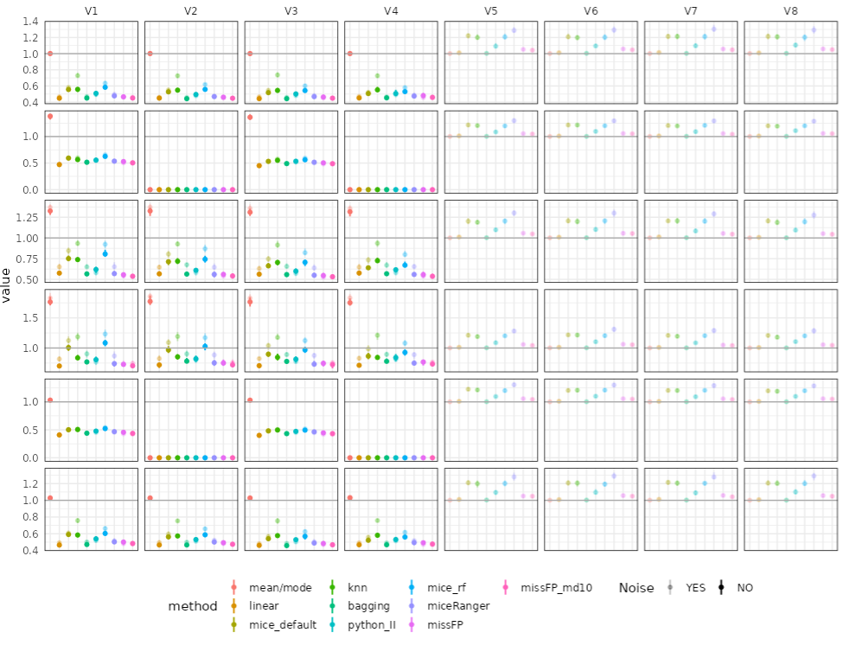
Backup slides
Simulated data: high correlation (0.7) & high AUROC (0.9)

Slide 29
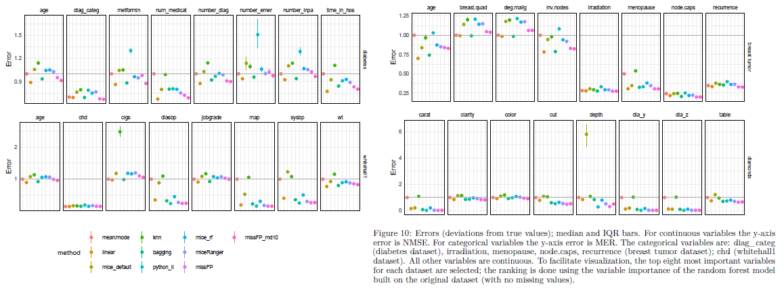
Backup slides
Real data with simulated missing values (MCAR)

Slide 30
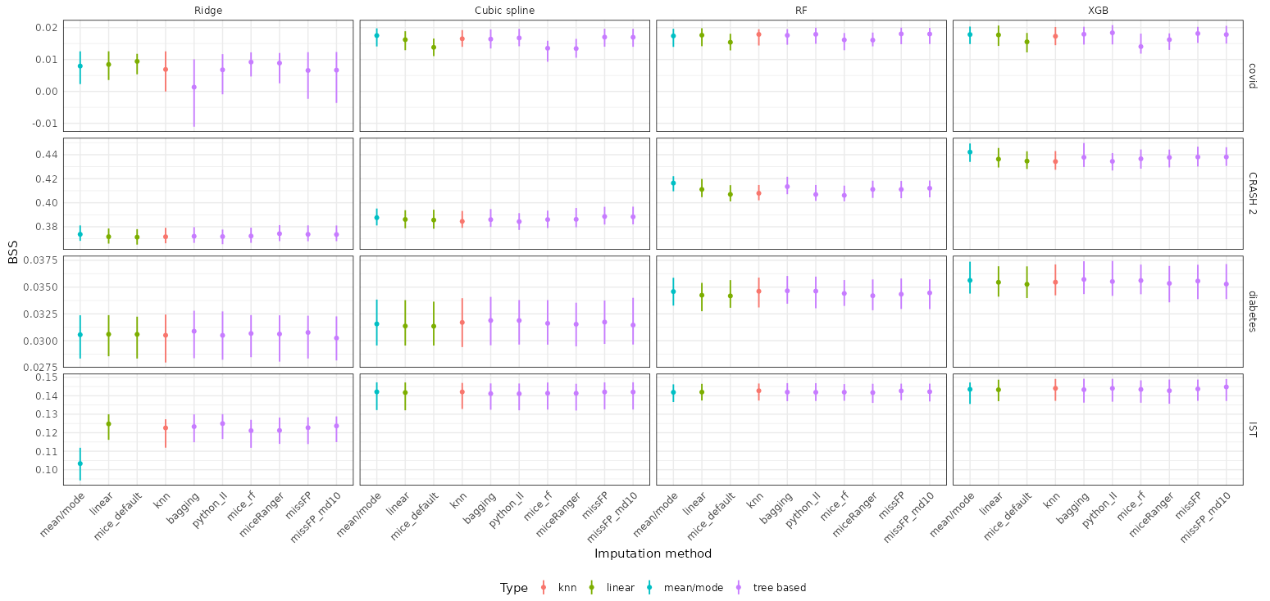
And… is it better?
Real data with missing values

