Slide 1



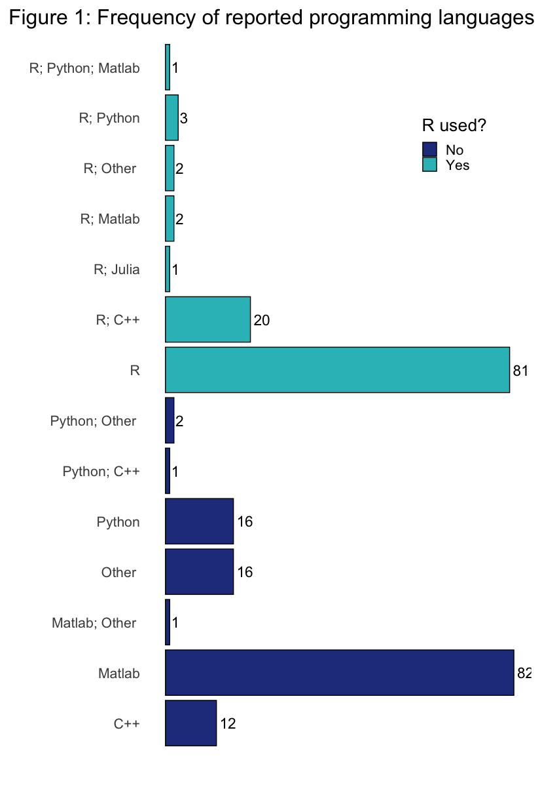
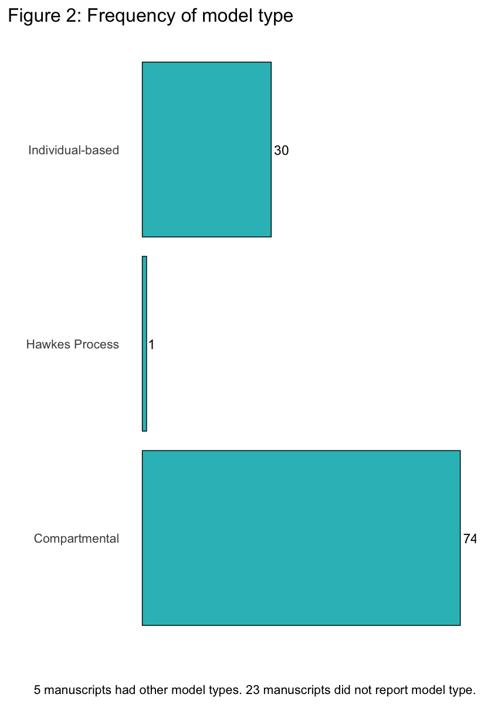
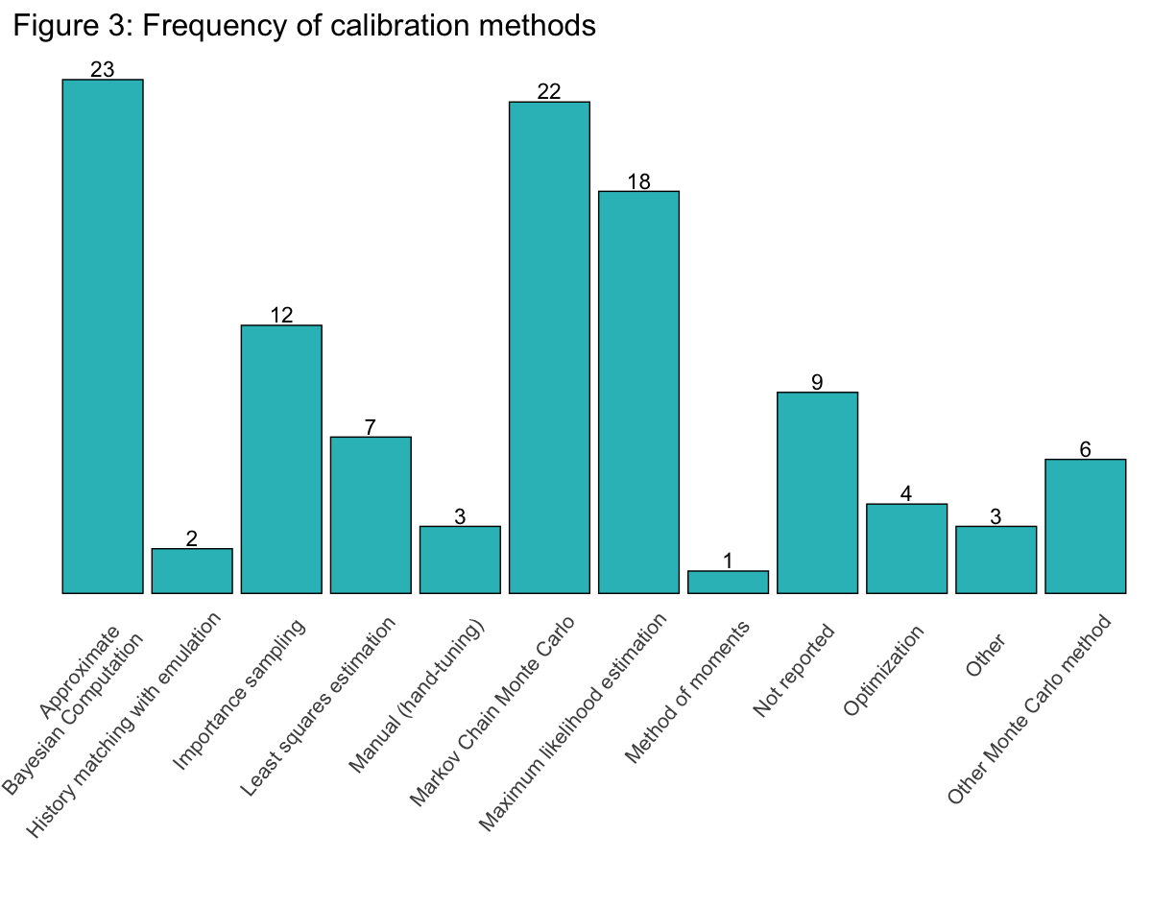
Use of R in the calibration of infectious disease models
Nicole A. Swartwood^{1*}, Cavalli L², Dankwa EA², Balasubramanian R², Jia K², Ofori SK², Can MH¹, Li Y¹, Cui H¹, Wade C³, Buckee C², Imai-Eaton, J², and Menzies NA^{1,2}
1) Department of Global Health and Population, Harvard T.H. Chan School of Public Health, Boston, MA, USA
2) Center for Communicable Disease Dynamics, Department of Epidemiology, Harvard T.H. Chan School of Public Health, Boston, MA, USA
3) Countway Library, Harvard University, Boston, MA, USA * denotes presenting author
Note: NAS performed this secondary analysis in conjunction with a primary scoping review. All other coauthors participated in the primary review; not all coauthors were able to review these findings prior to presentation.
BACKGROUND
RESULTS
Calibration approaches are commonly used in infectious disease modeling, but there has been little study to describe the current use of these techniques within the field.
R is increasingly used by epidemiologists to model infectious disease dynamics.
Of the 423 extracted models, 240 manuscripts named a programming language; 110 reported use of R.
R was used across diseases 54 HIV models, 34 TB models; and 25 Malaria models.
STUDY OBJECTIVE
To identify with which calibration strategies R is most commonly used and potential development areas in the available calibration packages within R. We also analyzed the data for any association with disease, model type, and or reducibility.
METHODS
R and C++ were used together in 9 compartmental and 11 individual-based models.
We searched PubMed, Embase, Web of Science, Biosis, and Global Health databases to identify eligible studies which contain in their title or abstract keywords related to “dynamic transmission models”, “HIV”, “tuberculosis” or “malaria”. We included papers from 2018–2023. The full scoping review protocol is available on Open Science Framework (link below).
We collected data on model characteristics, calibration methodology, and programming code. We explored frequency of the use of R across model types, disease, and calibration strategies. In addition to the formal review, NAS noted which R packages were cited in manuscripts describing the extracted models.
Commonly cited R packages were EasyABC, hmer, IMIS, and Rcpp.
DISCUSSION
R was the most common language reported by identified modeling studies.
R has supported a wide variety of calibration methods for infectious disease models.
R was used more frequently for compartmental models versus individual-based models.
Future development could focus on streamlining incorporation of packages that increase computational efficiency to facilitate individual based modeling.
author contact: nswartwood@hsph.harvard.edu scoping review protocol: https://doi.org/10.17605/OSF.IO/3VTJW

