Slide 1

VIGNAN'S INSTITUTE OF MANAGEMENT AND TECHNOLOGY FOR WOMEN Department of CSE(AI&ML) Project Title: Multi-College Students Interaction and Chatbot
Team mates:
G.Yashaswini-23up1a6618
K.Suneera-23up1a6625
G.Bhavya-23up1a6620
K.Mounika-23up1a6628
Guide name: A. Rupa
Designation : Assistant Professor
Department : CSE(AIML)

Slide 2
CONTENTS
Introduction
Literature Survey
Existing System and its Drawbacks
Problem statement
Hardware and Software requirements
Proposed system
System Architecture
UML Diagrams
Methodology
Scope and Purpose
Future Enhancement
Conclusion

Slide 3
ABSTRACT:
This project presents the design and development of an AI-based multi-college student interaction platform aimed at overcoming the limitations of existing communication tools used in academic collaboration. The proposed web-based system enables students from different colleges, departments, and regions to interact through structured communities and real-time chat facilities. An AI-powered chatbot supports students by answering academic queries, recommending learning resources, and providing guidance, while role-based access control, automated content moderation, and intelligent notification mechanisms ensure a secure and well-organized environment. The platform is designed to enhance knowledge sharing, encourage cross-college collaboration, and foster both academic and professional growth among students through a smart, scalable, and student-centric solution.

Slide 4
INTRODUCTION:
This project proposes a Multi College Students Interaction Chatbot Platform to address the limitations of existing digital communication tools that lack support for academic collaboration and cross-college interaction. The platform enables students from different colleges and departments to connect through structured communities for discussion, resource sharing, and collaborative learning. An AI-powered chatbot assists users by answering academic queries, recommending learning materials, guiding platform navigation, and supporting automated moderation. Features such as secure authentication, role-based access control, and intelligent notifications ensure a safe, organized, and scalable academic networking environment. The proposed system aims to enhance student engagement, promote collaborative learning, and bridge communication gaps between institutions

Slide 5
LITERATURE SURVEY:
Title | Author(s) | Description | Limitations
Smart Educational Chatbot Platforms (2025) | Patel et al. | Combines AI chatbot with structured academic platforms for collaboration, multi-task handling, and learning support. | High development cost and complexity in real-time implementation.
Cross-platform Student Interaction Systems (2024) | Lee et al. | Provides communication between students across different colleges and institutions. | Integration issues and lack of centralized control.
AI-based Student Assistance Systems (2023) | Sharma & Gupta | AI-driven systems offering personalized recommendations and academic query support. | Privacy concerns and dependency on continuous data updates.
Multi-functional Chatbot Systems in Education (2022) | Ramesh et al. | Chatbots handling multiple tasks like answering queries, reminders, and notifications. | Limited scalability and performance issues with many users.

Slide 6
EXISTING SYSTEMS :
Student communication currently relies on general-purpose platforms like whats app, telegram, discord, social media, and college-specific portals. These tools allow chatting, file sharing, and group formation, but are not designed for structured academic collaboration or cross-college interaction. Academic queries are typically addressed via faculty, emails, notice boards, or LMS, and there is no centralized platform connecting students from multiple colleges with ai-based support.
DRAWBACKS OF EXISTING SYSTEM:
Limited Cross-College Interaction
No Academic Structure
Absence of Intelligent Assistance
Information Overload & Distractions

Slide 7
PROBLEM STATEMENT:
Students face difficulty in getting quick answers to their academic and college-related queries. They need to check multiple sources like teachers and websites, which takes time. There is no single platform to handle all student needs . So, a chatbot is required to provide instant information anytime.

Slide 8
PROPOSED SYSTEM:
The proposed system is an AI-based Multi College Students Interaction Chatbot Platform developed to overcome the limitations of existing communication tools. It provides a structured academic environment that enables students from different colleges and departments to interact, collaborate, and share knowledge through organized communities. An AI-powered chatbot offers instant academic support by resolving queries, recommending learning resources, guiding platform usage, and assisting with automated moderation. The system also incorporates secure authentication, role-based access, and notification services to ensure a safe, organized, and scalable academic networking solution. Overall, the proposed system enhances collaborative learning, improves student engagement, and bridges communication gaps between institutions

Slide 9
SOFTWARE REQUIREMENTS:
1.Frontend Technologies: HTML ,CSS ,JavaScript,React.js or Bootstrap
2.Backend Technologies: Python using Flask or Django framework, REST
3.AI / Chatbot Technologies: Python programming language, Natural Language Processing (NLP) techniques, NLTK, Rule-based and basic AI-based chatbot models
4.Database:MySQL or PostgreSQL, MongoDB
5.Authentication and Security: JWT (JSON Web Tokens) , Role-based access control (student, admin, moderator),Password encryption and hashing techniques
6.Notification Service: Web push notifications , Web Sockets or Socket.io
7.Development Tools: Visual Studio Code, Git and GitHub, Postman for API testing, Web browser (Chrome)

Slide 10
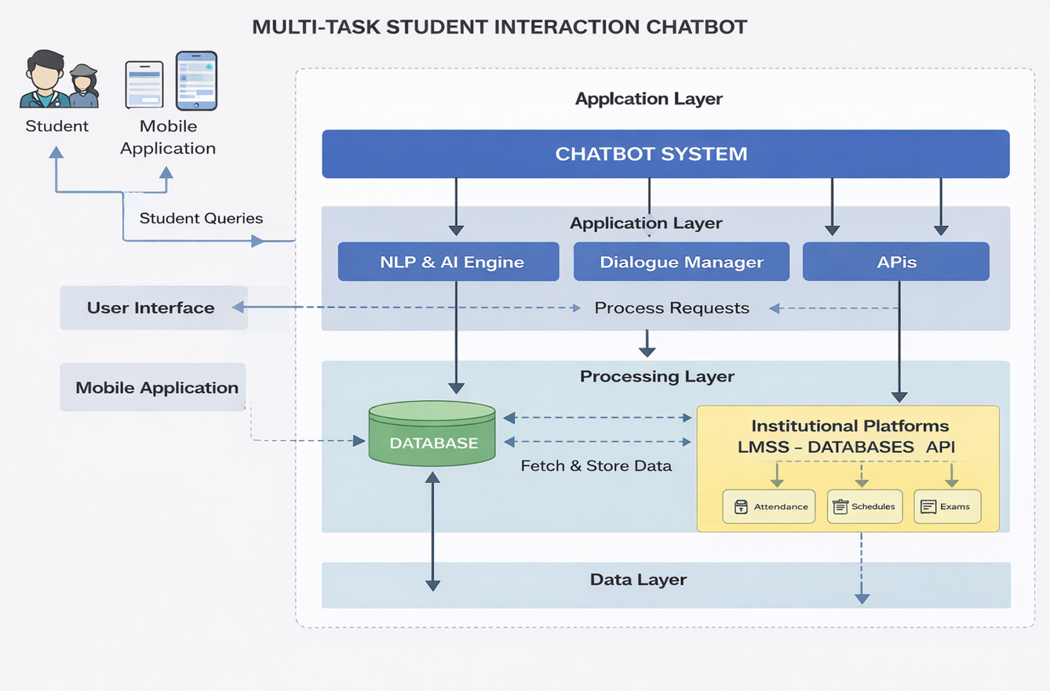
SYSTEM ARCHITECTURE:

Slide 11
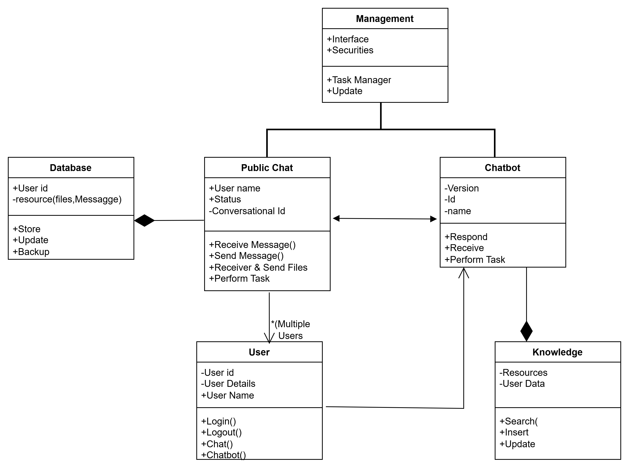
UML DIAGRAMS Class Diagram:

Slide 12
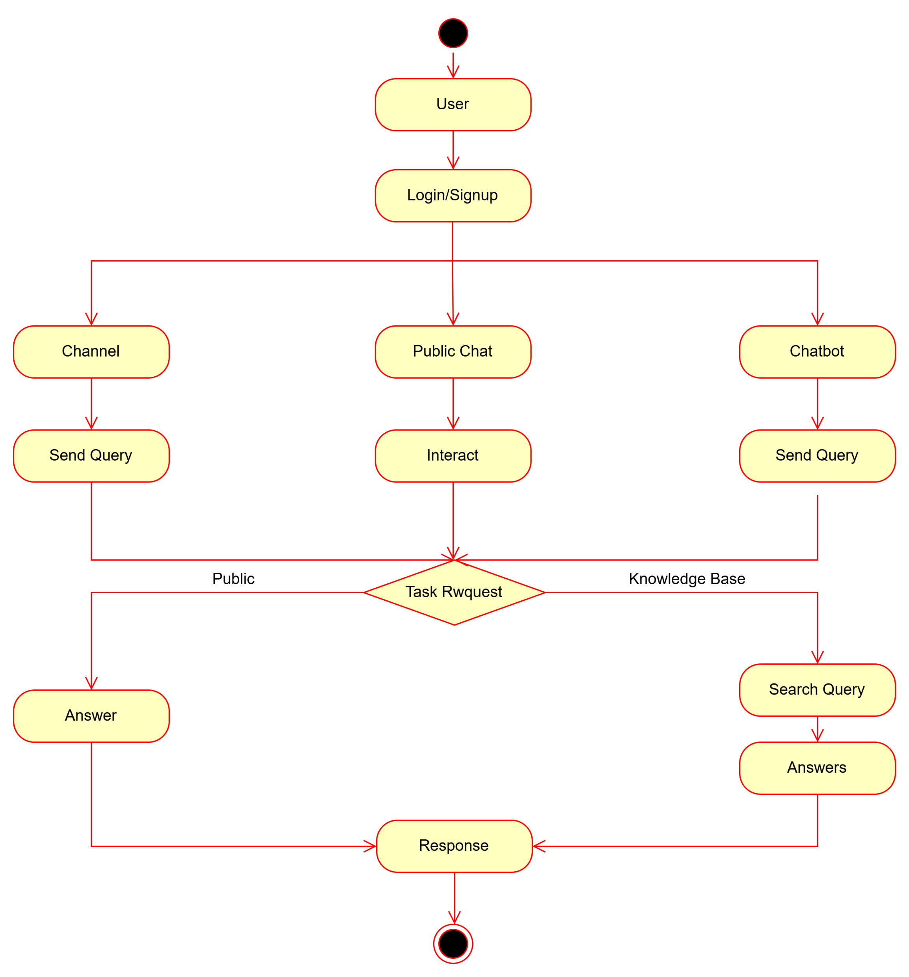
Activity Diagram:

Slide 13
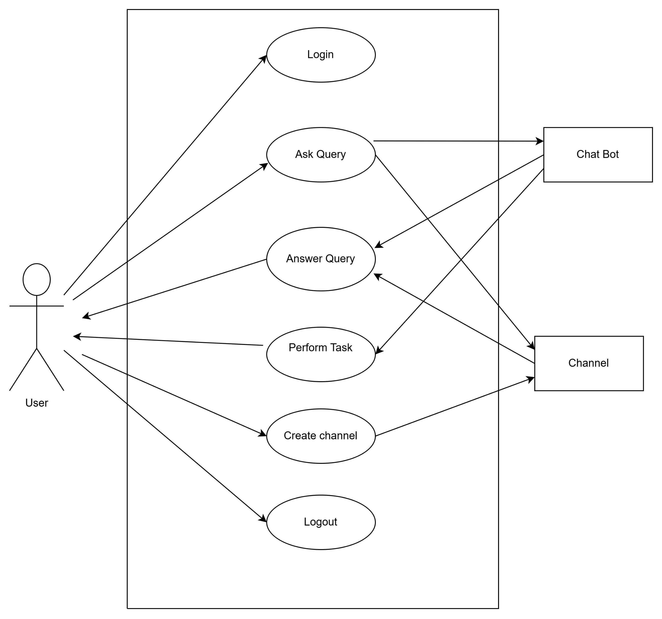
Use case:

Slide 14
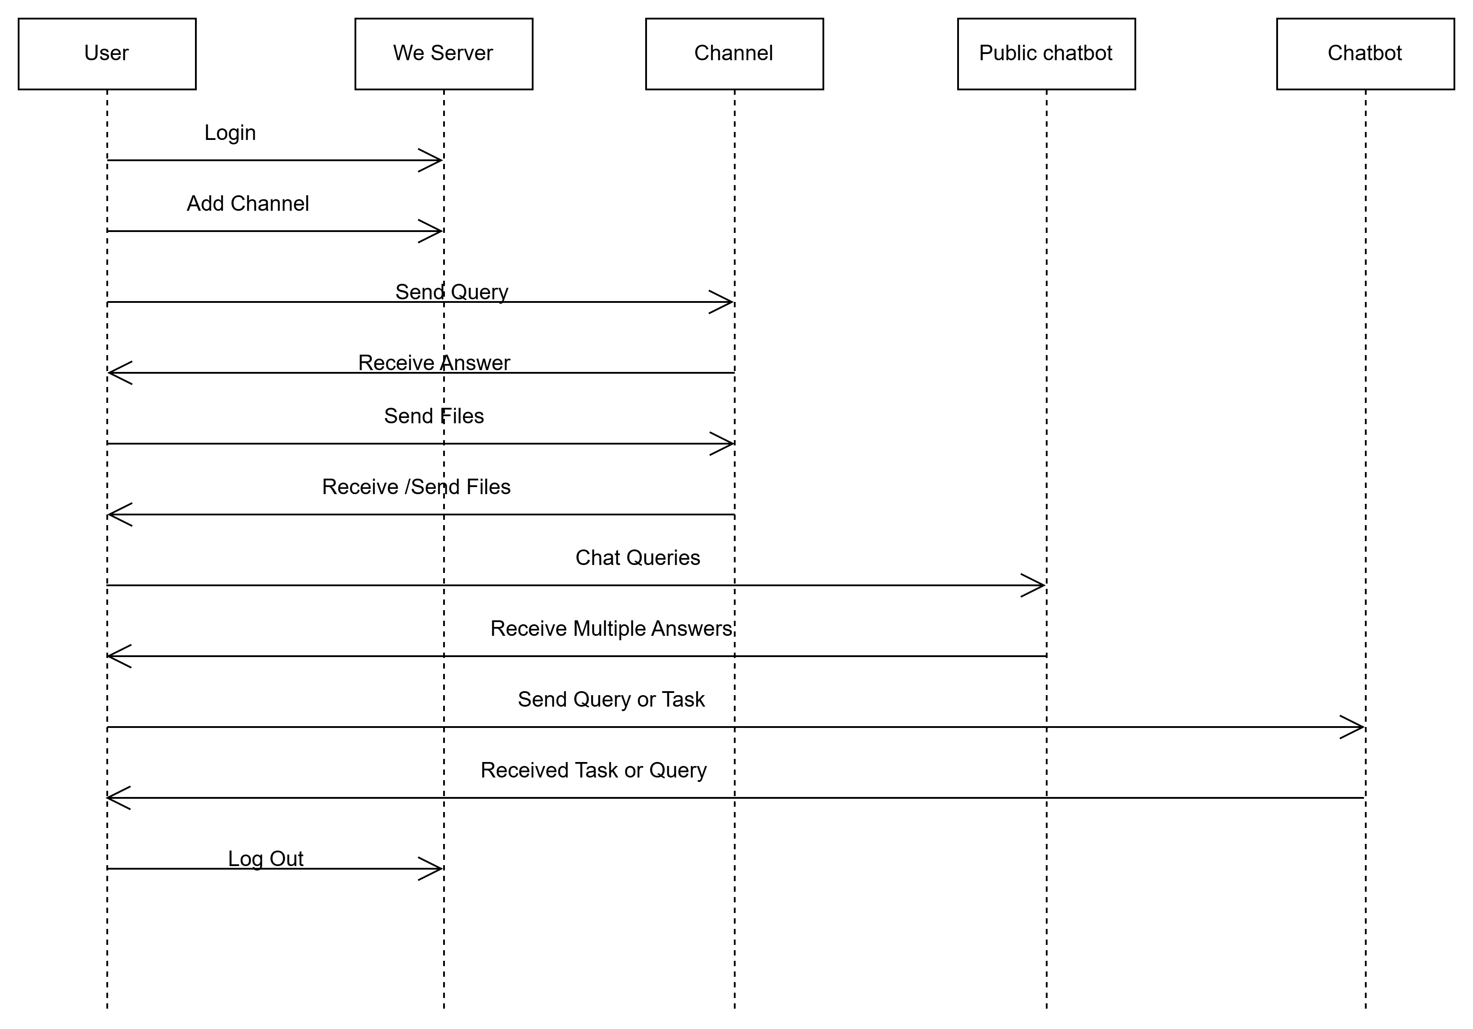
Sequence Diagram:

Slide 15
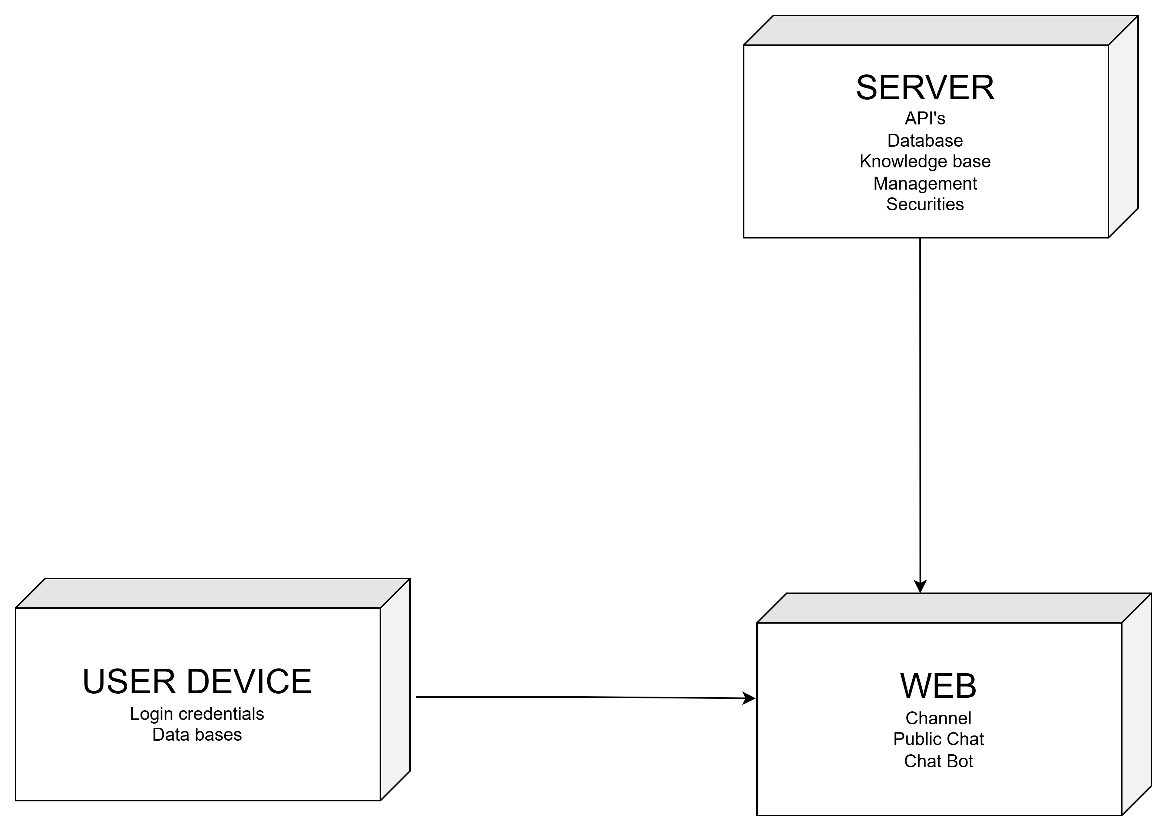
Deployment:

Slide 16
Methodology
Data Collection: Gather student queries (academics, schedules, exams, etc.)
Preprocessing: Clean and organize text data for training
Model Development: Use NLP techniques to understand user input
Intent Recognition: Identify student needs (queries, requests, tasks)
Response Generation: Provide accurate and relevant answers
Multi-task Handling: Support multiple features (Q&A, reminders, info)
Integration: Connect chatbot with database or college system
Testing & Evaluation: Check accuracy and improve performance

Slide 17
FUTURE ENHANCEMENT
Integration with AI for more intelligent responses
Voice-based interaction (speech recognition)
Multi-language support for better accessibility
Personalized recommendations for students
Integration with mobile apps and LMS platforms
Advanced analytics to track student behavior
Chatbot with emotion detection for better interaction
Continuous learning using machine learning

Slide 18
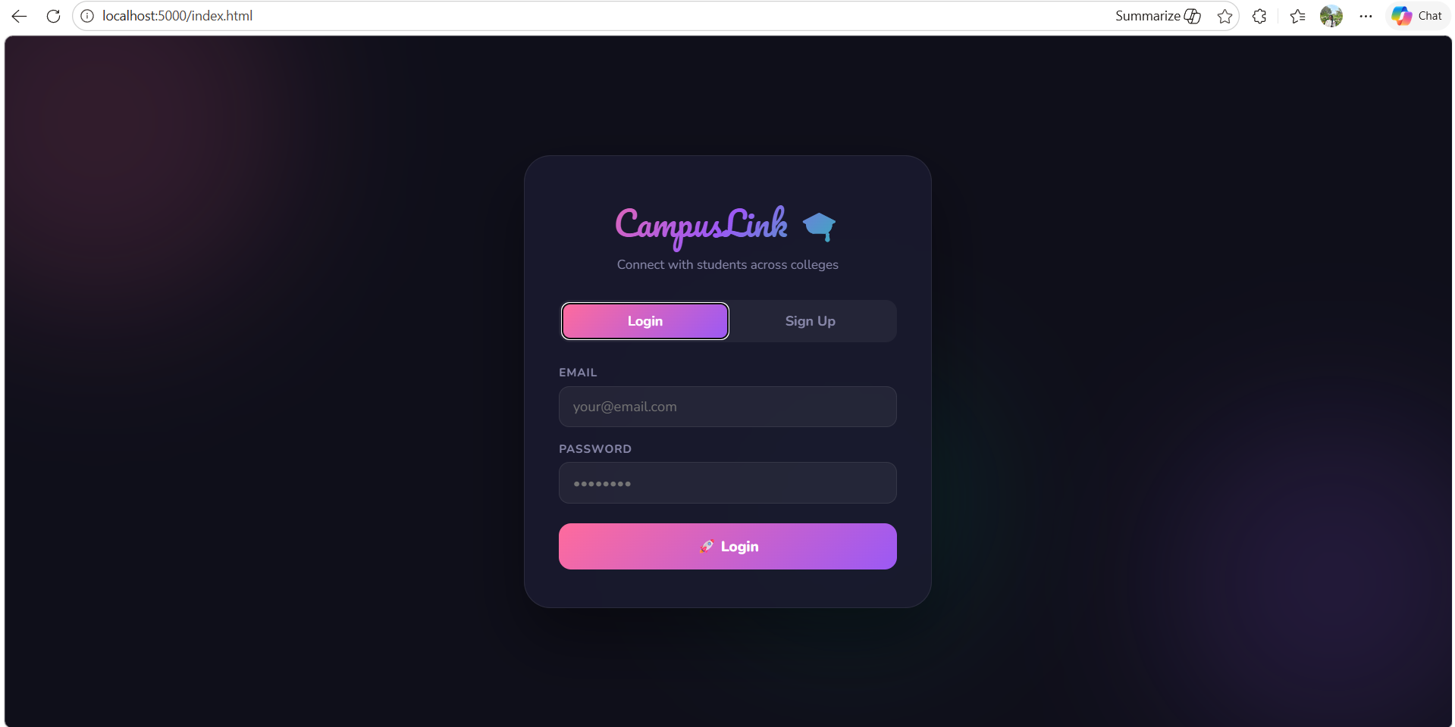
RESULTS :

Slide 19
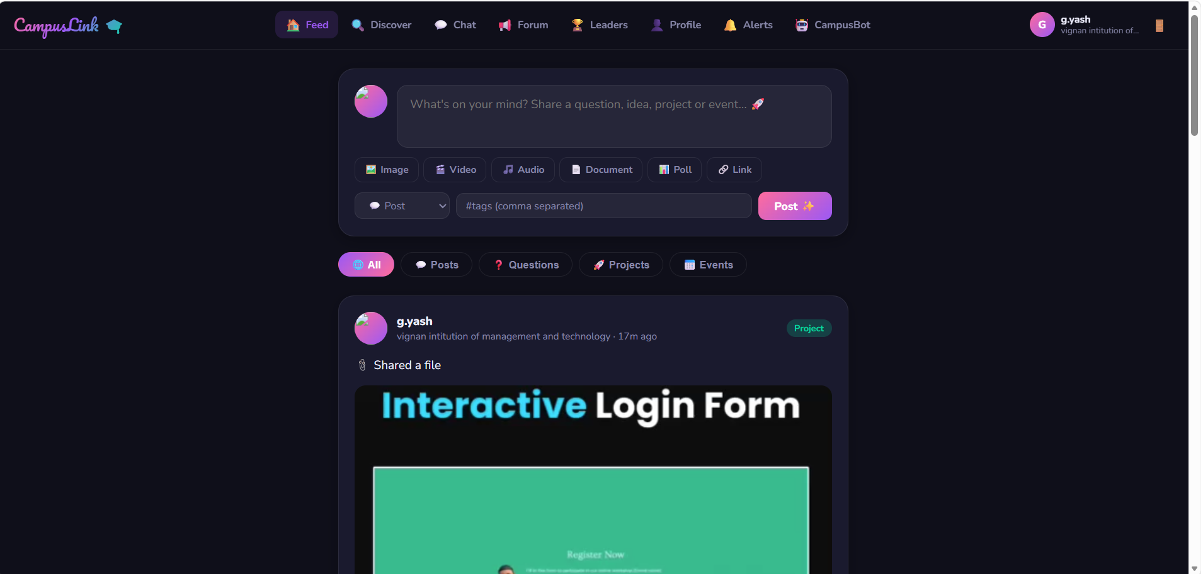

Slide 20
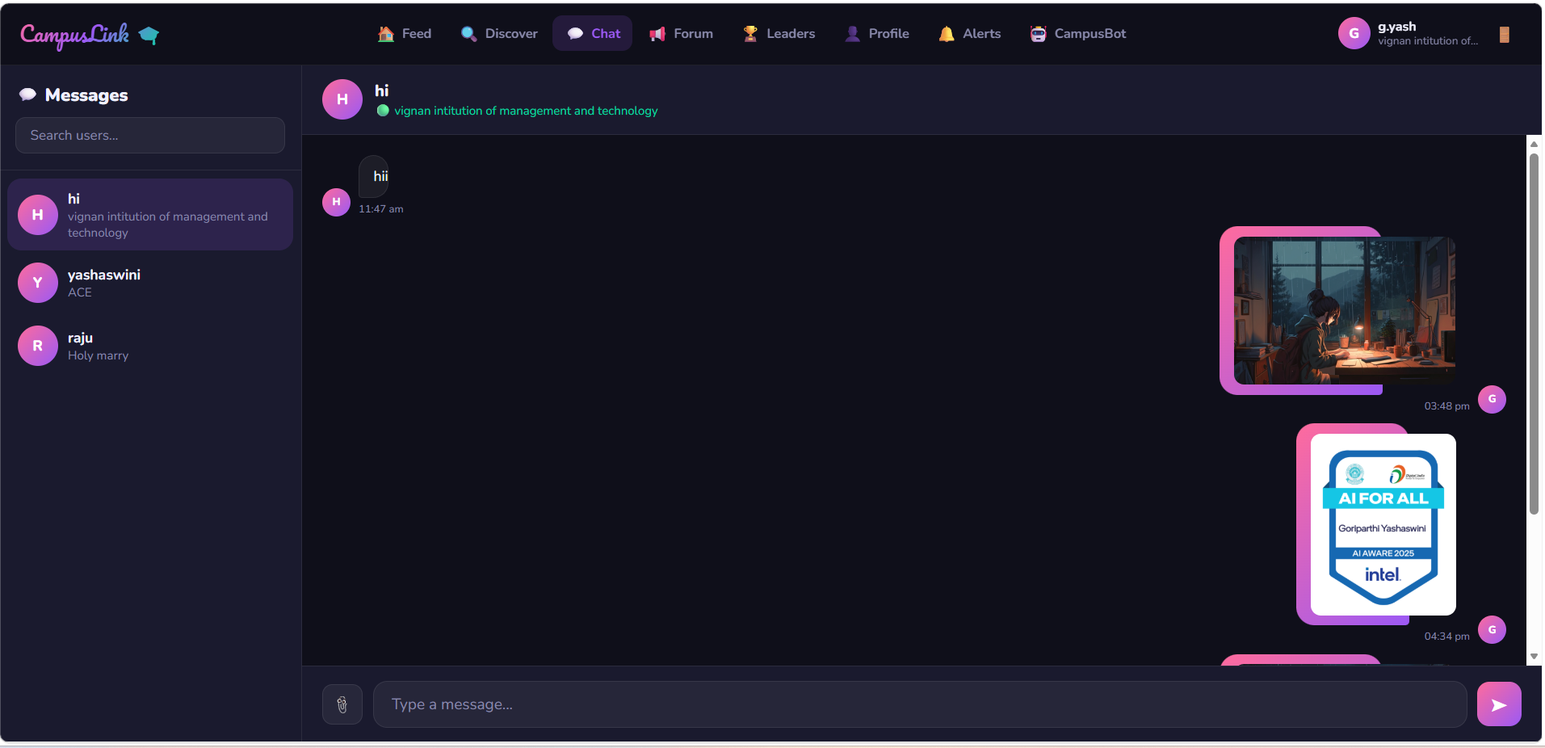

Slide 21
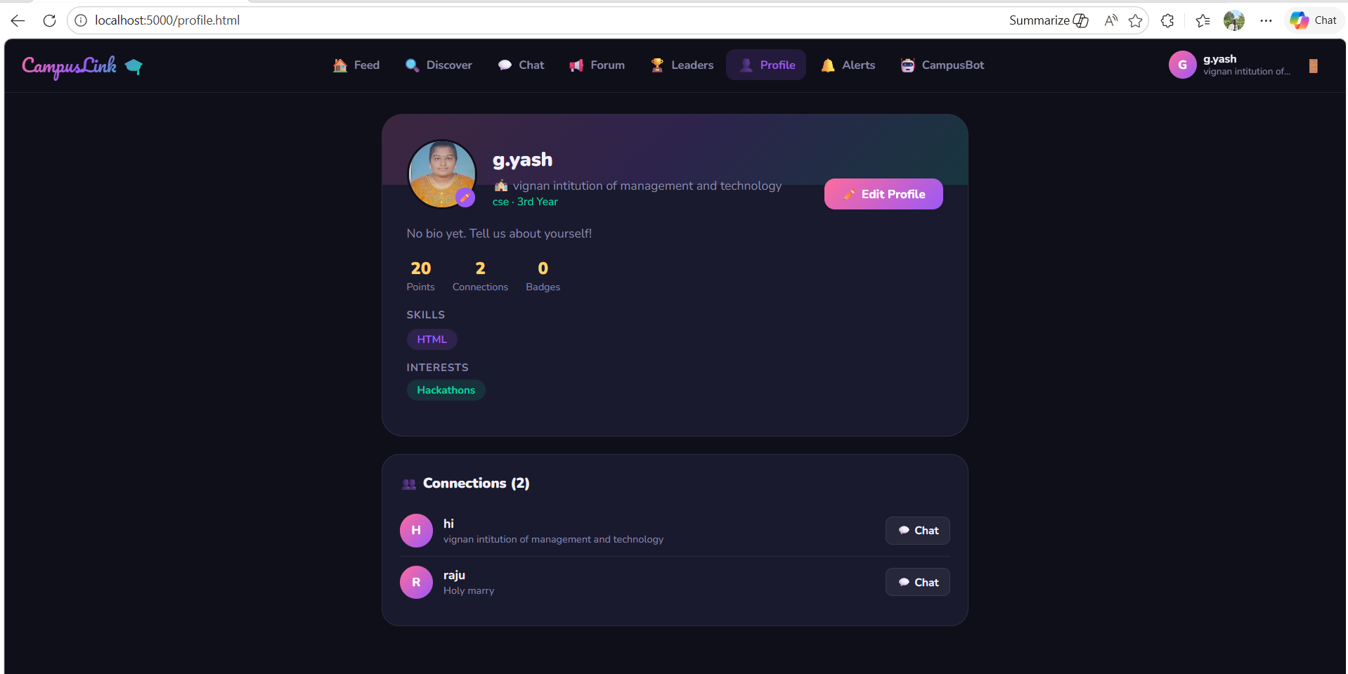

Slide 22
CONCLUSION
The Multi-Task Student Interaction Chatbot provides an efficient and user-friendly solution for handling various student queries and tasks. It simplifies communication by offering instant responses and reduces the workload on administrative staff. By using advanced technologies like Natural Language Processing, the chatbot can understand and respond accurately to student needs. It supports multiple functions such as answering academic queries, providing updates, and managing reminders. This system enhances student engagement and ensures accessibility at any time. Overall, the chatbot is a valuable tool for modern educational institutions, and with future enhancements, it can become even more intelligent and effective.

Slide 23
Reference
https://ieeexplore.ieee.org/document/8463313
https://www.researchgate.net/publication/334273741
https://dl.acm.org/doi/10.1145/3386527.3405940
https://www.sciencedirect.com/science/article/pii/S1877050920304865
https://www.sciencedirect.com/science/article/pii/S187705092100561X

Slide 24
Thank you!

